Slide 1
Effects of COVID-19 on the homeless population in the state of California
By DFT (Racheal, Elijah and Mark)

Slide 2
Overview of the Presentation
What is COVID-19
What are the impacts of COVID-19 to the world in General
Why we chose California

Slide 3
Overview
Title Slide
Your Background
Project Introduction / Background
Methods
Results
Summary
Conclusions
Questions

Slide 4
Background

Slide 5

What is COVID-19
COVID-19 is caused by a coronavirus …
WAIT!! What is a coronavirus?
Coronaviruses are viruses that are name fir the crown-like spikes on their surfaces.
There are coronaviruses that cause disease in humans and in animals.
Sometimes animal corona viruses evolve and become a new human coronavirus.
For example SARS from 2003 and now COVID-19

Slide 6
What is COVID-19
It is caused by a novel coronavirus, named Severe Acute Respiratory Syndrome coronavirus 2 (SARS-CoV-2).
It was identified as the cause of an outbreak of respiratory illness first detected in Wuhan China in 2019.
The illness caused by the virus has been named coronavirus disease 2019 (COVID-19).

Slide 7
What is COVID-19
SARS-CoV-2 is presumed to have been transmitted through bats, but this has not been confirmed. So the origin is still unknown
There is currently no vaccine for coronaviruses.

Slide 8
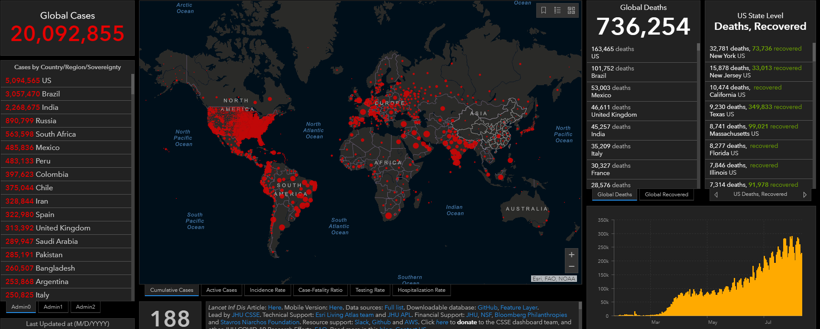
IMPACT OF COVID-19
Notes:
Over 20 million cases, over 700k death worldwide as of Aug 2020.
Every country was affected, in most ways, (economically, financially, socially etc.)

Slide 9
QN: Are the homeless cases equal to the general public cases.
We ran a one proportional z-test
A one proportion z-test is used to compare an observed proportion to a theoretical one, when there are only 2 categories
We discovered that , the homeless cases are not equal to the general public cases. In fact that the homeless cases are only 3.8% of the positive COVID19 cases observed in San Francisco.

Slide 10
QN: Are the number of homeless cases affecting the general public. Are the homeless spreading COVID19 because they have no homes?
We ran linear regression predictive analysis.
Linear regression will be used to explain the relationship between the homeless population and the general public population.
We discovered that the homeless population was responsible for 996% of the spread of COVID19 to the general public. The 4% can be explained by other factors.
How ever, we found a lot of variance, the data was not evenly distributed.

Slide 11
QN: Have the rooms availability in the homeless shelters been affected by the covid cases in the county of San Francisco?
We ran Independent Chi-Square analysis.
Independent Chi-Square will determine whether “homeless cases" is influencing "rooms availability".
We discovered that as the homeless cases increased, the rooms availability decreased in the county of San Francisco especially in the later months of June and July.

Slide 12
QN: Online source has stated that the homeless population was hit 80% harder compared to the general public?
We ran Goodness of Fit Chi-Squares analysis.
Goodness of Fit Chi-Squares will determine whether this percentage is true or not .
We discovered that this percentage isn’t even close to the real data.
We ran Two Proportion z-test analysis.
Two Proportion z-test will determine the proportions of the cases in the 2 populations so we can know the difference in percentage.
We discovered that the homeless were impacted by 2.51% compared to its own population. And the general public were impacted by 0.71 compared to its own population.
Using this tool @ https://www.calculatorsoup.com/calculators/algebra/percent-difference-calculator.php
we conclude that the Homeless was hit %111.8 harder than the general public.

Slide 14
Sources
Coronavirus
https://www.cdc.gov/coronavirus/types.html
https://www.cdc.gov/media/subtopic/images.htm
https://coronavirus.jhu.edu/map.html

