Slide 1
Effects of COVID-19 on the homeless population in the state of California
By DFT (Racheal, Elijah and Mark)

Slide 2
Overview of the Presentation
What is COVID-19
What are the impacts of COVID-19 to the world in General
Why we chose California

Slide 3
Overview
Title Slide
Your Background
Project Introduction / Background
Methods
Results
Summary
Conclusions
Questions

Slide 4
Background

Slide 5
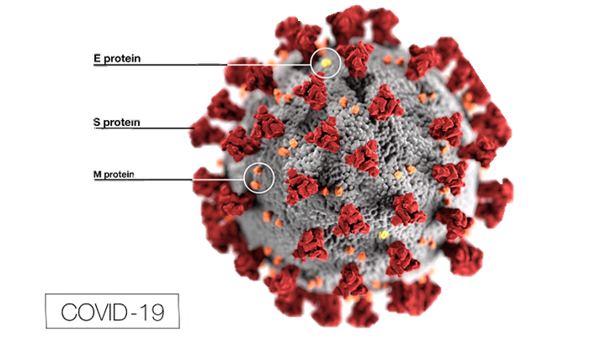
What is COVID-19
COVID-19 is caused by a coronavirus …
WAIT!! What is a coronavirus?
Coronaviruses are viruses that are name fir the crown-like spikes on their surfaces.
There are coronaviruses that cause disease in humans and in animals.
Sometimes animal corona viruses evolve and become a new human coronavirus.
For example SARS from 2003 and now COVID-19

Slide 6
What is COVID-19
It is caused by a novel coronavirus, named Severe Acute Respiratory Syndrome coronavirus 2 (SARS-CoV-2).
It was identified as the cause of an outbreak of respiratory illness first detected in Wuhan China in 2019.
The illness caused by the virus has been named coronavirus disease 2019 (COVID-19).

Slide 7
What is COVID-19
SARS-CoV-2 is presumed to have been transmitted through bats, but this has not been confirmed. So the origin is still unknown
There is currently no vaccine for coronaviruses.

Slide 8
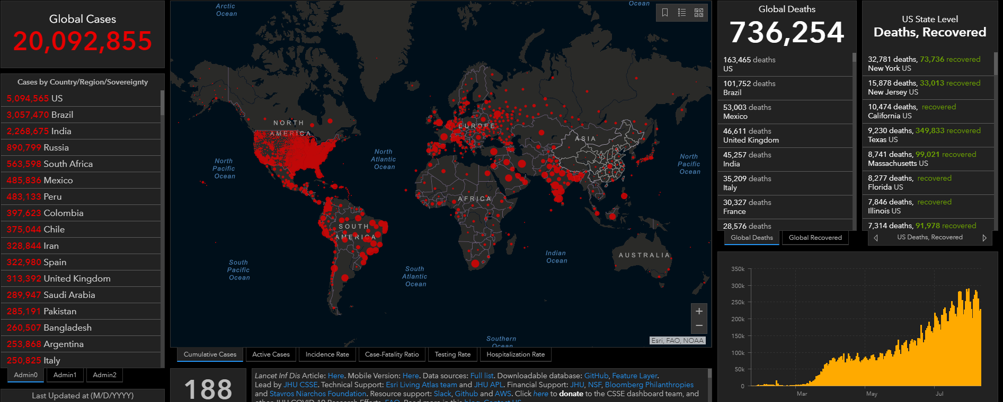
IMPACT OF COVID-19
Notes:
Over 20 million cases, over 700k death worldwide as of Aug 2020.
Every country was affected, in most ways, (economically, financially, socially etc.)

Slide 9
QN: Are the homeless cases equal to the general public cases.
We ran a one proportional z-test
A one proportion z-test is used to compare an observed proportion to a theoretical one, when there are only 2 categories
We discovered that , the homeless cases are not equal to the general public cases. In fact that the homeless cases are only 3.8% of the positive COVID19 cases observed in San Francisco.

Slide 10
QN: Are the number of homeless cases affecting the general public. Are the homeless spreading COVID19 because they have no homes?
We ran linear regression predictive analysis.
Linear regression will be used to explain the relationship between the homeless population and the general public population.
We discovered that the homeless population was responsible for 996% of the spread of COVID19 to the general public. The 4% can be explained by other factors.
How ever, we found a lot of variance, the data was not evenly distributed.

Slide 11
QN: Have the rooms availability in the homeless shelters been affected by the covid cases in the county of San Francisco?
We ran the Independent Chi-Square analysis.
Independent Chi-Square will be used to explain the relationship between the Shelter’s rooms availability and the homeless cases.
We discovered that as the homeless cases increased the rooms availability decreased especially, in the later months of June and July.

Slide 12
QN: Online source has stated that the homeless population was hit 80% harder compared to the public.?
We ran the Goodness of Fit Chi-Squares analysis.
Goodness of Fit Chi-Squares Analysis will be used to explain the relationship between the observed and expected values from that online source..
We discovered first that this stats is not even close to be true, then we ran the two proportion z test analysis and found that the impact in each population as follows; the homeless was impacted by 2.5% in their population. The general public was impacted by 0.71% in their population. Comparing the percentage to each other. We can conclude that the homeless was impacted 111.8% harder than the general public.

Slide 14
Sources
Coronavirus
https://www.cdc.gov/coronavirus/types.html
https://www.cdc.gov/media/subtopic/images.htm
https://coronavirus.jhu.edu/map.html

