Slide 1
INITIAL DRAFT • CONTENT REVIEW
FULLY NESTED CHECK
Mesh realization is
part of the result
Repeatability of individualized temporal-interference E-field simulations
40
×
40
independent meshes
solves per mesh
Boyan Ivanov • Lab Journal Club • 25 September 2026
Fresh remeshing produces percent-level spread; repeated solving on one mesh is nearly deterministic.
3,200 simulation records across cohort + nested experiments
Notes:
Opening (about 40 seconds): Individualized TI simulations are usually spoken about as though one anatomy and one montage produce one field map. This experiment asks whether that output is actually unique when the tetrahedral mesh is regenerated. The answer is no: in this workflow, the mesh realization contributes percent-level uncertainty.
Preview the two experiments: a ten-participant remesh-versus-fixed comparison and one fully nested 40-by-40 case that separates between-mesh from within-mesh variation.

Slide 2
TAKE-HOME FIRST
The field estimate is mesh-dependent
1.81–3.65%
1.62–2.79%
95.7%
99.9996%
Left-hippocampus CV across remesh repeats
Right-M1 CV across remesh repeats
Hippocampal draws with ≥1 rank reversal
Variance share attributed to mesh in one nested subject
Central conclusion
Within the evaluated CHARM–SimNIBS workflow, mesh generation—not repeated solution on a fixed mesh—dominates repeated-run variability.
Interpretation boundary
The 40×40 variance decomposition is a single-participant sensitivity analysis. It strengthens source attribution, but it is not a population variance estimate.
TI repeatability • journal club
Corrected spherical-ROI analysis freeze: 11 Sep 2026
02
Notes:
The cohort analysis shows remesh CVs of 1.81–3.65% in left hippocampus and 1.62–2.79% in right M1. A single remesh repeat often changes at least one pairwise subject ordering. In the fully nested subject, 99.9996% of observed variance is assigned to differences between meshes.
Emphasize the boundary: the nested percentage is conditional on one subject, one target, and this workflow. It is not a claim that all simulation uncertainty everywhere is mesh-driven.

Slide 3
WHY THIS MATTERS
Identical inputs still pass through a variable numerical representation
1
2
3
4
5
MRI + labels
CHARM mesh
FEM fields
TI envelope
Spherical ROI
fixed anatomy
regenerate or reuse
two carrier fields
max-TI combination
median field
experimental factor
Held constant
anatomy • tissue labels • electrodes • currents • conductivities • software settings • ROI definition
Question: can a new valid tetrahedralization change a conclusion even when every scientific input is unchanged?
TI repeatability • journal club
Context: Windhoff et al., 2013; Saturnino et al., 2019; Puonti et al., 2020
03
Notes:
Walk left to right. The anatomy, labels, montage, currents, conductivities, software, and ROI stay fixed. The experimental factor is whether CHARM creates a fresh tetrahedral mesh or the same mesh workspace is reused.
The study is not comparing two biological states. It is measuring numerical repeatability of the modelling pipeline.

Slide 4
STUDY DESIGN
Two complementary experiments separate pattern from source
COHORT CONTRAST
FULLY NESTED
Does the effect recur across people and targets?
Which stage contributes the variance?
10
2
40+40
1
40
40
participants
targets
runs / subject–target
participant
independent meshes
solves / mesh
Left hippocampus + right M1
CC320616 • left hippocampus
5 female / 5 male • ages 26.00–79.17 years
Participant selected once with a fixed seed
1,600 simulations
1,600 simulations
3,200 completed simulation records in the presentation evidence base
TI repeatability • journal club
CamCAN cohort; corrected spherical-fixed + nested analysis
04
Notes:
The cohort contrast asks whether remesh-versus-fixed behavior is consistent across ten participants and both a deep and superficial target. The fully nested experiment asks where variation enters by crossing 40 independently generated meshes with 40 repeated solutions per mesh.
Do not combine the two sample sizes as though 3,200 were independent biological observations. These are technical simulation records.

Slide 5
METHODS THAT AFFECT INTERPRETATION
The contrast changes one thing: the mesh realization
REMESH
FIXED MESH
PRIMARY OUTCOME
Fresh mesh generated
for every repeat
One mesh reused
for every repeat
Median maximum-TI envelope
within the optimizer-matched, parcel-clipped spherical ROI
Variation represented
Variation represented
mesh generation + FEM solution + export / ROI extraction
residual FEM solution + export / ROI extraction conditional on one mesh
200 mm³ hippocampus
100 mm³ M1
Analysis
Per-participant SD/CV
•
20,000 single-repeat rank draws
•
balanced one-way random-effects decomposition
Participant is the population unit; repeats quantify computational variation.
TI repeatability • journal club
Corrected selector aligned with the spherical analysis ROI
05
Notes:
The remesh arm includes everything that can vary after the fixed inputs, including tetrahedralization. The fixed arm measures only residual solution and post-processing variation conditional on one selected mesh.
The fixed mesh is the remesh geometry nearest the median spherical-ROI result for that participant and target. This deliberately makes it representative of the remesh distribution; it does not make it the most anatomically accurate mesh.
Mention the correction only if useful here: the current fixed arm was rebuilt after aligning mesh selection with the optimizer-matched spherical ROI.

Slide 6
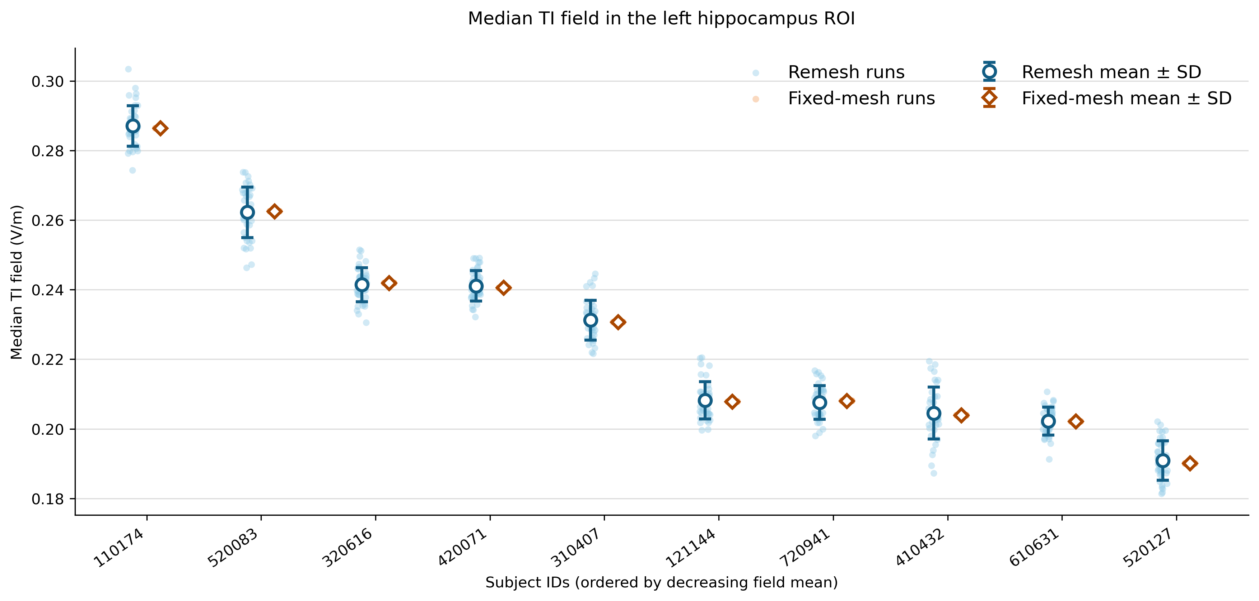
RESULT 1 • LEFT HIPPOCAMPUS
Hippocampal fields vary by 1.81–3.65% under remeshing
2.40%
median remesh CV
≥99.19%
minimum reduction in SD with fixed mesh
≤0.016%
maximum fixed-mesh CV
Blue spread collapses to an almost single orange value for every participant.
TI repeatability • journal club
n=10; 40 remesh + 40 fixed-mesh repeats per participant
06
Notes:
Read the plot as within-participant technical variability, not between-person uncertainty. Each pale blue cloud is 40 independently remeshed simulations. The orange fixed-mesh repeats are visually collapsed.
The corrected spherical-ROI remesh CV range is 1.81–3.65%, with a median of 2.40%. The smallest participant-level SD reduction after mesh reuse is 99.19%.

Slide 7
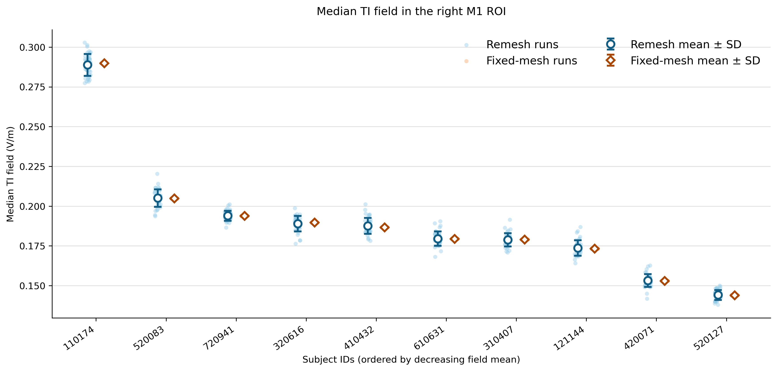
RESULT 2 • RIGHT M1
M1 shows the same pattern: 1.62–2.79% remesh CV
2.54%
median remesh CV
≥99.78%
minimum reduction in SD with fixed mesh
≤0.0053%
maximum fixed-mesh CV
Replication in a superficial target argues against a hippocampus-only artifact.
TI repeatability • journal club
n=10; 40 remesh + 40 fixed-mesh repeats per participant
07
Notes:
The right-M1 result is qualitatively the same. Corrected spherical-ROI remesh CVs range from 1.62% to 2.79%, median 2.54%. The fixed-mesh SD reduction is at least 99.78%.
This replication supports robustness across the two evaluated targets, but not universal generalization to all montages, meshing tools, or ROIs.

Slide 8
RESULT 3 • RANKING UNCERTAINTY
Percent-level spread matters when subjects are closely matched
LEFT HIPPOCAMPUS
RIGHT M1
95.7%
88.5%
of 20,000 draws contained ≥1 reversed pair
of 20,000 draws contained ≥1 reversed pair
0.867
47.9%
0.911
44.7%
median Kendall agreement
largest exact pair reversal
median Kendall agreement
largest exact pair reversal
Closest high-risk pair: CC121144 vs CC720941
Closest high-risk pair: CC610631 vs CC310407
Global ordering remains fairly concordant, but a one-mesh ranking is fragile near ties.
TI repeatability • journal club
One remesh repeat selected independently for each participant per draw
08
Notes:
The reference ordering uses each participant's 40-repeat mean. In each of 20,000 draws, one repeat is selected independently per participant.
At least one pair reverses in 95.7% of hippocampal draws and 88.5% of M1 draws. Median agreement remains high, so the message is not that all rankings are random. It is that close pairs are sensitive to which valid mesh was selected.
These are uncertainty measures, not p-values.

Slide 9
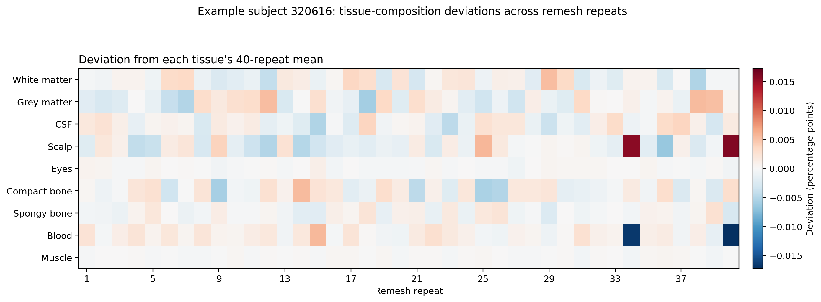
MECHANISTIC EVIDENCE
Remeshing changes the numerical head model—not only the final scalar
7,369
mean within-participant SD of total tetrahedral element count • hippocampus
7,704
mean within-participant SD of total tetrahedral element count • M1
Interpret carefully
Element count and tissue fractions confirm different realizations; they do not identify the causal boundary change.
Example: CC320616, left-hippocampus remesh arm
TI repeatability • journal club
Tissue deviations are percentage points from each tissue's 40-repeat mean
09
Notes:
The heatmap shows small but structured shifts in the proportion of volume assigned to tissue classes across remesh realizations. Total tetrahedral element count also varies substantially within participant, while it is constant when the mesh is reused.
Do not claim that a particular tissue transition caused the field changes. Element count is coarse, and local boundaries, element quality, electrode–skin geometry, and interpolation can also matter.

Slide 10
NESTED DESIGN
The nested design creates two separable levels of technical variation
BALANCED
40 independent meshes
each reused for 40 complete solutions
40 meshes × 40 solutions
mesh 01
…
Every mesh contributes the same number of observations and therefore has equal weight.
mesh 02
…
NESTED
Each solution belongs to one mesh
mesh 03
…
Within-mesh comparisons hold the geometry fixed; mesh means are compared across geometries.
mesh 04
…
RANDOM MESH EFFECT
mesh 05
…
Meshes are sampled realizations
The goal is to estimate pipeline variability—not to compare named meshes as conditions.
⋮
40 repeats conditional on the same geometry
Two questions: how far apart are mesh means, and how tightly do repeats cluster within a mesh?
TI repeatability • journal club
One fixed participant and target • 40 independently generated meshes • 40 complete solutions per mesh
10
Notes:
The hierarchy matters before the equation. The design is balanced because all 40 meshes have 40 solutions. It is nested because every solution belongs to exactly one mesh. Mesh is a random effect because the numbered meshes are sampled realizations of the pipeline, not scientific conditions of interest. The subject and target are fixed.

Slide 11
RANDOM-EFFECTS MODEL
The model separates between-mesh from within-mesh variation
ONE OBSERVED ROI FIELD
observed field
=
overall mean
+
mesh-specific shift
+
repeat-to-repeat residual
yₘᵣ = μ + uₘ + εₘᵣ
BETWEEN MESHES • MESH VARIANCE
WITHIN A MESH • RESIDUAL VARIANCE
Do independently generated geometries give different average fields?
If geometry is fixed, how much do repeated solutions still differ?
1 Average the 40 solutions within each mesh
1 Compare each solution with its own mesh mean
2 Compare the 40 mesh means
2 Pool the remaining within-mesh scatter
Large value → remeshing changes the estimated field
Small value → the same mesh solves reproducibly
Total technical variance = mesh variance + within-mesh variance • mesh share = mesh variance / total
Scope: one fixed participant and target. The model attributes technical variation; it does not estimate population variance.
TI repeatability • journal club
m = mesh • r = repeated solution • uₘ = mesh effect • εₘᵣ = residual within that mesh
11
Notes:
Read the equation in plain language: an observed field is the overall mean plus the shift associated with that mesh plus residual repeat-to-repeat variation. The left component is estimated from the spread of mesh means. The right component is estimated from scatter around each mesh's own mean. Because there is one fixed participant and target, this is source attribution within this workflow, not population inference.

Slide 12
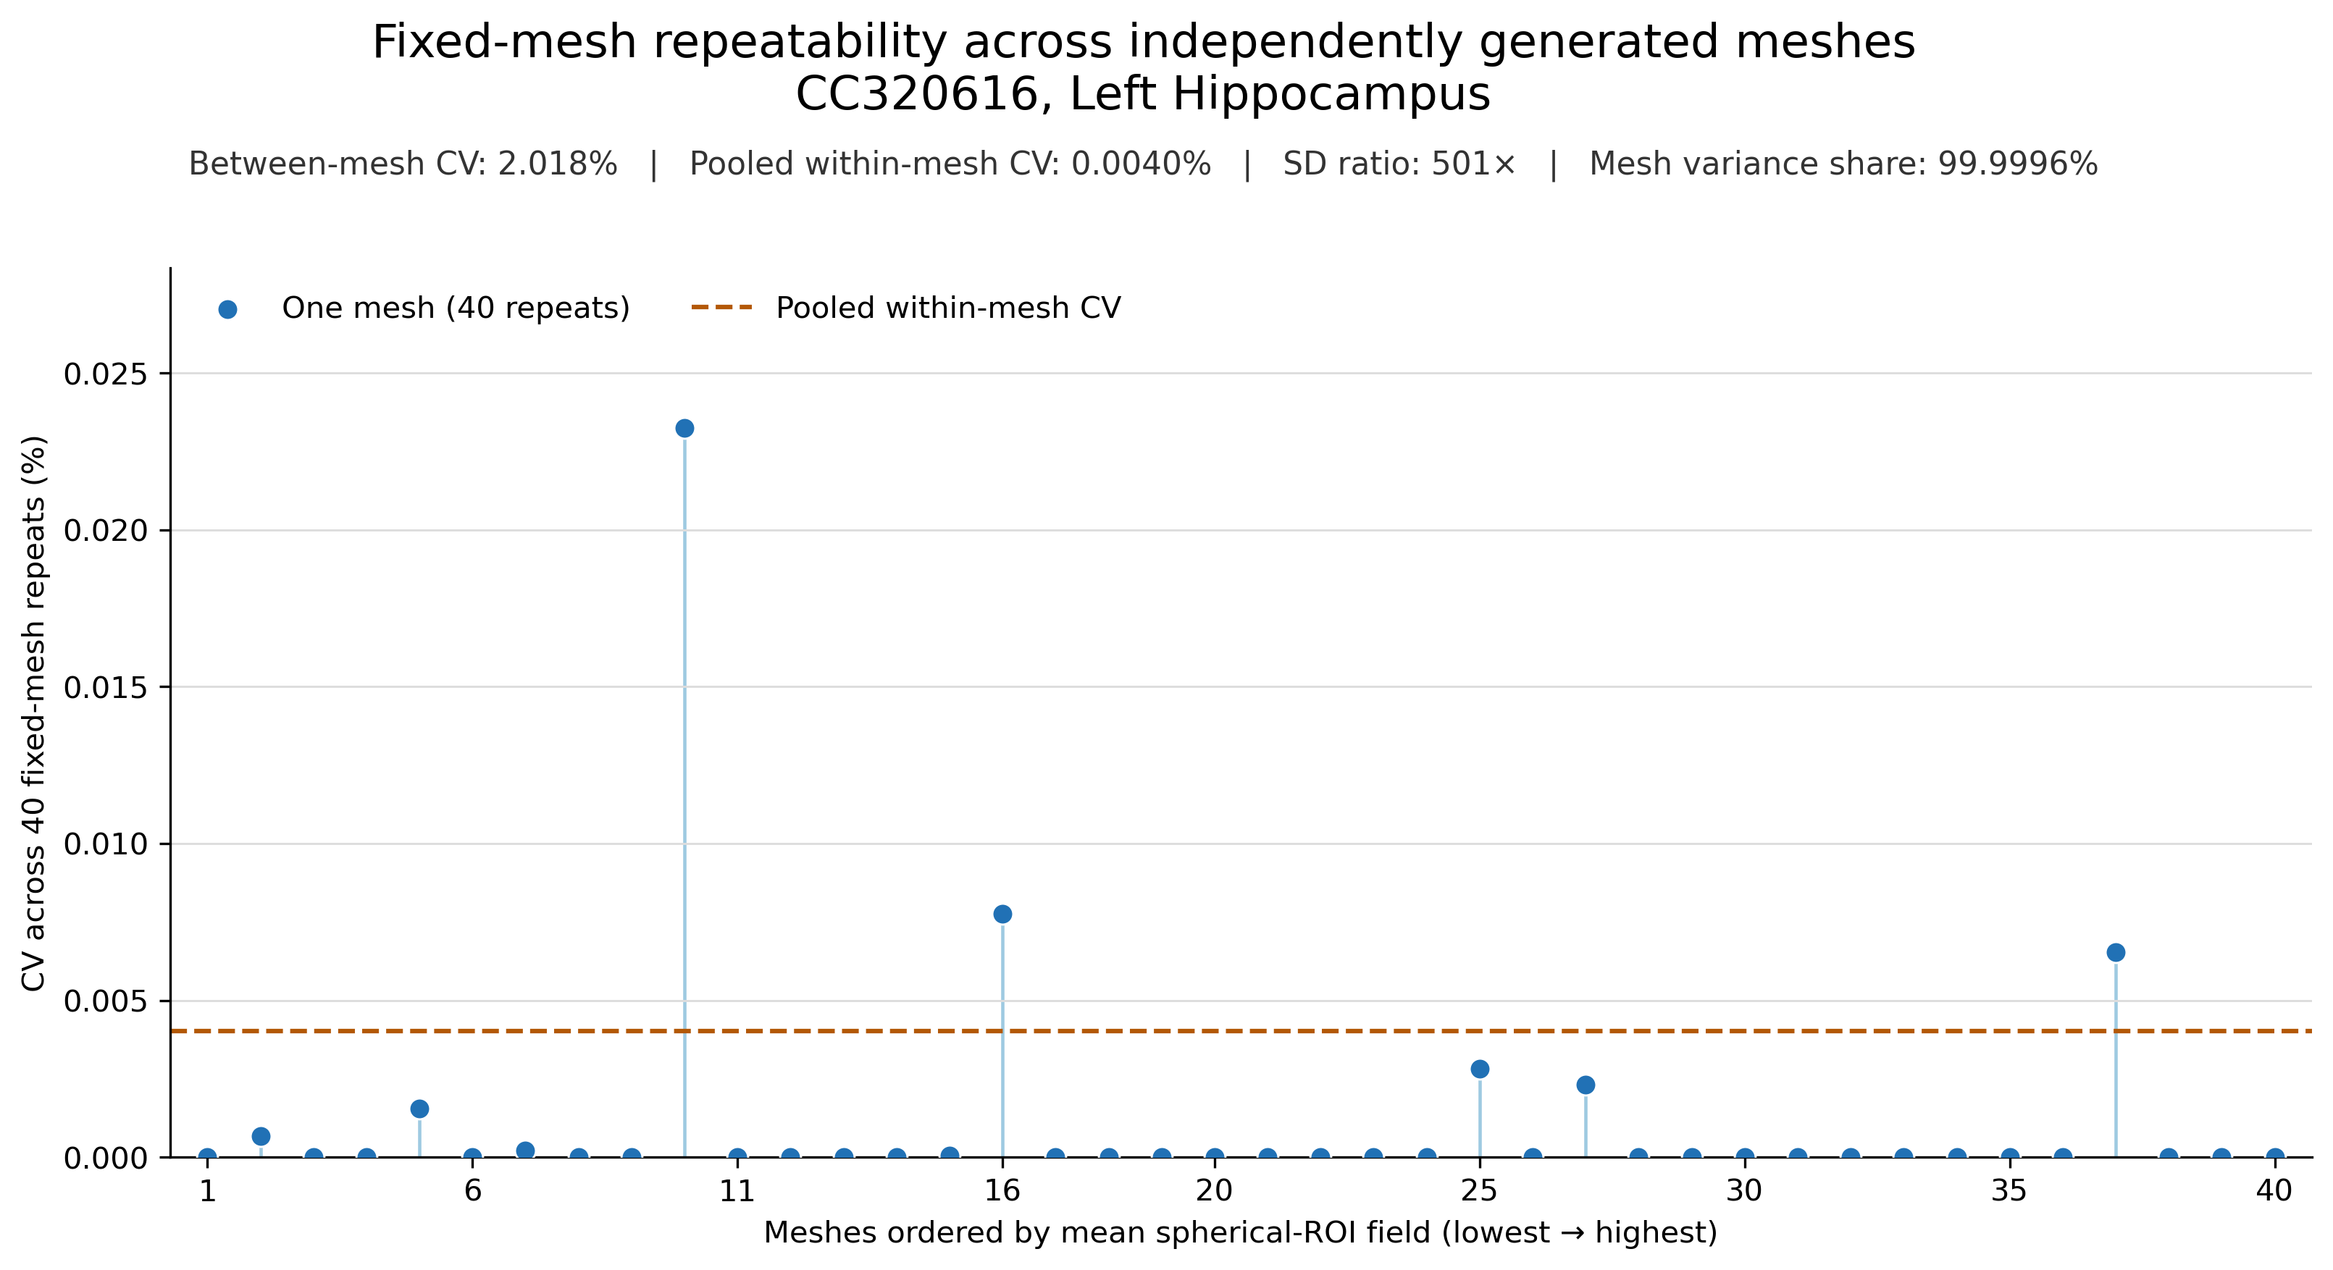
RESULT 4 • FULLY NESTED SUBJECT
The nested case assigns virtually all observed variance to mesh generation
Boundary: one participant • one target • one workflow. Source attribution, not population prevalence.
TI repeatability • journal club
Between-mesh CV 2.018% • within-mesh CV 0.0040% • SD ratio 501×
12
Notes:
Each point is the CV across 40 repeated solutions on one mesh. Most are exactly or effectively zero. The dashed line is the pooled within-mesh CV.
The between-mesh CV is 2.018%; pooled within-mesh CV is 0.0040%. The component SD ratio is 501-fold, and 99.9996% of total observed variance is attributed to mesh generation.
Keep saying 'in this participant' and 'in this workflow.'

Slide 13
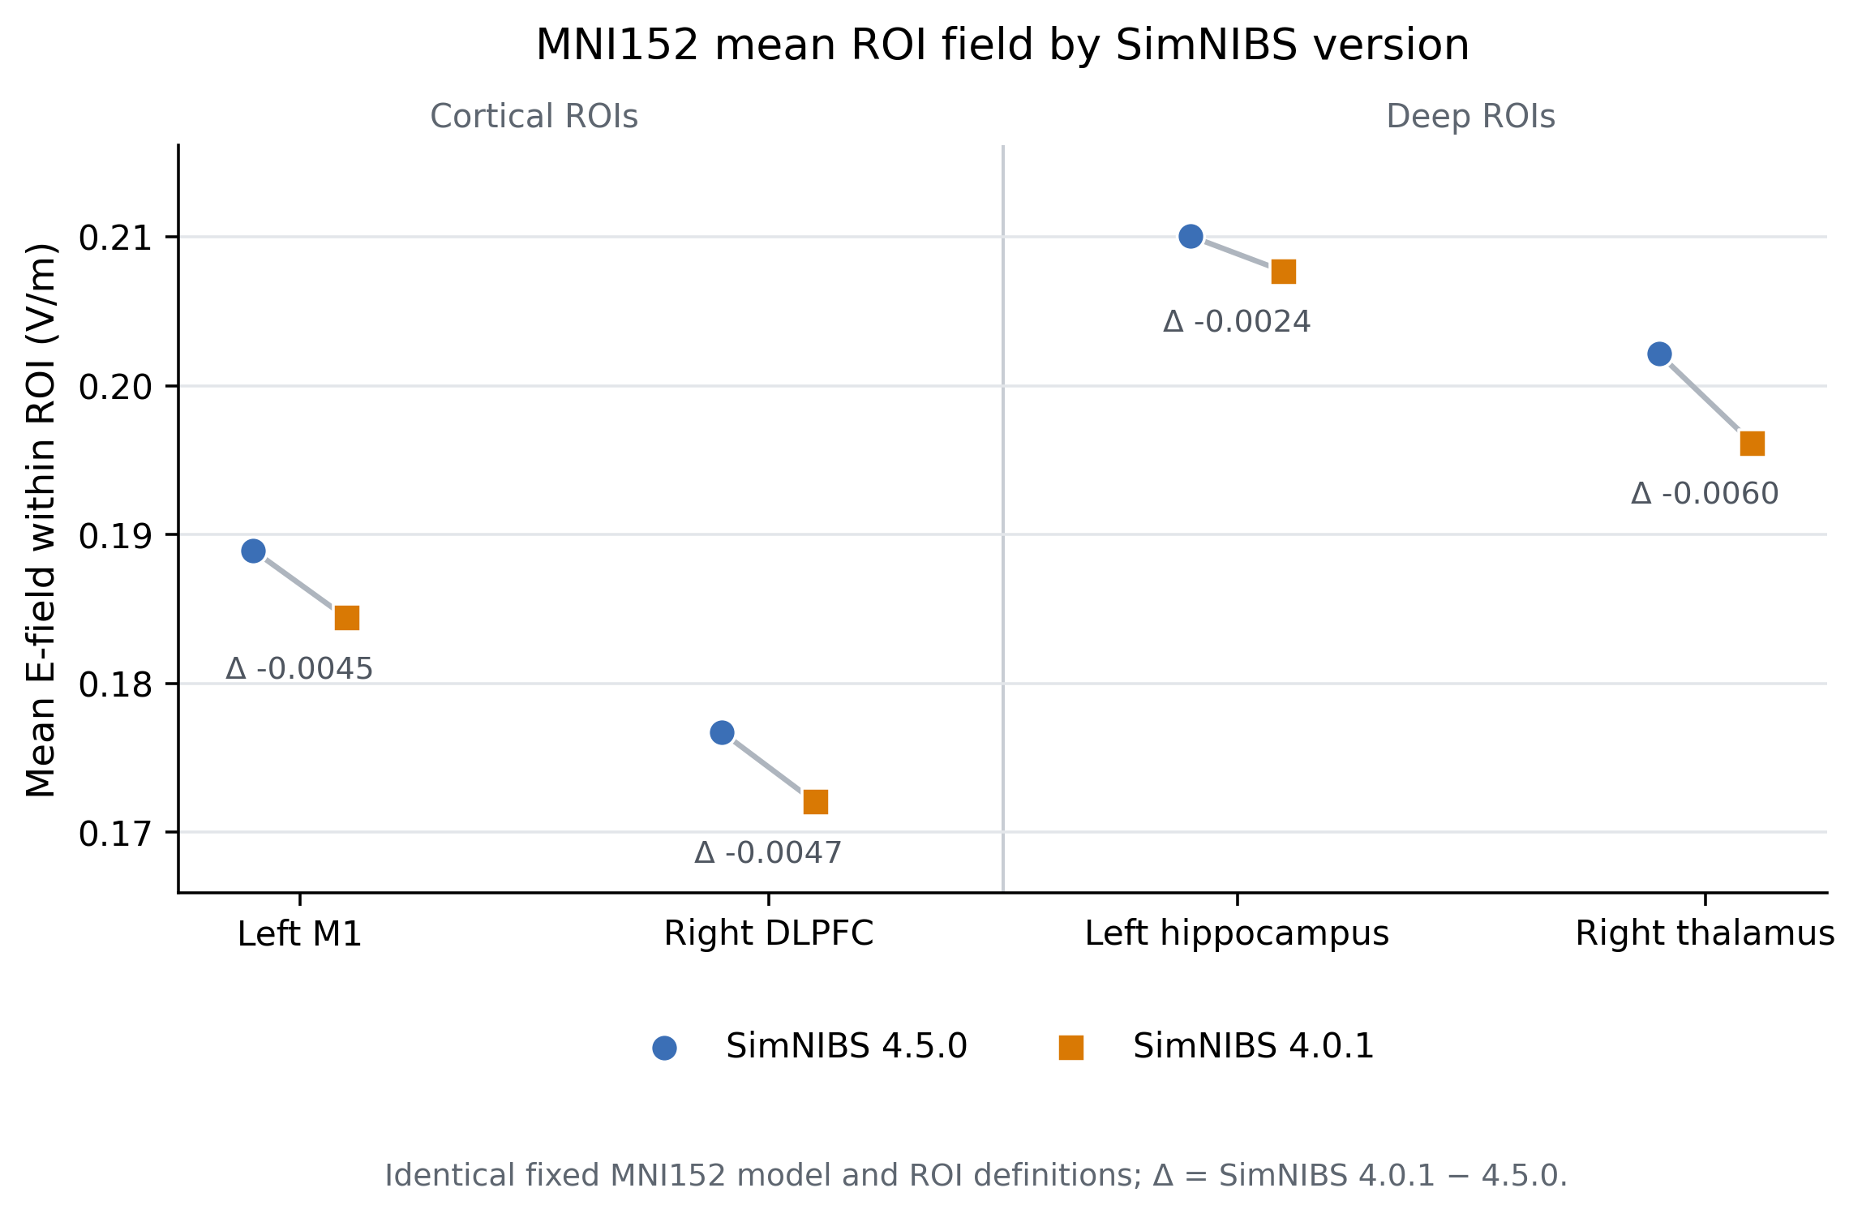
SENSITIVITY • FIXED MNI152 MODEL
Version sensitivity is systematic in amplitude—not spatial pattern
4 / 4
ROIs lower under SimNIBS 4.0.1
−1.13% to −2.97%
change in mean field, 4.0.1 versus 4.5.0
r ≥ 0.99983
whole-brain voxelwise agreement
One fixed model: software sensitivity, not participant-level repeatability.
TI repeatability • journal club
Fixed mesh, reference image, montage, ROI definitions, conductivities, and currents; runtime version changed
13
Notes:
This is a separate sensitivity analysis on one fixed MNI152 model. The mesh, reference image, ROI definitions, montages, conductivities, currents, and electrode geometry were held constant; only the SimNIBS runtime version changed.
SimNIBS 4.0.1 produced a lower mean ROI field than 4.5.0 in all 4 ROIs. The relative shift ranged from −1.13% to −2.97%. Whole-brain spatial agreement remained extremely high, with Pearson r at least 0.99983; relative L2 differences ranged from 0.82% to 3.54%.
The interpretation is a small, systematic amplitude shift with the spatial pattern largely preserved. Do not pool this fixed-model version comparison with the participant or remeshing distributions, and do not attach population inference to the four ROIs.

Slide 14
INTERPRETATION
Within-version evidence converges on mesh realization
1
2
3
Cohort contrast
Nested decomposition
Structural correlates
Remesh repeats spread; fixed-mesh repeats collapse across 10 participants and two targets.
Between-mesh SD is 501× the residual within-mesh SD in the fully nested subject.
Element count and tissue-volume composition change across remesh realizations.
Inference: mesh realization is a numerical experimental factor and belongs in the uncertainty budget.
Dominant source of repeated-run variation ≠ proof that the selected mesh is the most accurate anatomy.
TI repeatability • journal club
Evidence triangulation across field, variance, and mesh outcomes
14
Notes:
The conclusion does not rest on a single plot. The main cohort shows the condition contrast, the nested experiment attributes the variance source, and structural metrics show that remeshing creates different numerical head models.
This is evidence that mesh realization is part of the computational specification. It is not evidence that any one realization is anatomically truer.

Slide 15
IMPLICATIONS
The practical response depends on the scientific comparison
Controlled contrasts
Percent-level effects
Freeze and checksum the mesh when comparing conditions within the same anatomy and meshing is a nuisance factor.
Repeat remeshing—or otherwise quantify discretization uncertainty—when the expected effect is similar to the observed CV.
Subject ranking
Reproducibility
Avoid fine-grained selection or responder stratification from one mesh when participant means are close.
Report meshing policy, selected-mesh provenance, software version, seed/selection rule, and remesh variability.
Rule of thumb for interpretation
If the scientific contrast is smaller than the mesh-induced spread, the mesh must enter the design or uncertainty statement.
TI repeatability • journal club
Recommendations are scoped to the evaluated workflow
15
Notes:
Mesh reuse is useful for controlled comparisons because it removes a nuisance source. It is not automatically the best strategy for absolute dosimetry or accuracy claims.
If the effect of interest is a few percent, either average or model multiple mesh realizations, or demonstrate empirically that mesh uncertainty is negligible relative to that contrast. Preserve and checksum the chosen mesh so the model can be reproduced.

Slide 16
LIMITATIONS AND CLAIM BOUNDARIES
The result is strong about repeatability—and deliberately narrow about validity
SUPPORTED
NOT ESTABLISHED
● Fresh remeshing introduces percent-level field variation in both evaluated targets.
● Repeated solving on one copied mesh is effectively deterministic.
● A single mesh can alter close between-subject rankings.
● The nested case isolates mesh generation as the dominant source for one participant.
● Which mesh is anatomically or physically most accurate.
● Generalization beyond 10 datasets, two targets, and this CHARM–SimNIBS pipeline.
● A specific tissue boundary or mesh metric as the causal mechanism.
● Population inference from the 1,600 nested technical observations.
Design caveat: the fixed mesh was selected using the primary outcome, so central agreement is partly imposed by design.
TI repeatability • journal club
Technical repeats are not independent participants
16
Notes:
The experiment is designed to quantify numerical repeatability, not validation against measured fields. Ten anatomical datasets and two targets provide replication, but not broad coverage of every montage or software stack.
The representative fixed mesh was selected using the primary field outcome, so its central value is expected to sit near the remesh center. The meaningful fixed-arm result is the near-zero spread conditional on that mesh—not independent accuracy.

Slide 17
DISCUSSION
If the claim is smaller than the mesh noise, the mesh belongs in the claim
Should future primary analyses average across mesh realizations—or standardize one mesh and treat it as part of the model definition?
1
What numerical-uncertainty threshold is acceptable before a simulated field difference is interpreted biologically?
2
Which extension adds the most value: more targets, another mesher, local boundary metrics, or convergence testing?
3
Take-home: a reproducible individualized field estimate requires specifying the mesh—not only the anatomy and montage.
TI repeatability • journal club
Questions / critique / next experiment
17
Notes:
Pause on the take-home sentence, then invite discussion. These questions are intentionally methodological: whether to average or standardize, how to set a numerical tolerance, and what experiment would most efficiently test generalization.

Slide 18
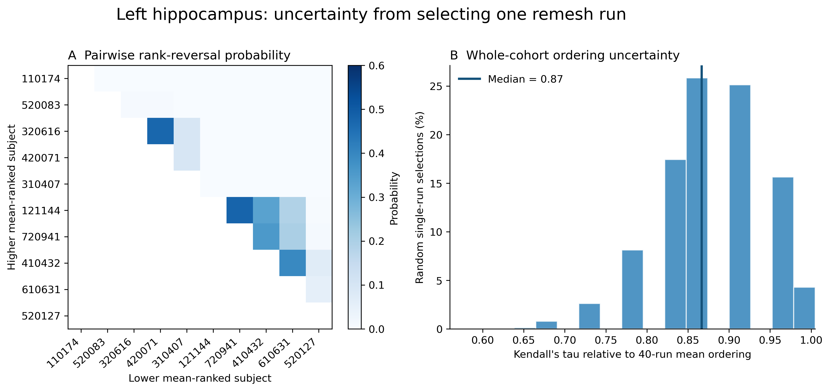
BACKUP
Appendix • full ranking analysis: left hippocampus
TI repeatability • journal club
Exact pairwise probabilities + 20,000 one-repeat-per-participant draws
18
Notes:
Use only if the audience wants to inspect which pairs drive ranking uncertainty.

Slide 19
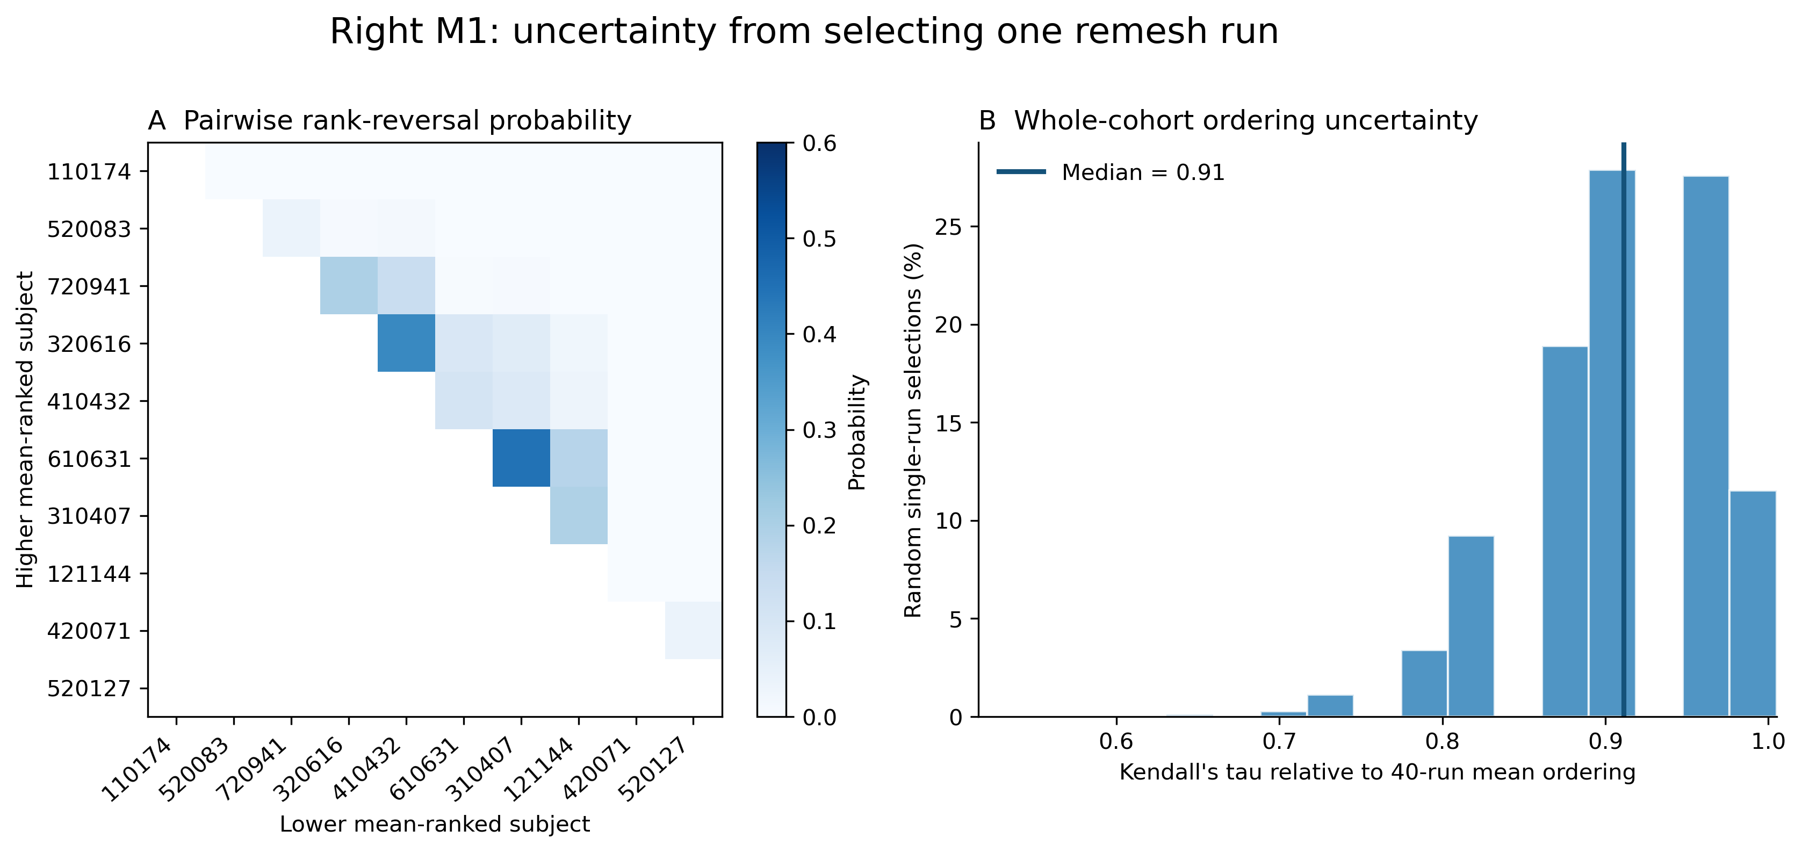
BACKUP
Appendix • full ranking analysis: right M1
TI repeatability • journal club
Exact pairwise probabilities + 20,000 one-repeat-per-participant draws
19
Notes:
Use only if the audience wants to inspect which pairs drive ranking uncertainty.

Slide 20
BACKUP
Appendix • cohort and stimulation parameters
CamCAN cohort
Target-specific TI montages
ID
Recorded sex
Age
Target
Electrode pair
Current
CC110174
Female
26.00
Left hippocampus
F8–P8
2.000 mA
CC121144
Male
26.00
CC310407
Female
39.00
T7–P7
1.588656 mA
CC320616
Male
39.08
Right M1
Fp2–F6
2.000 mA
CC420071
Female
52.58
CC410432
Male
52.58
C4–CP2
0.632456 mA
CC520083
Female
65.08
CC520127
Male
66.00
CC610631
Female
77.58
20 × 20 × 2 mm circular in-plane • conductivity 1.4 S/m
Electrodes
CC720941
Male
79.17
TI repeatability • journal club
Same participants evaluated for both target ROIs
20
Notes:
The cohort is balanced by recorded sex and covers five age bands. Both target experiments use the same ten participants.

Slide 21
PROVENANCE AND SENSITIVITY CHECKS
Appendix • the current results use the corrected spherical-ROI workflow
Fixed-mesh selection correction
Finite-support sensitivity audit
Historical selector
whole anatomical parcel median
97%
99%
minimum finite ROI fraction • hippocampus
minimum finite ROI fraction • M1
Corrected selector
optimizer-matched spherical ROI median
Within participant × condition correlations between finite support and field were weak:
18 / 20
participant–target representative meshes changed
hippocampus r = −0.074, ρ = −0.030
Current deck uses the corrected fixed runs and unchanged historical remesh rows.
M1 r = 0.097, ρ = 0.063
Descriptive sensitivity check; not evidence of causality.
Analysis status: complete • 1,600 corrected cohort rows + 1,600 nested rows • source outputs read only
TI repeatability • journal club
Analysis manifests dated 11 Sep 2026
21
Notes:
The historical fixed mesh was selected using the anatomical parcel median, while the paper endpoint was refreshed to the optimizer-matched spherical ROI. Recomputing selection changed 18 of 20 participant–target representatives. The current presentation uses the regenerated spherical-fixed runs.
Some spherical ROI voxels were non-finite in a subset of runs, but support remained at least 97% in hippocampus and 99% in M1. Within-group correlations with the field metric were weak and are descriptive only.

Slide 22
BACKUP
References and evidence sources
1
Grossman N, et al. Noninvasive deep brain stimulation via temporally interfering electric fields. Cell. 2017;169:1029–1041.e16.
2
Rampersad S, et al. Prospects for transcranial temporal interference stimulation in humans: A computational study. NeuroImage. 2019;202:116124.
3
Windhoff M, Opitz A, Thielscher A. Electric field calculations in brain stimulation based on finite elements. Human Brain Mapping. 2013;34:923–935.
4
Saturnino GB, et al. SimNIBS 2.1: A comprehensive pipeline for individualized electric-field modelling. In: Brain and Human Body Modeling. 2019.
5
Puonti O, et al. Accurate and robust whole-head segmentation from MRI for individualized head modelling. NeuroImage. 2020;219:117044.
6
Indahlastari A, Chauhan M, Sadleir RJ. Benchmarking transcranial electrical-stimulation finite-element models. J Neural Eng. 2019;16:026019.
7
Shafto MA, et al. The Cambridge Centre for Ageing and Neuroscience study protocol. BMC Neurology. 2014;14:204.
Primary presentation evidence: corrected spherical-fixed and nested analysis manifests generated 11 September 2026.
TI repeatability • journal club
Internal initial draft • source paths documented in build script
22
Notes:
These references support the TI, SimNIBS, finite-element, and CamCAN context. The numerical results in the deck come from the corrected local analysis artifacts, not the older manuscript tables.

