Slide 1





















i
ii
iii
A
B
A
B
A
B
C
C
C

Slide 2



















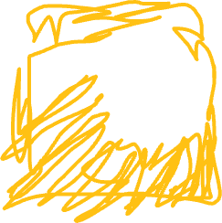

iv
v
A
B
A
B
A
B
C
C
C

Slide 3
15
A_{only}= 20
5
B_{only}= 8
10
15
3
C_{only}= 24

Slide 4
12
R = 26
12
4
4
6
5
F = 12
5
1
1
J = 2
1
1
1
8
8
P = 16
8

