Slide 1
Weather Dashboard and Slack Integration
Jason(Haozhe) Zhang
12/06/2023
"Bringing Real-time Weather Data to Your Fingertips"

Slide 2
Problem Statement
“With the scripting or coding language of your choosing, make an API call to get the weather for Portland, Oregon and then post it to any modern chat app that you care to use (like slack, matrix, telegram, discord, etc.) Please provide the code. ”
Open to extra features, yeah!!!☺

Slide 3
Overview
Goal:
Real-time Weather Data
Request History
Slack Notifications
User-friendly Dashboard
Tech Stack:
Backend: Node.js, Express.js
Semi-Frontend: EJS
Database: MongoDB
HTTP Client: Axios
APIs: Tomorrow.io, Slack, google places API

Slide 4
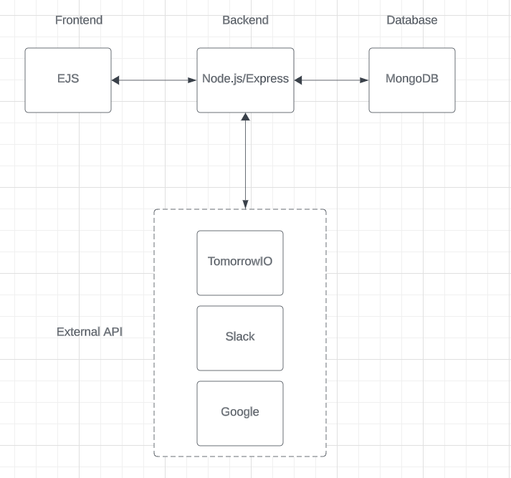
Architecture
3-tier architecture
Flexible to alternatives

Slide 5
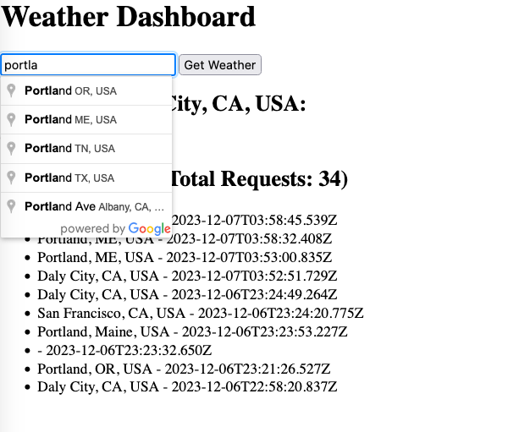
Dashboard

Slide 6
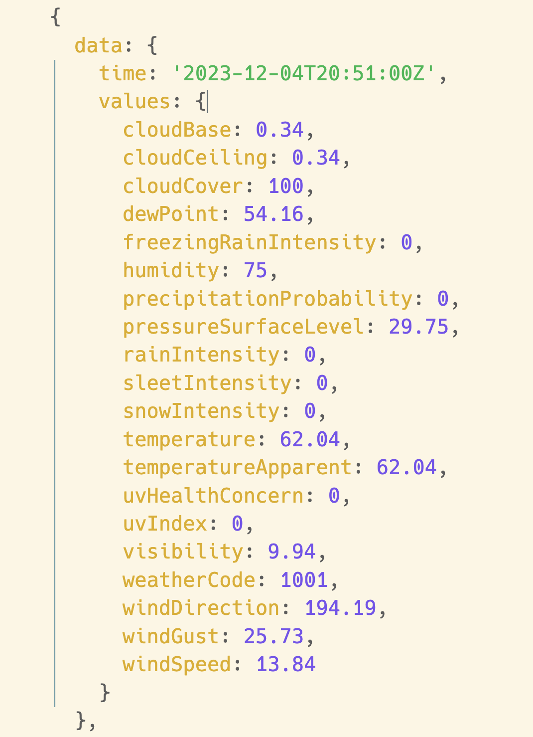
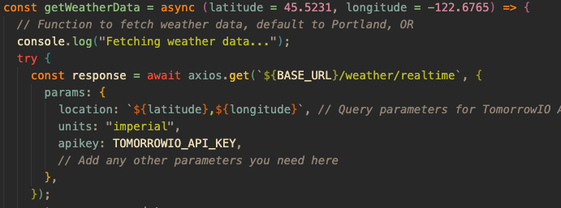
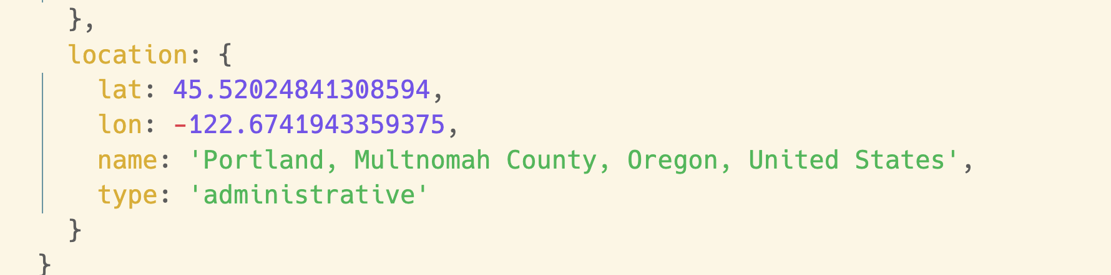
Fetch Weather Data

Slide 7
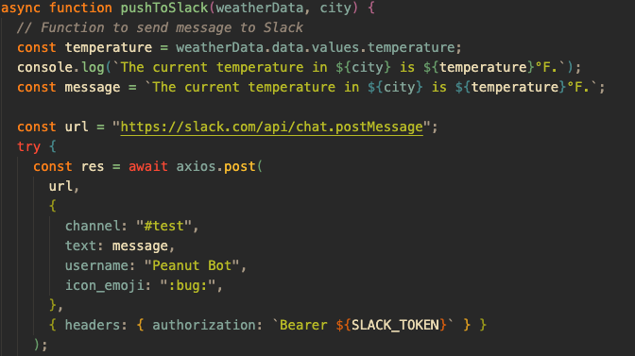
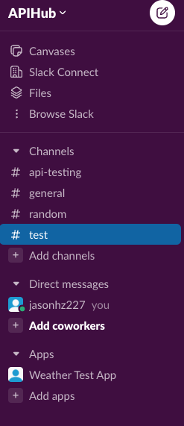

Slack Notification

Slide 8
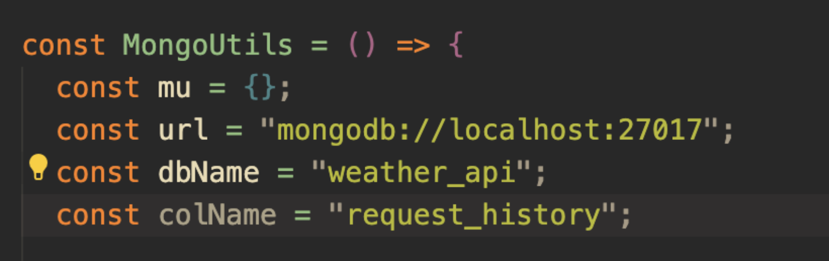
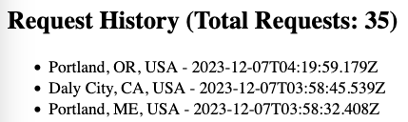
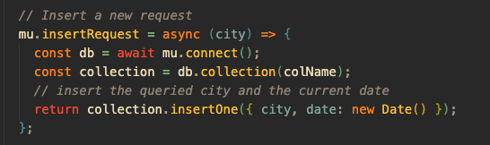
Database

Slide 9
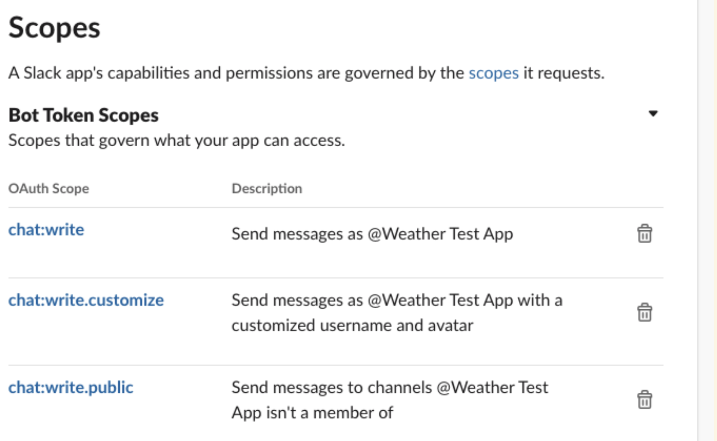
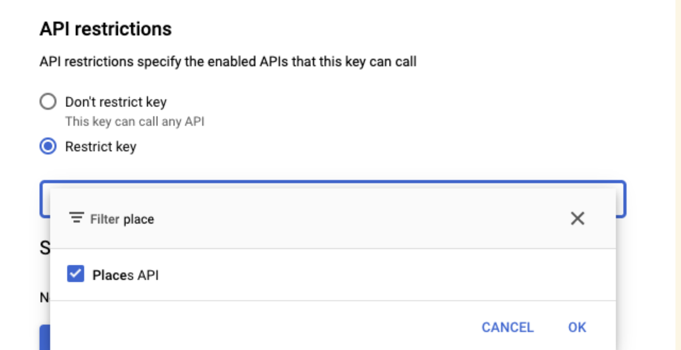
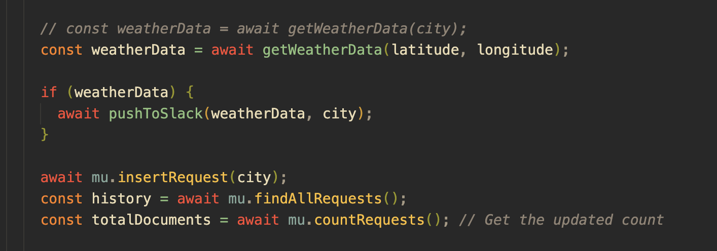
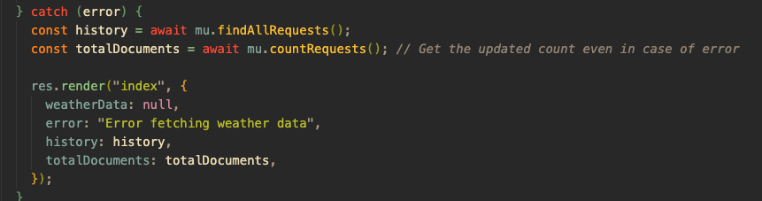
Good Security Practice
Least Privilege
Server-side API calls
HTTPS (axios)
Error Handling

Slide 10
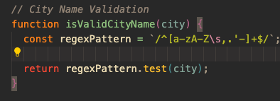
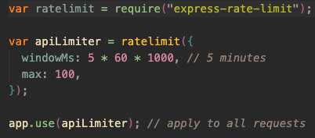

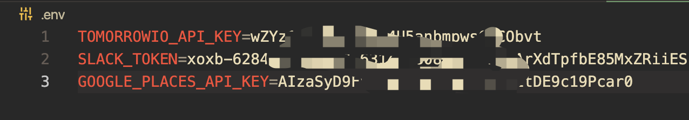
Good Security Practice Cont’d
Input Validation
Rate Limiting
Separate code and environment

Slide 11
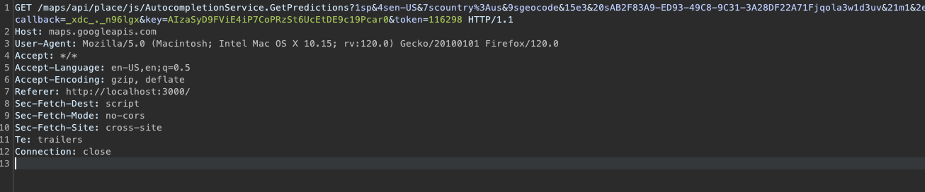
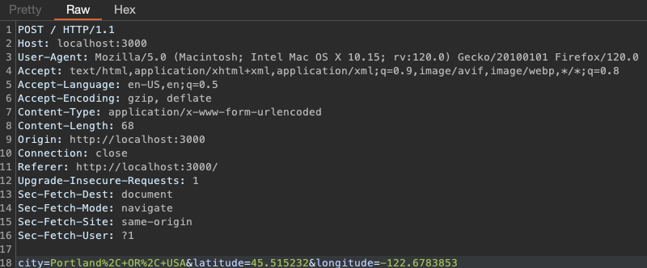
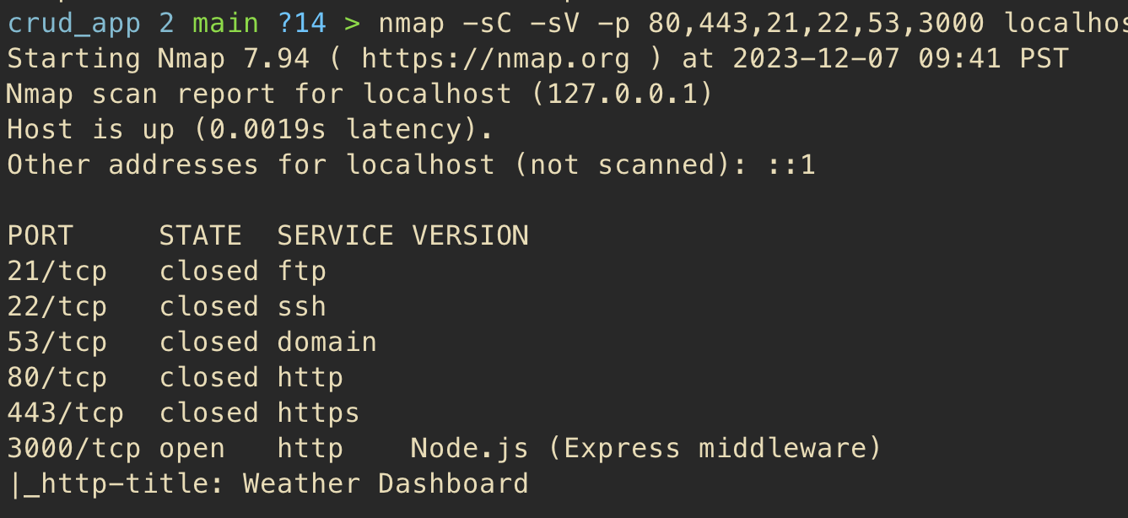
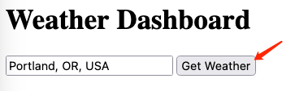
Security Concern
Exposed API key
Client-side info
Sever-side open ports

Slide 12
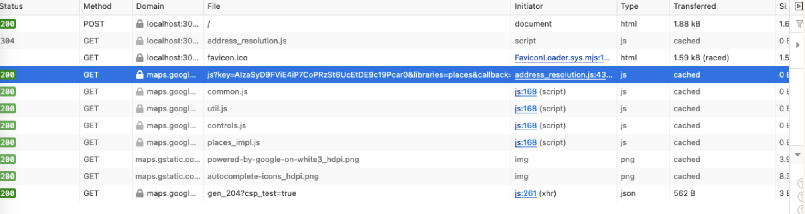
Challenges & Solutions
Exposing API keys in Client-side

Slide 13
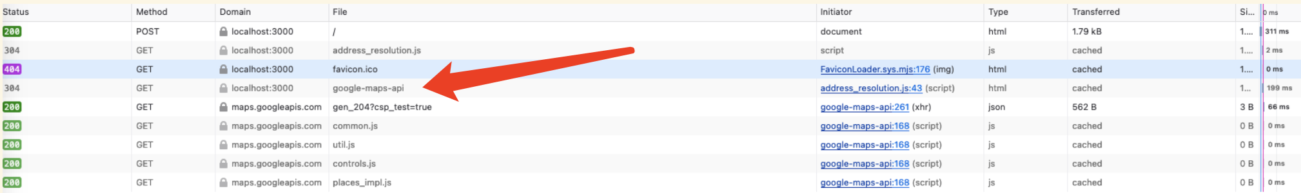
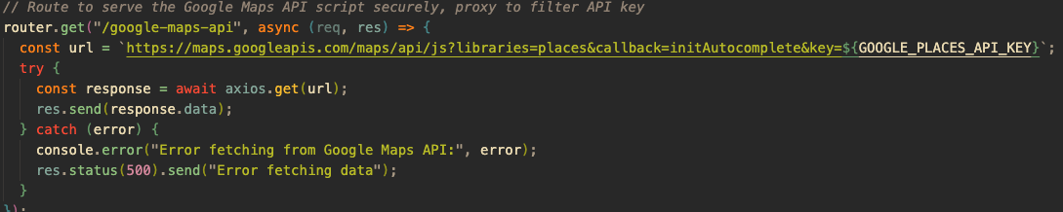
Challenges & Solutions

Slide 14

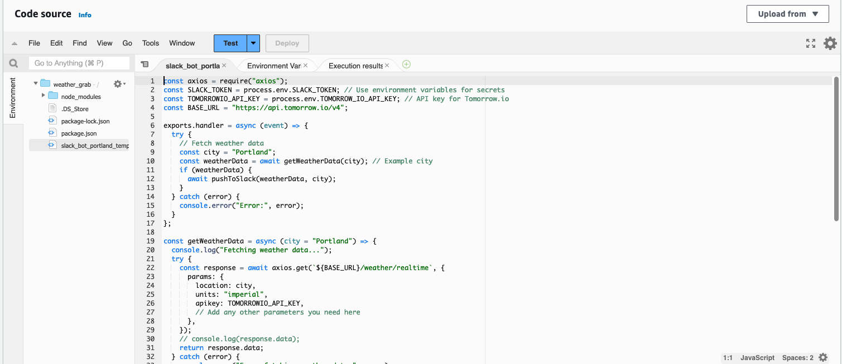
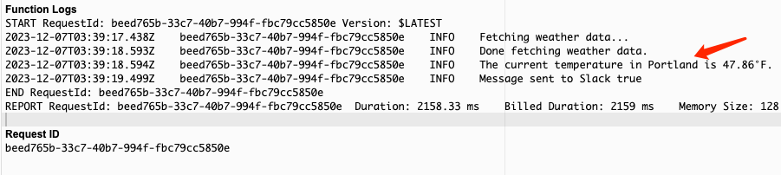
Bonus
Serverless Run
Automation
Scalability

Slide 15
Future Potentials
Planned
Backend Processing (e.g. extracting geo-coordinates, CSRF impl)
Continuous Monitoring (e.g. logging, alerting system)
Customizable Slack Notifications(e.g. Interactive Bot)
Vision
Integration with IoT devices: automated, weather responsive system
Integration with GPT to achieve AI-powered clothing recommendation based on Weather Data

Slide 16
Questions?

