Slide 1
Weather Dashboard and Slack Integration
Jason(Haozhe) Zhang
12/06/2023
"Bringing Real-time Weather Data to Your Fingertips"

Slide 2
Overview
Goal:
Real-time Weather Data
Request History
Slack Notifications
User-friendly Dashboard
Tech Stack:
Backend: Node.js, Express.js
Semi-Frontend: EJS
Database: MongoDB
HTTP Client: Axios
APIs: Tomorrow.io, Slack, google places API

Slide 3
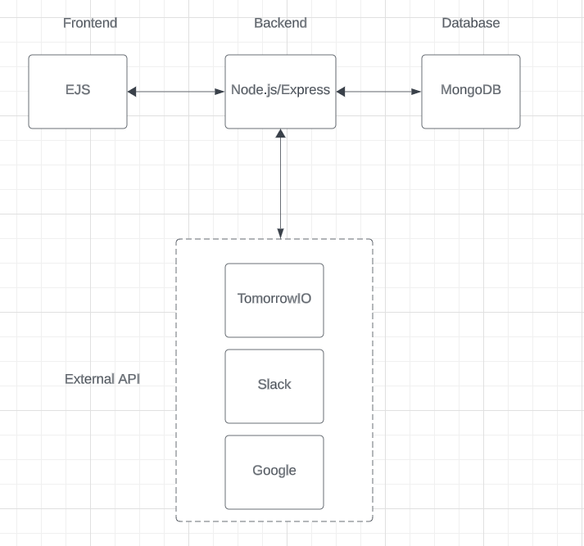
Architecture
3-tier architecture
Flexible to alternatives

Slide 4
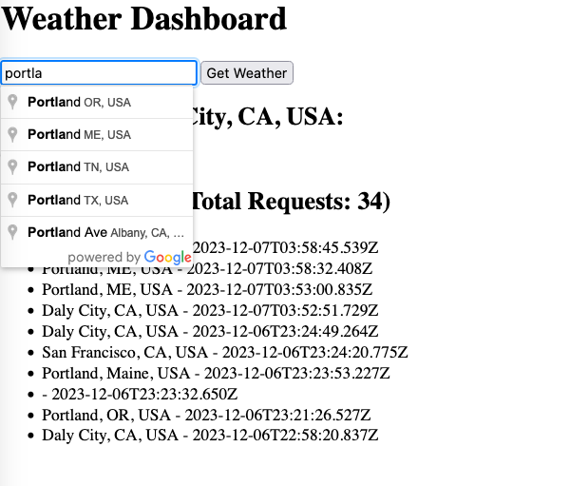
Dashboard

Slide 5
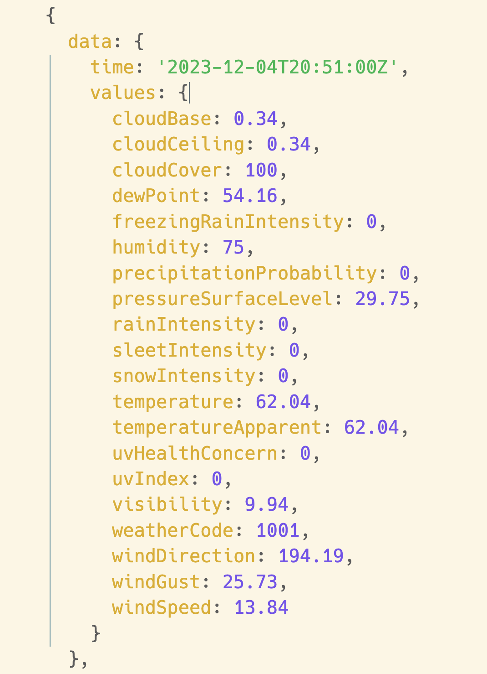
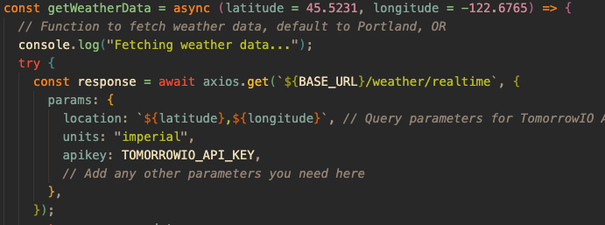
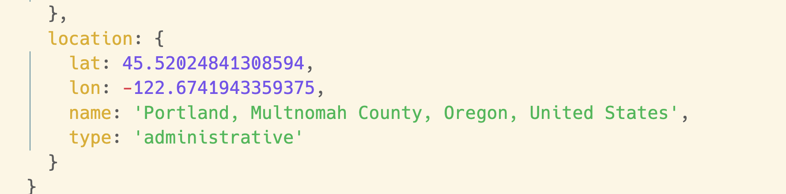
Fetch Weather Data

Slide 6
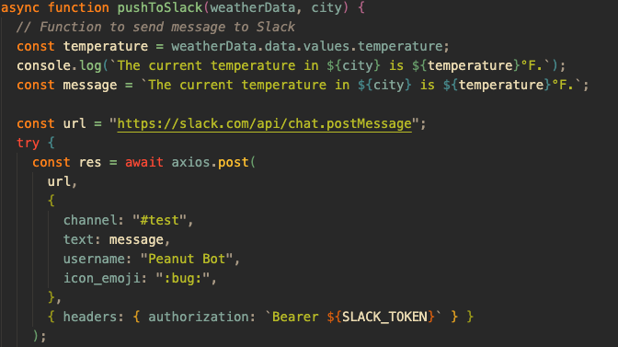
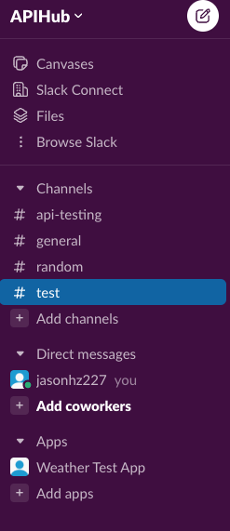

Slack Notification

Slide 7
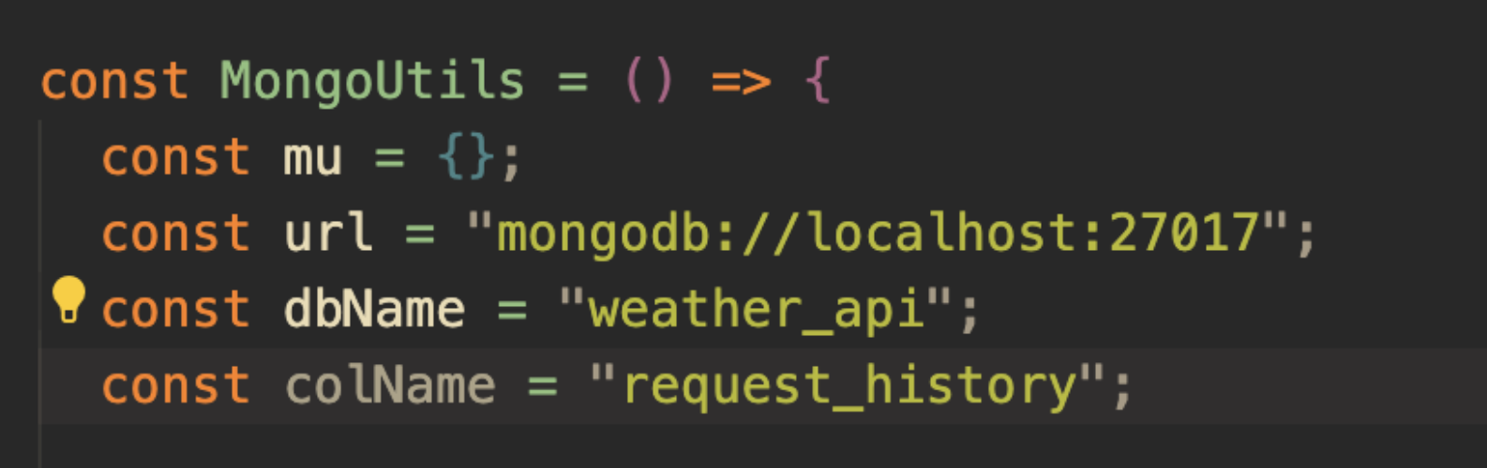
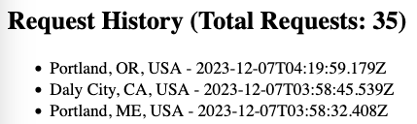
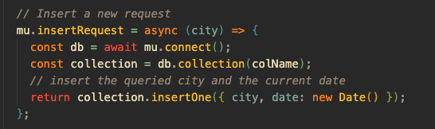
Database

Slide 8
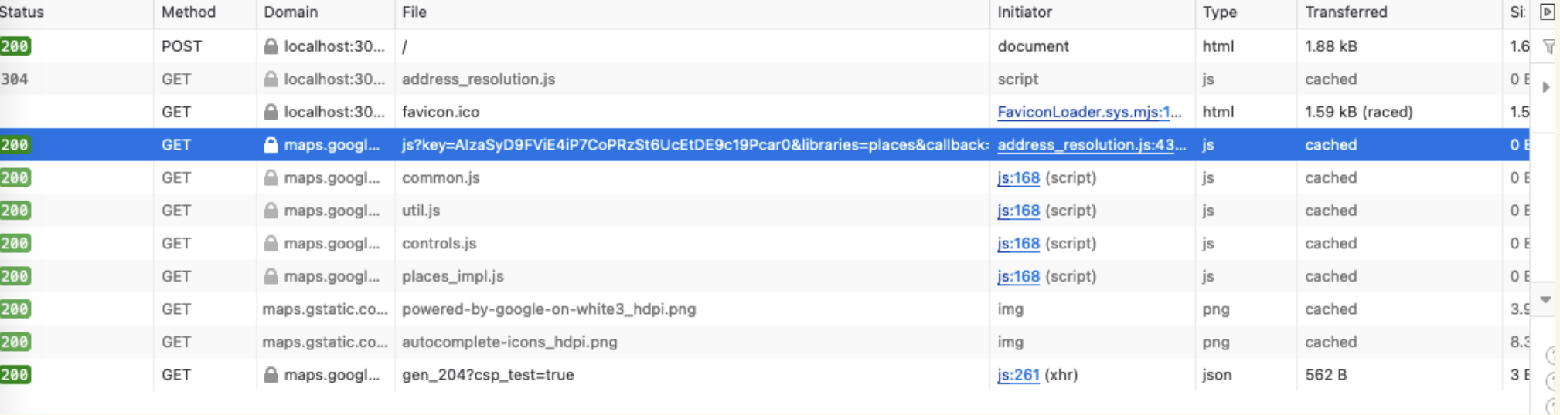
Challenges & Solutions
Exposing API keys in Client-side

Slide 9
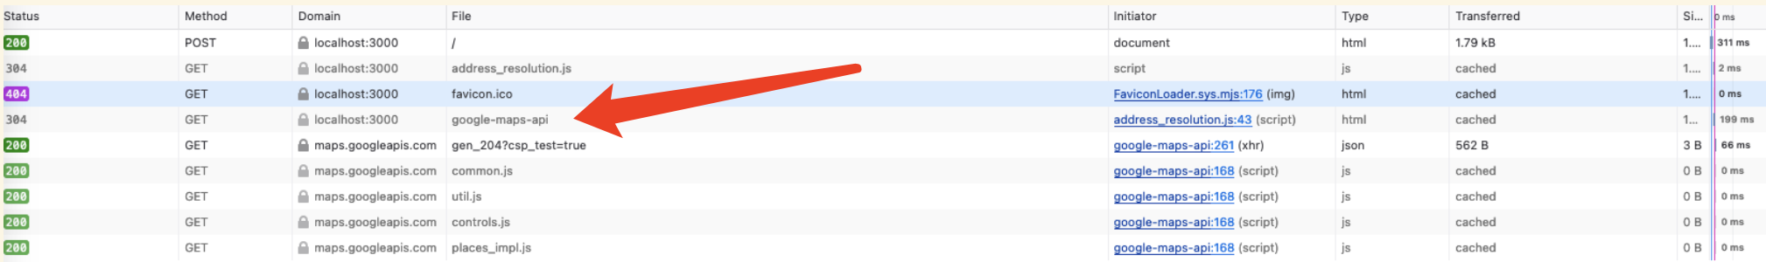
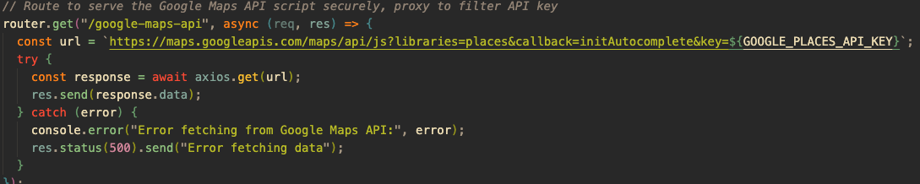
Challenges & Solutions

Slide 10
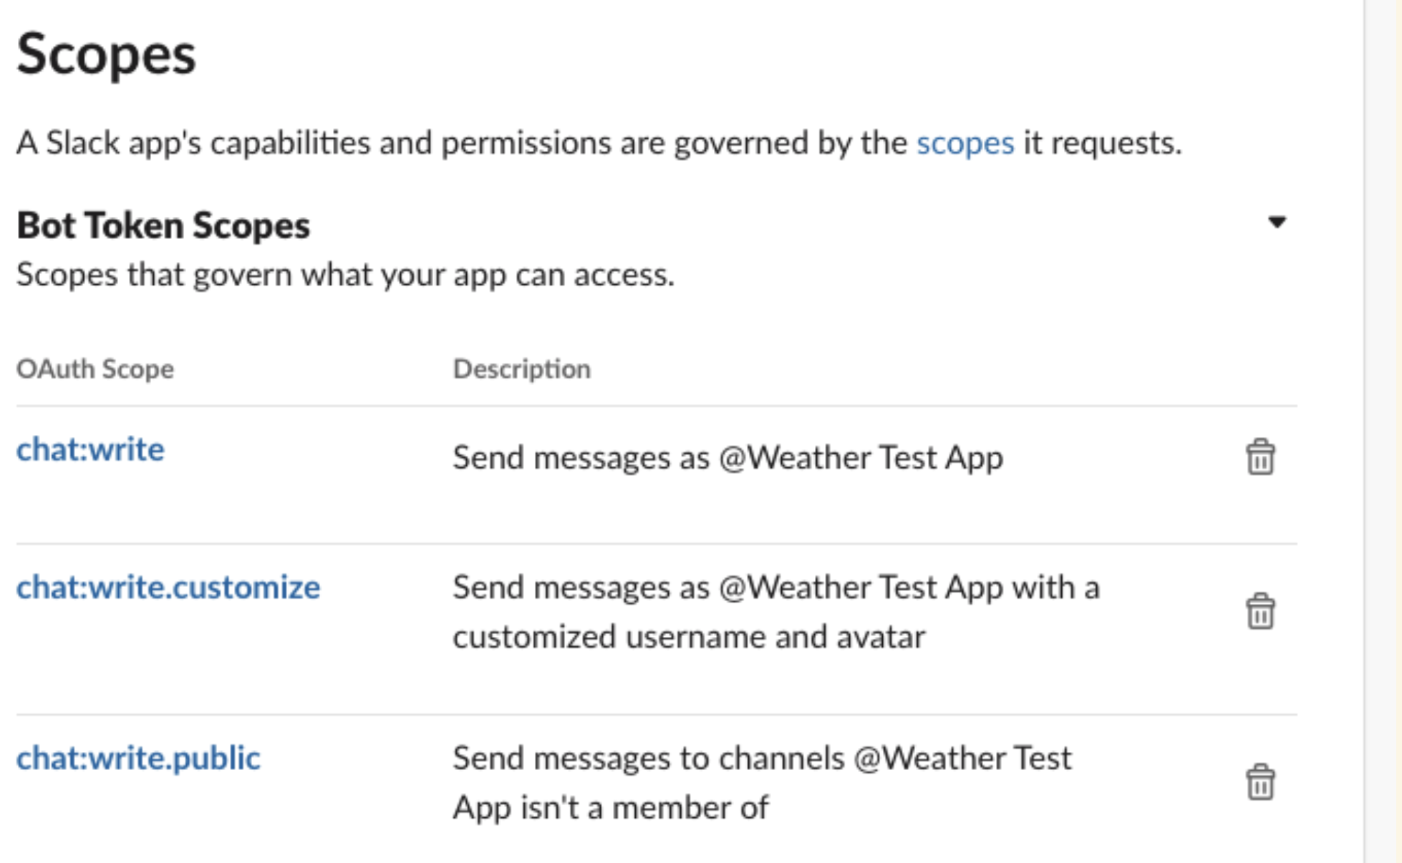
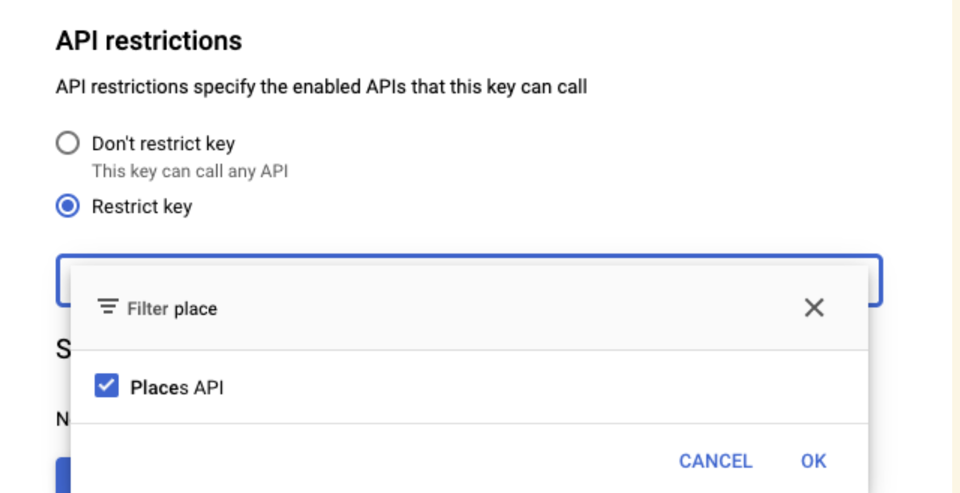
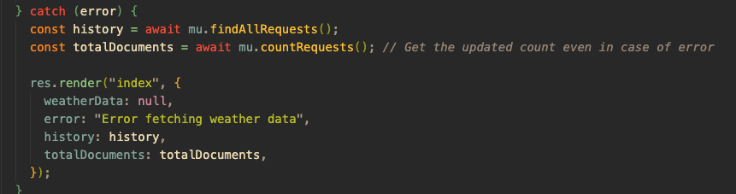

Good Security Practice
Least Privilege
Separate code and environment
Server-side API calls
HTTPS (axios)
Error Handling

Slide 11
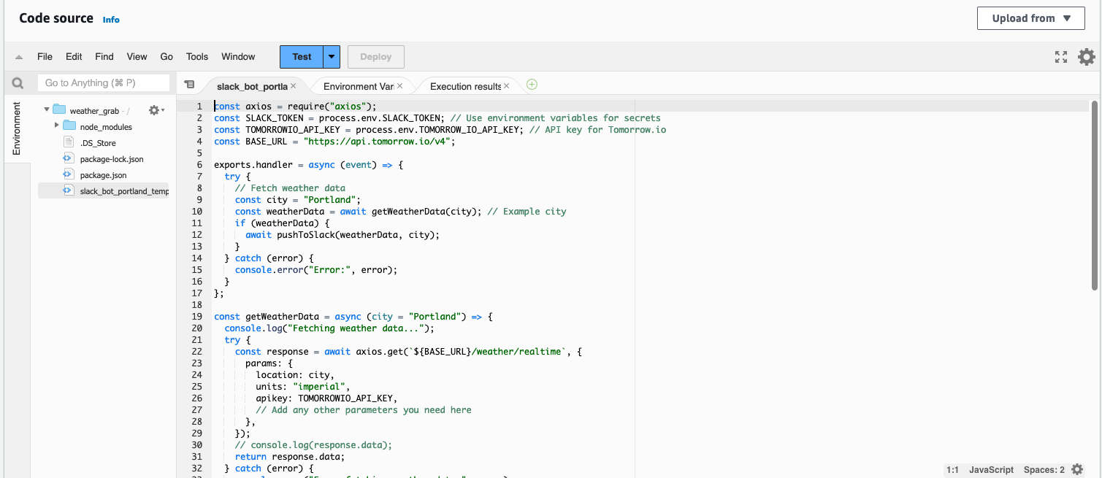
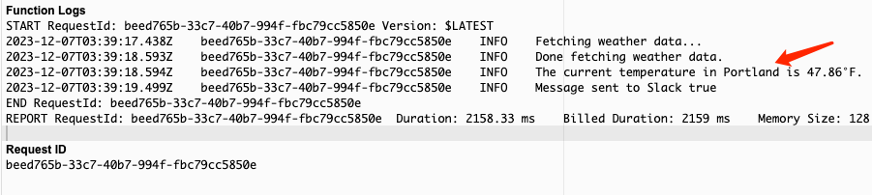
Bonus
Serverless Run
Automation
Scalability

Slide 12
Future Potentials
Planned
Multi-City Monitoring
Customizable Slack Notifications(e.g. Interactive Bot)
Weather Forecast
Vision
Integration with IoT devices: automated, weather responsive system
Integration with GPT to achieve AI-powered clothing recommendation based on Weather Data

Slide 13
Questions?

