Slide 1
SDEV2150
Lesson 05: Asynchronous Data

Slide 2
Lesson Objectives
In this lesson, students will:
Explain how JavaScript handles asynchronous operations
Use fetch with async / await to load data
Describe how async data flows through an application
Compare two approaches to coordinating fetched data

Slide 3
Agenda
Review synchronous vs asynchronous execution
Review fetch and async data loading
Instructor demo
Refactor: component-driven fetching
Practice and reflection

Slide 4
Connecting

Slide 5
Why async matters
Network requests take time
JavaScript must stay responsive
Data often arrives after UI renders
Async code lets the app keep moving.

Slide 6
Mental Model

Slide 7
JavaScript does not block
Long operations move off the call stack
Results come back later
Code reacts when data arrives
This lesson focuses on reacting to data over time.

Slide 8
Promises

Slide 9
What a Promise represents
A value that will exist later
One of three states:
pending
fulfilled
rejected
Promises model work that hasn’t finished yet.

Slide 10
Promise Chaining

Slide 11
Handling steps in order
fetch(url)
.then(res => res.json())
.then(data => console.log(data))
.catch(err => console.error(err));
Each .then() waits for the previous step
Errors bubble to .catch()

Slide 12
async / await

Slide 13
Promise syntax made readable
try {
const res = await fetch(url);
const data = await res.json();
} catch (err) {
console.error(err);
}
async/await does not replace Promises, it uses them.

Slide 14
Promise.all()

Slide 15
Coordinating multiple async tasks
const [a, b] = await Promise.all([
fetch(urlA),
fetch(urlB),
]);
Runs async operations in parallel
Resolves when all complete
Rejects if any fail

Slide 16
Stage 1: Fetch COORDINATION

Slide 17
Starting simple
Application loads
The app container/shell fetches resources
Data is passed into components
Everything is explicit and easy to trace.

Slide 18
Fetching Data

Slide 19
Using fetch with async/await
const response = await fetch(url);
const data = await response.json();
Await pauses this function
The app keeps running
Data arrives later

Slide 20
Coordinating Data

Slide 21
App shell as coordinator
Owns the fetch
Handles success and failure
Pushes data into components
Components stay focused on rendering.

Slide 22
Async States

Slide 23
What we're not solving yet
Loading indicators
Error messages
Retry logic
We note these now and add them later.

Slide 24
Stage 2: Component Fetching

Slide 25
Making components reusable
Instead of fetching in the app shell (e.g., index.js or main.js), we let the component load its own data.

Slide 26
Passing the endpoint

Slide 27
Attribute-driven data
<component attribute="http://url-to-some/data"></component>
Attribute defines where data comes from
Component decides how to fetch and render

Slide 28
Reactive Attribute Changes

Slide 29
A new reactive pattern
Attribute changes
Async side effect runs
Component updates state
UI re-renders
This mirrors how frameworks behave.

Slide 30
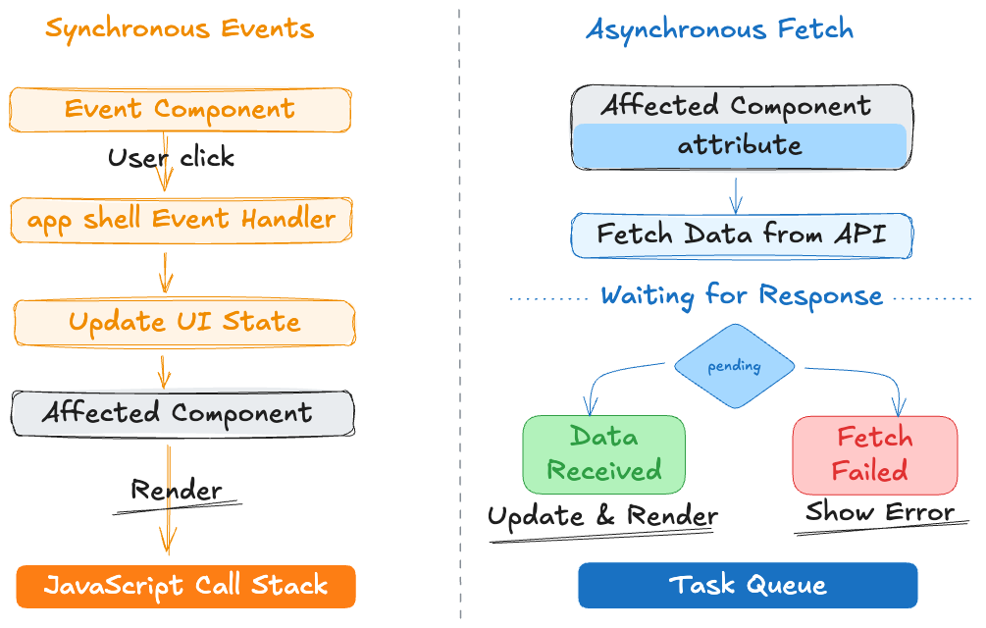
Sync vs. Async

Slide 31
Comparing the Approaches

Slide 32
Fetch in app shell
Fetch in the component
Clear and explicit
Easy to debug
Centralized coordination
But app shell can grow quickly.
Reusable and portable
Encapsulated async logic
Cleaner app bootstrap
But more complex component code.

Slide 33
Real-World Perspective

Slide 34
You'll see both patterns
App shells fetching data
Components loading their own resources
Shared data services
The best choice depends on context.

Slide 35
Hands-on Practice
Exercise: Update an existing component-based app load asynchronous data
Objective: Implement fetch API to retrieve and display dynamic data
Obtain the exercise starter files
Fetch resources from the backend API
Render results when data arrives
Keep filtering and selection working
Ask questions if you are unsure of what to do or how the code works.

Slide 36
Lesson Summary
In this lesson, we covered the following:
Explain how JavaScript handles asynchronous operations
Use fetch with async / await to load data
Describe how async data flows through an application
Compare two approaches to coordinating fetched data
Complete lesson 5 checklist

Slide 37
Exit Ticket
“Where does async work actually happen?”
“When would you fetch in a component instead of the app shell?”

