Slide 1

University Hackathon
Team Name : <Your Team Name>
Team Member-1 Name
Team Member-2 Name
Team Member-3 Name
EcoDrive Intelligence
Smart PLC–HMI–VFD–Energy Management for Real-Time Industrial Energy Optimization

Slide 2
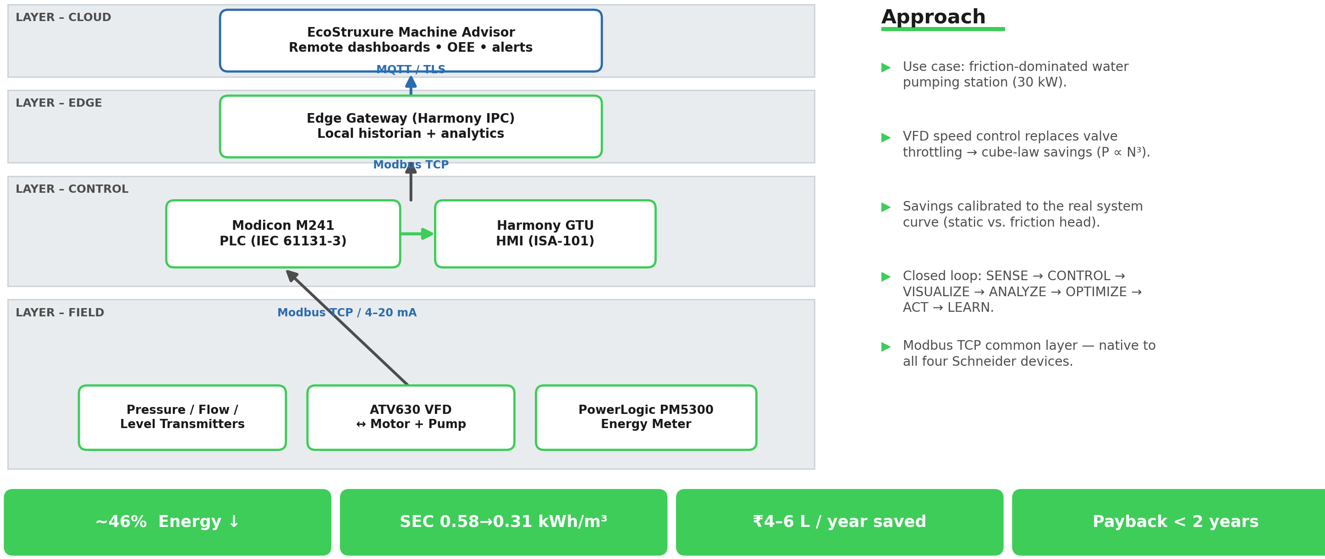
Architecture / Approach
LAYER – CLOUD
Approach
EcoStruxure Machine Advisor
Remote dashboards • OEE • alerts
MQTT / TLS
▶ Use case: friction-dominated water pumping station (30 kW).
▶ VFD speed control replaces valve throttling → cube-law savings (P ∝ N³).
▶ Savings calibrated to the real system curve (static vs. friction head).
▶ Closed loop: SENSE → CONTROL → VISUALIZE → ANALYZE → OPTIMIZE → ACT → LEARN.
▶ Modbus TCP common layer — native to all four Schneider devices.
LAYER – EDGE
Edge Gateway (Harmony IPC)
Local historian + analytics
Modbus TCP
LAYER – CONTROL
Modicon M241
PLC (IEC 61131-3)
Harmony GTU
HMI (ISA-101)
Modbus TCP / 4–20 mA
LAYER – FIELD
Pressure / Flow /
Level Transmitters
ATV630 VFD
↔ Motor + Pump
PowerLogic PM5300
Energy Meter
~46% Energy ↓
SEC 0.58→0.31 kWh/m³
₹4–6 L / year saved
Payback < 2 years

Slide 3
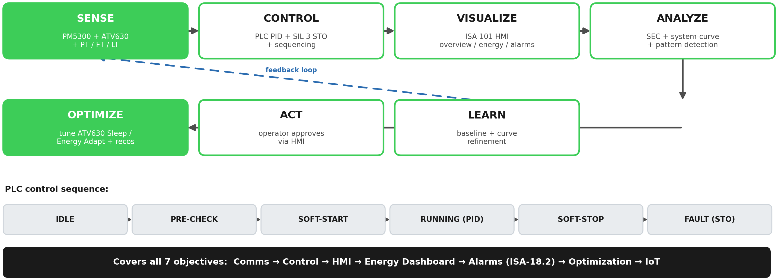
Overall Sequence flow

Slide 4
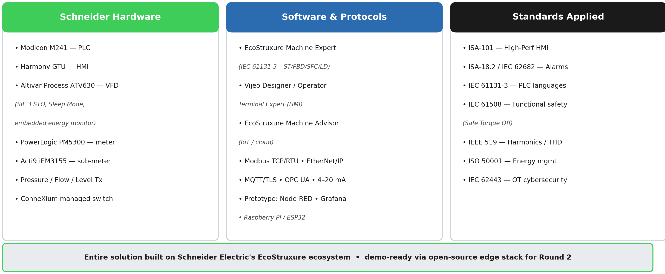
Tools used

