Slide 1

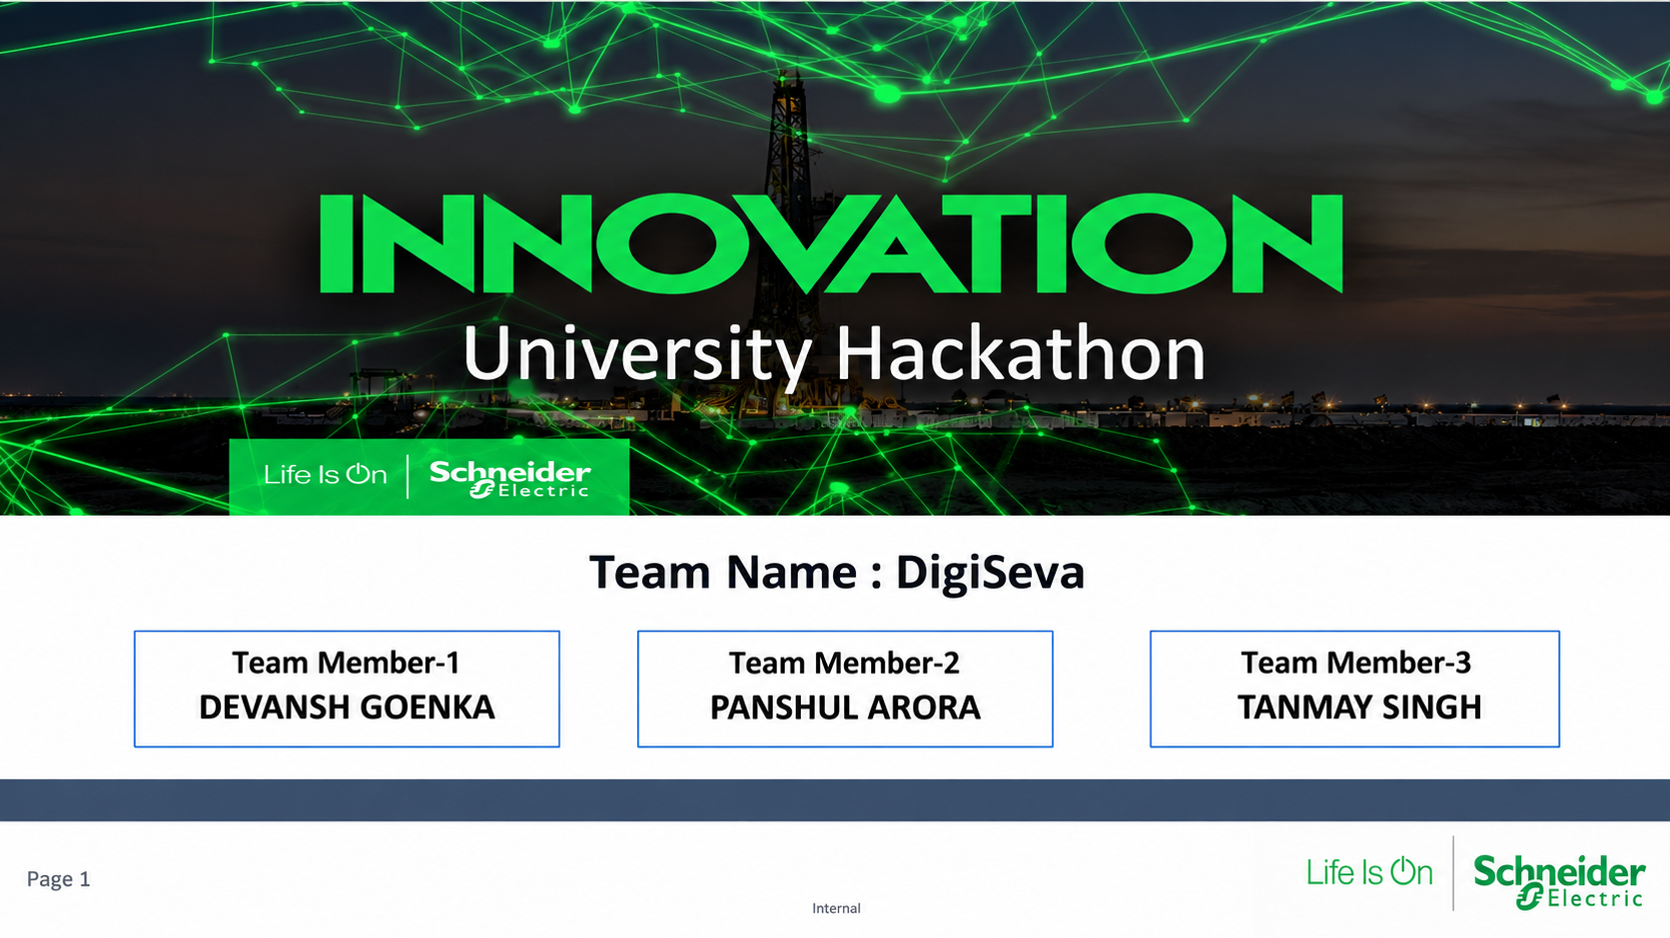
University Hackathon
Team Name : DigiSeva
Team Member-1
DEVANSH GOENKA
Team Member-2 PANSHUL ARORA
Team Member-3 TANMAY SINGH

Slide 2
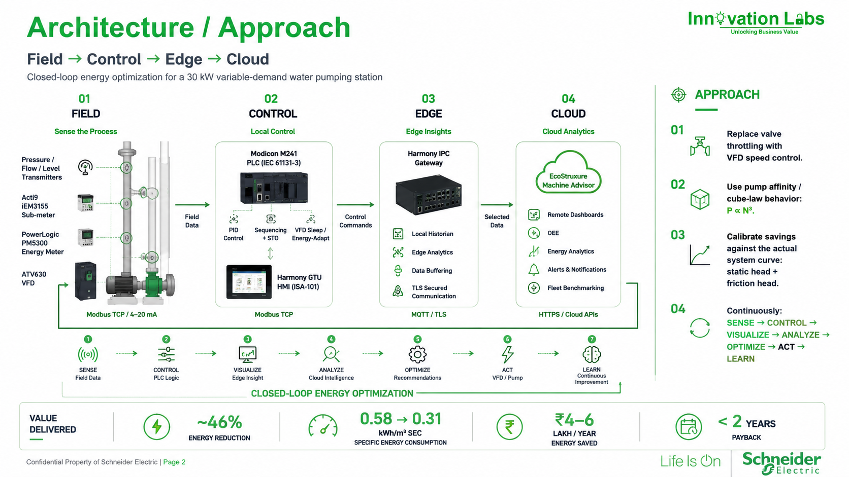
Architecture / Approach

Slide 3
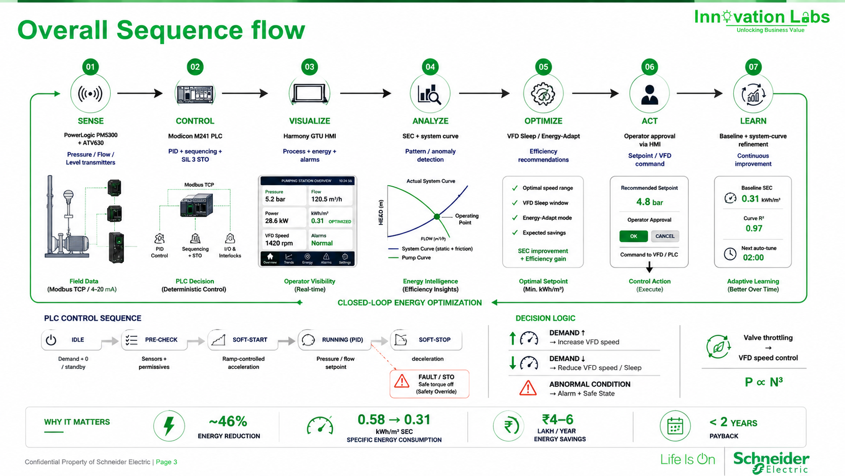
Overall Sequence flow

Slide 4
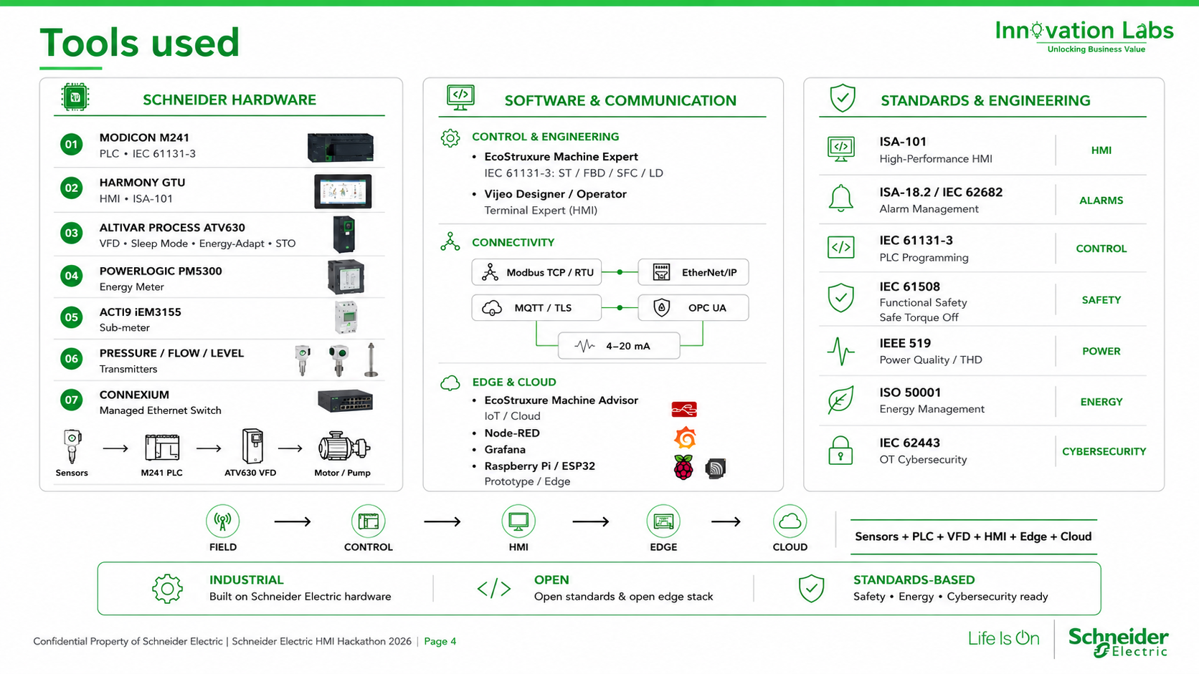
Tools used

