Slide 1
b00le0
A GAME MADE BY: VIS!00

Slide 2

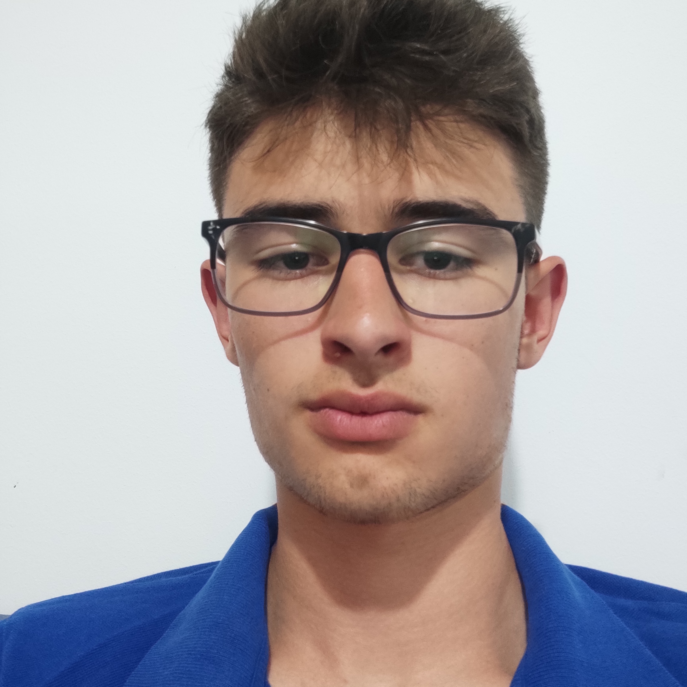
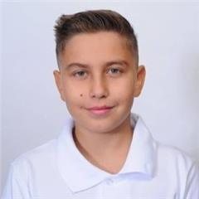
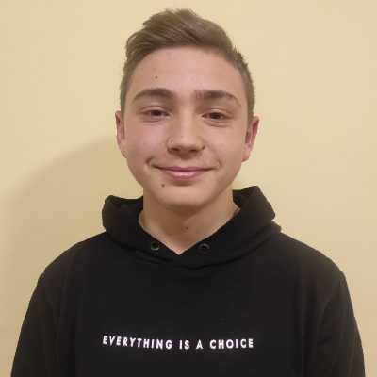
OUR TEAM
Lubomir Georgiev
Ivailo
Stoyanov
Georgi
Kotakov
Denislav
Bratoevski
Scrum trainer
Backend
developer
Backend
developer
QA engineer

Slide 3
Stages of realization
The presentation
The backend creation
The frontend creation
The idea

Slide 4










USED TECHNOLOGIES

Slide 5
NOW LET’S MOVE ON TO OUR REPOSITORY!

Slide 6
THANK YOU FOR YOUR ATTENTION! WE ARE WAITING FOR YOUR QUESTIONS.

