Slide 1


FISH GUNNER
The Fish Tower Defense Game

Slide 2
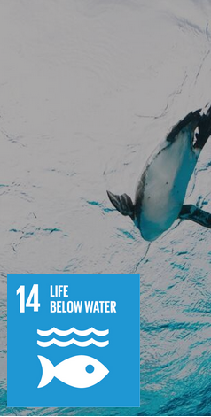
Concept
Fish Gunner is a Tower Defense Game in which the fish are fighting back against plastic pollution. Use the fish at your disposal and kill plastic trash and ships trying to destroy the ocean.
With this in mind, the game is about bringing attention to UN goal 14: Life Below Water.

Slide 3




Fish (Units)
Sea Cucumber
The supporter, gives a damage buff to other fish
Piranha
The simplest Fish of them all
Shark
Likes biting things
Jellyfish
Zaps the Enemies, does AOE damage

Slide 4




Enemies
Boat
Very fast (vrooooom)
Trash
The most effective ocean polluter
Ship
Strong and slow, spawns 3 Divers on death
Diver
Not all are bad, but this one is. Also very simple, but stronger

