Slide 1
Project Learning by Doing :
LearnIT
Presentation by Dimana Foteva, 9th “G” class

Slide 2
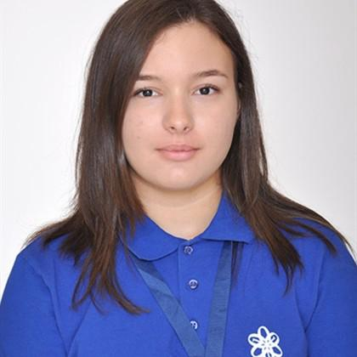

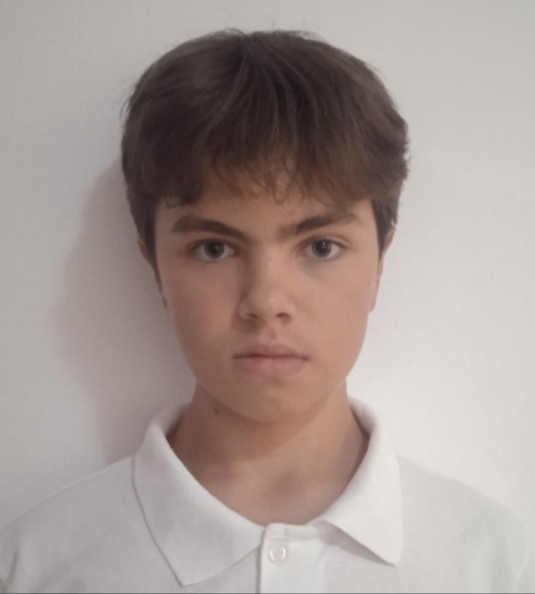
Our team:
Dimana Foteva, 9th “G”
Mariela Apostolova, 9th “B”
Vsevolod Bolotov, 9th “V”
Dimana Foteva
Mariela Apostolova
Vsevolod Bolotov
Front-end Developer
Front-end Developer
Designer

Slide 3
The concepts of our idea
Concept 1
Concept 2
Concept 3
Concept 4
Connection
Internships
Tasks
Jobs
Dual form students can connect with IT companies
Students can apply for internships at the chosen company
Students do tasks made to prepare students for real work
If the company likes the student, they can give them a permanent job

Slide 4
Our main goals
Accessibility
Make internships accessible and available for everyone
Our Project
Training
Train dual form students for real-life tasks and jobs
Abilities
Give students a chance in developing their abilities

Slide 5







What we used:

Slide 6
Let’s move onto our website now

