Slide 1




Presented by :
the Evalua team​
EVALUA

Slide 2





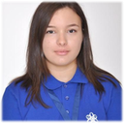




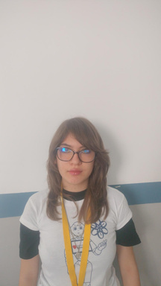
Our Team
Dimana Foteva
Mariela Apostolova
Scrum Trainer
Backend Developer
Vsevolod Bolotov
Rosica Velkova
Backend Developer
Quality Engineer

Slide 3


About our project​
Service 01
Service 03
Evalua is designed to be an engaging school platform focused on mathematics education
Including practice exercises, homework tasks, and tests drawn from categorized question banks
Service 02
Service 04
Featuring lessons on Trigonometry, Geometry, Algebra, Calculus, and Combinatorics.
Evalua is made to deliver an effective learning experience

Slide 4
Our progress
First step
Third step
Team assembling - Building a team with the right skills for the project.
Finalization - Completing the project and making final improvements.
Second step
Fourth step
Project developing - Developing and building the main parts of the project.
Presenting - Explaining and demonstrating the final project.

Slide 5















Used softwares and programmes and languages​

Slide 6


Now let’s move onto the project…

