Slide 1
NEU Software Engineering(International English)
Deep Learning Based (CNN)
Real-time Dynamic
Vehicle Detection
李远识
Yuanshi Li

Slide 2
CONTENTS
PART ONE Theoretical introduction
PART TWO YOLO
PART THREE YOLO based Vehicle Detection
PART FOUR Technology Application

Slide 3
01
PART ONE Theoretical introduction

Slide 4
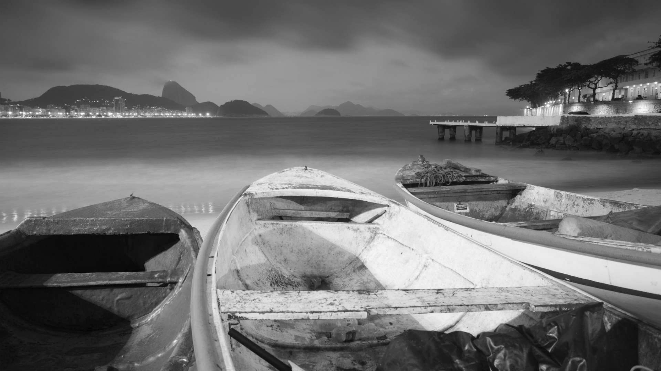
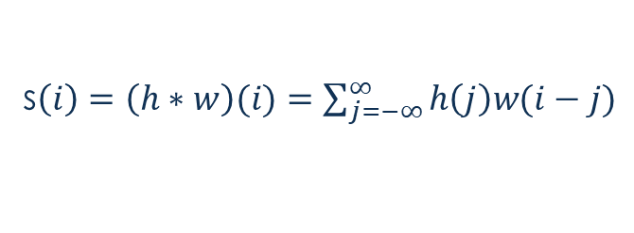
PART ONE
What is convolution
Convolution operation
Convolution is a special linear operation, a mathematical operation on two real-valued functions. As we all known, the Kalman filter which was introduced in the GNSS INS Integration part uses one-dimensional discrete convolution operation. One dimensional discrete convolution formula is as following:
s$\left(i\right)=\left(h∗w\right)(i)=\sum_{j=−∞}^{∞}{h\left(j\right)w(i−j)}$
i is the operation state, j is the distance to i state. h is input, w is kernel function and s is the feature map.
NEU | Autonomous Driving

Slide 5
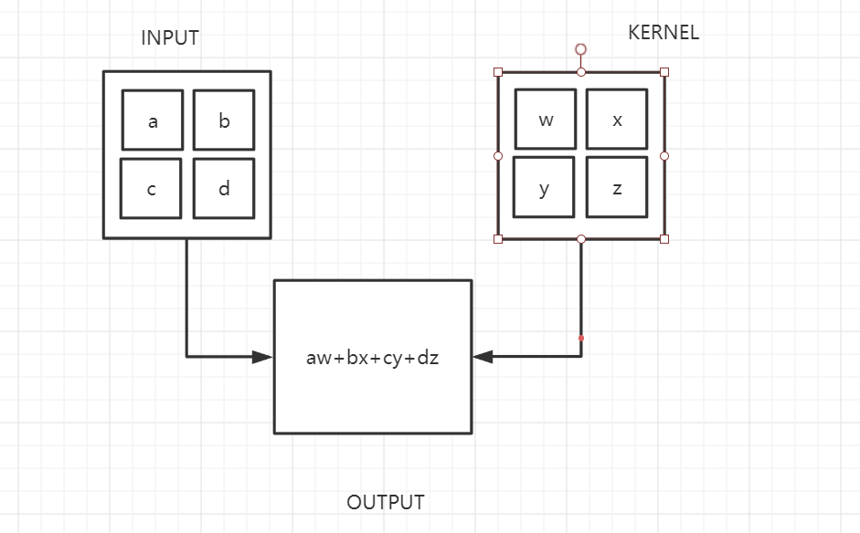
PART ONE
What is convolution
Convolution operation
Two-dimensional convolution operation formula can be shown as following:
(m,n) is the pixel location and (i,j) is the scope of the consideration
$$S\left(m,n\right)=\left(I∗K\right)(m,n)=\sum_{i}{\sum_{j}{I\left(i,j\right)K(m−i,n−j)}}$$
NEU | Autonomous Driving

Slide 6
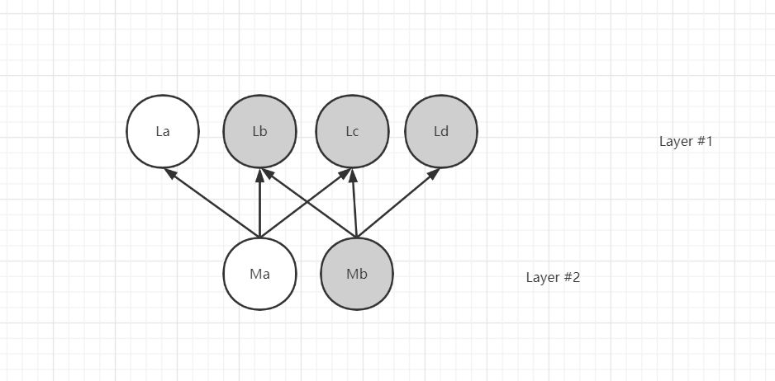
PART ONE
Why we use convolution
We use convolution to improve machine learning systems
In this diagram, Mb is only associated with Lb, Lc and Ld.
Sparse Interactions
For a convolutional network, the nodes in the next layer are only related to the nodes affected by the convolutional kernel
NEU | Autonomous Driving

Slide 7

PART ONE
Why we use convolution
Parameter sharing & Equivariant representations
The convolution kernel slides the window over the input image, which means that the pixels of the input image share this set of parameters
Since the whole input picture shares a set of parameters, the model has equal variability for translation of some features in the image.
We use convolution to improve machine learning systems
The formula of equal variability:
$$f(g(x))=g(f(x))$$
These two properties can help simplify the input parameters of the CNN and improve the efficiency of machine learning system.
NEU | Autonomous Driving

Slide 8
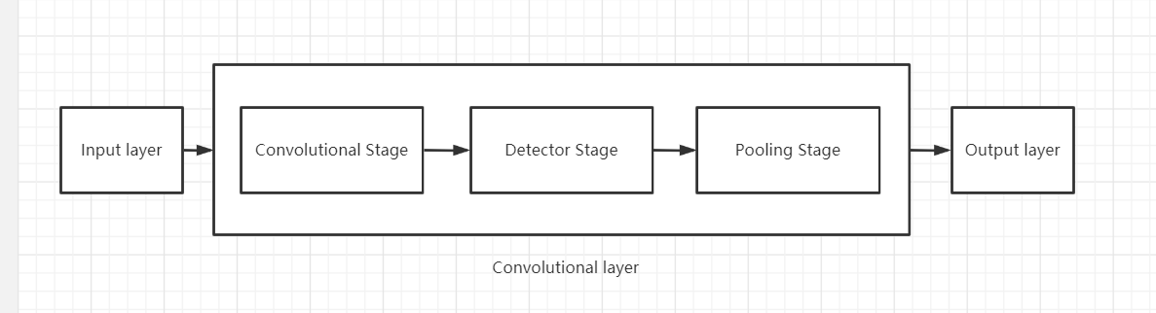
PART ONE
CNN
Convolutional layer
NEU | Autonomous Driving

Slide 9
02
PART TWO YOLO

Slide 10
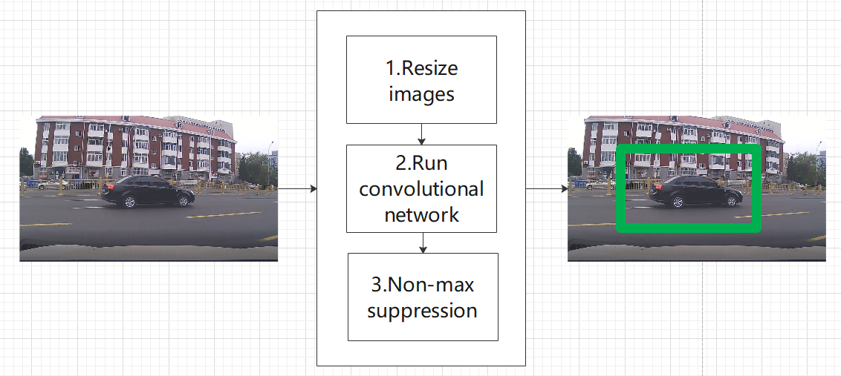
PART TWO
YOLO
The work flow is like the following diagram:
YOLO(You only look once) sees target detection as a regression problem.

Slide 11
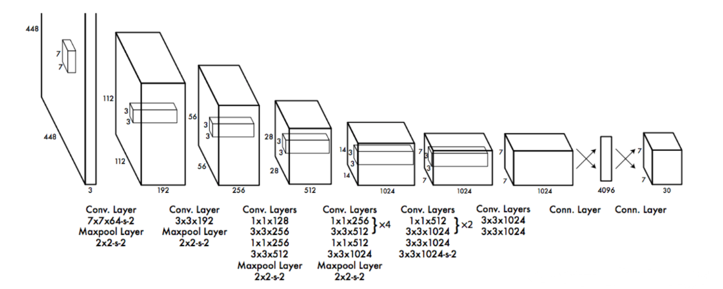
PART TWO
YOLO
The specific network structure of YOLO:
YOLO uses the entire image as input. YOLO's specific network structure is as follows.
The entire network consists of 24 convolutional layers and 2 fully connected layers.

Slide 12
PART TWO
Pre-training classification network
&
Training detection network
Training detection network
Pre-training classification network
First, a classification network with input of 224×224 is trained on the ImageNet dataset using the first 20 convolutional layers + an average pooling layer + a full connection layer
After the pre-trained 20 convolutional layers, we add 4 convolutional layers and 2 fully linked layers. The input is 448 × 448 and the output is a 7 × 7 × 30 tensor which means the input images will be fragmented into 7 × 7 small pieces.
Then what we need to focus on is the regression prediction of these 7 × 7 grids.
Each small area contains three pieces of information: The center coordinates, the height and width of the area and the confidence.
Each grid need to predict two pieces of images so we have (3+2)*2 = 10 outputs.
According to YOLO , we have to predict 20 classes. The expectable output of each grid is 30 values.

Slide 13
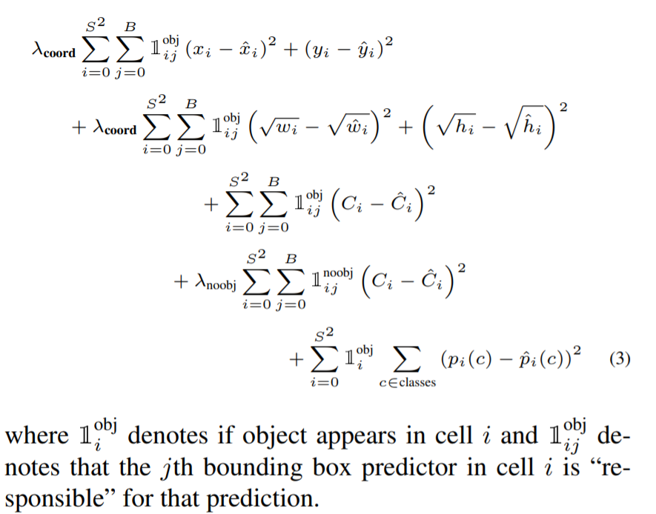
Partial reference from YOLO’s paper
PART TWO
LOSS FUNCTION
Loss function
This is just essentially a regression equation
We have got 30 output values from training the detection network.
To get a good return on these 30 values, the loss function design must be balanced in the center coordinates, the height and width of the area and the confidence.
A search of YOLO's papers shows that we need to use the multi-part loss function to balance the three attributes.

Slide 14
PART TWO
Final Test
Final Test
Non-maximum suppression(NMS), it first generates a detection box based on object detection score. The detection box M with the highest score is selected, and other detection boxes with obvious overlap with the selected detection box are suppressed.
In final test step, the category information of each grid prediction is multiplied by the confidence of bounding box(each piece of these segmented image) prediction so that we get the class-specific confidence score.
If we do this for each grid of the entire image, we can get 7 × 7 × 2 = 98 bounding boxes, which contain both coordinate and category information.
After the class-specific confidence score of each box is obtained, the threshold value is set, boxes with low scores are filtered out, and rest boxes are processed by NMS to obtain the final detection result.

Slide 15
03
PART THREE YOLO based Vehicle Detection

Slide 16
PART THREE
Vehicle Detection
Due to the high real-time requirement of vehicle detection, we use a simplified version of YOLO: Fast YOLO. This model uses a simple 9-layer convolution instead of the original 24-layer convolution. It sacrifices some accuracy and is faster in processing, improving from YOLO's 45fps to 155fps. To meet the needs of real-time target detection.
I use tensorflow as the background and keras framework to implement the YOLO’s network.
http://localhost:8888/notebooks/car_detection.ipynb
After choosing the yolo weight file, I found the yolov3_tiny weight file from the darknet has the best performance.

Slide 17
04
PART FOUR Technology Application

Slide 18
This algorithm can be used in the autonomous driving system’ detection part.
Its input could be the images which are taken by the camera on the vehicles.
The output will be used in driving perception that prevent collision.
I think there are some things that could be improved.
Lack of tracking detection model training to the current model.
The yolo_tiny model only has 9 convolution layers so that some specific value will not be fully trained.
The limitation of YOLO itself which has a strong spatial constraints on bounding box predictions so that it struggles to generalize to objects in new or unusual aspect ratios or configurations.
Environmental noise problem.
NEU | Autonomous Driving

Slide 19
THANK YOU!

