Slide 1
Dataset: Wisconsin Breast Cancer (Original)
Applying numerous machine learning algorythms

Slide 2
Structure of the presentation
What I have done?
Logistic Regression
Neural Networks
Error, bias vs variance
What does the future brings?
SVM
Diagnostic
Prognostic

Slide 3
First steps
Number of instances: 699
Number of attributes: 10 + class atribute
Sample code number
9 attributes from 1 to 10 values.
Class attribute: 2 for benign, 4 for malignant
Missing attributes: 16 instances
Class distribution:
Benign: 458 (65.5%)
Malignant: 241 (34.5%)

Slide 4
First steps
Number of instances: 699
Number of attributes: 10 + class atribute
Sample code number
9 attributes from 1 to 10 values.
Class attribute: 2 for benign, 4 for malignant
Missing attributes: 16 instances
Class distribution:
Benign: 458 (65.5%)
Malignant: 241 (34.5%)
How do we work with this dataset:
Reading the dataset file .data
Removing the “Sample code number attribute”
Transforming the output from 2 and 4 to 0 and 1
Y = (Y == 4);

Slide 5
Logistic Regression
With the data recently read, let’s try how good is our hypothesis.
Without regularization.
Splitting the dataset in two: 70% is for training data, 30% is for cross-validation data.

Slide 6
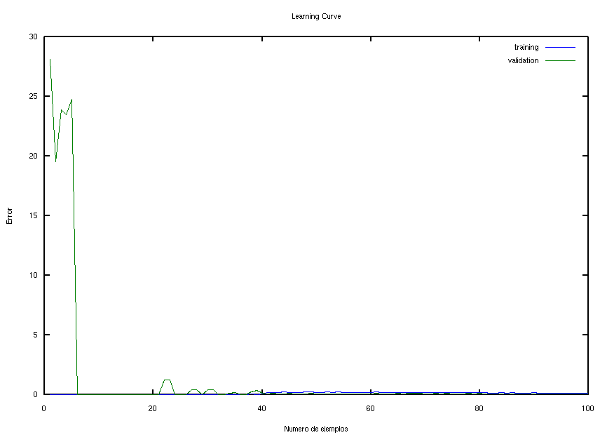
Logistic Regression
With the data recently read, let’s try how good is our hypothesis.
Without regularization.
Splitting the dataset in two: 70% is for training data, 30% is for cross-validation data.
NaN values has turn to 0

Slide 7
Logistic Regression
With the data recently read, let’s try how good is our hypothesis.
Without regularization.
Splitting the dataset in two: 70% is for training data, 30% is for cross-validation data.
NaN values has turn to 0
We can do it better...

Slide 8
Logistic Regression
Increasing the degree of our hypothesis (by increasing the number of features)
Using a function that combine the features geometrically
X1,X2,X1*X2,X1^2,X2^2...

Slide 9
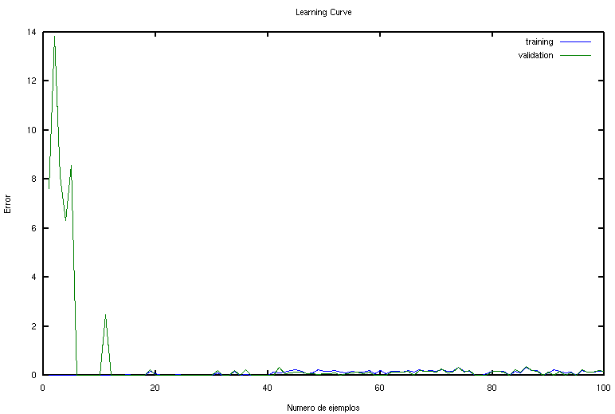
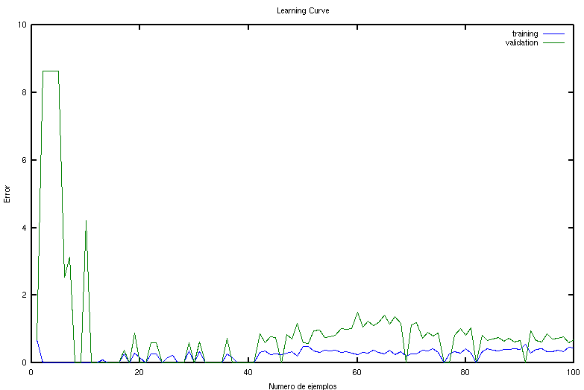
Logistic Regression
DEGREE=2
DEGREE=5
You can check that an increasing in the degree of the polynomial implies a low bias between 40 and 80 dataset size, but high bias >80. (Increment of variance)

Slide 10
Logistic Regression
We assume that:
λ↑ fixes high bias Our Problem
λ↓ fixes high variance
Now splitting in three the dataset:
60% Training
20% Cross-Validation
20% Testing

Slide 11
Logistic Regression
What to do:
High lambda
Just right one-
Low lambda
We assume that:
λ↑ fixes high bias Our Problem
λ↓ fixes high variance
Now splitting in three the dataset:
60% Training
20% Cross-Validation
20% Testing

Slide 12
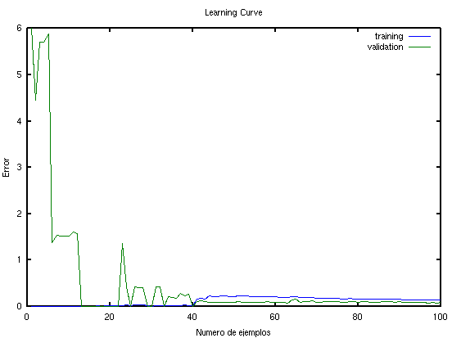
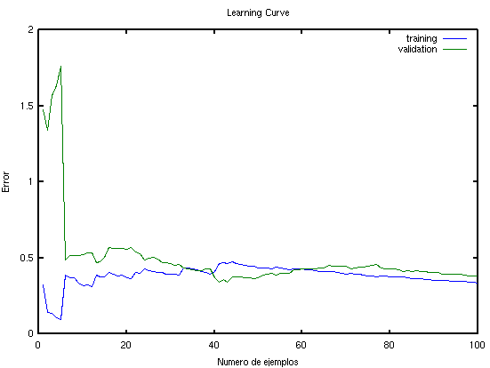
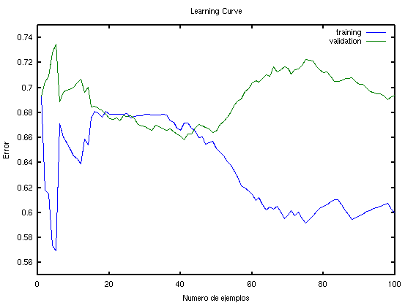
Logistic Regression
Low lambda (0.001)
High bias
Just right lambda (3)
The greatest of the 100% test result
High lambda (300)
High variance

Slide 13
Logistic Regression
Just one thing left… Put it all together.
Looking for the best relation bias-variance.
Testing diferents splittings of the data to know what kind of split its the better.
Try to diagnose, by giving an hand-made example, if is begning or malignant.

Slide 14
Neural Networks
Looking for the right structure of our network.
Best number of hidden units
Best number of hidden layers

Slide 15
Neural Networks
Looking for the right structure of our network.
Best number of hidden units
Best number of hidden layers
More hidden units/layers
High variance (overfitting)
Less hidden units/layers
High bias (underfitting)

Slide 16
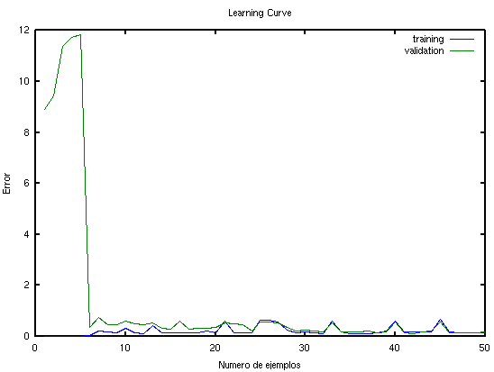
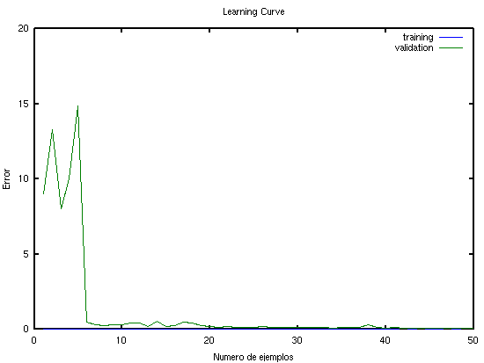
Neural Network
Lowest hidden units
Highest hidden units

Slide 17
Neural Network
NO IMPROVEMENT
Lowest hidden units
Highest hidden units

Slide 18
Neural Network
Adding polynomial features reduces high bias.
Pit it all together
Combine more hidden units/layers with more features.
Degrees 2, 3, 4 and 5.
Hidden Units 2, 4, 10, 50 and 100.

Slide 19
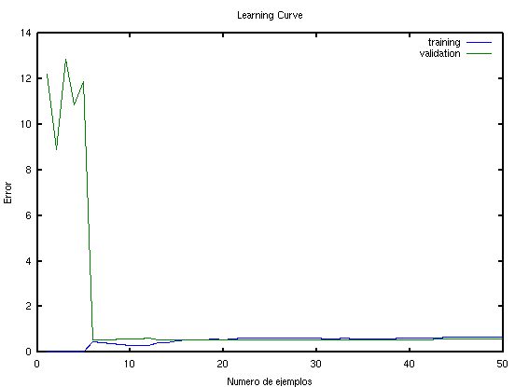
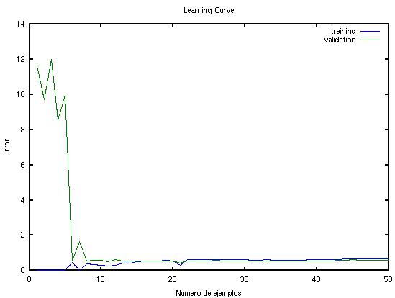
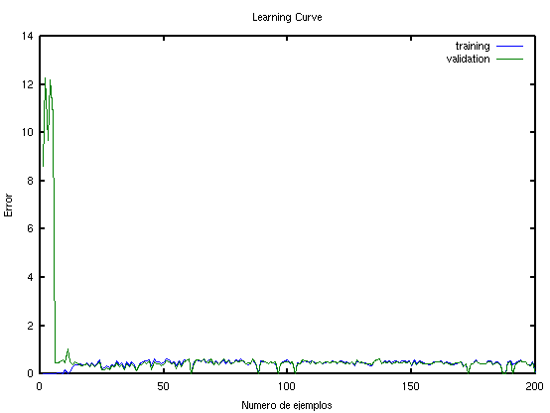
Neural Network
The same result as before.
More training sets

Slide 20
Neural Network
NO IMPROVEMENT
The same result as before.
More training sets

Slide 21
Neural Network
Only thing left is to add the regularization parameter lambda.
Remember:
λ↑ fixes high bias Our Problem
λ↓ fixes high variance

Slide 22
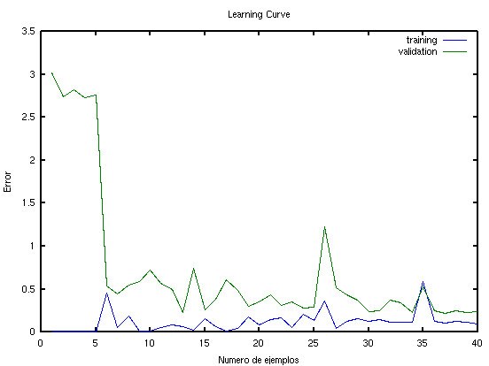
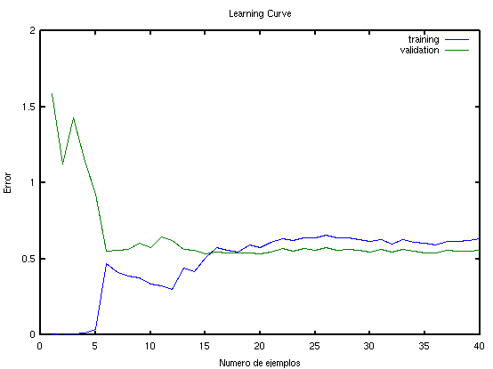
Neural Network
Lowest lambda
Highest lambda
A big difference between regularizated and non-regularizated.

Slide 23
Conclusions
Regularization is far the most important thing to be aware of.
Is positive to use polynomial adding (only if it worths).
For every algorythm implemented, Error check is a must do.

Slide 24
Which is better?
LOGISTIC REGRESSION
NEURAL NETWORK
1
SVM ?
2
3

Slide 25
What does the future brings?
SVM
Best C Parameter.
Which kernel is the better.
Check what percentage of data makes the best model.
Diagnostic
Using the same algorythms as before.
Prognostic
With all the data learning, to prognose if a patient would be regresive or no regresive.
Maybe more…

