Slide 1
Introduction-FLEX

Slide 2
FLEX POSITIONING

Slide 3
FLEX POSITIONING
The flex CSS property is a shorthand property specifying the ability of a flex item to alter its dimensions to fill available space. Flex items can be stretched to use available space proportional to their flex grow factor or their flex shrink factor to prevent overflow.

Slide 4
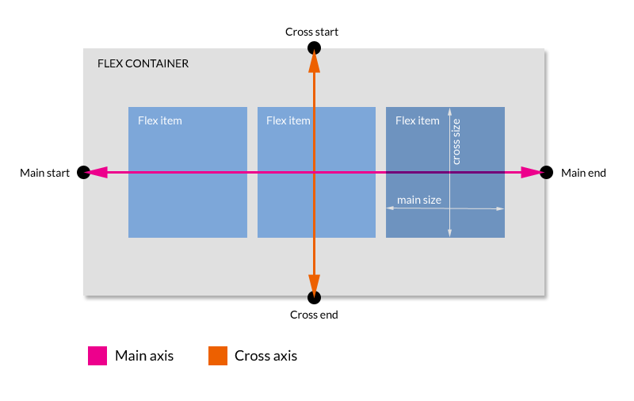
FLEX POSITIONING

Slide 5
div.father { display: flex; display: -webkit-flex; }
FLEX POSITIONING
First, tell the container its kids are « flex »:
<div class=“father”> <div></div> <div></div> <div></div> <div></div> </div>
Notes:
IE Support: supported from v10 (old syntax, with –ms- prefix -> display:-ms-flexbox). Foresee fallback with float
Consider –webkit prefix also

Slide 6
div.father div { flex: 1 0 auto; -webkit-flex: 1 0 auto; }
FLEX POSITIONING
Then, determine how the kids will behave:
<div class=“father”> <div></div> <div></div> <div></div> <div></div> </div>

Slide 7
div.father { display: flex; display: -webkit-flex; flex-direction: row; -webkit-flex-direction: row; }
FLEX POSITIONING
Flow of content: flow-direction
1
2
3
4
5
Notes:
Remember to always add –webkit prefix!
Values are: row, column, row-reverse, column-reverse (default “row”)

Slide 8
div.father { display: flex; display: -webkit-flex; flex-wrap: wrap; -webkit-flex-wrap: wrap; }
FLEX POSITIONING
Flow of content: flow-wrap
1
2
3
4
5
Notes:
Remember to always add –webkit prefix!
Values are: wrap, nowrap, wrap-reverse (default “nowrap”)

Slide 9
div.father { display: flex; display: -webkit-flex; flex-flow: row wrap; -webkit-flex-flow: row wrap; }
FLEX POSITIONING
Flow of content: A Shorthand
flexcontainer { flex-flow: <flex-direction> || <flex-wrap>; }
1
2
3
4
5
Notes:
Better use always shorthand declarations

Slide 10
div.father { display: flex; display: -webkit-flex; flex-flow: row wrap; -webkit-flex-flow: row wrap; justify-content: center; -webkit-justify-content: center; }
FLEX POSITIONING
Alignment of content (main-axis): justify-content
1
2
3
4
5
Notes:
defines how a browser distributes available space between and around elements when aligning flex items in the main-axis of the current line.
Default: flex-start
Stretch, flex-start, flex-end, center, space-between, space-around

Slide 11
div.father { display: flex; display: -webkit-flex; flex-flow: row wrap; -webkit-flex-flow: row wrap; align-content: center; -webkit-align-content: center; }
FLEX POSITIONING
Alignment of content (cross-axis): align-content
1
2
3
4
5
My kids are displayed in multiple lines!
Notes:
Aligns a flex container's lines within the flex container when there is extra space on the cross-axis. This property has no effect on single line flexible boxes.
Default: stretch
Stretch, flex-start, flex-end, center, space-between, space-around

Slide 12
div.father { display: flex; display: -webkit-flex; flex-flow: row wrap; -webkit-flex-flow: row wrap; align-items: center; -webkit-align-items: center; }
FLEX POSITIONING
Alignment of content (perpendicular): align-items
1
2
3
4
5
Notes:
aligns flex items of the current flex line the same way as justify-content but in the perpendicular direction.
Default: stretch
Stretch, flex-start, flex-end, center, baseline

Slide 13
div.father { display: flex; display: -webkit-flex; flex-flow: row wrap; -webkit-flex-flow: row wrap; } div.father div { flex-basis: 35%; -webkit-flex-basis: 35%; }
FLEX POSITIONING
Flex item behavior: flex-basis
1
2
3
4
5
Notes:
Item initial main size (width) – based on content-box

Slide 14
div.father { display: flex; display: -webkit-flex; } div.father div { flex-basis: 5%; } div.father div:nth-child(3) { flex-grow: 3; }
FLEX POSITIONING
Flex item behavior: flex-grow
1
2
3
4
5
Notes:
Specifies the flex grow factor of a flex item

Slide 15
div.father { display: flex; display: -webkit-flex; } div.father div { flex-basis: 5%; } div.father div:nth-child(3) { flex-shrink: 0; }
FLEX POSITIONING
Flex item behavior: flex-shrink
1
2
3
4
5
Notes:
Will keep initial width

Slide 16
div.father { display: flex; display: -webkit-flex; flex-flow: row wrap; -webkit-flex-flow: row wrap; } div.father div { flex: 1 1 auto; }
FLEX POSITIONING
Flex item behavior: A Shorthand
flexitem { flex: <flex-grow> || <flex-shrink> || <flex-basis>; }
1
2
3
4
5
Notes:
Will grow, will shrink, no initial main size value

Slide 17
div.father { display: flex; display: -webkit-flex; flex-flow: row wrap; -webkit-flex-flow: row wrap; } div.father div:nth-child(3) { flex: 1 1 auto; order: -1; }
FLEX POSITIONING
Flex item order: order
3
1
2
4
Notes:
specifies the order used to lay out flex items in their flex container. Elements are laid out by ascending order of the order value. Elements with the same order value are laid out in the order they appear in the source code. Default value = 0

Slide 18

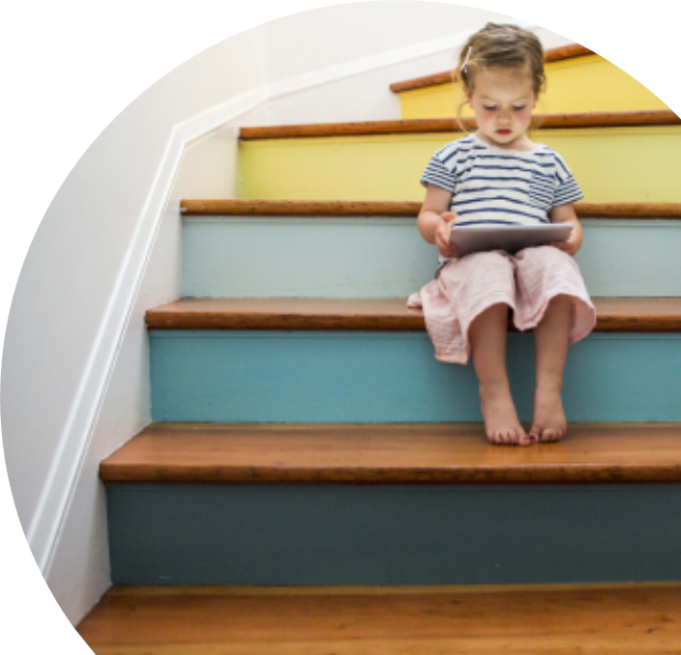
Source
http://got5.github.io/TrainingHTML5/html5-css3/
References
Flex Box Cheatsheets http://www.sketchingwithcss.com/samplechapter/cheatsheet.html http://jonibologna.com/flexbox-cheatsheet/

Slide 19
Thank you

