Slide 1
Responsive Web Design

Slide 2

Agenda
WHAT & WHY?
How ?
Viewport & Breakpoints
Elements of RWD
RWD vs AWD
Summary and Q&A

Slide 3
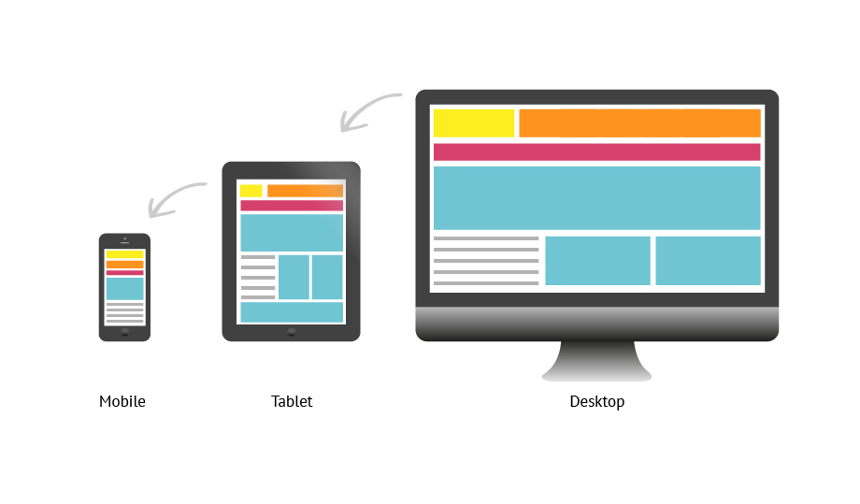
What is Responsive Web Design or RWD
Multi-device patterns
Technology to automatically respond to the user's preferences.
An approach that suggests that design and development should respond to the user's behavior and environment based on screen size, platform and orientation.

Slide 4

Why Responsive Web Design or RWD?
Single codebase – Maintainability & Dev cost
Helps increasing user experience
Covers all screen sizes
Saves time & effort
Readability and Usability
Search Engine Optimization
Fluid Grid

Slide 5

How?

Slide 6
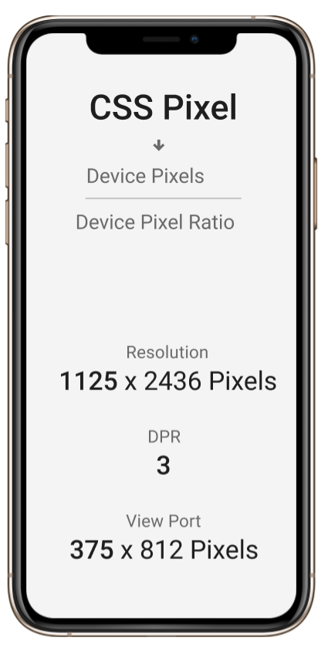
Device Resolution & Pixels ?
4K Devices
Pixels (Horizontal & Vertical)
New Devices – Developers ?
CSS Pixels (W3C Standard)
Before high density display - Pixel Density (PPI)
1 css pixel = 1 hardware pixel
Pixel Ratio (DPR)

Slide 7
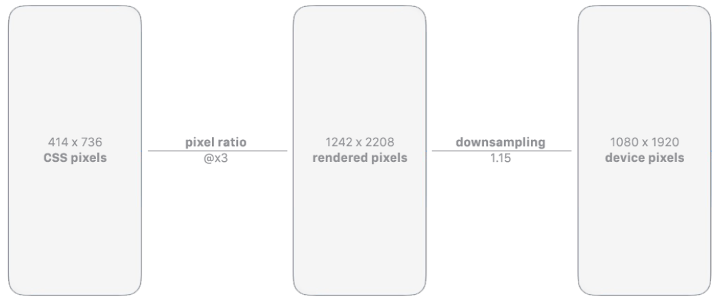
Downsampling
Rendered Pixel
IPhone Plus family - 1.15 downsize applied

Slide 8
Viewport & Media Query
<meta name="viewport" content="width=device-width, initial-scale=1.0">
/* Portrait and Landscape Media Query*/
@media only screen and (min-device-width: 375px) and (max-device-width: 667px) { }

Slide 9
Understanding the Elements of Responsive Web Design
Media Queries
Meta Tags
Grid System
Frameworks
Using CSS3 media queries, presentations can be tailored to a specific range of output devices without changing the content itself.
It describes few aspects of the contents of a web page.
A grid is a set of number of “columns” and intervening “gutters” (margins) inside a “container” with any width and flexibility.
Skeleton
Foundation
Bootstrap

Slide 10
Responsive Web Design vs Adaptive Web Design
Fluid Grids
Client-side scripting layer-JavaScript
CSS3
Presentation layer- CSS & Styling
The @Media Rule
Responsive Web Design A process that fluidly alters its layout to fit the structure in which it is being used.
Adaptive Web Design A process that changes the sites’s layout to fit a pre-determined series of screen sizes. Similar to progressive enhancements
Media Queries
Supported by flexible videos, images and fluid test
Content layer-rich semantic markup

Slide 11
Thank you

