Slide 1
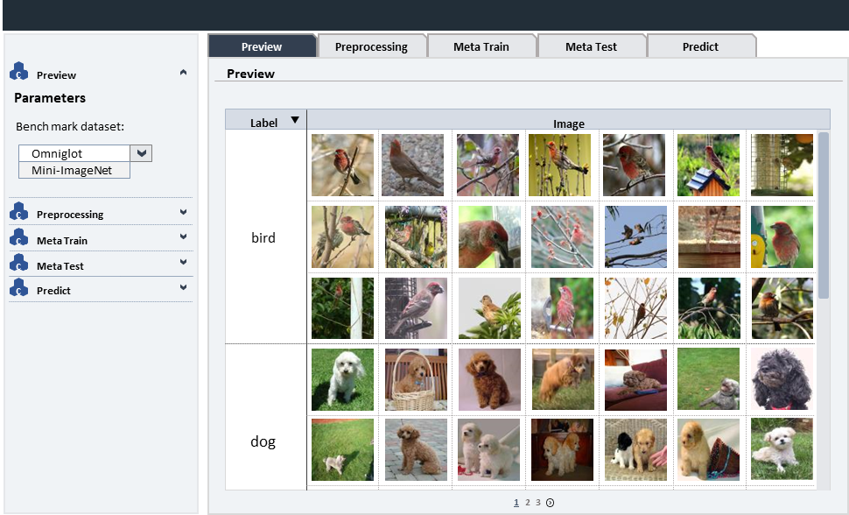
1. Preview

Slide 2
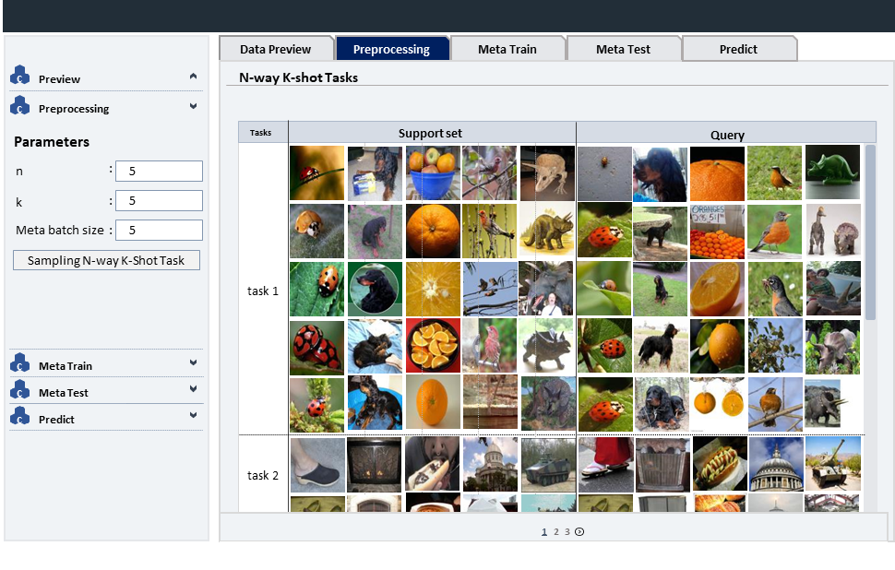
2. Preprocessing

Slide 3



































1. Preview
Preview
Preprocessing
Meta Train
Meta Test
Predict
c
Preview
Preview
Parameters
Bench mark dataset:
Label
Image
Omniglot
Mini-ImageNet
c
Preprocessing
c
Meta Train
bird
c
Meta Test
c
Predict
dog
1
2
3

Slide 4































































총괄 데모 계획
i-stream 및 i-canvas 연동
Data Preview
Preprocessing
Meta Train
Meta Test
Predict
c
Preview
N-way K-shot Tasks
c
Preprocessing
Parameters
Tasks
Support set
Query
n
:
5
k
:
5
Meta batch size
:
5
Sampling N-way K-Shot Task
task 1
c
Meta Train
c
Meta Test
c
Predict
task 2
1
2
1
3
2
3

Slide 5
총괄 데모 계획
i-stream 및 i-canvas 연동
Data Preview
Preprocessing
Meta Train
Meta Test
Predict
c
Preview
N-way K-shot Tasks
c
Preprocessing
Parameters
Tasks
Support set
Query
n
:
5
k
:
5
Meta batch size
:
5
Sampling N-way K-Shot Task
task 1
c
Meta Train
c
Meta Test
c
Predict
task 2
1
2
1
3
2
3

Slide 6
ladybug
ladybug
ladybug
ladybug
ladybug

Slide 7
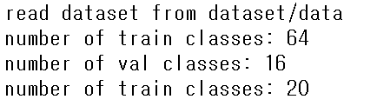
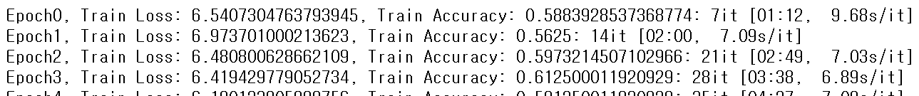
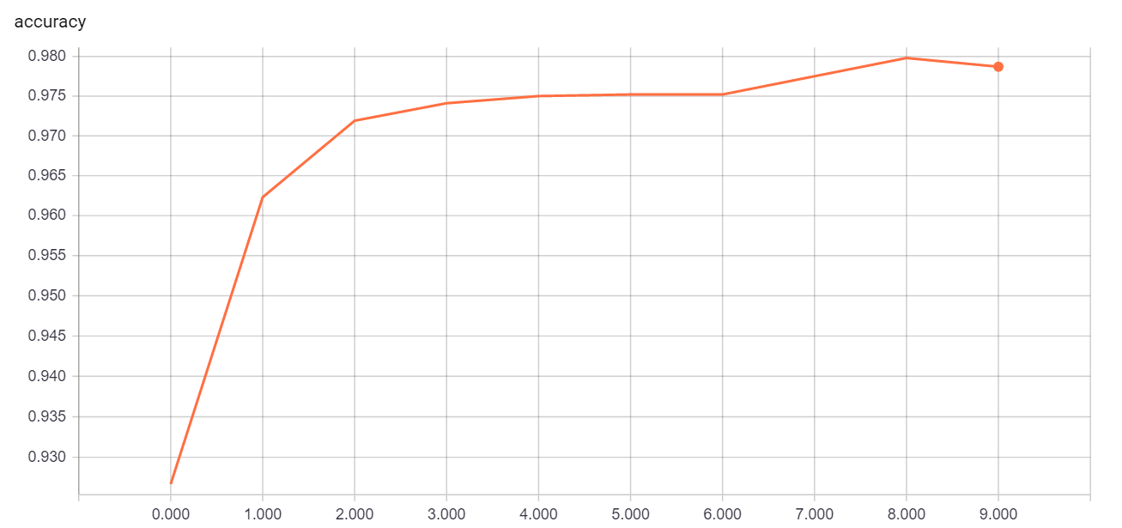
총괄 데모 계획
i-stream 및 i-canvas 연동
Data Preview
N-way K-shot
Meta Train
Meta Test
Predict
c
Preview
Train log
c
Preprocessing
c
Meta Train
Parameters
epochs
:
5
network_cls
:
5
meta_learning_rate
:
0.002
:
Loss & Accuracy graph
meta_batch_size
4
num_steps_ml
:
5
lr_inner_ml
Train Loss
Train Accuracy
:
0.002
num_steps_validation
:
5
:
save_after_epochs
100
report_validation_
frequency
:
50
Start Training
c
Meta Test
c
Predict
1
2

Slide 8
총괄 데모 계획
i-stream 및 i-canvas 연동
Data Preview
N-way K-shot
Meta Train
Meta Test
Predict
c
Preview
Train log
c
Preprocessing
c
Meta Train
Parameters
epochs
:
5
network_cls
:
5
meta_learning_rate
:
0.002
:
Loss & Accuracy graph
meta_batch_size
4
num_steps_ml
:
5
lr_inner_ml
Validation Loss
Validation Accuracy
:
0.002
num_steps_validation
:
5
:
save_after_epochs
100
report_validation_
frequency
:
50
Start Training
c
Meta Test
c
Predict
1
2

Slide 9
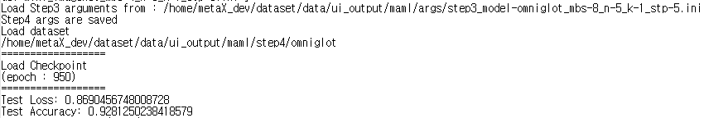
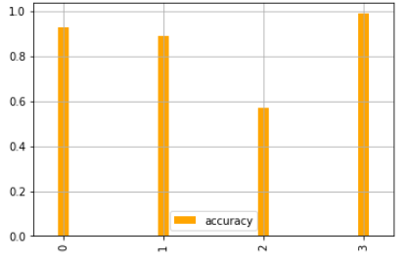
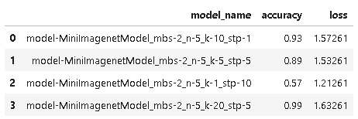
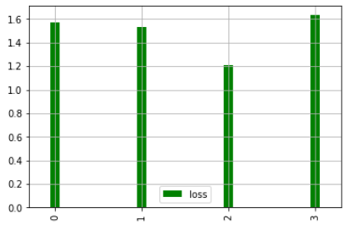
총괄 데모 계획
i-stream 및 i-canvas 연동
Data Preview
N-way K-shot
Meta Train
Meta Test
Predict
c
Preview
Test log
c
Preprocessing
c
Meta Train
c
Meta Test
Parameters
iterations
:
5
Start Meta-Testing
Compare with other settings
c
Predict
Model Table
Validation Accuracy
Validation Loss

Slide 10
총괄 데모 계획
i-stream 및 i-canvas 연동
Data Preview
N-way K-shot
Meta Train
Meta Test
Predict
c
Preview
Predict
c
Preprocessing
c
Meta Train
Tasks
Support set
Query
c
Meta Test
ladybug
dog
orange
bird
tricera..
ladybug
dog
orange
bird
tricera..
c
Predict
Predict
task 1
1
2
1
1
3
2
2
3

Slide 11
총괄 데모 계획
i-stream 및 i-canvas 연동
Data Preview
Preprocessing
Meta Train
Meta Test
Predict
c
Preview
N-way K-shot Tasks
c
Preprocessing
Parameters
Tasks
Support set
Query
n
:
ladybug
dog
orange
bird
tricera..
ladybug
dog
orange
bird
tricera..
5
k
:
5
Meta batch size
:
5
Sampling N-way K-Shot Task
task 1
c
Meta Train
c
Meta Test
c
Predict
1
2
1
3
2
3

Slide 12










총괄 데모 계획
i-stream 및 i-canvas 연동
Data Preview
N-way K-shot
Meta Train
Meta Test
Predict
c
Preview
Preview
c
Preprocessing
n
3
k
2
c
Meta Train
Tasks
Support set
Query
Parameters
epochs
:
5
task 1
network_cls
:
5
meta_learning_rate
:
5
task 2
:
meta_batch_size
5
num_steps_ml
:
5
lr_inner_ml
task 3
:
0.002
num_steps_validation
:
5
:
save_after_epochs
100
task 4
report_validation_
frequency
:
50
Start Training
task 5
c
Meta Test
c
Predict
1
2
3

