Slide 1
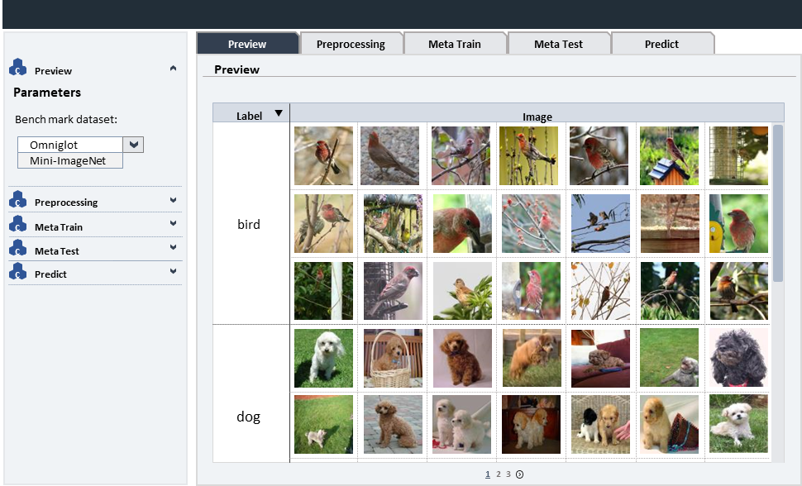
1. Preview

Slide 2
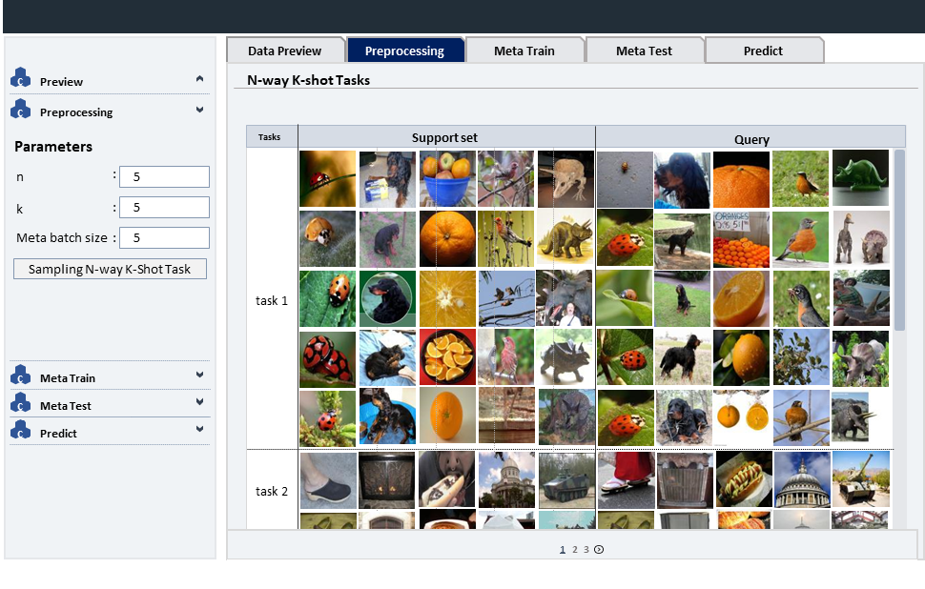
2. Preprocessing

Slide 3



































1. Preview
Preview
Preprocessing
Meta Train
Meta Test
Predict
c
Preview
Preview
Parameters
Bench mark dataset:
Label
Image
Omniglot
Mini-ImageNet
c
Preprocessing
c
Meta Train
bird
c
Meta Test
c
Predict
dog
1
2
3

Slide 4































































총괄 데모 계획
i-stream 및 i-canvas 연동
Data Preview
Preprocessing
Meta Train
Meta Test
Predict
c
Preview
N-way K-shot Tasks
c
Preprocessing
Parameters
Tasks
Support set
Query
n
:
5
k
:
5
Meta batch size
:
5
Sampling N-way K-Shot Task
task 1
c
Meta Train
c
Meta Test
c
Predict
task 2
1
2
1
3
2
3

Slide 5
총괄 데모 계획
i-stream 및 i-canvas 연동
Data Preview
Preprocessing
Meta Train
Meta Test
Predict
c
Preview
N-way K-shot Tasks
c
Preprocessing
Parameters
Tasks
Support set
Query
n
:
5
k
:
5
Meta batch size
:
5
Sampling N-way K-Shot Task
task 1
c
Meta Train
c
Meta Test
c
Predict
task 2
1
2
1
3
2
3

Slide 6
ladybug
ladybug
ladybug
ladybug
ladybug

Slide 7
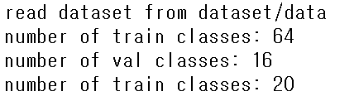
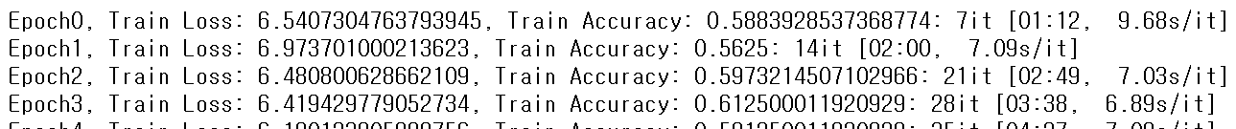
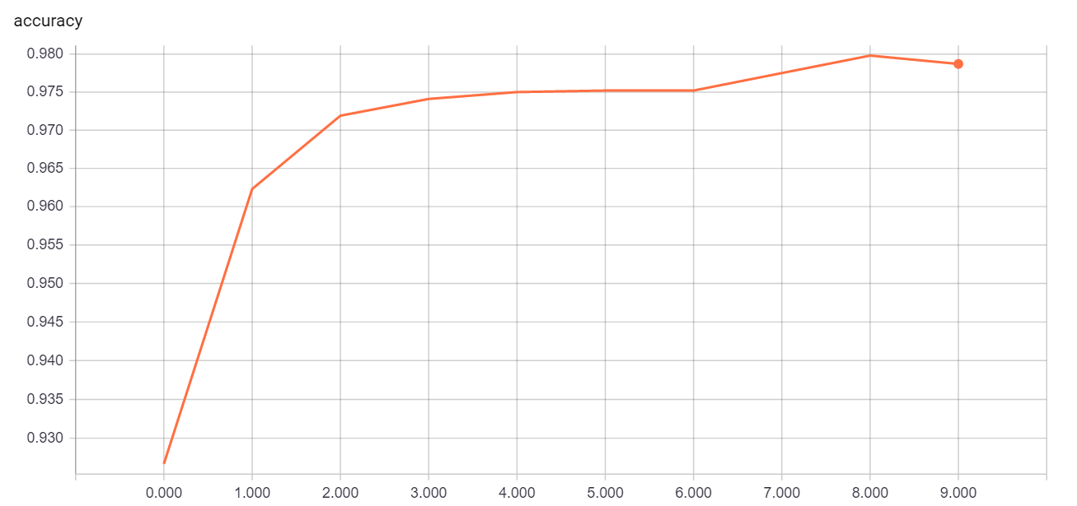
총괄 데모 계획
i-stream 및 i-canvas 연동
Image 분석
Data Preview
N-way K-shot
Meta Train
Meta Test
Predict
c
Data 미리보기
Train log
c
N-way K-shot 세팅 확인
c
Meta 학습
c
Meta 테스트
Loss graph
1
2
3

Slide 8










총괄 데모 계획
i-stream 및 i-canvas 연동
Image 분석
Data Preview
N-way K-shot
Meta Train
Meta Test
Predict
c
Data 미리보기
Preview
c
N-way K-shot 세팅 확인
n
3
k
2
c
Meta 학습
Tasks
Support set
Query
c
Meta 테스트
task 1
task 2
task 3
task 4
task 5
1
2
3

