Slide 1

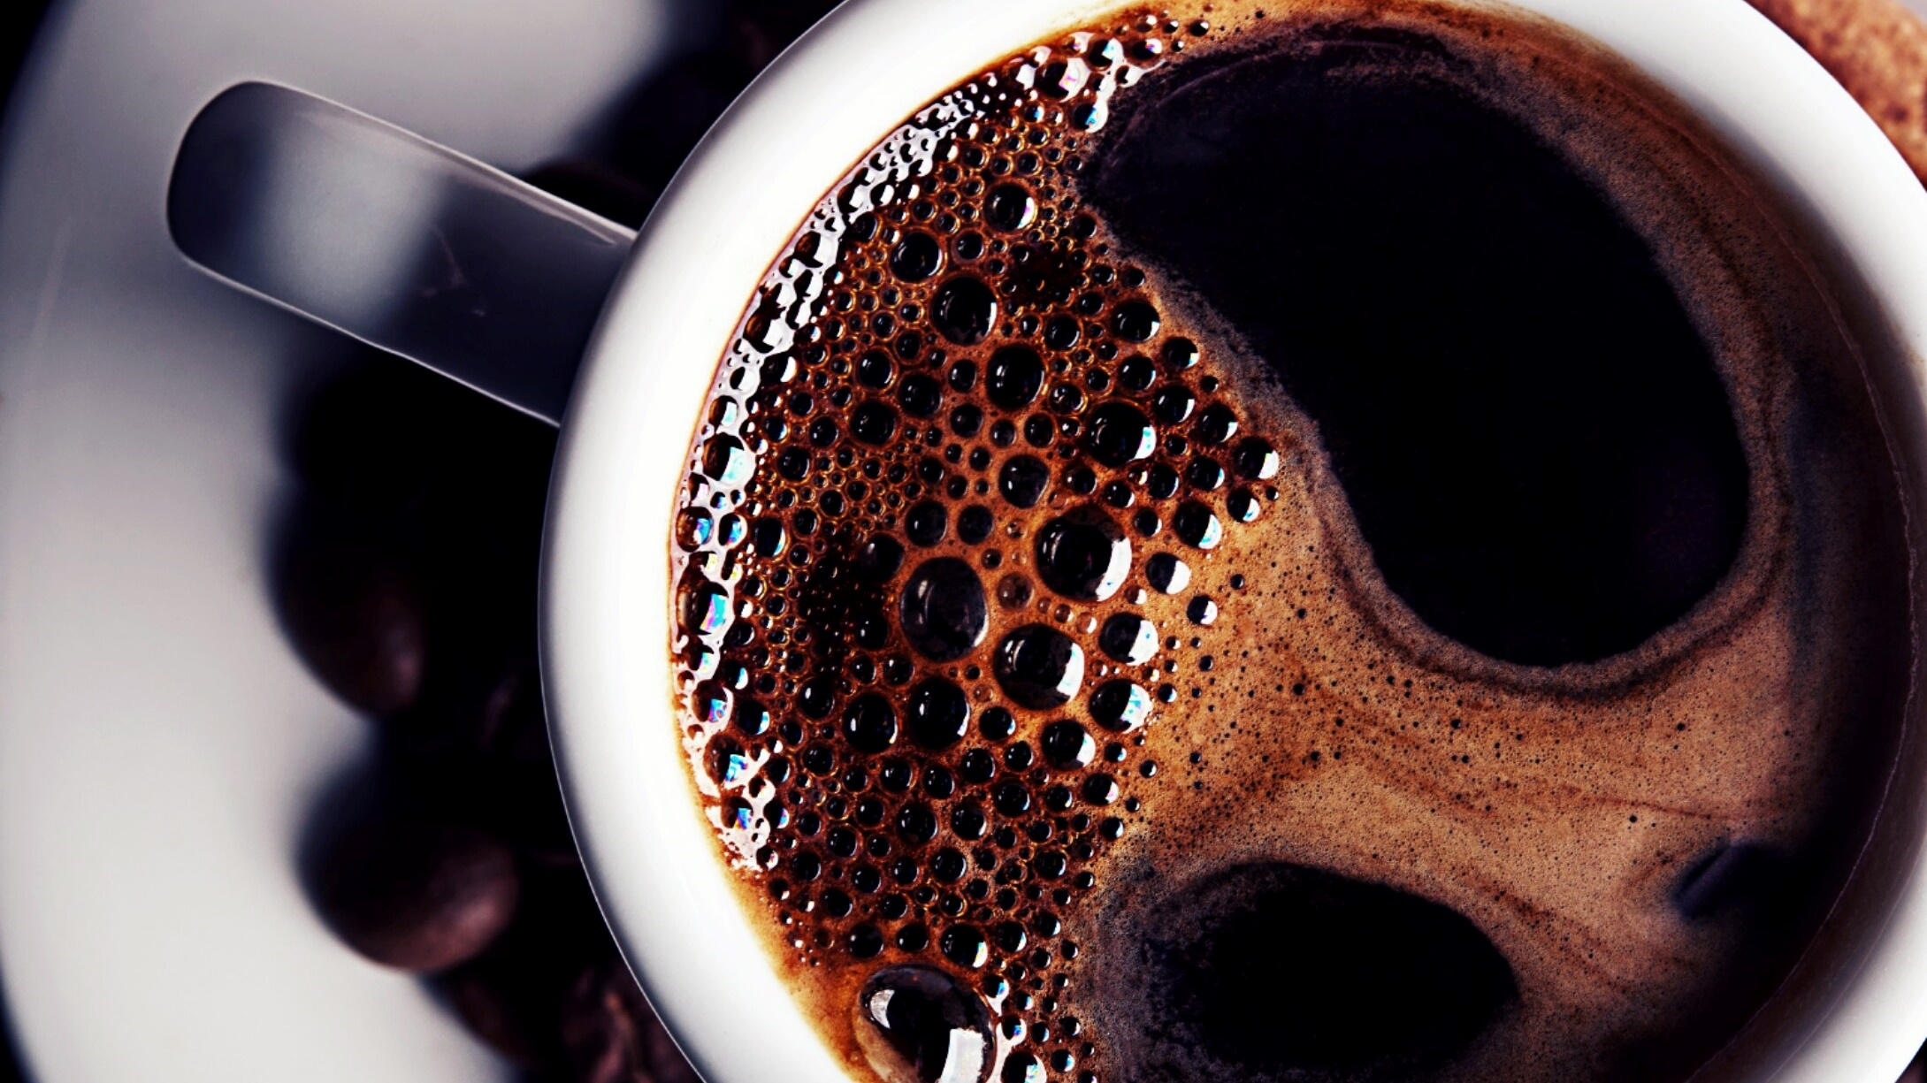
CoffeeCompass
Final project by David Guillet and Laurens Duin

Slide 2
Finding good coffee can be challenging
Many different options
Difficult to estimate what different coffees taste like
Many problems, one solution: CoffeeCompas

Slide 3
Many problems, one solution: CoffeeCompas CoffeeCompass offers different options:
Custom selection:
You’re a connoisseur.
CoffeeCompass prompts you for some inputs and recommends a coffee based on the provided information.
03
Top five best or budget:
You either have or don’t have a lot of money.
CoffeeCompass provides a top five coffees based on the highest rating or lowest price.
02
Random suggestion:
You’re feeling adventurous.
CoffeeCompass suggests a completely random coffee from the database with 4949 reviews.
01
Notes:
Centralized
All what you need to choose the best coffee
Powered by machine learning

Slide 4
CoffeeCompass provides succinct information on the selected coffee(s)
Reviews are from coffeereview.com
Information provided includes:
Coffee name
Roaster & location
Roast type
Origin
Price
Overall rating (scale 50-100)
Points awarded for aroma, body, flavour and aftertaste (scale 1-10)
The results of the blind assessment

Slide 5
Option 3 – Custom selection
The coffees were clustered with Machine Learning based on the following features: aroma, body, flavor, aftertaste and rating
Natural Language Processing was used to extract the words most often mentioned in the blind assessments. These were then used to create groups of characteristics.
4949

