Slide 1
Description of Congestion Measures

Slide 2
Congestion Measures
We look to identify three characteristics of congestion levels on each segment:
Severity of Congestion
How bad does congestion get on a reoccurring basis?
Duration of Congestion
How long does a user experience congestion on a reoccurring basis?
Variability of Congestion
How does congestion impact a user’s travel decisions?
“I know my commute in peak hour is going to be congested, but will the delay be consistently 40 minutes or could it range from 20 – 60 minutes?”

Slide 3
Severity of Congestion
90th percentile TTI
90th percentile TTI, calculated across all time periods over all days, will remove the effect of outliers such as severe snow storms or crashes on the network.
TTI value of 1 represent travel at free flow conditions.
TTI values greater than 1.33 represent congested conditions (e.g. 45 mph on 60mph posted speed limit).

Slide 4
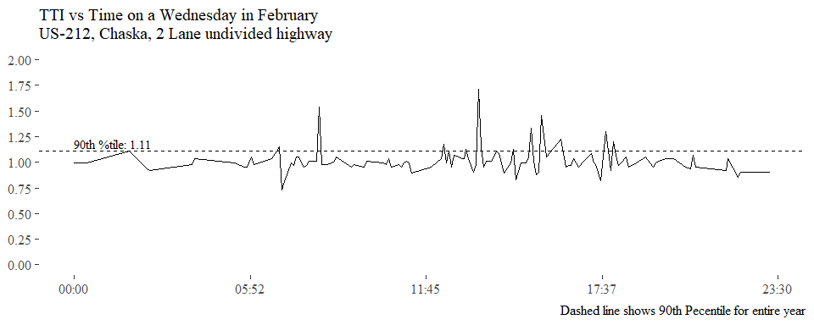
Severity of Congestion

Slide 5
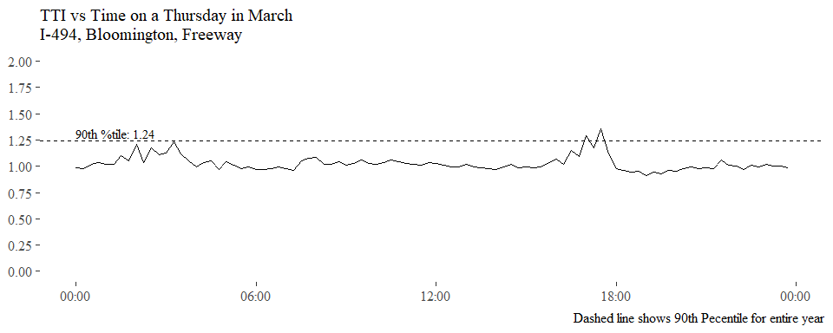
Severity of Congestion

Slide 6
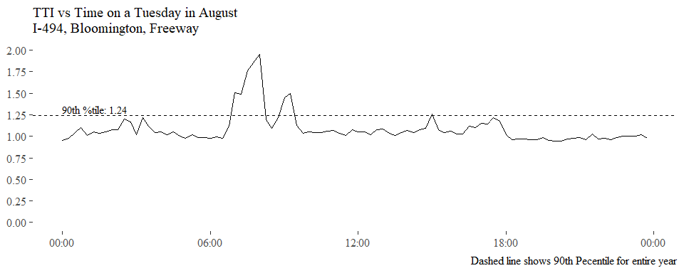
Severity of Congestion

Slide 7
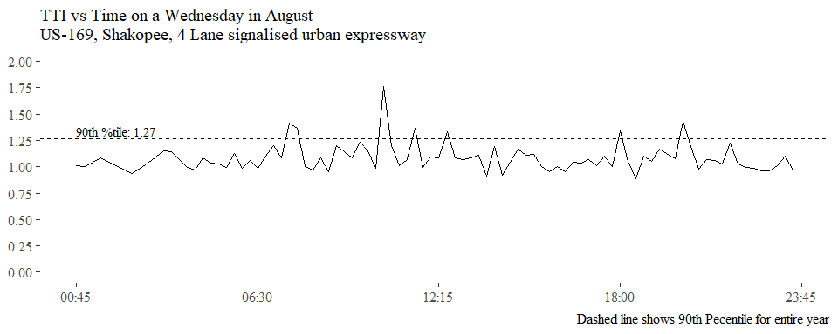
Severity of Congestion

Slide 8
Duration of Congestion
AVERAGE HOURS OF CONGESTION PER DAY
Time periods with TTI values greater than 1.33 will be considered congested.
For each day in the dataset, the total time the segment spends with conditions above TTI threshold is calculated.
The average daily duration of congestion is reported for the segment.
This measure provides and easily interpretable number that can be compared across all segments.
The measure reports how average time the segment was in a congested state, e.g. 1.5 hours of congestion per day.

Slide 9
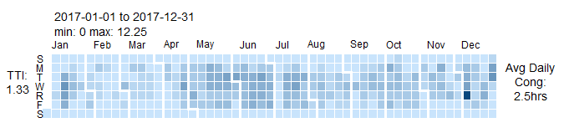

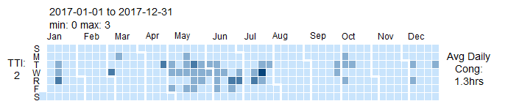
Duration of Congestion
The heatmap calendars to the right shows consistent congestion throughout the year.
The section displayed is a portion of I-494 in Bloomington.
As the threshold for TTI increases the duration of congestion is reduced.

Slide 10
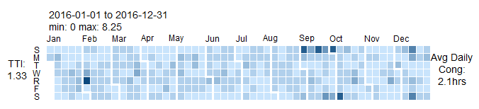
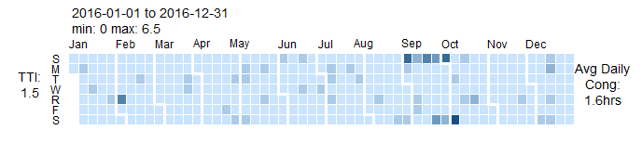
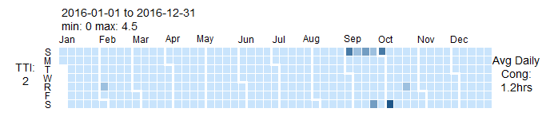
Duration of Congestion
The heatmap calendars to the right shows periods of congestion throughout the year.
The section displayed is a portion of US-169 in Shakopee.
As the threshold for TTI increases the duration of congestion is reduced.

Slide 11
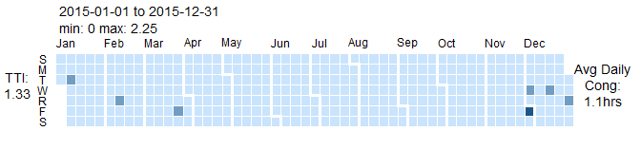
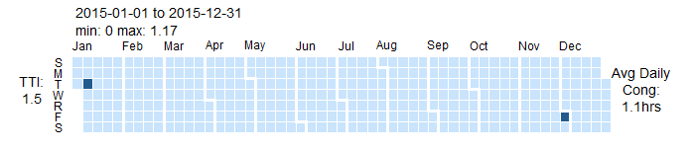

Duration of Congestion
The heatmap calendars to the right shows little reoccurring congestion throughout the year.
The section displayed is a portion of US-212 in Chaska.
As the threshold for TTI increases the duration of congestion is reduced.

Slide 12
Variability of Congestion
STANDARD DEVIATION OF CONGESTED CONDITIONS
Time periods with TTI values greater than 1.33 will be considered congested.
The standard deviation of the TTIs values above the threshold will be calculated.
This value will describe how much variation there are in the congested conditions.
A standard deviation of 0.05 would represent very consistent TTIs. Higher levels of congestion may be tolerable to users if they come with low variability.
A standard deviation of 0.5 would represent very inconsistent TTIs and would be very undesirable to users of the network.

Slide 13
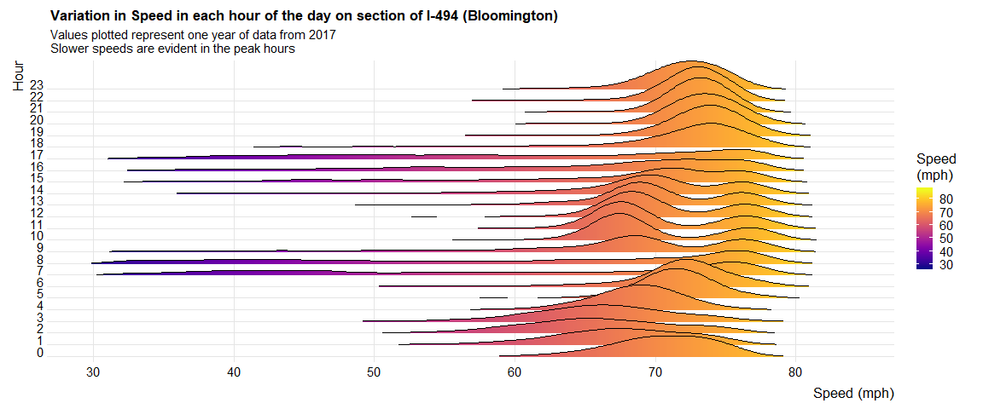
Variability of Congestion
1.33 TTI: 52mph
Standard deviation of TTIs below 1.33: 0.11

Slide 14
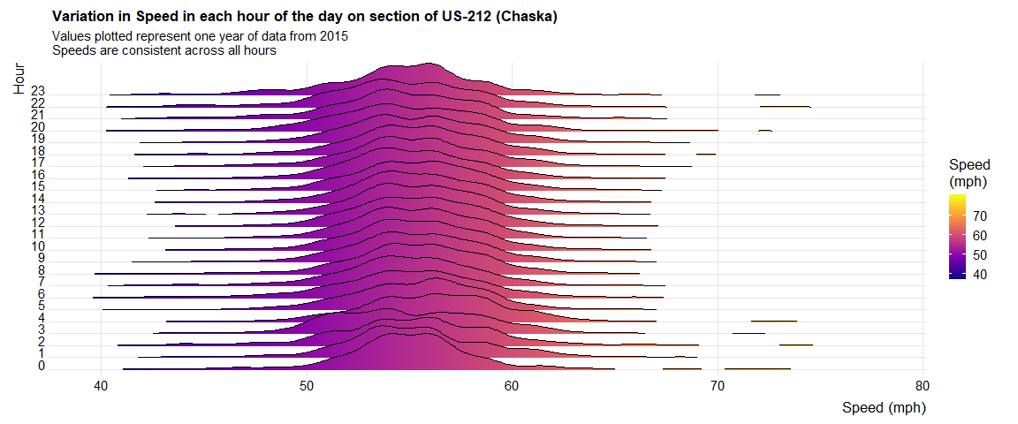
Variability of Congestion
No significant decrease in speeds throughout the day.

Slide 15
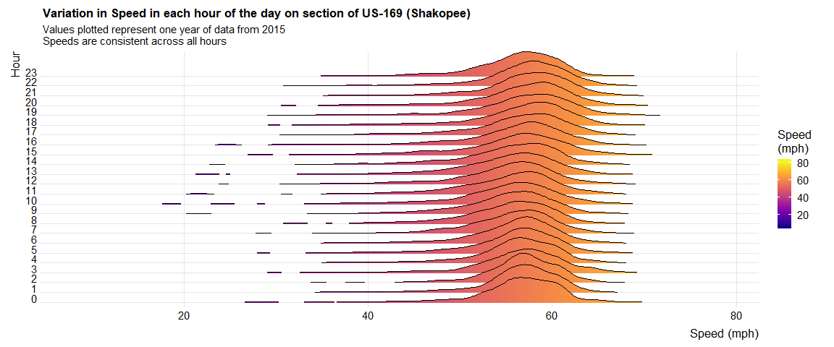
Variability of Congestion
TTI 1.33 = 45mph
Standard Deviation of TTIs below 1.33: 0.22

Slide 16
Congestion Measures
When taken in isolation each congestion measure does not give a full picture on the congestion experienced on a segment of roadway.
However when combined, they provide a powerful description of a users experience of congestion on the segment.
Namely, how bad the congestion can be, how long it lasts on average and how unpredictable it is.

