Slide 1
Description of Congestion Measures

Slide 2
Congestion Measures
We look to identify three characteristics of congestion levels on each segment:
Severity of Congestion
Duration of Congestion
Variability of Congestion

Slide 3
Severity of Congestion
90th percentile TTI
90th percentile TTI, calculated across all time periods over all days, will remove the effect of significant events such as severe snow storms or crashes on the network.
It provides an one number summary of TTI for the entire time period
Using TTI as the metric allows the measure to be compared to segments of differing size and operating speed
TTI is calculated for freeways using the posted speed limit as the free flow speed.

Slide 4
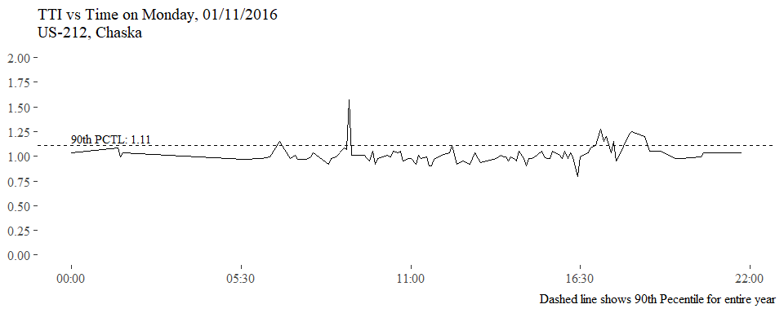
Severity of Congestion

Slide 5
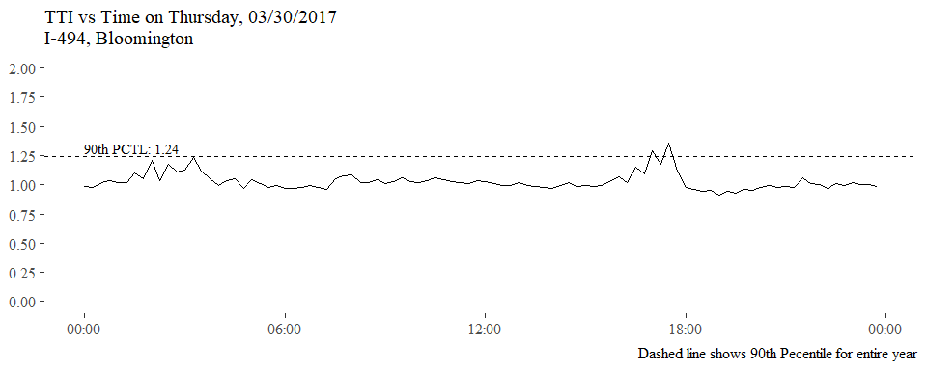
Severity of Congestion

Slide 6
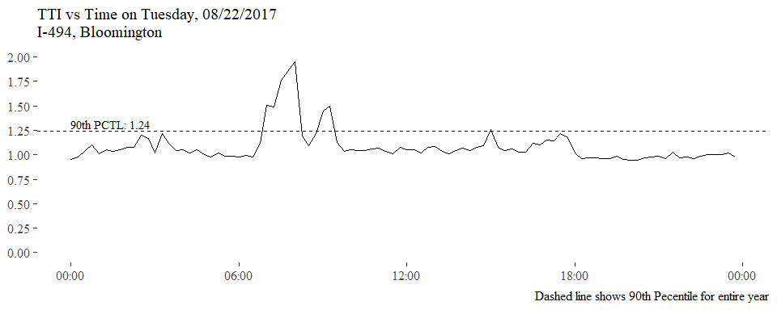
Severity of Congestion

Slide 7
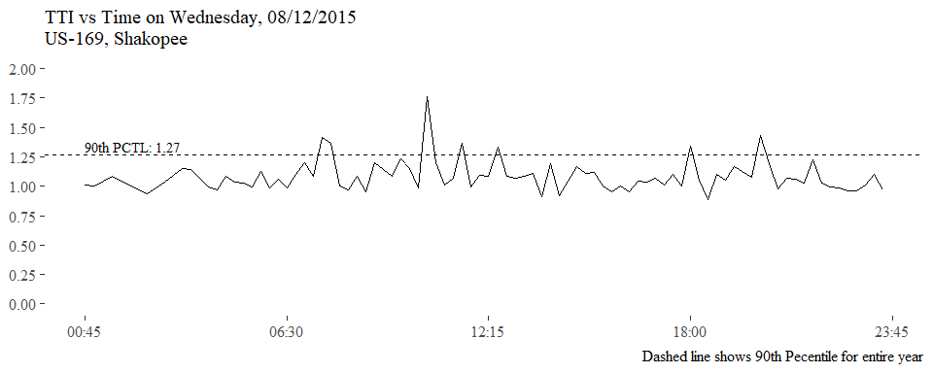
Severity of Congestion

Slide 8
Duration of Congestion
AVERAGE HOURS OF CONGESTION PER DAY
Determine a TTI threshold for congestion and non congestion e.g. 1.25, 1.5, 2.0.
For each day in the dataset, the total time the segment spends with conditions above TTI threshold is calculated.
The average daily duration of congestion is reported for the segment
This measure provides and easily interpretable number that can be compared across all segments.
The measure is not describing the severity of the delay or when the delay occurred.
The measure reports how long the segment was in a congested state, e.g. 1.5 hours of congestion per day.

Slide 9
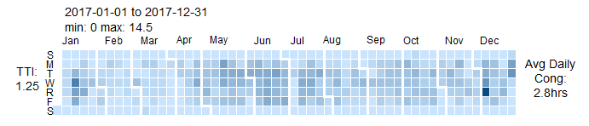

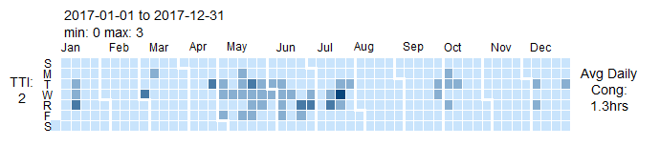
Duration of Congestion
The heatmap calendars to the right show the varying duration of congestion per day in hours, throughout the year
The section displayed is a portion of I-494 in Bloomington.
As the threshold for TTI increases the duration of congestion is reduced.

Slide 10
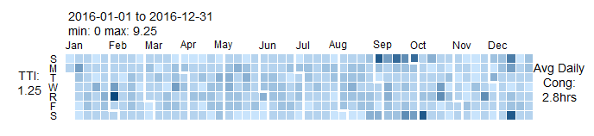
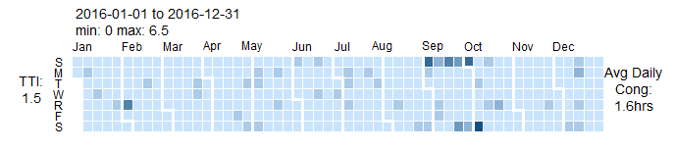
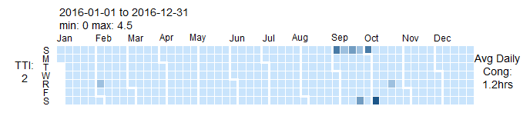
Duration of Congestion
The heatmap calendars to the right show the varying duration of congestion per day in hours, throughout the year
The section displayed is a portion of US-169 in Shakopee.
As the threshold for TTI increases the duration of congestion is reduced.

Slide 11
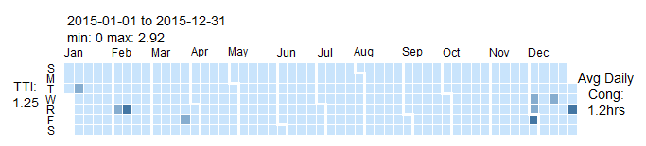
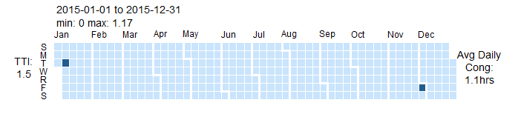

Duration of Congestion
The heatmap calendars to the right show the varying duration of congestion per day in hours, throughout the year
The section displayed is a portion of US-212 in Chaska.
As the threshold for TTI increases the duration of congestion is reduced.

Slide 12
Variability of Congestion
Method 1:
Variability by time of day:
Calculate the mean TTI for each hour of the day in the dataset, resulting in 24 mean values.
Calculate the standard deviation of these 24 mean values.
The greater this standard deviation, the greater the variability in congestion.
Method 2
Variability in each time period
Calculate the standard deviation of TTI values for the peak periods.
The greater this standard deviation, the greater the variability in congestion.

Slide 13
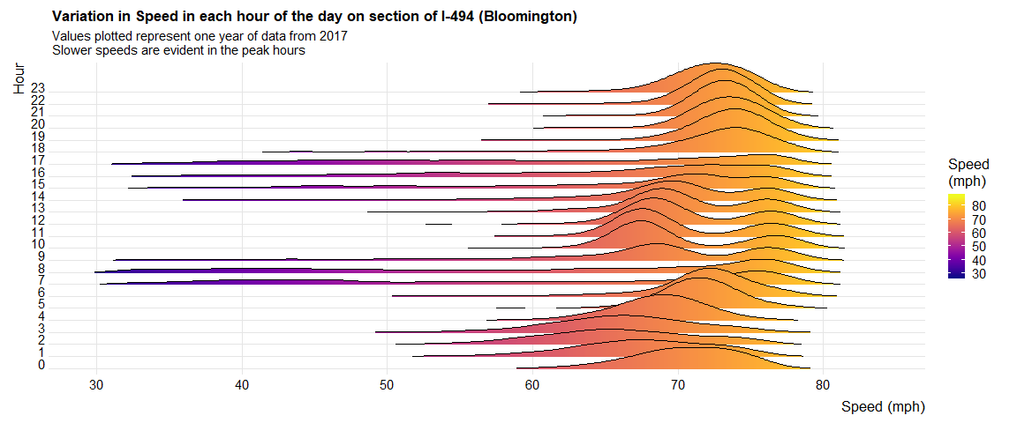
Variability of Congestion
High variability in peak hour speeds

Slide 14
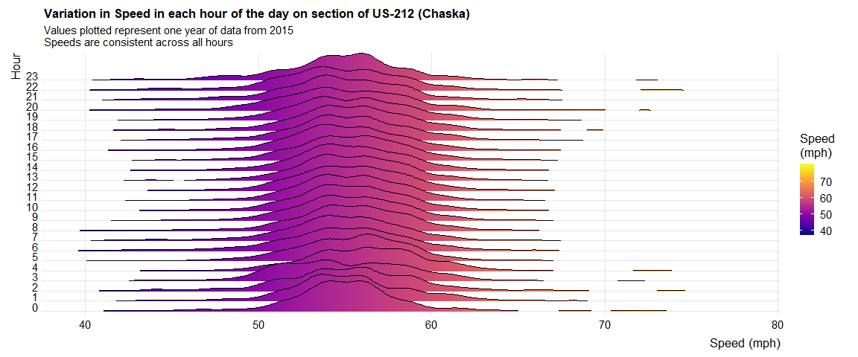
Variability of Congestion
No noticeable decrease in speeds throughout the day.

Slide 15
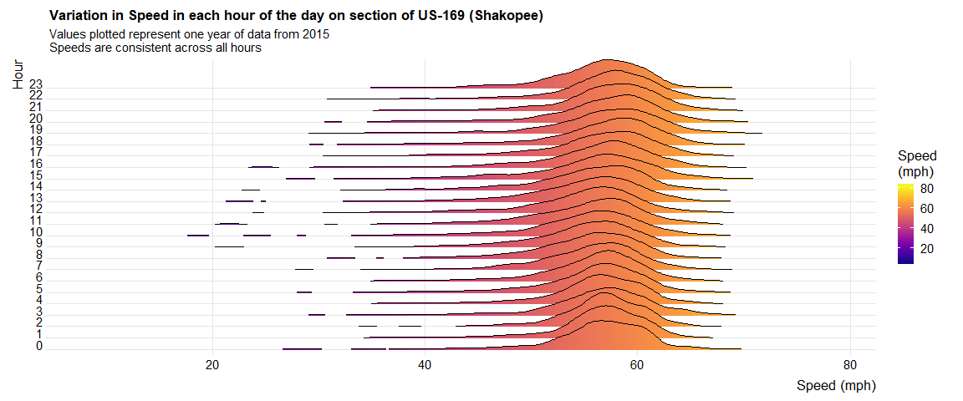
Variability of Congestion
Variability in speeds is constant throughout the day.

Slide 16
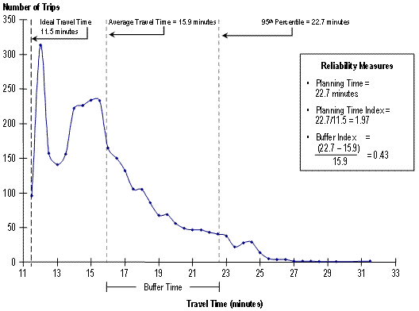
Variability of Congestion
Buffer Index
FHWA Report:
Traffic Congestion and Reliability: Trends and Advanced Strategies for Congestion Mitigation (graphic to the left included in report)
Planning Time Index may be replaced by the TTI metric.
Buffer Index will provide a measure for how spread out the travel times and speeds are.
Buffer Index could be calculated on peak periods or over all time periods

