Slide 1
Effect of GDP Per Capita on Life Expectancy
Econometrics 2
Professor: Lasha Chochua
Nika Kobakhidze
Nanuka Kasradze
Giorgi Shekiladze
Durmishkhan Gigineishvili
Elene Dzneladze

Slide 2
Would government’s decision to increase fiscal spending aimed at economic growth increase life expectancy?
Research question:
1) Life expectancy is a key indicator of human well-being.
2) It has to be one of top priorities for governments to meet sustainable development goals
1) Economic development is assumed to improve health outcomes.
2) When fiscal spending goes up, especially through investment in technologies, capital it is going to have positive long-lasting consequences on economy and GDP grows.
3) As a result of GDP growth GDP per capita also grows taking into account population does not tend to increase dramatically in a short run

Slide 3
Our goal in this project:
Data
Source: WDI (World bank development indicators)
Panel data for all countries around the world with the time span of 50 years from 1975 to 2024
Estimate casual effect of GDP per capita on life expectancy and infer whether or not Fiscal spending in question would improve Life Expectancy

Slide 4


Exploratory data analysis:
The structure of data collected
Comparing a large and a small economy to underline importance of time fixed effects
Importance of country fixed effects

Slide 5
General Econometric Model
Life expectancy
GDP Per Capita
Control Variables
Dependent variable
Independent variables
IV’s for GDP Per Capita
Urban_population, Fertility_rate, Immunization_DPT, Immunization_measles
export, FDI
We are using log transformed GDP per capita because its values are large in size, probably skewed and harder to interpret but by applying log transformation, which is a monotonic transformation we:
Reduce Skewness and Scale
Can interpret results in terms of %
Stabilize Variance

Slide 6
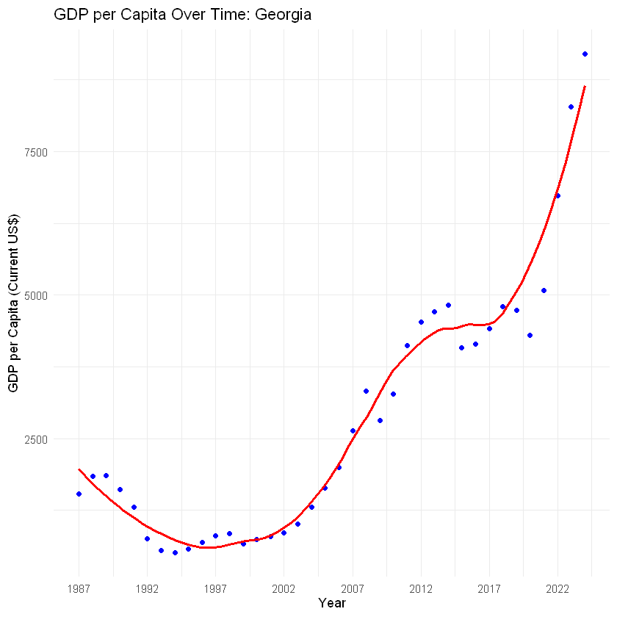
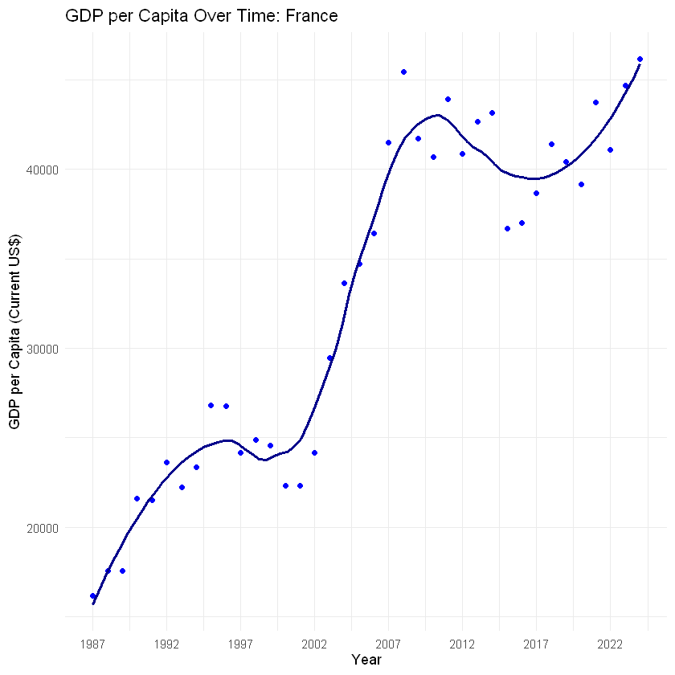
Georgia and France chosen to show small and large economy examples:
Filtered data from 1987
Fluctuations of GDP Per Capita

Slide 7

Importance of fixed effects
common major decrease in GDP came in 2008-2009 which is related to Global Banking Crisis.
another common significant drop came in 2020-2021 which corresponds to breakout of COVID-19.
That pattern shows why we should include Time fixed effects as well as country fixed effects in the following parts. Time fixed effect will eliminate potential bias coming from unobserved variation due to G.F.C, COVID and other events; As for as geographical and cultural effects and other time invariant effects, they will be eliminated using country fixed effects.

Slide 8
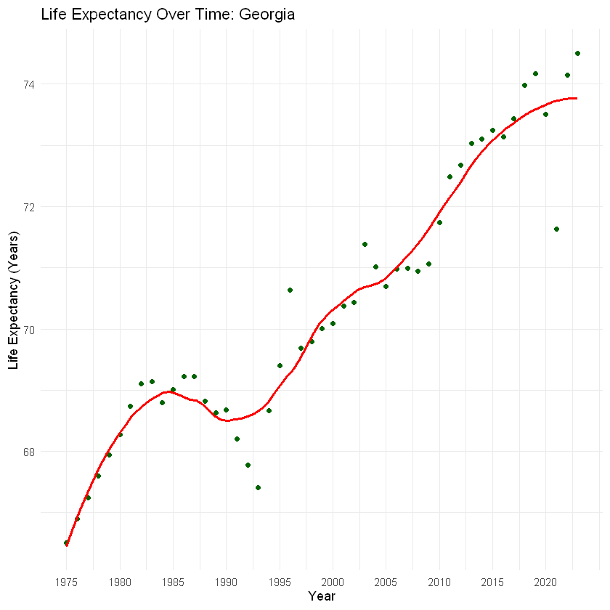
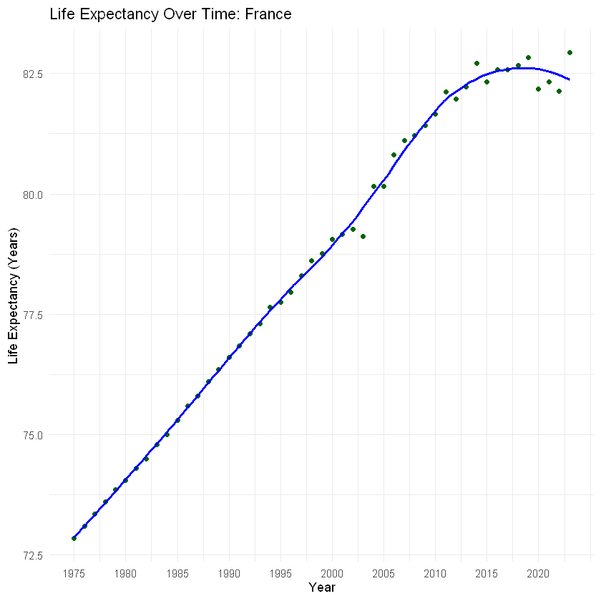
Fluctuations in life expectancy
Due to COVID in both country life expectancy decreased in 2020-2021. In Georgia decrease was more dramatic, probably primarily because of Healthcare services, which apparently are at lower level compared to what's available in France on average.

Slide 9
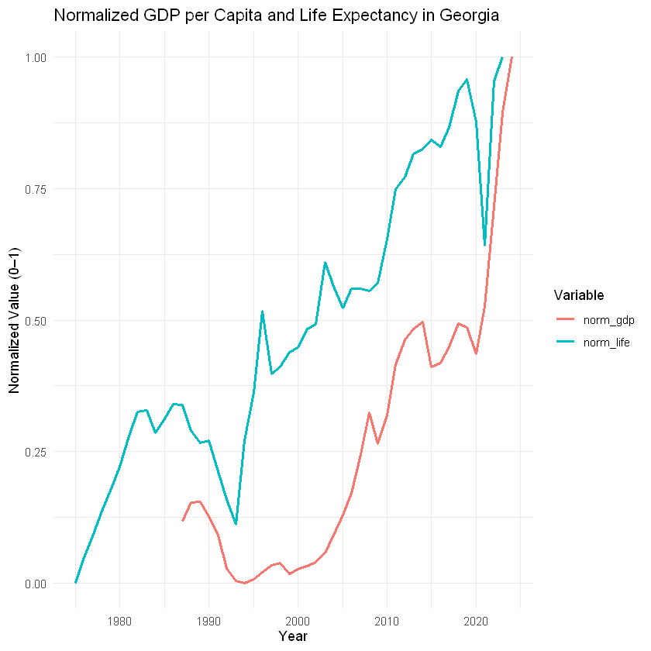
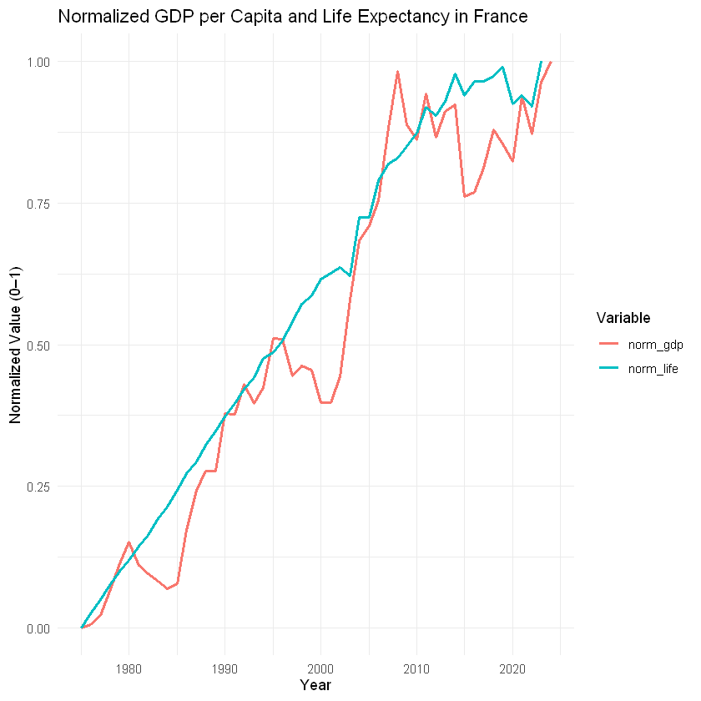
Let's observe GDP per capita and life expectancy together
As we see from the graphs above both GDP per capita and life expectancy have upwards trend. They are indeed positively correlated and as GDP per capita is causally linked with life expectancy we should expect B1 to be positive.

Slide 10
Before we started working on the models ,We came across potential multicollinearity problem:
V.I.F factors for age dependency ratio and urban population were both above accepted threshold of 10, so we decided to drop one of them, specifically we dropped age dependency ratio to safely run the other models.
After that V.I.F –s remained at most ~5 and below.

Slide 11
Baseline model : OLS
Variable | Coefficient | Std. Error | t-Statistic | p-value | Significance
Intercept | 50.42 | 0.54 | 92.52 | < 2e–16 | ***
log(GDP per capita) | 2.325 | 0.05 | 43.18 | < 2e–16 | ***
Immunization (DPT) | 0.074 | 0.0054 | 13.54 | < 2e–16 | ***
Immunization (Measles) | –0.0148 | 0.0052 | –2.87 | 0.004 | **
Urban Population (%) | 0.0314 | 0.003 | 10.30 | < 2e–16 | ***
Fertility Rate | –2.329 | 0.04 | –51.57 | < 2e–16 | ***
Signif. Codes: | *** p<0.001 | ** p<0.01 | * p<0.05 | . p<0.1 | .
R²: 0.8175 → 82% of the variation in life expectancy is explained
F-statistic: 5642 (p < 2.2e–16)
N = 7,565 observations
The OLS regression results above shows that there is positive relationship between high GDP per capita and Life expectancy. However, it does not account for potential bias coming from time fixed, entity fixed or other omitted variables, and its standard error is also likely to be incorrect as it does not account for heteroskedasticity.
Significance: *** p<0.001, ** p<0.01, * p<0.05, . p<0.1

Slide 12
Upgraded model: Fixed Effects Regression
- Country fixed
- Time fixed
Variable | Coefficient | Std. Error | t-Statistic | p-value | Significance
log(GDP per capita) | 0.7 | 0.29 | 2.41 | 0.016 | *
Immunization (DPT) | 0.06 | 0.01 | 5.87 | 1.8e-08 | ***
Immunization (Measles) | 0.013 | 0.0093 | 1.39 | 0.16
Urban Population (%) | 0.04 | 0.032 | 1.24 | 0.21
Fertility Rate | –0.92 | 0.3268 | –3.43 | 97.37e-04 | ***
Signif. Codes: | *** p<0.001 | ** p<0.01 | * p<0.05 | . p<0.1
Observations: 7,565
Countries (Fixed effects): 192
Years (Fixed effects): 44
Clustered SEs: By country
RMSE: 2.24
Adjusted R²: 0.94
Within R²: 0.184
Note that compared to ordinary linear regression B coefficient of GDP per capita dropped from 2.32 to 0.7 which hints at the fact that GDP per capita without controlling for fixed effects was capturing effect of unobserved fixed factors too, which probably inflated its coefficient.

Slide 13

Woorldridge Test for autocorrelation
Pesaran CD Test for Cross-Sectional Dependence
Null Hypothesis: No autocorrelation in errors
Test statistic: χ² = 4826, p < 0.001 Reject null hypothesis
Evidence of autocorrelation in panel residuals
Handled via clustered standard errors by country
Null Hypothesis: No cross-sectional dependence
Test statistic: z = 88.256, p < 0.001 Reject null hypothesis
Evidence of cross-sectional dependence (common shocks across countries)
Addressed using clustering across time
As we see in both of the cases we reject null hypothesis, so there is autocorrelation in errors and cross-sectional dependence, meaning that we should cluster both across countries and across time to make sure we get unbiased standard error estimates.

Slide 14
FE regression with "Two-way" clustered standard errors
Variable | Estimate | Std. Error | t value | Significance
log(GDP_per_capita) | 0.7 | 0.30 | 2.35 | p < 0.05
Immunization_DPT | 0.046 | 0.01 | 5.75 | p < 0.001
Immunization_measles | 0.013 | 0.0091 | 1.42 | p Not significant
Urban_population | 0.04 | 0.031 | 1.28 | Not significant
Fertility_rate | -0.92 | 0.277 | -3.32 | p < 0.01
Signif. Codes: | *** p<0.001 | ** p<0.01 | . p<0.1
Coefficient estimates remain the same, but standard errors are now adjusted.
Clustered SEs correct for bias from heteroskedasticity, autocorrelation, and cross-sectional dependence.
Now, GDP per capita is significant at the 5% level.
When clustering by countries only also significant at 5% as std error increased by 0.01 only.
A 1% increase in GDP per capita → +0.007 years of life expectancy
→ ≈ 2.55 extra days of life
If GDP per capita doubles (≈ 100% increase) →
Life expectancy increases by 0.491 years
→ ≈ 179 days or ~6 months
RMSE: 2.24
Adjusted R²: 0.94
Within R²: 0.184

Slide 15
FE regression with IV
IV-s used:
Exports
Foreign direct investment
Why we thought they could be good instruments?
When exports or FDI go up GDP per capita goes up holding other variables constant but they does not necessarily affect life expectancy, correlation with error term is not expected

Slide 16

FE+IV Regression
RMSE: 1.99
Adjusted R²: 0.952
Within R²: 0.181
Observations: 6190
Variable | Estimate | Std. Error | t value | p-value | Signif.
fit_log(GDP_per_capita) | 1.32 | 0.62 | 2.13 | 0.038 | *
Immunization_DPT | 0.04 | 0.01 | 4.31 | 0.00093 | ***
Immunization_measles | 0.028 | 0.0099 | 2.84 | 0.0028 | **
Urban_population | 0.0032 | 0.036 | 0.088 | 0.93
Fertility_rate | -1.08 | 0.27 | -3.96 | 2.76E-04 | ***
Signif. Codes | *** p<0.001 | ** p<0.01 | . p<0.1

Slide 17
Discussion of results of F.E. Regression with IV
The p-value for GDP per capita increased from 0.022 (FE) to 0.038 (IV), reflecting the trade-off between consistency and precision when using IV.
Standard error rose from 0.30 to 0.62, but the estimate is now unbiased and consistent.
Fewer observations in the IV model (~1,400 less) are due to missing values in instruments, not model flaws.
Both models cluster standard errors two ways → robust to serial correlation and heteroskedasticity.
First-stage F-stat = 2,514 → strong instruments (Stock-Yogo rule: F > 10)
Wu–Hausman test (p = 5.3e-12) → GDP per capita is clearly endogenous
Sargan test (p = 0.87) → instruments are valid and uncorrelated with the error

Slide 18
Interpretation of coefficient of GDP per capita after eliminating bias coming from fixed effects and omitted variables:
A 1% increase in GDP per capita → +0.0132 years of life expectancy
→ ≈ 54.8 extra days of life
If GDP per capita doubles (≈ 100% increase) →
Life expectancy increases by 0.922 years
→ ≈ 336.5 days or ~11.2 months

Slide 19

Conclusion
GDP per capita has a causal and statistically significant effect on life expectancy
1
IV estimation improves causal interpretation by addressing endogeneity not handled by FE alone
2
Using valid instruments allows for a credible and consistent estimate of GDP’s impact
3

Slide 20

Will government’s decision to increase fiscal spending in question increase life expectancy?
We have clear evidence that this kind of increase in GDP will result in increase in GDP per capita, for that reason we proved that GDP per capita has statistically significant effect on life expectancy and managed to find its positive causal effect on it.
Policy Implication:
Long-term fiscal policies that boost GDP per capita (e.g., infrastructure, health systems, education) are likely to improve population health and longevity.

Slide 21
Thank you for your attention!

Slide 22

Bibliography
World Bank. (n.d.). World Development Indicators [Dataset]. Retrieved July 2025, from https://databank.worldbank.org/source/world-development-indicators
Wickham, H., François, R., Henry, L., & Müller, K. (2023). dplyr: A grammar of data manipulation (R package version 1.1.0) [Computer software]. https://CRAN.R-project.org/package=dplyr
Wickham, H., & Girlich, M. (2024). tidyr: Tidy messy data (R package version 1.3.0) [Computer software]. https://CRAN.R-project.org/package=tidyr
Wickham, H. (2016). ggplot2: Elegant graphics for data analysis (R package version 3.4.2) [Computer software]. https://CRAN.R-project.org/package=ggplot2
Correia, S. (2019). fixest: Fast fixed-effects estimation (R package version 0.9.0) [Computer software]. https://CRAN.R-project.org/package=fixest
Croissant, Y., & Millo, G. (2008). plm: Linear models for panel data (R package version 2.4-7) [Computer software]. https://CRAN.R-project.org/package=plm
Zeileis, A., Leisch, F., Hornik, K., & Kleiber, C. (2005). lmtest: Testing linear regression models (R package version 0.9-42) [Computer software]. https://CRAN.R-project.org/package=lmtest
Fox, J., & Weisberg, S. (2019). An R companion to applied regression (3rd ed.). Sage Publications. R package version 3.1-2. https://CRAN.R-project.org/package=car

Slide 23
How variables were picked from WDI:
Project Variable | WDI Indicator Code | Description
Life_expectancy | SP.DYN.LE00.IN | Life expectancy at birth, total (years)
GDP_per_capita | NY.GDP.PCAP.CD | GDP per capita (current US$)
Age_dependency_ratio_young (Dropped due to multicollinearity) | SP.POP.DPND.YG | Age dependency ratio: young (% of working-age population)
Urban_population | SP.URB.TOTL.IN.ZS | Urban population (% of total population)
Fertility_rate | SP.DYN.TFRT.IN | Fertility rate, total (births per woman)
Immunization_DPT | SH.IMM.IDPT | Immunization, DPT (% of children ages 12–23 months)
Immunization_measles | SH.IMM.MEAS | Immunization, measles (% of children ages 12–23 months)
Exports | NE.EXP.GNFS.CD | Exports of goods and services (current US$) (Used as IV)
FDI | BX.KLT.DINV.WD.GD.ZS | Foreign direct investment, net inflows (% of GDP) (Used as IV)
📊 WDI Variables Used:
Note: You can copy their codes and find each of them quickly like that
on WDI variables’ section called “Series”. As for countries we picked all available 217, and time span of 50 years which was most we could get.

