Slide 1
TBRPF Protocol
Dan Gridish
311366405
Functional Programming in Concurrent and Distributed Systems

Slide 2
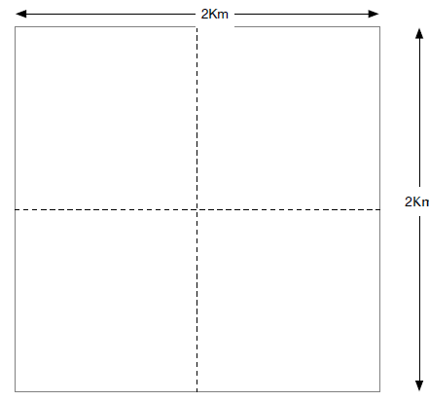
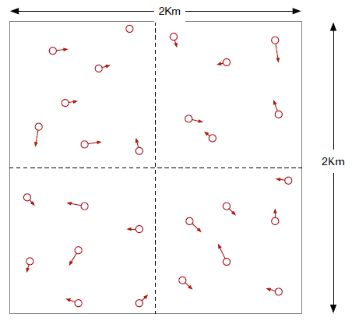
TBRPF Project
The project describes communication conduct between mobile communication elements via TBRPF protocol.
The elements can move according to a predefined mathematical motion model.
3
4
The traffic area is a square with a 2 km long edge. This area is divided into four quarters, each square with a side of 1 km.
1
2
The elements can move between the four quarters while in motion.
Notes:
(CLICK)
הפרויקט מתאר התנהלות תקשורתית בין אלמנטי תקשורת ניידים ללא תשתית מוכנה מראש. (CLICK)
האלמנטים יכולים לנוע על פי מודל תנועה מתמטי ומוגדר מראש. (CLICK)
אזור התנועה הוא ריבוע בגודל 2 ק"מ על 2 ק"מ. השטח הזה מחולק לארבעה רבעים שווים. (CLICK)
האלמנטים יכולים, תוך כדי תנועה, לעבור בין הרביעים. (CLICK)
(CLICK) מעבר שקופית

Slide 3
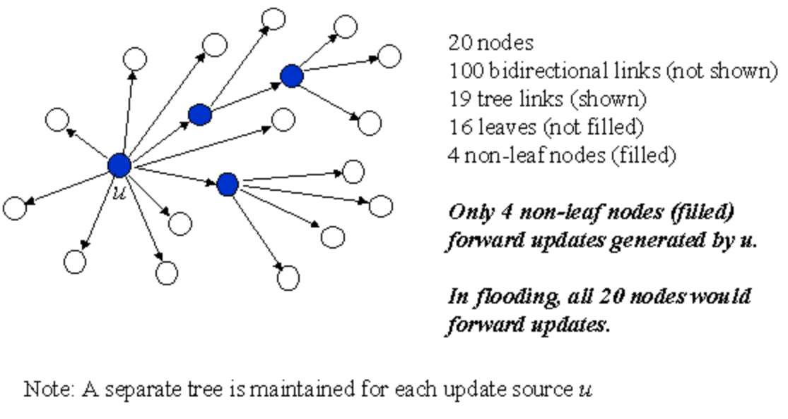
TBRPF Protocol
Topology broadcast based on reverse-path forwarding (TBRPF) is a proactive routing protocol.
TBRPF is a full-topology link-state protocol: each node is provided with the state of each link in the network (or within a cluster if hierarchical routing is used).
Each link-state update is broadcast reliably along a dynamic min-hop-path tree rooted at the source U of the update
Each update is sent along a single path to each node, resulting in improved efficiency.
Notes:
(CLICK)
TBRPF - Topology broadcast based on reverse-path forwarding – פרוטוקול ניתוב יזום. פרוטוקול שימושי כאשר יש צורך במספר רב של מסלולים וליישומים שאינם יכולים לספוג את עיכוב גילוי המסלול.
(CLICK)
כל צומת מקבל מידע אודות הקישורים ברשת.
(CLICK)
כל עדכון משודר לאורך עץ מינימום דינמי. (CLICK)
כאשר כל עדכון נשלח בנתיב יחיד לכל צומת, דבר המשפר את יעילות תעבורת הנתונים.
(CLICK) מעבר שקופית

Slide 4
Planning considerations
Messaging traffic trade off: Routine high messaging traffic - fast time handling application Against Routine low message traffic - slow time processing request
Memory storage trade off: Storing a lot of information in each element - takes up a lot of space Against Little information storage in any process - it is necessary to request the information
Using ETS tables – constant access time, parallel access, store large mounts of data
Using tuple in order to store information - less space

Slide 5
Block diagram
Main Node
Open Q nodes (processes).
Saves information from all Q’s.
Communicates with the GIU.
Screen printing for user tracking
Q Node
Start element nodes.
Keep data for all his nodes.
Update Main node.
Q Node
Q Node
Q Node
Elements
1
2
3
n
1
2
3
n
1
2
3
n
1
2
3
n
Movement model
For each element
TBRPF Protocol
Notes:
(CLICK)
התהליך הראשי אחראי על פתיחת תהליכי המשנה, מתקשר איתם, מעביר את המידע מהם לממשק משתמש.
התהליכים המשניים אחראיים על יצירת האלמנטים והתקשורת איתם ועם התהליך הראשי.
כל צומת שנוצר מקבל מודל תנועה לפיו הוא ינוע, ומתקשר לפי פרוטוקול באטמן עם שאר הצמתים במערכת.
(CLICK) סיום

Slide 6
Main Node
Use gen_server to create a client-server relation - OTP Design Principles.
Start the Q nodes and monitor them.
Provides the information needed for Q nodes when a request is sent.
Responsible for handling crashed nodes, If Q node crashes, responsible for transferring the elements to another Q node.
Sends a request to send a message and prints information to the screen periodically.
Two ETS: Q’s, All elements.

Slide 7
Q Node
Use gen_server to create a client-server relation - OTP Design Principles.
Start the element nodes.
Provides the information needed for Element nodes when a request is sent.
Ability to contact other nodes requesting to send elements not in its area.
ETS: Own elements.

Slide 8
Element Node
Use gen_server to create a client-server relation - OTP Design Principles.
movement model: Direction and speed.
Responsible for maintaining an up-to-date list of neighbors
Find the shortest path for messaging

Slide 9
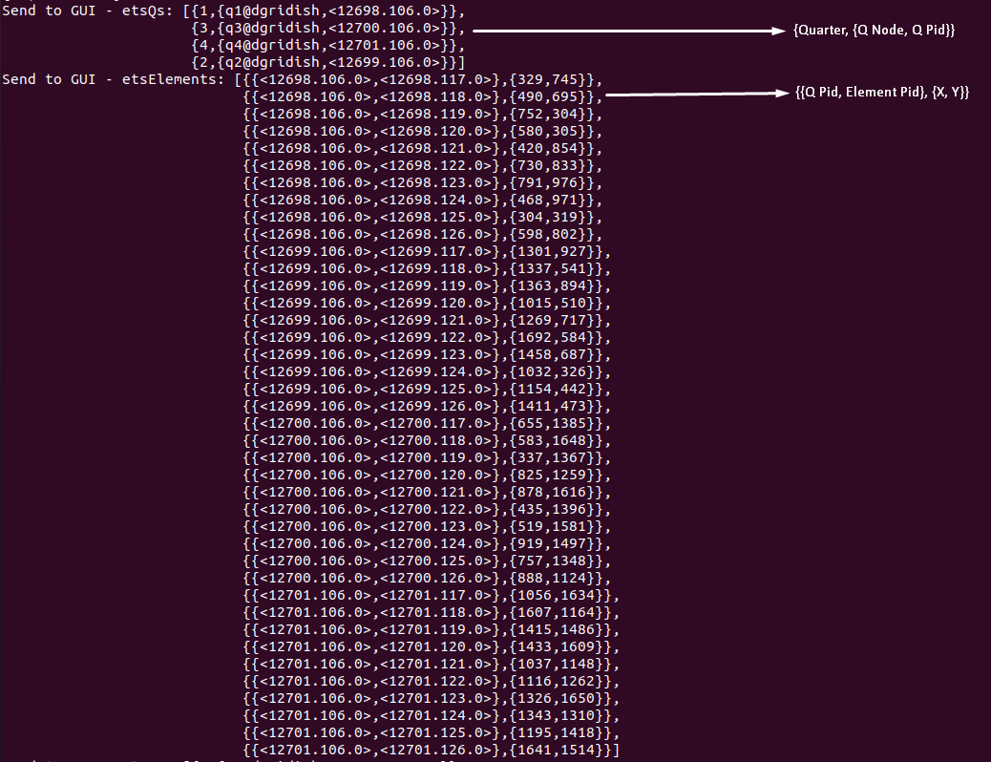
Examples
40 Elements:

Slide 10
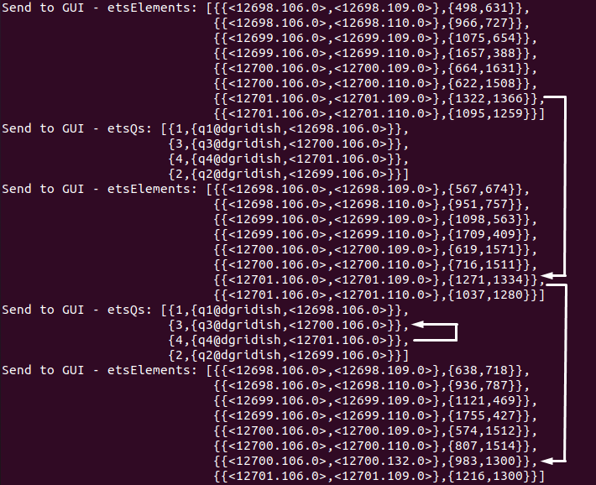
Examples
Element move to other quarter:
Once the element has crossed the boundary (1000 meters), it is transferred to the responsibility of the quarter manager to whom it has moved.
Note that the element was dropped on one side and created on the other (new PID number)
Element moving in quarter 4 towards quarter 3.

Slide 11
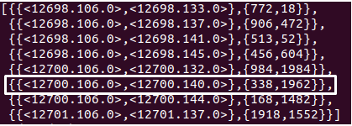
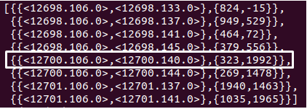
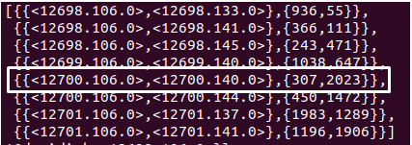
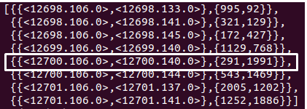
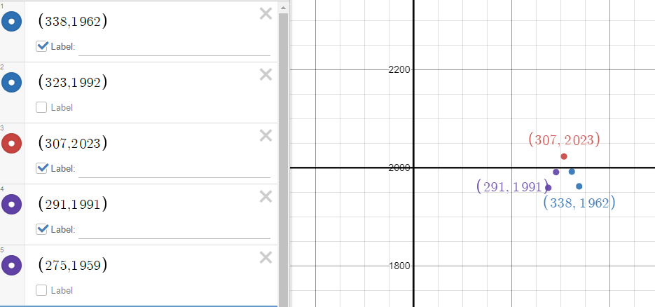
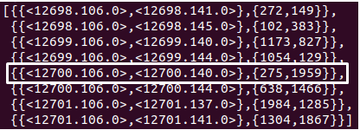
Examples
Billiard table movement:

Slide 12
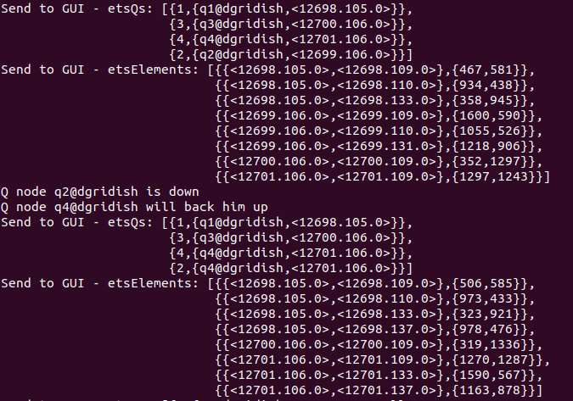
Examples
Handling crashed nodes:

Slide 13
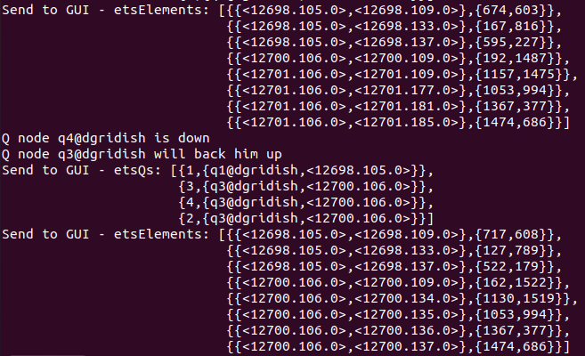
Examples
Handling crashed nodes:

Slide 14
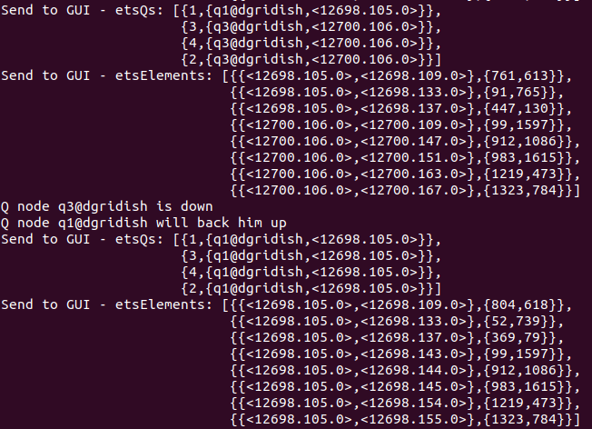
Examples
Handling crashed nodes:

Slide 15
Summary and Conclusions
Exposure to Erlang's abilities (200K Element in 0.5 seconds!!).
Experience in systems engineering.
A good word about exposure to Git.
Erlang as an alternative robot control system software architecture, improve the scalability and reliability limitations of ROS
See Real-time Robot Camera Control in Erlang by Andreea C. Lutac

