Slide 1
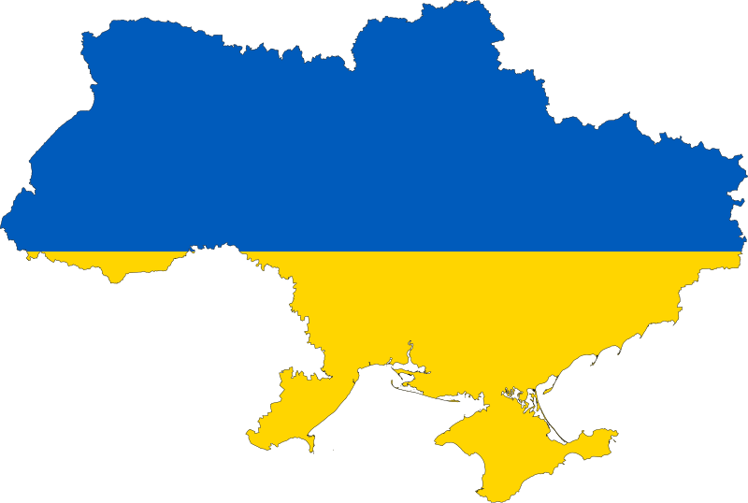
Ukraine food trade balance-2019

Slide 2
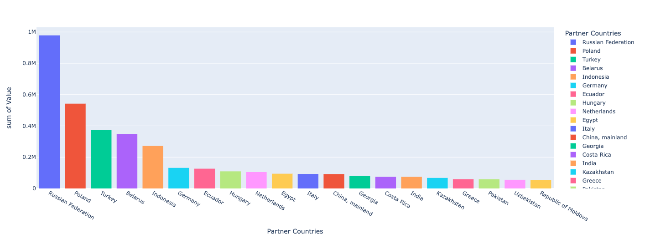
Import top 20 countries (tonnes)

Slide 3
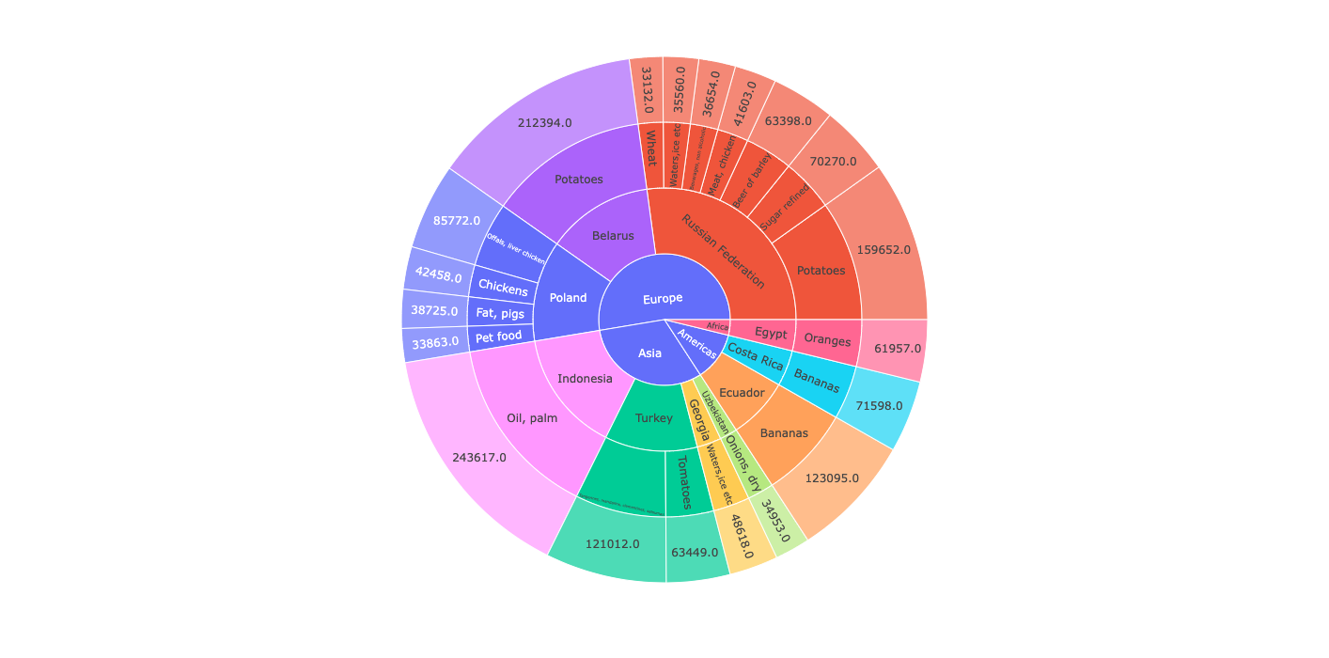
Import top 20 products (tonnes), by partner country

Slide 4
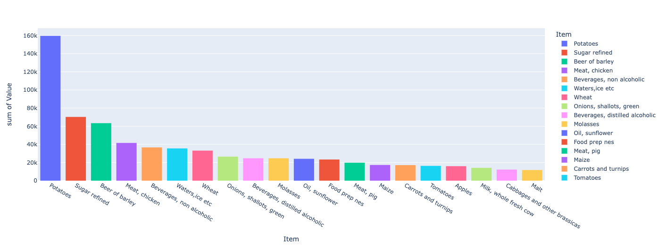
Import top 20 products (tonnes), from Russia

Slide 5
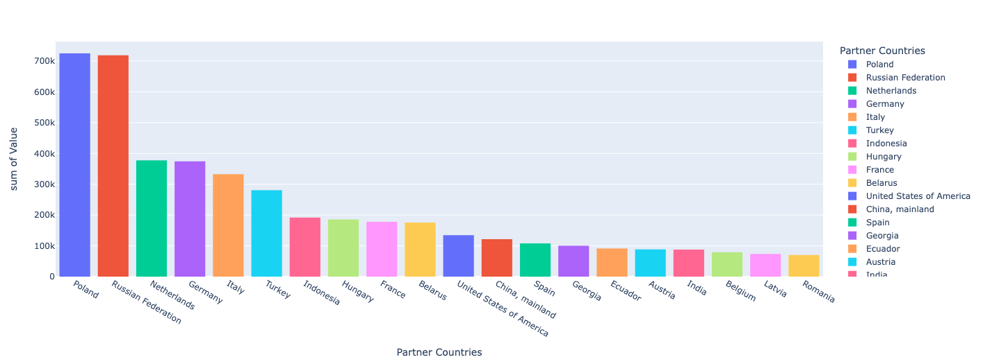
Import top 20 countries (1000$)

Slide 6
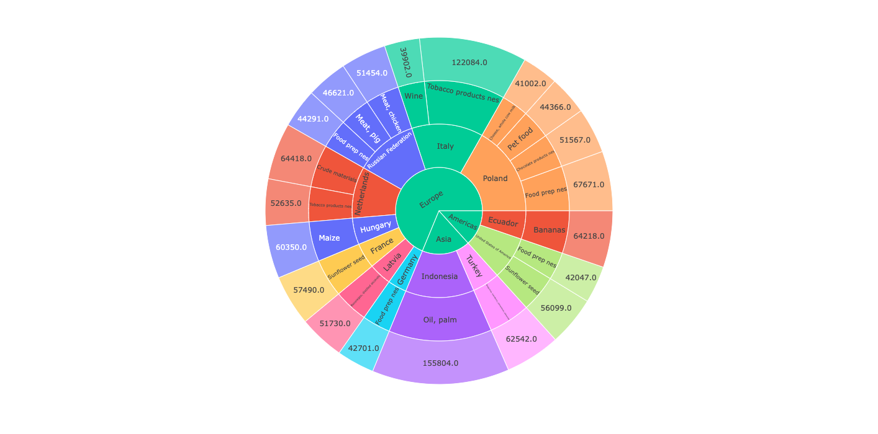
Import top 20 products (1000$), by partner country

Slide 7
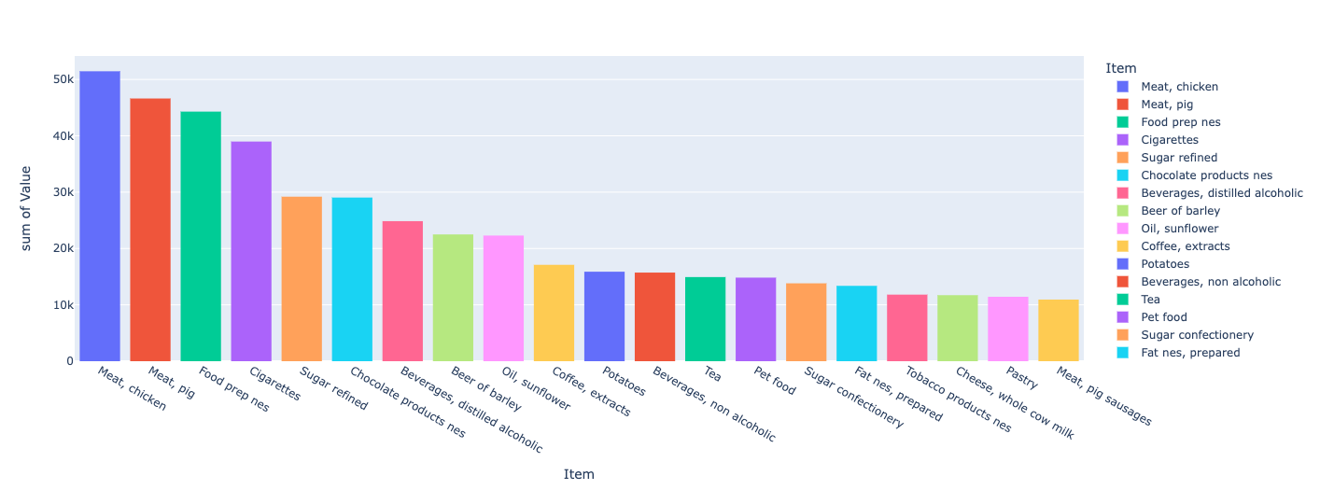
Import top 20 products(1000$), from Russia

Slide 8
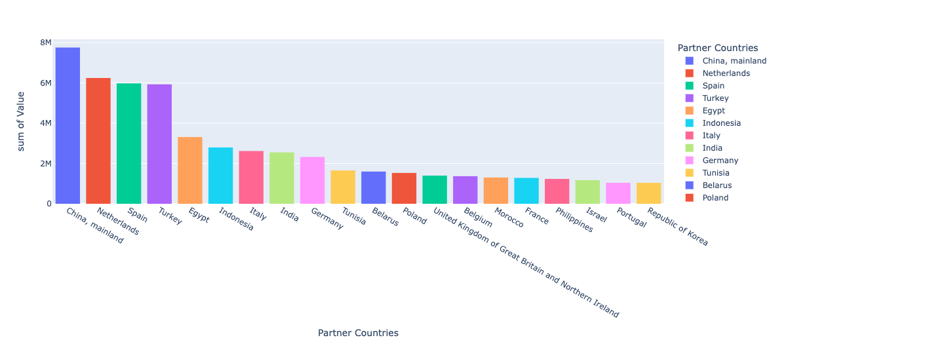
Export top 20 countries (tonnes)

Slide 9
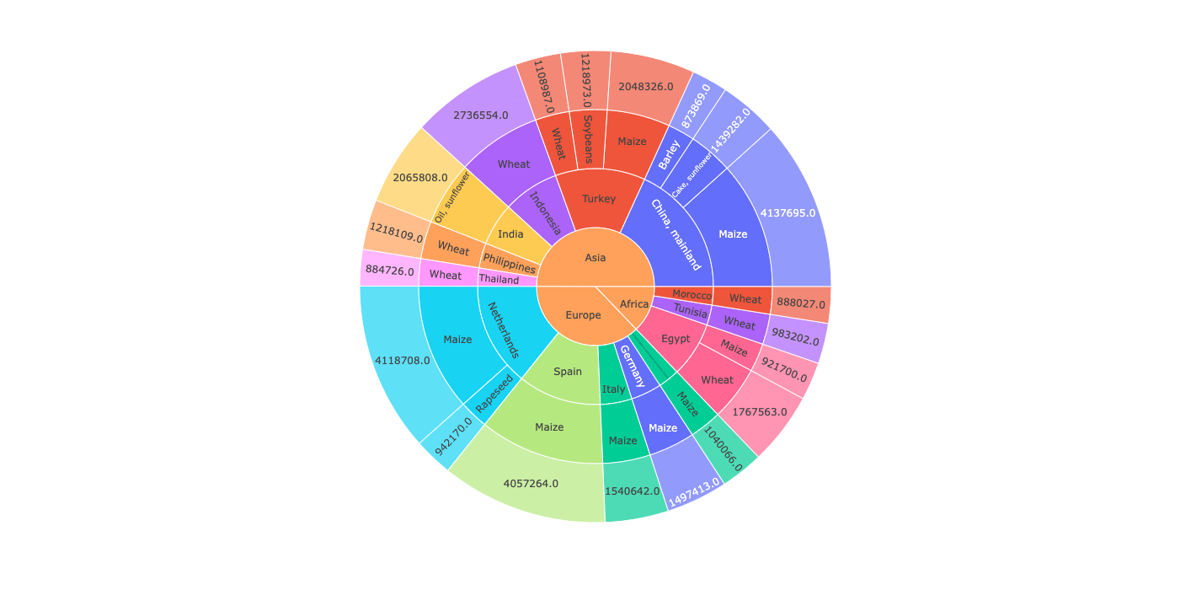
Export top 20 products (tonnes), by partner country

Slide 10
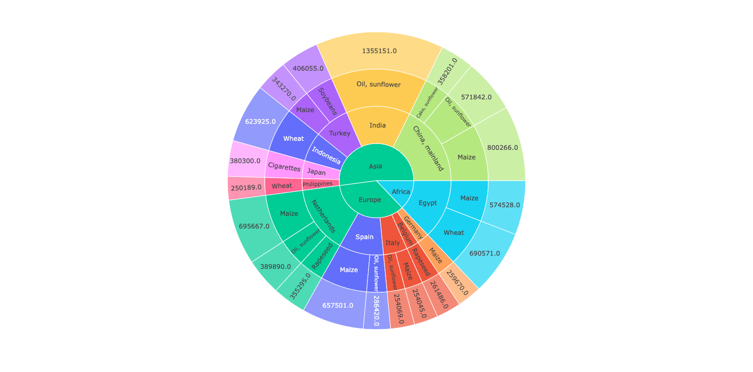
Export top 20 products (1000$), by partner country

Slide 11
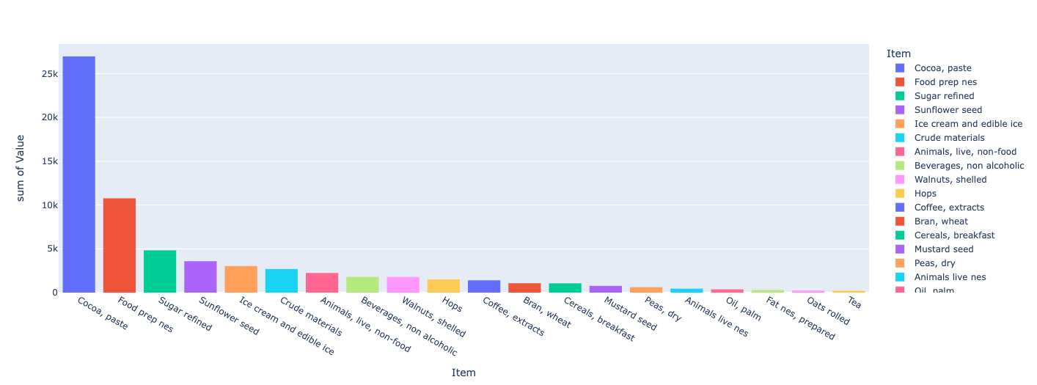
Export top 20 products(1000$), to Russia

Slide 12
CONCLUSIONS
Considering import quantities, the top five countries are: Russia, Poland, Turkey, Belarus and Indonesia.
When looking at the main import products, potatoes is the number one product for Russia and Belarus, palm oil for Indonesia, fruits for Turkey, and pig meat and poultry meat for Poland.
Considering import value, Poland and Russia lead this area. An important remark on the appearance of EU countries with manufactured import, such as Netherlands, Germany and Italy.
Considering export quantities, main combinations of top products and partners are: China (corn and barley), Netherlands (corn), Spain (corn) and Turkey (corn and wheat). Corn and wheat are the main exported products from Ukraine.
In terms of export value, main combinations of top products and partners are: China (corn), Netherlands (corn), Egypt (wheat and corn), India (sunflower oil) and Turkey (corn).
As we can see there is certain correspondence in export top products between its quantity and its value. That is not the case when taking in consideration import top products. In this case we can see the appearance of manufactured goods and its impact on Ukraine trade deficit.

