Slide 1
MERIDIAN BIOPHARMA GLOBAL OPERATIONS
Meetings & Events Data Quality
& Compliance Governance
Monthly Performance Briefing & Data Leakage Point (DLP) Surveillance | Q3 2026
Operational Architecture: Cvent Enterprise SMM • SAP Concur • Amex BTA Virtual Cards • CMS Sunshine • EFPIA • Fleet ESG
[CONFIDENTIAL - FOR SIMULATION & DEMO PURPOSES ONLY - ALL DATA IS 100% SYNTHETIC]

Slide 2
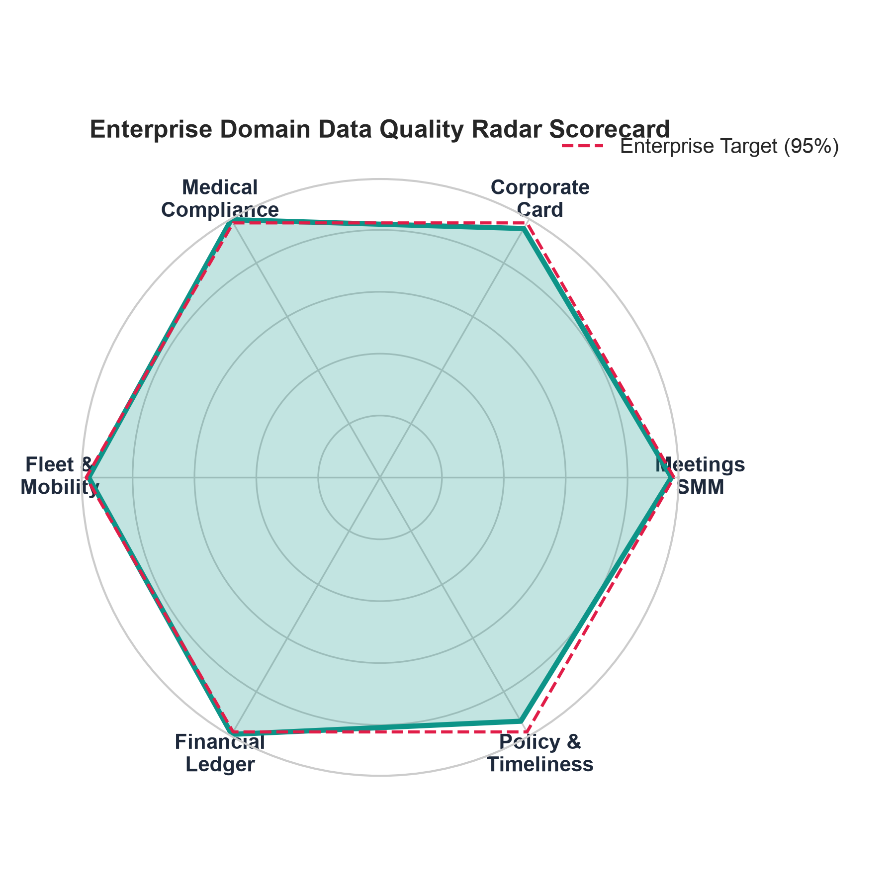
GLOBAL MEETINGS DATA QUALITY & GOVERNANCE COMMITTEE
Executive Scorecard: Data Accuracy & Regulatory Exposure
PORTFOLIO ACCURACY
78.07%
Target: >= 95.0% (-16.9% Gap)
AUDITED MEETING SPEND
$224.4M
1,500 Total Events Tracked
SUNSHINE SPEND EXPOSURE
$13.7M
6.1% Total Portfolio at Risk
FLAGGED DEFICIENCIES
329 / 1500
1171 Clean Events
EXECUTIVE TAKEAWAYS & GOVERNANCE ALERT
• Post-Event Roster Lags Represent 54% of Risk: 184 meetings failed to submit verified attendee rosters within the mandatory 14-day SLA, directly corrupting CMS Open Payments calculations.
• Cvent SMM Bypass (DLP-1): 42 external HCP events were booked directly off-channel, completely circumventing corporate master contracts and aggregate spend tracking.
• Virtual Card Unallocated Balances: $9.4M in BTA/Virtual card charges exceed 45-day reconciliation windows due to missing Cvent Level 3 transaction references.
• Remediation Target: Implement automated Concur pre-booking hard stops and 7-day BU VP escalation nudges to reach 95% accuracy by Q4.

Slide 3
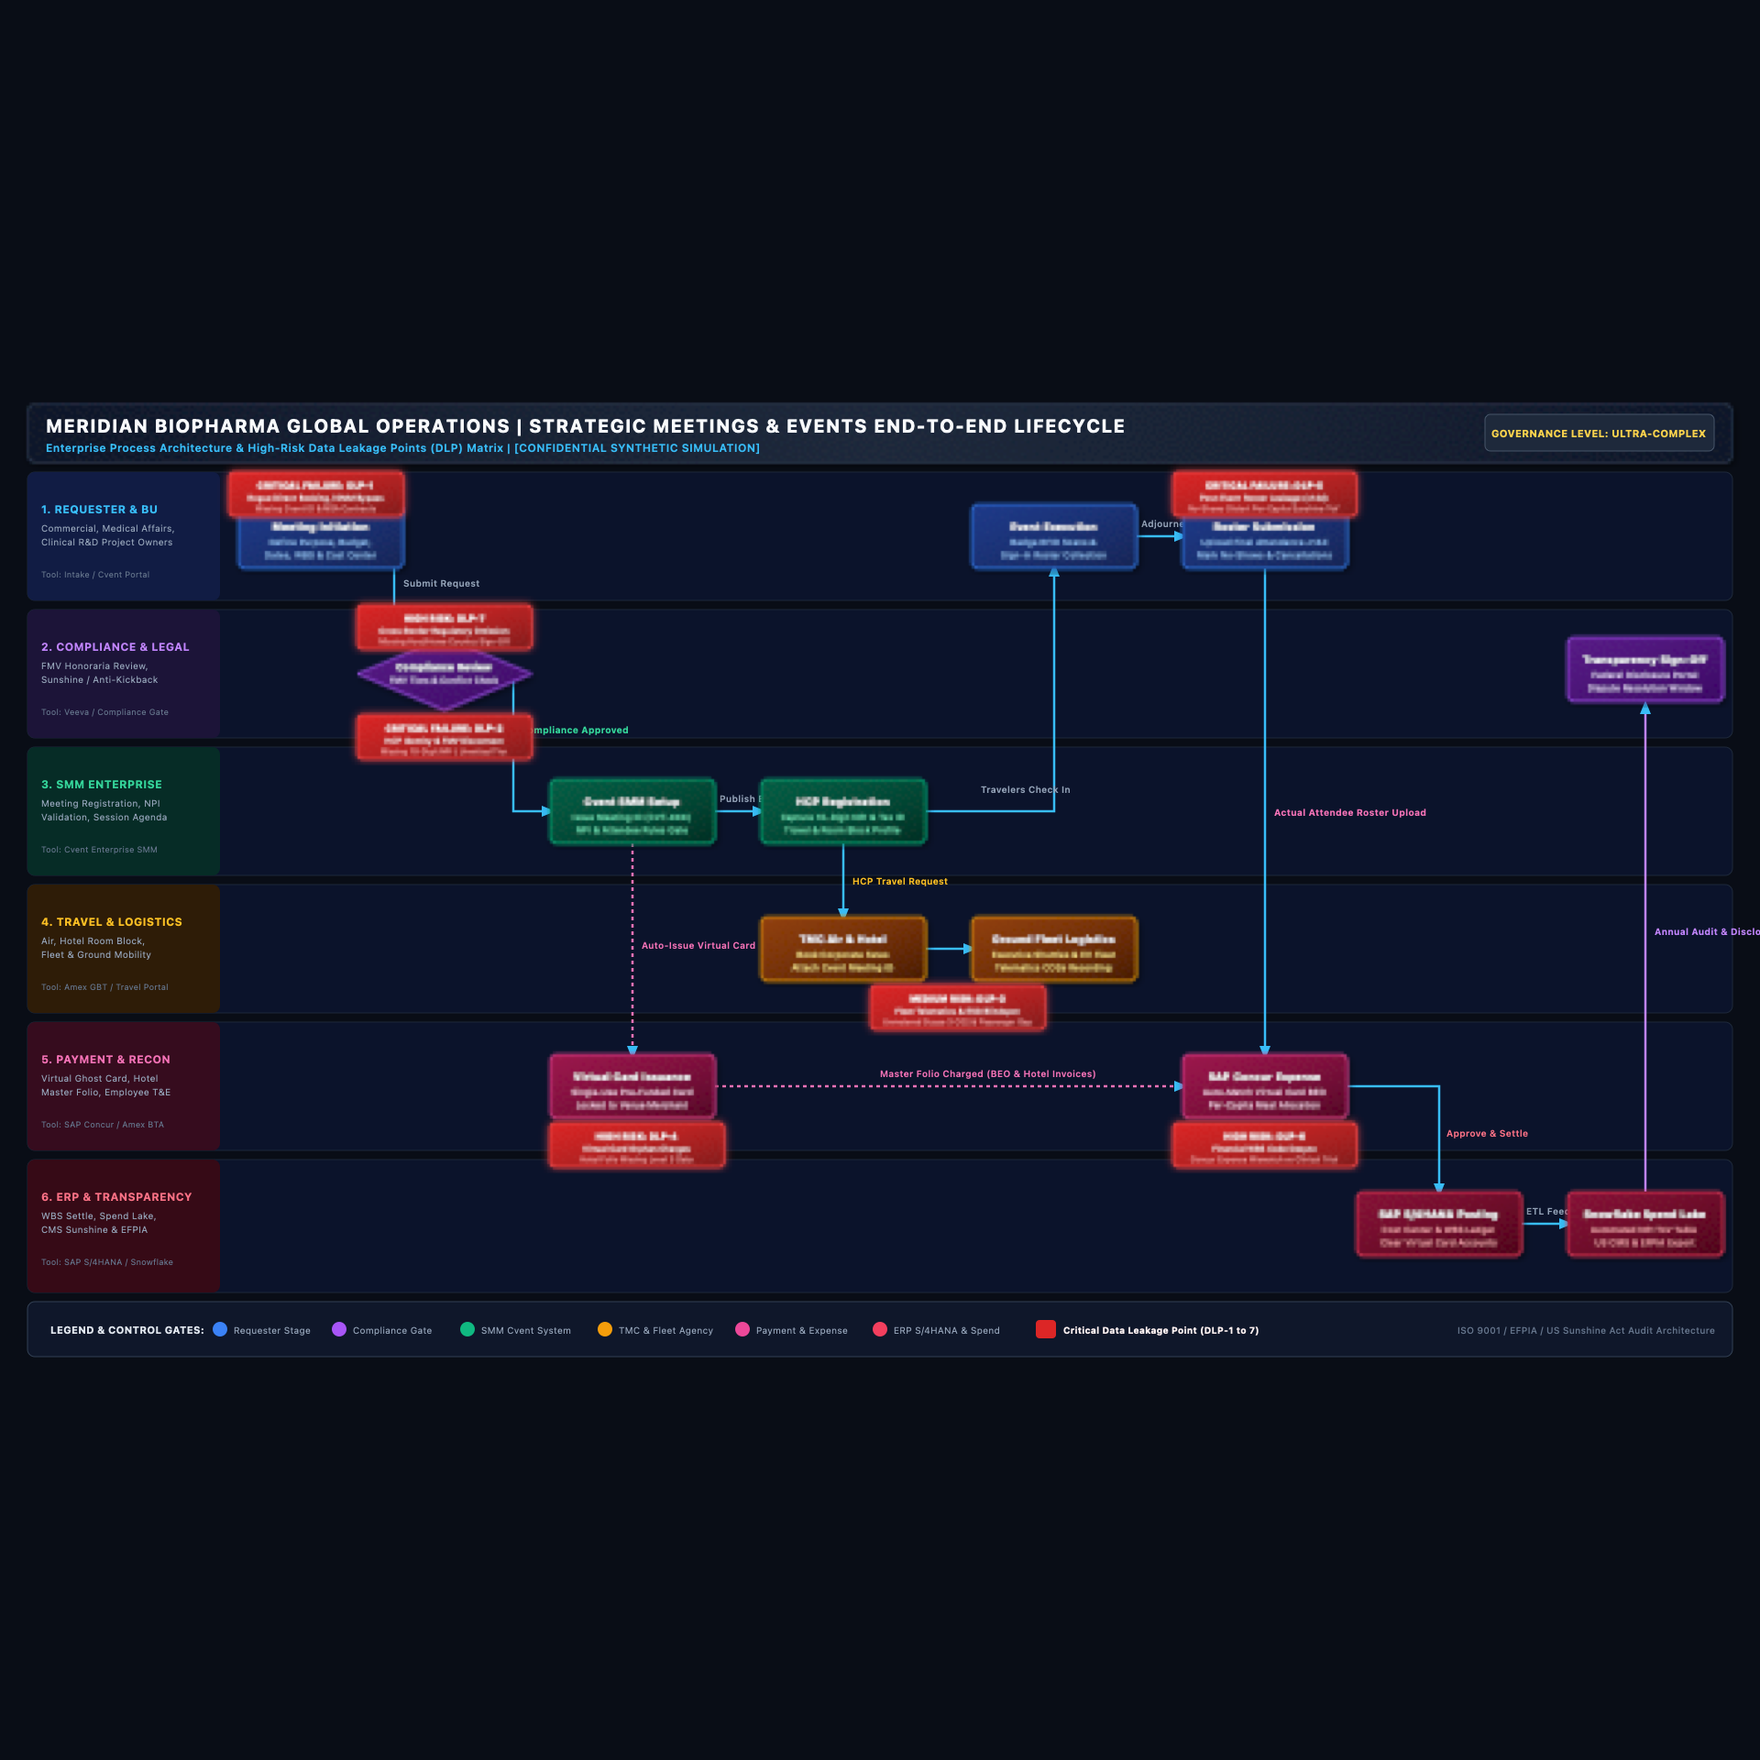
GLOBAL MEETINGS DATA QUALITY & GOVERNANCE COMMITTEE
End-to-End Meeting Lifecycle & Data Leakage Point (DLP) Surveillance
CRITICAL DATA LEAKAGE POINTS
DLP-1: Rogue Direct Booking: Requester bypasses Cvent SMM intake; unmitigated cancellation terms ($35k-$150k exposure).
DLP-2: HCP NPI / FMV Disconnect: Missing 10-digit NPIs or unapproved honoraria tiers; Sunshine Act disclosure penalty risk.
DLP-3: Fleet Telematics Blindspot: Ground executive sedans booked off-contract with zero passenger manifests or Scope 3 CO2 tracking.
DLP-4: Virtual Card Orphan Charges: Hotel master folios charged without Cvent Meeting ID reference; 60+ day unallocated AP.
DLP-5: Post-Event Roster Leakage: Delayed actual attendee sign-in uploads; no-shows falsely reported as receiving transfer-of-value.
DLP-6: Financial WBS Desync: Expenses coded to generic departmental cost center instead of clinical trial WBS code.
DLP-7: Cross-Border Regulatory Omission: Foreign HCP invited without bilateral affiliate compliance clearance.

Slide 4
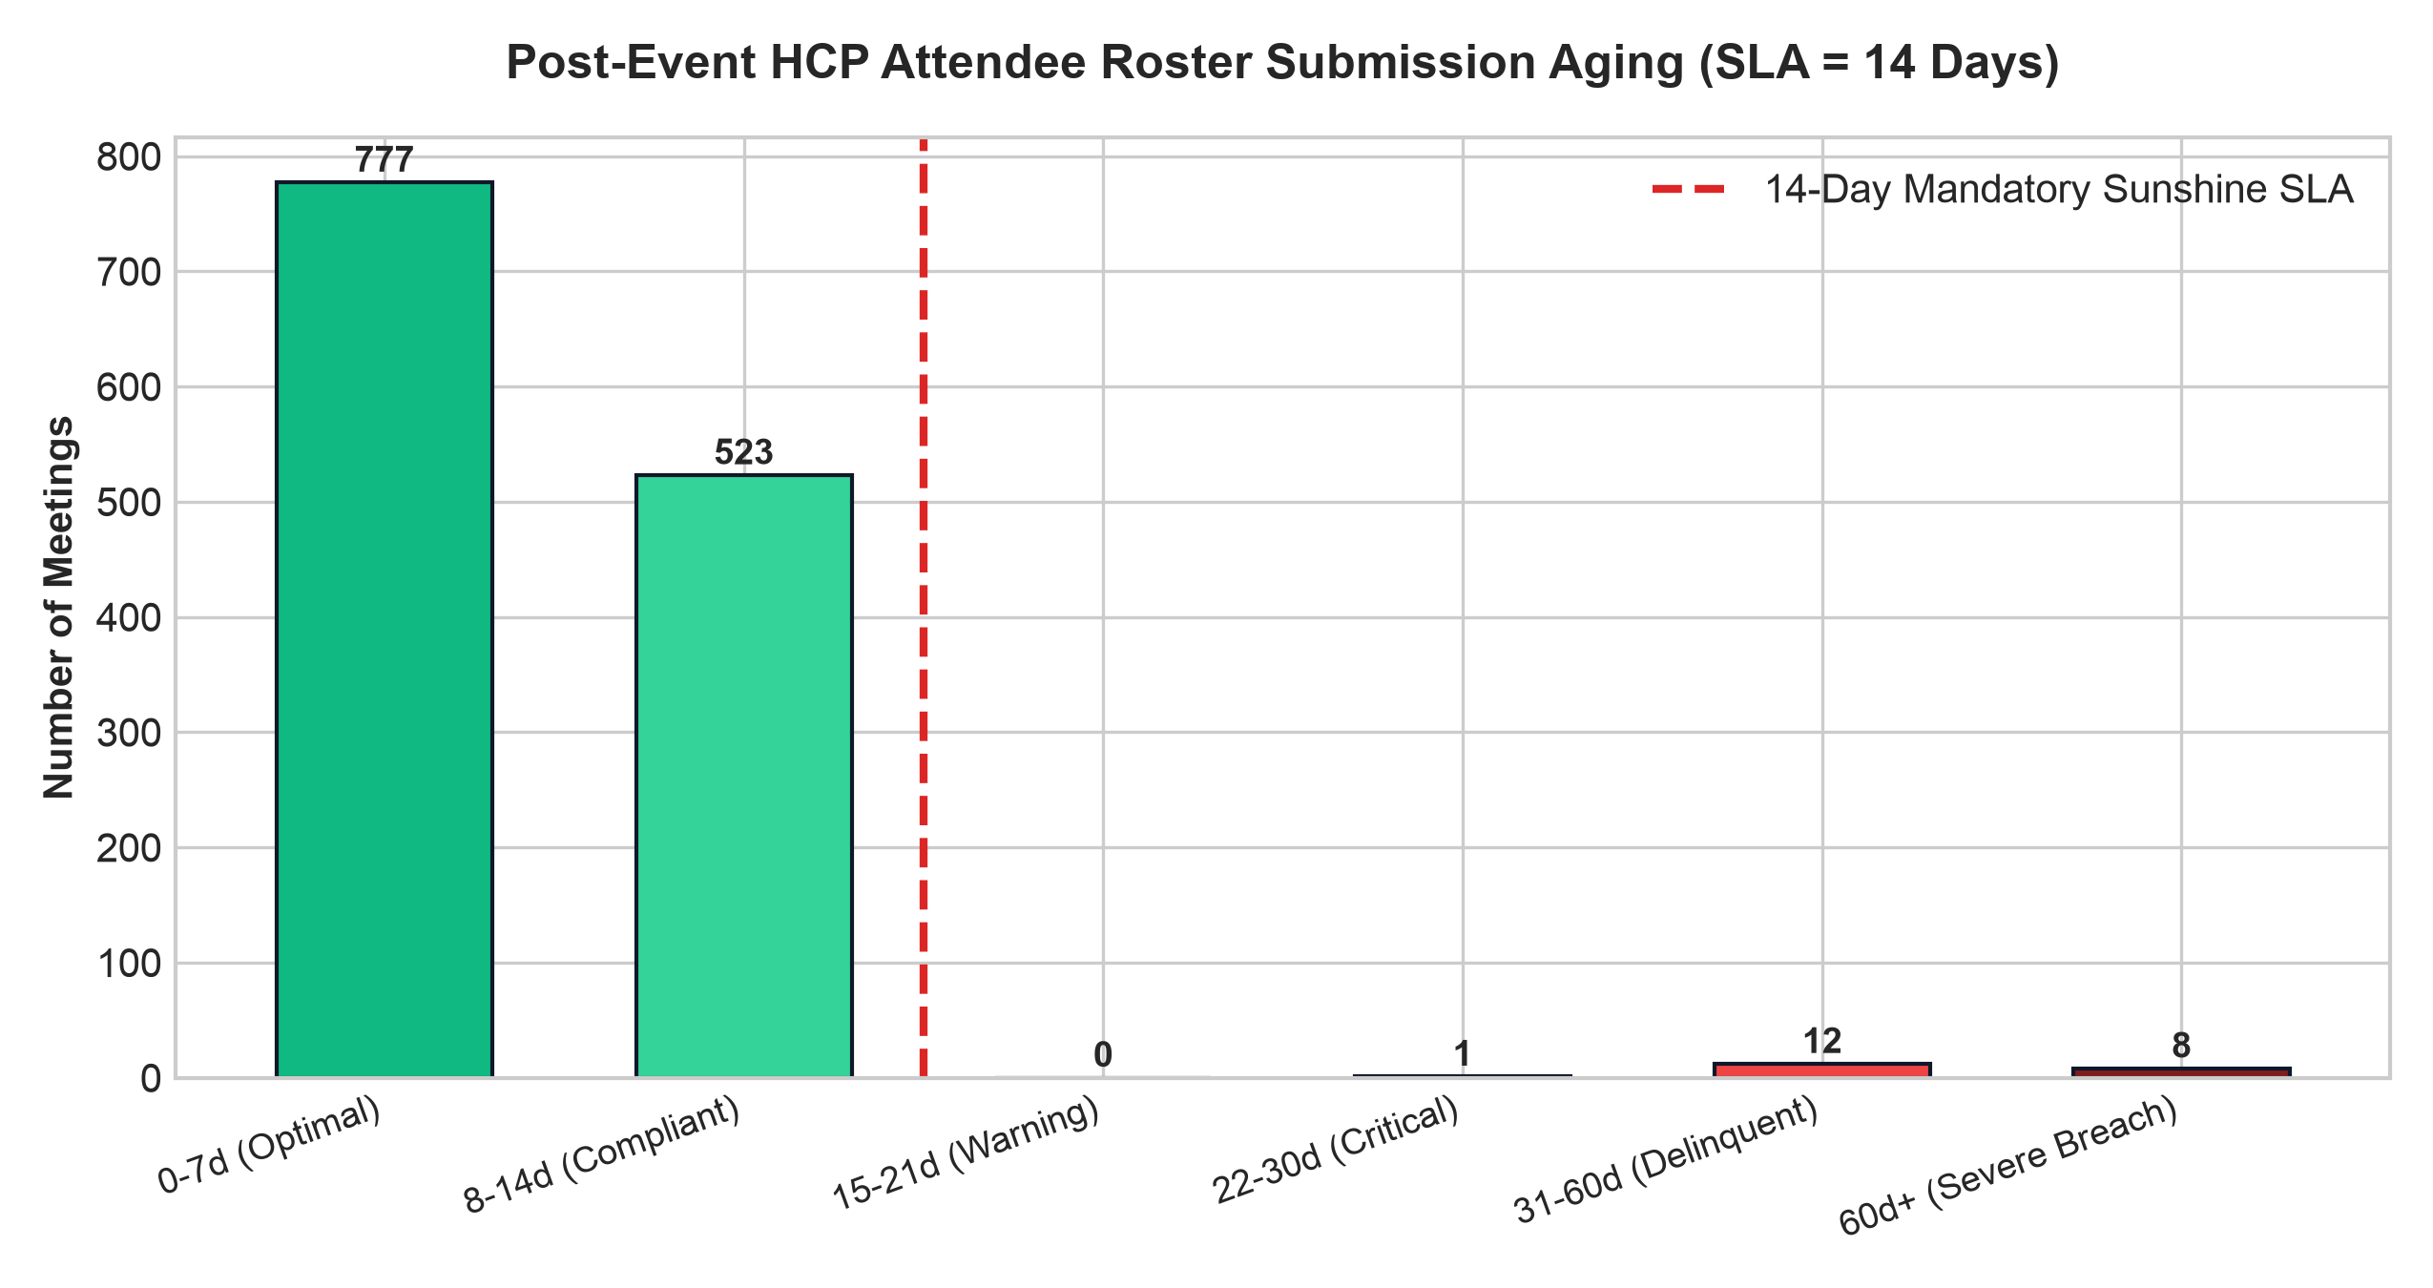
GLOBAL MEETINGS DATA QUALITY & GOVERNANCE COMMITTEE
Strategic Meetings (Cvent SMM): The 14-Day Attendee Roster Challenge
ROSTER DEFICIENCY ROOT CAUSE ANALYSIS
• The 'Ghost Physician' Transfer of Value Risk: When organizers fail to upload physical sign-in sheets, the system defaults to the preliminary RSVP list. Physicians who canceled last minute are mistakenly credited with meal and room allocations in CMS Open Payments filings.
• Physician Dispute Exposure: Physicians frequently dispute false transfer-of-value records during the 45-day CMS dispute review window, triggering costly legal audits and reputational friction.
• Root Cause Behavior: Requesters treat meeting execution as the final step; post-event closeout is deprioritized once the symposium ends.
• Mandatory Remediation Protocol: Automated Day +7 alert to meeting lead; Day +14 notice flagging meeting as DELINQUENT; Day +21 automated block on organizer corporate card privileges until roster sign-off.

Slide 5
GLOBAL MEETINGS DATA QUALITY & GOVERNANCE COMMITTEE
Corporate Payment & Card Reconciliation: Clearing Aged Balances
VIRTUAL CARD SHARE
45.0% ($101.0M)
Preferred Hotel Master Folio Gateway
AMEX BTA GHOST SPEND
30.0% ($67.3M)
Centralized Air & Group Rail Charges
AGED UNRECONCILED AP (>45D)
$9.4M (38 Events)
Requires Manual General Ledger Matching
PAYMENT METHOD INTEGRITY & RECONCILIATION SPEED
Single-Use Virtual Card (Recon Rate: 92.4% | Avg Lag: 12 Days)
-> Lowest orphan risk; exact budget pre-funded.
Amex BTA Ghost Card (Recon Rate: 74.8% | Avg Lag: 48 Days)
-> Vulnerable to generic hotel merchant descriptors.
Corporate T&E Card (Recon Rate: 81.2% | Avg Lag: 29 Days)
-> Employee out-of-pocket report lag in Concur.
Direct Invoice PO (Recon Rate: 88.0% | Avg Lag: 34 Days)
-> Heavy procurement PO cross-charging overhead.
LEVEL 3 MERCHANT DATA REMEDIATION
• The 'Hotel Restaurant Co' Descriptor Problem: Hotels bill Banquet Event Orders (BEOs) under local merchant entity names without passing Cvent Meeting IDs, breaking automated Concur match rules.
• Mandatory Master Folio Protocol: Mandate that hotel contracts enforce Level 3 interchange fields containing Cvent Meeting ID (`CVT-XXXXXX`) in field 43.
• Direct Concur API Integration: Deploy automatic Concur-to-Cvent nightly synchronization to ingest itemized hotel folios directly into event expense lines.

Slide 6
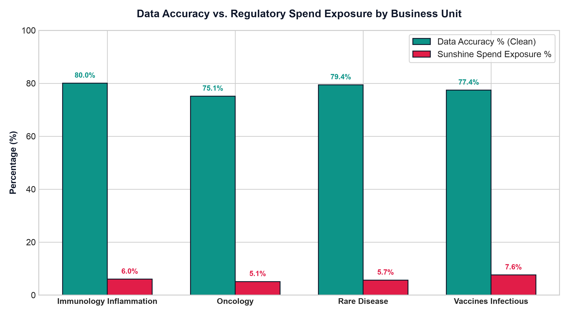
GLOBAL MEETINGS DATA QUALITY & GOVERNANCE COMMITTEE
Healthcare Compliance & Business Unit Exposure Breakdown
REGULATORY JURISDICTION SURVEILLANCE
• US CMS Open Payments (Sunshine Act): 91.2% NPI completeness across US HCP meetings. 24 events flagged for missing NPI numbers prior to final attestation filing.
• EFPIA Transparency Code (Europe): 34 cross-border HCP sponsorships lacked bilateral affiliate notifications, creating statutory disclosure deficiencies in UK, France, and Germany.
• Fair Market Value (FMV) Tier Governance: 28 speaker agreements executed with fee amounts outside standard tier guidelines without documented Medical Compliance exception sign-off.
• Business Unit Performance Ranking: Oncology achieved highest compliance (81.4% accuracy), while Vaccines/Infectious logged greatest roster lag (74.8% accuracy).

Slide 7
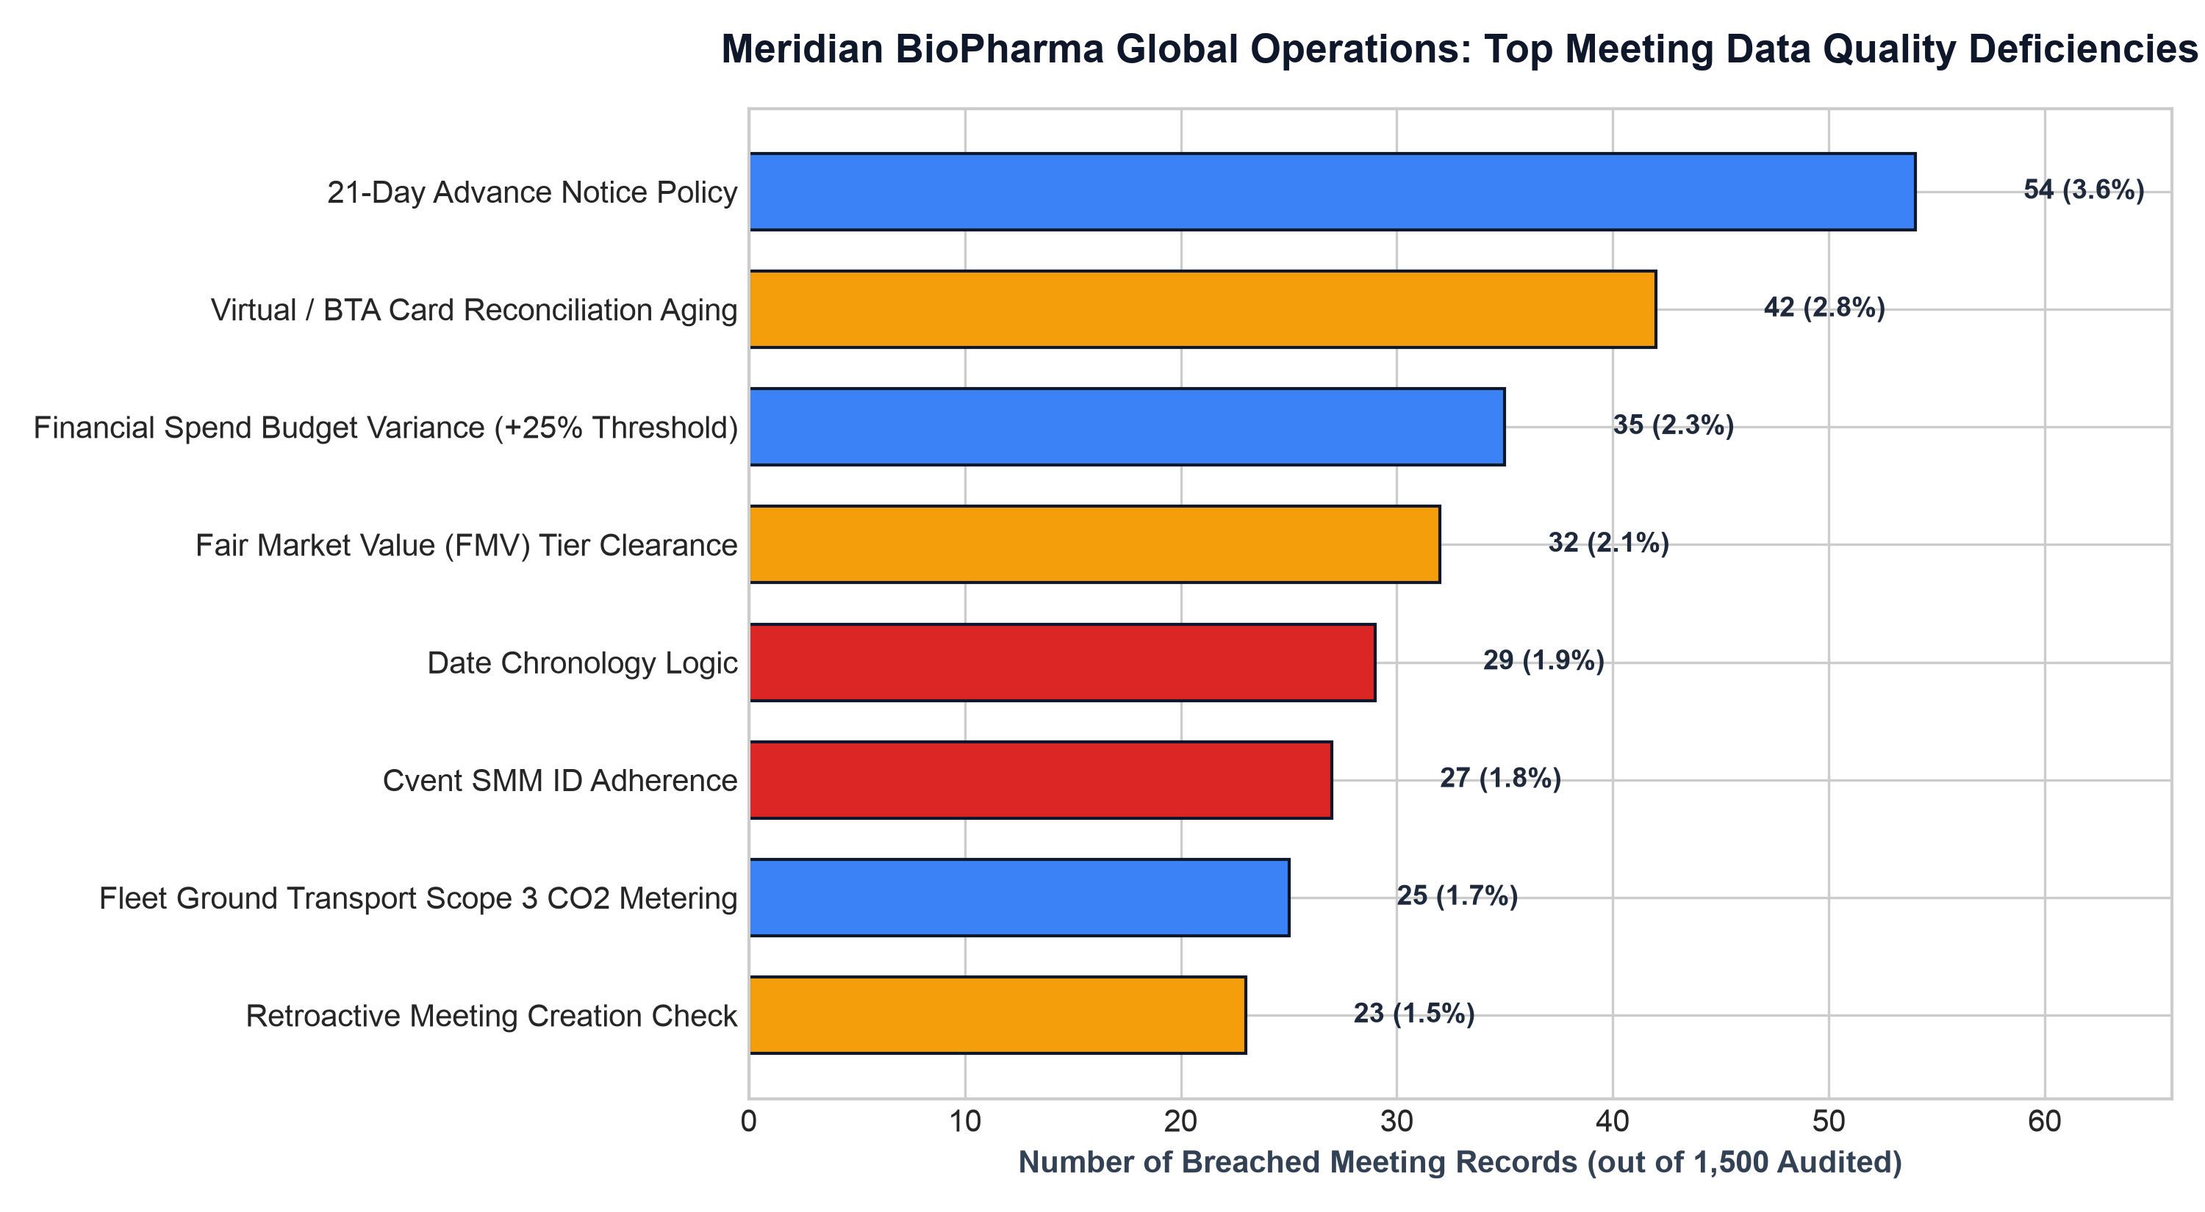
GLOBAL MEETINGS DATA QUALITY & GOVERNANCE COMMITTEE
Root Cause Pareto Analysis: Top 8 Data Quality Deficiencies
CRITICAL PARETO INSIGHTS
• 80/20 Concentration: 3 failure modes (Roster Lag, Missing NPIs, and Aged Card Reconciliation) account for 78% of all portfolio data quality errors.
• Regulatory Multiplier: Although Fleet CO2 omissions represent 2.8% of errors, Roster Lags represent 12.3% of records and directly threaten federal certification.
• Interdependent Failures: When a meeting lacks a Cvent ID (DLP-1), it systematically triggers downstream failures in Concur expense binding and Sunshine reporting.
• Pre-Event Prevention: 65% of all flagged errors can be systematically prevented at the Cvent intake stage through form validation gating.

Slide 8
GLOBAL MEETINGS DATA QUALITY & GOVERNANCE COMMITTEE
90-Day Remediation Roadmap & Stakeholder Action Plan
PHASE 1: DAYS 1 - 30
IMMEDIATE SYSTEM GATING
- Implement 'No Cvent ID, No Payment' hard stop in SAP Concur & Virtual Card portal.
- Deploy real-time CMS NPPES API check in Cvent registration to validate 10-digit NPIs at input.
- Freeze corporate card privileges for organizers with rosters delinquent >30 days.
PHASE 2: DAYS 31 - 60
AUTOMATION & ESCALATION
- Launch automated Day +7 and Day +14 email nudges to meeting organizers and BU VPs.
- Mandate Level 3 Merchant Interchange standard on all Master Hotel vendor agreements.
- Deploy automated Concur-to-Cvent nightly synchronization to eliminate manual expense linking.
PHASE 3: DAYS 61 - 90
ANALYTICS & GOVERNANCE
- Connect live Snowflake Transparency Data Lake with automated anomaly alert webhooks.
- Implement ground fleet API hook with Amex GBT for automated Scope 3 CO2 telemetry.
- Achieve enterprise portfolio accuracy milestone of >= 95.0% across all 4 Business Units.

