Slide 1
Deep Learning for Language Analysis
Deep Learning Introduction – Hands on
Institut für Digital Humanities | Johanna Binnewitt & Valmir Etemi | 09.-10.09.2019

Slide 2
Text Classification
1. Define Research Goal
Binary Sentiment Classification for movie reviews
2. Retrieve Data
ACL IMDb Dataset
Movie reviews divided into positive and negative categories
25.000 entries for training and 25.000 for testing
https://ai.stanford.edu/~amaas/data/sentiment/

Slide 3
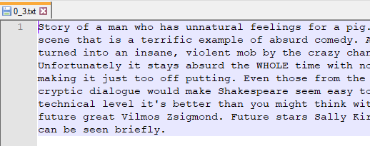
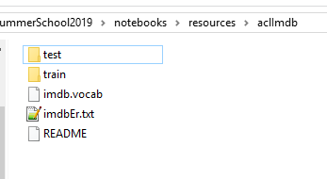
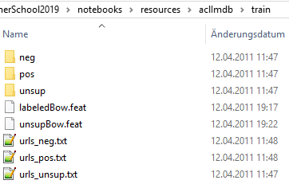

Text Classification
ACL IMDb Dataset

Slide 4
3. Prepare Data
Train/Val/Test Data
Train Data: to build the model
Validation Data: to validate/improve the model
Test Data: to evaluate the final model
Read .txt-Files from train folder into a Pandas Data Frame
split Data Frame into train (80%) and validation (20%) set

Slide 5
3. Prepare Data
Prepare Reviews
Goal: transform reviews (strings) into a suitable model
Method: Bag of Words
TF-IDF Vectorization
Binary Vectorization

Slide 6
3. Prepare Data
Prepare Labels
Label as output of the Neural Net
One-Hot-Encoding

Slide 7
4. Explore Data
Statistics: How many positive and negative reviews?
Representative Data
Iterativer Prozess: stimmen meine Daten? Wenn nein, retrieve Data

Slide 8
5. Model Data
Goal: Binary Classification

Slide 9
6. Improve Model
Classify some „unseen“ reviews from the evaluation set
Evaluate Neural Net
(Confusion Matrix)
Evaluation Values (Precision, Recall)

