Slide 1
Deep Learning for Language Analysis
Deep Learning Introduction
Institut für Digital Humanities | Johanna Binnewitt & Valmir Etemi | 09.-10.09.2019

Slide 2
Introduction
What are you going to learn?
Brief introduction to Machine Learning
Neural Network Architectures
Implementing Neural Networks in Keras

Slide 3
Introduction
Which technologies are we going to use?
Python
Keras
Jupyter Notebook
… in a Docker Container

Slide 4
Schedule
Time | Monday, September 09 | Tuesday, September 10
09:00 |  | Neural Network Architecture
10:30 |  | Coffee Break
11:00 |  | Tuning the Neural Network
12:30 |  | Lunch Break
14:00 | Welcome / Introduction | Hands on: Text Classification
15:30 | Coffee Break
16:00 | Introduction / Setup | Parallel Session Presentation
17:00 | Closing | Closing

Slide 5
Data Pipeline
Define Research Goal
Retrieve Data
Prepare Data
Explore Data
Model Data
Improve Model

Slide 6
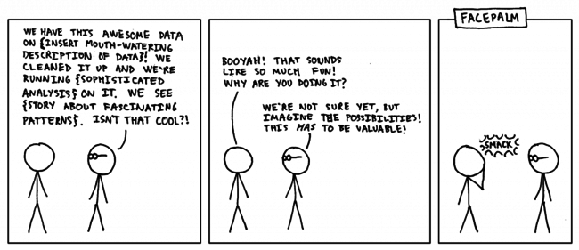
Data Pipeline 1. Define Research Goal
https://medium.com/the-data-experience/building-a-data-pipeline-from-scratch-32b712cfb1db
Notes:
Just because we technical can do it doesn‘t mean that we should do research on it

Slide 7
Data Pipeline 2. Retrieve Data
Depending on your research area
Example repositories:
https://archive.ics.uci.edu/ml/datasets.php
https://www.kaggle.com/datasets
Collect own data
Notes:
Depending on your research question you could either search for existing data sets. Or maybe you collected data by yourself that you want to analyze

Slide 8
Data Pipeline 3. Prepare Data
Data cleansing: remove false, inconsistent or unnecessary data)
Data integration: enrich data with other sources
Data transformation: transform data into suitable format
How to transform text data into a model?
Notes:
Data Transformation: e.g. transform csv to data frame

Slide 9
Data Pipeline 3. Prepare Data
Types of Data
Structured data (e.g. SQL Databases)
Semi-structured data (e.g. CSV files)
Unstructured data (e.g. text files)
Sources of Data
Machine generated (e.g. server log files)
Natural Language
Audio, video, images
Streaming

Slide 10
Data Pipeline 3. Prepare Data
Types of Data
Structured data (e.g. SQL Databases)
Semi-structured data (e.g. CSV files)
Unstructured data (e.g. text files)
Sources of Data
Machine generated (e.g. server log files)
Natural Language
Audio, video, images
Streaming

Slide 11
Data Pipeline 4. Explore Data
Understand retrieved data
How do variables interact?
Methods: descriptive statistics, plotting and simple modelling

Slide 12
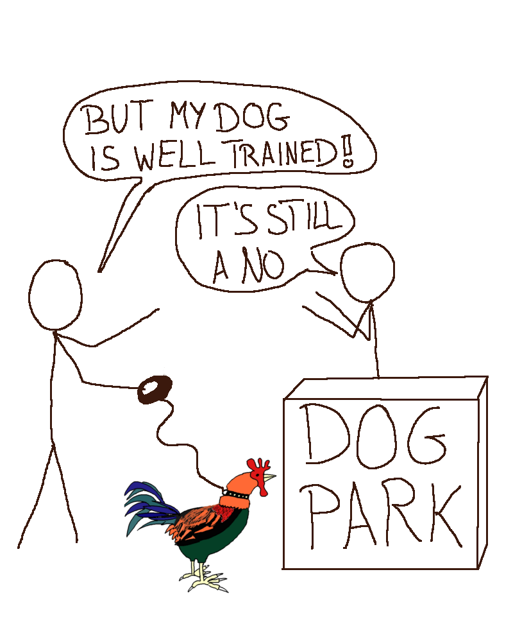
Data Pipeline 5. Model Data
Build a model which suits your research goal
Models should depend on the task you want to solve
https://bentoml.com/posts/2019-04-19-one-model/

Slide 13
Data Pipeline 5. Model Data
ML Task: Clustering
Example Goal: grouping tweets on similar topics
Source
Time
“Words”
Involved twitter users
…
Fancy ML-Model
Similar Tweets
/
Separated from dissimilar tweets
Notes:
We have different tasks that can be solved by Machine Learning. 3 examples:

Slide 14
Data Pipeline 5. Model Data
ML Task: Classification
Example Goal: predict heart disease for a person
Age
Cholesterol Level
Heart Rate
Fitness Level
…
Fancy ML-Model
Probability for Heart Disease

Slide 15
Data Pipeline 5. Model Data
ML Task: Regression
Example Goal: estimating real estate values
Number of bathrooms
Distance supermarket
Year of construction
Distance primary school
….
Fancy ML-Model
House Value

Slide 16
Data Pipeline 5. Model Data
Each problem can be solved by different ML Models
K-Means:
Solves clustering problems
Iteratively adjusts the centroid of a cluster
Naïve Bayes:
Solves (binary) classification problems
Predicts a label by taking the appearance of a specific feature into account

Slide 17
Data Pipeline 5. Model Data
Each problem can be solved by different ML Models
Neural Network:
Solves ,i.a., regression problems
Weights all features according to how they influence the predicted output value

Slide 18
Data Pipeline 6. Improve Model
Evaluate the results of your model
Change configurations to improve the results
Input variables
Model configuration (number of clusters or number of layers or …)
Whole Model

