Slide 1
Deep Learning for Language Analysis
Deep Learning Introduction – Technical Introduction
Institut für Digital Humanities | Johanna Binnewitt, Valmir Etemi | 09.09.2019

Slide 2
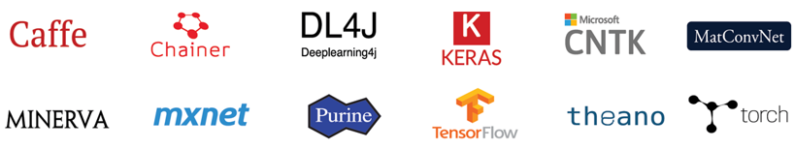
How do I get started with DL?

Slide 3




Tools and Framework

Slide 4
Tools and Frameworks
Why Docker? From the Homepage….
Flexible: Even the most complex applications can be containerized
Lightweight: Containers leverage and share host kernel
Interchangeable: Deploy updates and upgrades on-the-fly
Portable: Build locally, deploy to the cloud, and run anywhere
Scalable: Increase and automatically distribute container replicas
Stackable: Stack services vertically on-the-fly

Slide 5


Tools and Frameworks
Container vs. Virtual Machine
Source: https://docs.docker.com/get-started/

Slide 6
Tools and Frameworks
Why Jupyter Notebook?
Browser based environment for coding
Ad hoc coding
Learn and try out Python
Contains: Live Code, Visualizations, explanatory text

Slide 7
Tools and Frameworks
Why Keras?
Quickly train and test model
Nice and easy to use API
Wraps multiple frameworks
(Simplified) interface to Theano, CNTK or TensorFlow
TensorFlow is default API

Slide 8
How do I build a Neural Network in Keras?
Pipeline
Define Network
Compile it
Fit it
Evaluate it
Make Predictions

Slide 9
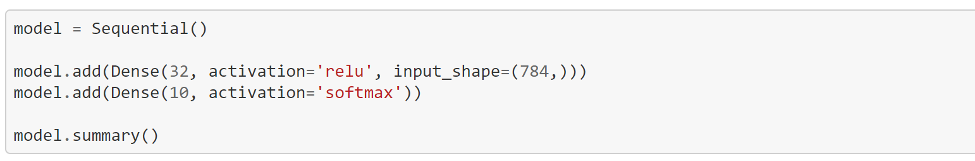
How do I build a Neural Network in Keras?
Define Network
Create an instance of the sequential class
Define sequence of layers
Add new lines (each line is a new layer)
First Layer: number of inputs (can differ depending to the network type)

Slide 10
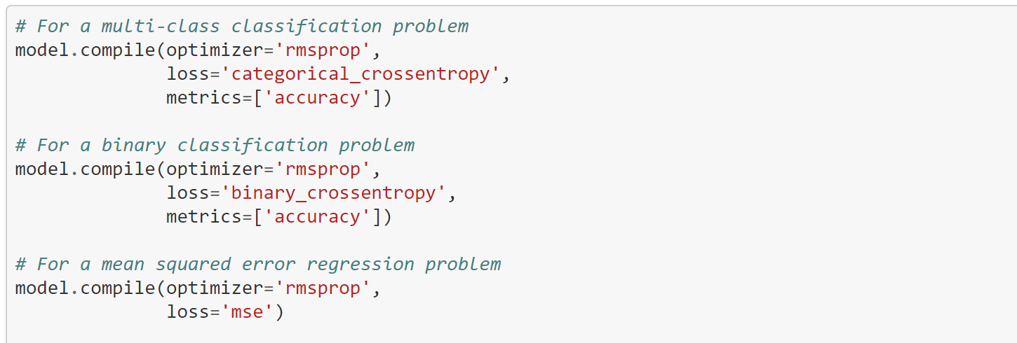
How do I build a Neural Network in Keras?
Compile it
Transforms a simple sequence of layers into a highly efficient series of matrix transforms
Intended to be executed on the GPU (depending on the configuration set)
Optimization: Train the network
Loss Function: Evaluate the network

Slide 11
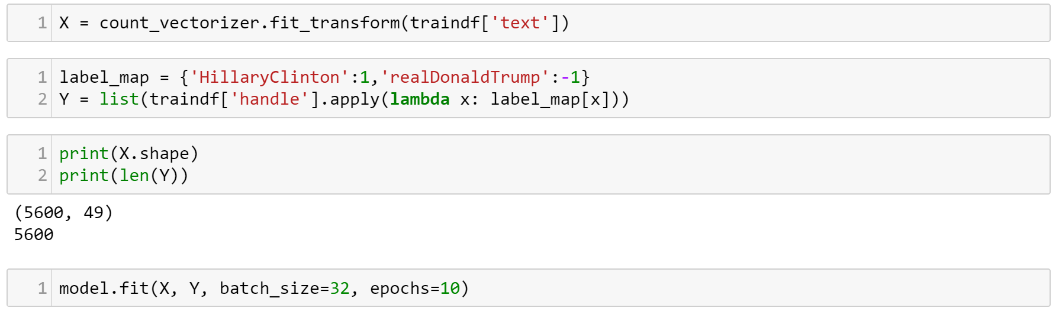
How do I build a Neural Network in Keras?
Fit Network
Adapting the weights of the training data set
Input X => Matrix of input patterns
Output Y => Array of matching output patterns

Slide 12
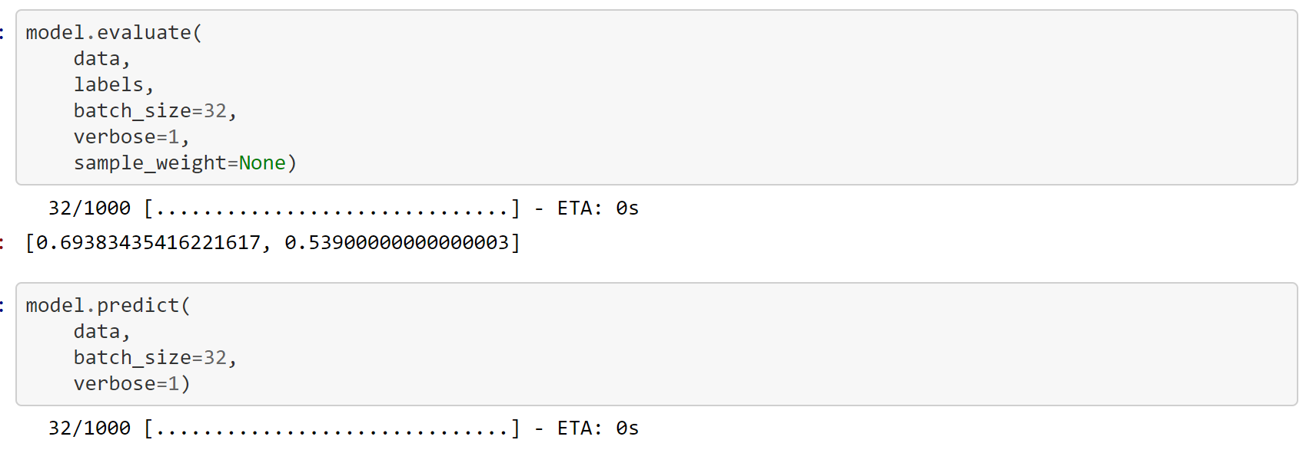
How do I build a Neural Network in Keras?
Evaluate Network and use it to make predictions
How good does model work? Evaluate it!
  Input X => Matrix of input patterns (test data)
  Output Y => Array of matching output patterns (test data)

Slide 13
Tools and Frameworks
Documentation and Code
Download: https://github.com/DH-Cologne/SummerSchool2019
Or Git clone if you have Git installed

