Slide 1
Deep Learning for Language Analysis
Deep Learning Introduction – Neural Network Basics
Institut für Digital Humanities | Johanna Binnewitt, Valmir Etemi | 10.09.2019

Slide 3
Introduction

Slide 4
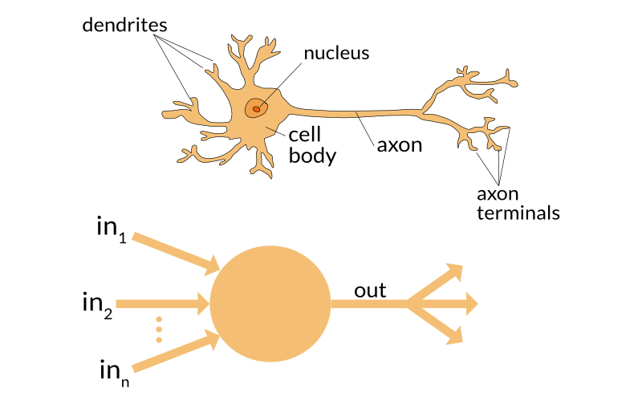
Introduction
Biological Inspiration
Source: https://towardsdatascience.com/the-differences-between-artificial-and-biological-neural-networks-a8b46db828b7

Slide 5
Introduction
Brief History
1943 First Perceptron Model developed
1960s AI was considered to replace all human activity
But too less data and low hardware stopped early progression
1990s starting to grow again due to more available data, better hardware and more efficient networks
Is this only the next hype of AI?
We‘ll see...

Slide 6
Perceptron

Slide 7
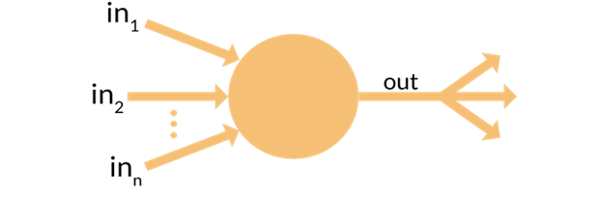
Perceptron
Components
Input
Weight
Prediction
Output
Optimization

Slide 8
Perceptron
INPUT – General
Inputs must be numerical values
If data is not represented as numerical values they must be transformed into numbers
In order to train the Perceptron the class is needed for every data
Most of the time each entry is eventually represented as vector with different values

Slide 9
Perceptron
INPUT – Example
Perceptron should learn if a patient has illness based on blood values, i.e. binary classification problem (sick or not sick)
Blood values of a patient:
Input_1 = Amount of Iron
Input_2 = Amount of White Blood Cells
Input_3 = Amount of Sugar
Vector Components: { Input_1, Input_2, Input_3 }
Train Data could be as following:
Patient_1 = { 1, 0, 1 } => Class 1 (sick)
Patient_2 = { 1, 1, 1 } => Class 0 (not sick)
…

Slide 10
Perceptron
WEIGHTS – General
Each input type has its own weight
The weights are used to calculate the output class
They are also represented as vector
If weights lead to wrong class then they need to be adjusted
The adjustment will go on until the correct output class for a vector is calculated
But what are the intial values?
Most of the time semi-randomly generated

Slide 11
Perceptron
WEIGHTS – Example
Input types are blood values of patients (Input_1, Input_2, Input_3)
Each input type is connected to one weight
3 input types => 3 different weights

Slide 12
Perceptron
PREDICTION – General
The calculation is based on the dot product of the input vector and the weights vector
The result is something between 0 and 1

Slide 13
Perceptron
PREDICTION - Example
Patient_1 has following blood values:
Input_1 = 2 (Amount of Iron)
Input_2 = 3 (Amount of White Blood Cells)
Input_3 = 2 (Amount of Sugar)
Vector = { 2, 3, 2 }
Intial weights = { 0.5, -0.2, 0.1 } (randomly generated)
Calculation = 2 * 0.5 + 3 * (-0.2) + 2 * 0.1 = 0.6

Slide 14
Perceptron
OUTPUT – General
The output is the result of the dot product and an activation function.
Determines the class
Activation functions can be super simple functions, e.g. thresholds or more complex ones, e.g. Sigmoid

Slide 15
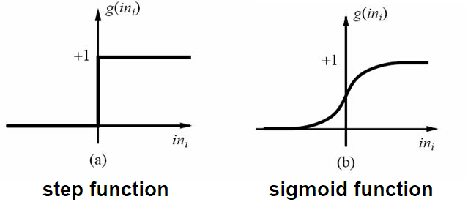
Perceptron
OUTPUT – General

Slide 16
Perceptron
OUTPUT – Example
Vector = { 2, 3, 2 }
Intial weights = { 0.5, -0.2, 0.1 } (randomly generated)
Calculation = 2 * 0.5 + 3 * (-0.2) + 2 * 0.1 = 0.6
Threshold = 0.5
Class predicted is = 0.6 > 0.5 => 1 (patient is sick)

Slide 17
Perceptron
OPTIMIZATION - General
If calculation of prediction outputs a wrong class
Then the weights have to be adjusted in order to calcuate the correct class
If the predicted class > actual class, then decrease weights
If the predicted class < actual class, then increase weights
Optimizer functions can also be simple, e.g. Hebbian Learn Rule or very complex

Slide 18
Perceptron
OPTIMIZATION - Training
Hebbian Learn Rule:
Weight Adjustment = Learning Rate * Input Value * Error
Learning Rate is a Hyperparameter
The higher the rate the faster the perceptron adapts to new values but forgets faster already learned insights
Error is calculated as the following:
Error = Target Class – Predicted Class

Slide 19
Perceptron
OPTIMIZATION – Example
Vector = { 2, 3, 2 }
Intial weights = { 0.5, -0.2, 0.1 } (randomly generated)
Calculation = 2 * 0.5 + 3 * (-0.2) + 2 * 0.1 = 0.6
Threshold = 0.5
Class predicted is = 0.6 > 0.5 => „1“ (patient is sick)
Target class is = „0“ (patient is not sick)
Error = 0 (Target) – 1 (Result) = -1
Learning Rate = 0.02
Adjustment for Input_1 and Weight_1 = 0.02 * 2 * (-1) = -0.04
New Weight_1 = 0.5 (Old weight) – 0.04 (Adjustment) = 0.46
Weights before: { 0.5, -0.2, 0.1 }
Weights after: { 0.46, -0.26, 0.06 }

Slide 20
Multi Class Perceptron

Slide 21
Multi Class Perceptron
Multi Class Problem
Previously only two classes: „0“ or „1“ (Sick – Not Sick, Spam – No Spam, etc.)
Example for Multi Class Problem:
Image Recognition
Each picture (dog, cat, mouse, etc.) equals to one class

Slide 22
Multi Class Perceptron
From Binary to Multi?
Is it possible to use perceptrons for multiple classes?
If not, what could we change to make it work?

Slide 23
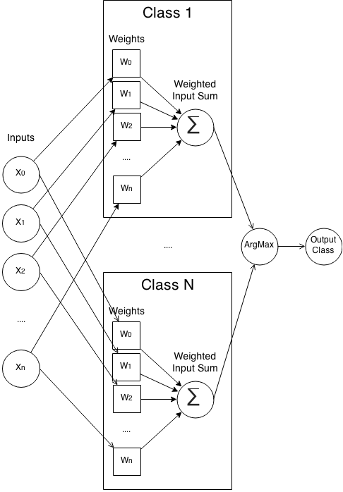
Multi Class Perceptron
General

Slide 24
Multi Class Perceptron
CALCULATION
Each class is one perceptron and will be trained separately
That is, each class/perceptron has its own set of weights to train
Calculation remains the same

Slide 25
Multi Class Perceptron
INPUT
The whole input will be trained with each class weight set

Slide 26
Multi Class Perceptron
PREDICTION
Results of each class weight calculation will be compared
The class with the highest calculation is the class of prediction (ArgMax Function)

Slide 27
Multi Class Perceptron
TRAINING
But how do we train now?

Slide 28
Multi Class Perceptron
TRAINING
If the prediction is wrong, the weights of the predicted class have to be decreased for the particular input
Weights of correct (but not predicted) class have to be adjusted upwards

Slide 29
Multi Layer Perceptron

Slide 30
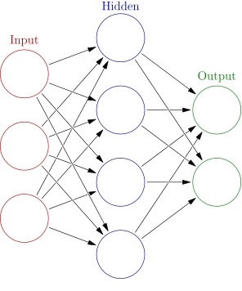
Muli Layer Perceptrons
Structure of Multi Layer Perceptrons (aka Neural Networks)
Multi Class Perceptrons have one hidden layer where all the calculations is done
For more complex problems neural networks with several layers have been developed (and nowadays called „deep“)
Source: https://en.wikipedia.org/wiki/Artificial_neural_network

Slide 31
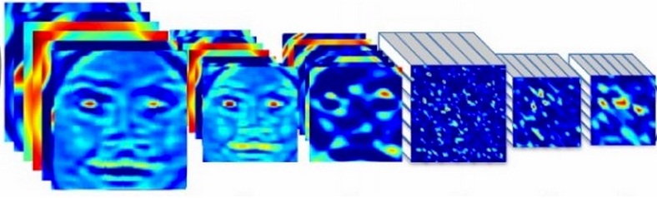

Muli Layer Perceptrons
Example for Deep Learning – Convolutional Neural Network
…
Dog?
…
Human?
…
...?
Convolution/Pooling Neurons
Fully-connected Neurons
Input

Slide 32
Muli Layer Perceptrons
Recurrent Neural Network
Recurrent Neural Network (RNN) as model
RNNs have a „memory“
Takes not only input into calculation for each neuron but also the result of previous neurons
Much more like the human brain (reading, speaking, etc.)

Slide 33
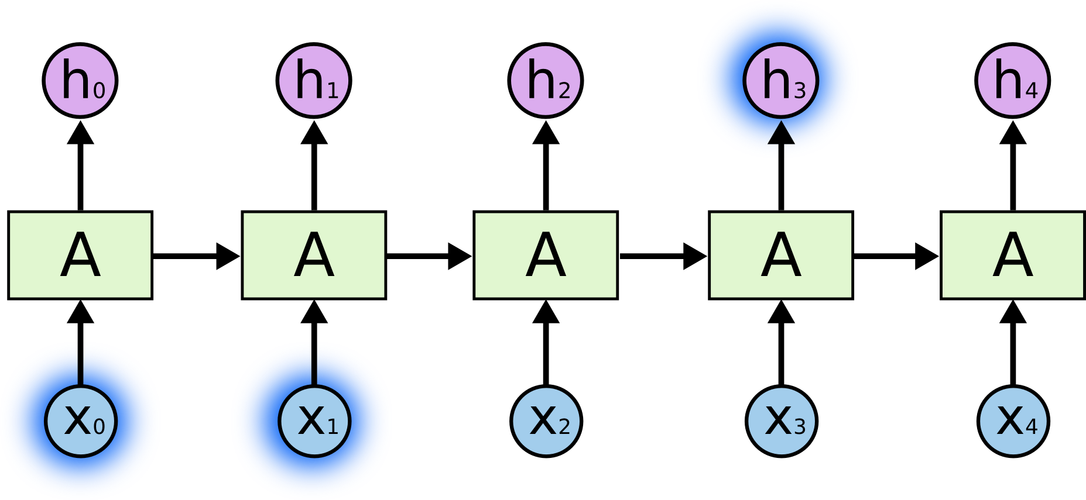
Muli Layer Perceptrons
Recurrent Neural Network – Remember previous
Source: https://colah.github.io/posts/2015-08-Understanding-LSTMs/

Slide 34
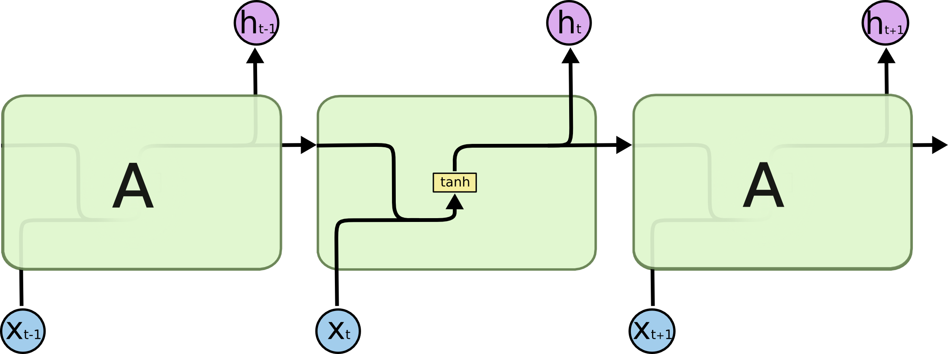
Muli Layer Perceptrons
Recurrent Neural Network – Internal Calculation

Slide 35
Summary

Slide 36
Neural Network Basics
Summary and terms
Input: Numerical vectors or matrices
Activation: Can be a threshold or other functions to determine if Neuron fires or not („0“ or „1“)
Learning rate: Determines how fast an algorithm should adjust to new data. A high learning rate adjusts better and faster to new data but also discards learned insights
Optimizer: Function to optimize model (i.e. weights)
Epochs: An epoch is a whole iteration of than one iteration of all data to have an optimal model for the given problemall input data. Algorithms need more
Batches: Sometimes data is too big to put fully into RAM. Then it needs to be processed into data slices (aka batches).
Overfitting: If model adapts perfectly on training data but not on new unseen data, then we talk of overfitting. It is like remebering by heart
Regularization: Goal is to use as less variables for a model as possible to prevent overfitting, e.g. by dropping out a fixed number of neurons

