Slide 1
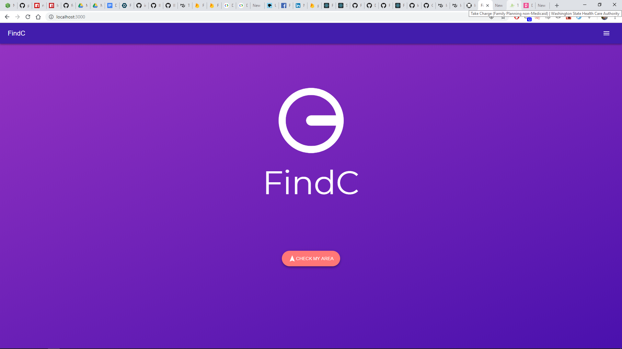
The problem
What is the problem?
Access to information about free or discounted contraceptives
Ryan Yang
William Kwok
Access to information about free or discounted contraceptives

Slide 2
The problem
Access to information about free or discounted contraceptives

Slide 3
Why is it a problem?
The problem
Access to information about free or discounted contraceptives
Usage likely prevents over 272,000 maternal deaths a year (Johns Hopkins Bloomberg School of Public Health)
Usage is linked to a better quality of life for women (Planned Parenthood)
Advances the economy for everyone (Planned Parenthood)

Slide 4
Why this issue?
Why is it a problem?
Personal connections
Huge problem in the world
Usage likely prevents over 272,000 maternal deaths a year (Johns Hopkins Bloomberg School of Public Health)
Usage is linked to a better quality of life for women (Planned Parenthood)
Advances the economy for everyone (Planned Parenthood)

Slide 5
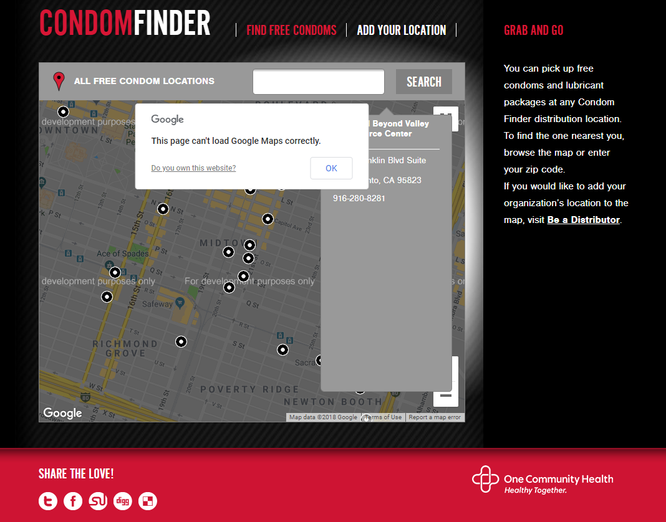
Existing Solutions?
Poor implementation
Insecure
Non-inclusive
Inaccessible
http://www.condomfinder.org/find.php

Slide 6
Existing Solutions?
Existing Solutions
Poor implementation
Insecure
Non-inclusive
Inaccessible
http://www.condomfinder.org/find.php

Slide 7
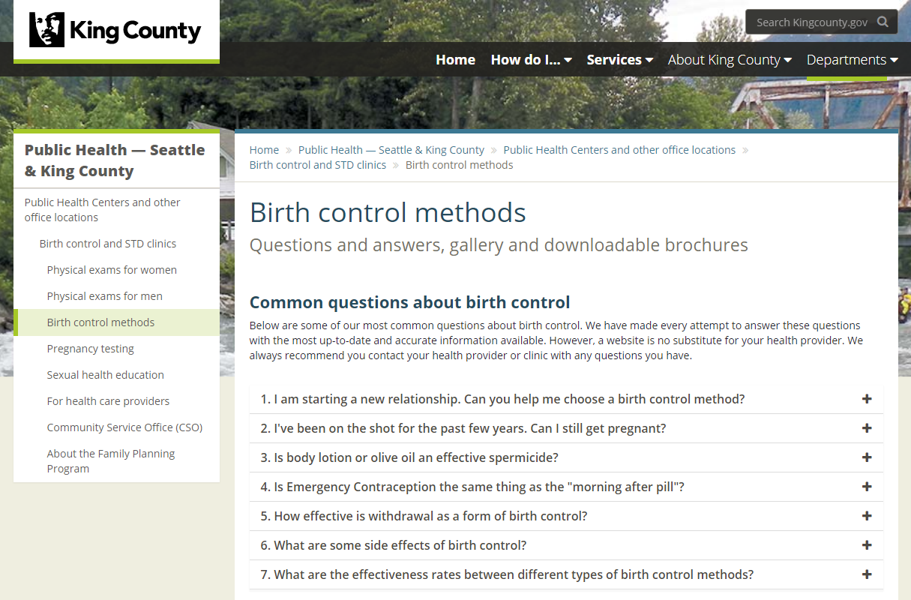
Existing Solutions
Poor implementation
Insecure
Non-inclusive
Inaccessible
Localized
Difficult to parse
https://www.kingcounty.gov/depts/health/locations/family-planning/birth-control.aspx
http://www.condomfinder.org/find.php
Our Solution

Slide 8
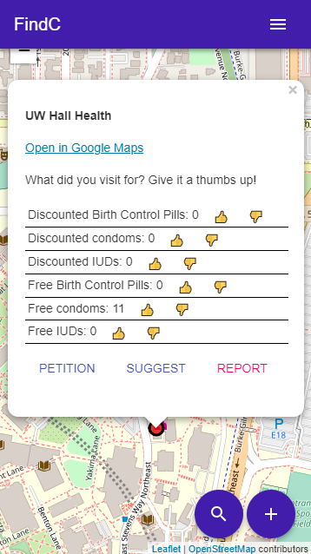
Localized
Difficult to parse
https://www.kingcounty.gov/depts/health/locations/family-planning/birth-control.aspx
Our Solution
Our Solution
Information hub for resources in the about page
Simple
Fast loading application due to small build file size
Quick lookups for addresses and loading data using Google Firebase and Google Cloud Geolocation API
Easy to use filtering system for information
Socially mediated using a system similar to Waze, where people self report. They can upvote and downvote
Desktop and mobile friendly
Scalable

Slide 9
Our Solution
Information hub for resources in the about page
Simple
Fast loading application due to small build file size
Quick lookups for addresses and loading data using Google Firebase and Google Cloud Geolocation API
Easy to use filtering system for information
Socially mediated using a system similar to Waze, where people self report. They can upvote and downvote
Desktop and mobile friendly
Scalable

Slide 10
Stakeholders
Our Solution
Information hub for resources in the about page
Simple
Fast loading application due to small build file size
Quick lookups for addresses and loading data using Google Firebase and Google Cloud Geolocation API
Easy to use filtering system for information
Socially mediated using a system similar to Waze, where people self report. They can upvote and downvote
Desktop and mobile friendly
Scalable

Slide 11
Stakeholders – Young Adults
Social media from upvotes/downvotes
Website instead of downloadable application

Slide 12
Stakeholders – Rural Areas
Build to be fast and reliable using code splitting
Fast to download, fast to get to interactive

Slide 13
Stakeholders – Non tech-savvy
Simple

Slide 14







Ethical concerns
States with general public against contraception
Petitioning system
Small town shops
Report or contact us

Slide 15
Technical Description
React, React Router
Google Firebase
Google Cloud Geocoding API
LeafletJS
MaterialUI

Slide 16


Future plans
Use Google Cloud Functions to do filtering, rather than client side
Hide the exposed API Key
Implement more filtering functions in the search menu
Fix UI inconsistencies
Reduce duplicated code
Implement more features for accessible contraceptives
Github
App

Slide 17
Thank you for listening! Questions? Comments?
Github
App

