Slide 1

The problem
What is the problem?
Access to information about free or discounted contraceptives
Access to information about free or discounted contraceptives

Slide 2
The problem
Access to information about free or discounted contraceptives

Slide 3
Why is it a problem?
The problem
Access to information about free or discounted contraceptives
Usage likely prevents over 272,000 maternal deaths a year (Johns Hopkins Bloomberg School of Public Health)
Usage is linked to a better quality of life for women (Planned Parenthood)
Advances the economy for everyone (Planned Parenthood)

Slide 4
Why this issue?
Why is it a problem?
Personal connections
Huge problem in the world
Usage likely prevents over 272,000 maternal deaths a year (Johns Hopkins Bloomberg School of Public Health)
Usage is linked to a better quality of life for women (Planned Parenthood)
Advances the economy for everyone (Planned Parenthood)

Slide 5
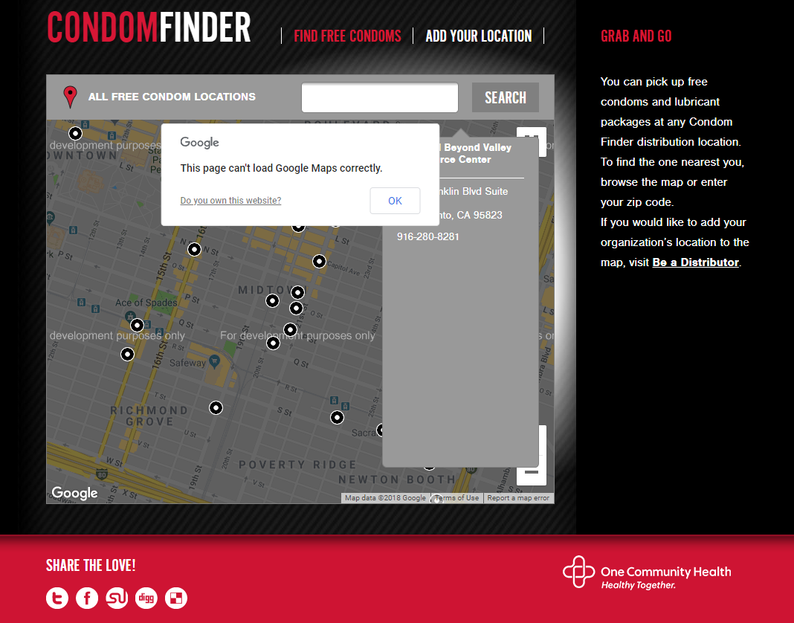
Existing Solutions?
Poor implementation
Insecure
Non-inclusive
Inaccessible
http://www.condomfinder.org/find.php

Slide 6
Existing Solutions?
Poor implementation
Insecure
Non-inclusive
Inaccessible
http://www.condomfinder.org/find.php

Slide 7
Poor implementation
Insecure
Non-inclusive
Inaccessible
http://www.condomfinder.org/find.php

