Slide 1

FanField
Group:- 17
IT314 – software engineering

Slide 2
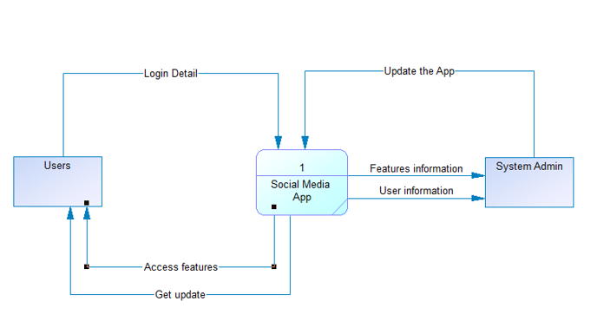
Context diagram

Slide 3
Functional summary (User Stories)
Register / Login : As a User, I should be able to register & login to my own account.
View(home page) : As a User, I should be able to view a list of online friends, feed, number of likes, etc..
Search bar: As a User, I should be able to search their friends or anyone’s account by searching the username or name in the search bar.
Like/Comment: As a User, I can like others' posts, I can write something in the comment section.
Logout : As a user, I should be able to logout from the application.

Slide 4
Functional summary (User Stories)
Users Profile page: As a users, I can see, edit my profile page.
Post: As a user, I should be able to post photos/ videos.
Chat: Users can chat with their friends and request to chat with other users.
Follow friends: As a User, I should be able to follow other users to be friends.
Delete post/account: As a user, if I want to delete any of my post or delete if I want.
Feeds: As user I can see recent activities in home page from my friends or from Who I follow.

Slide 5
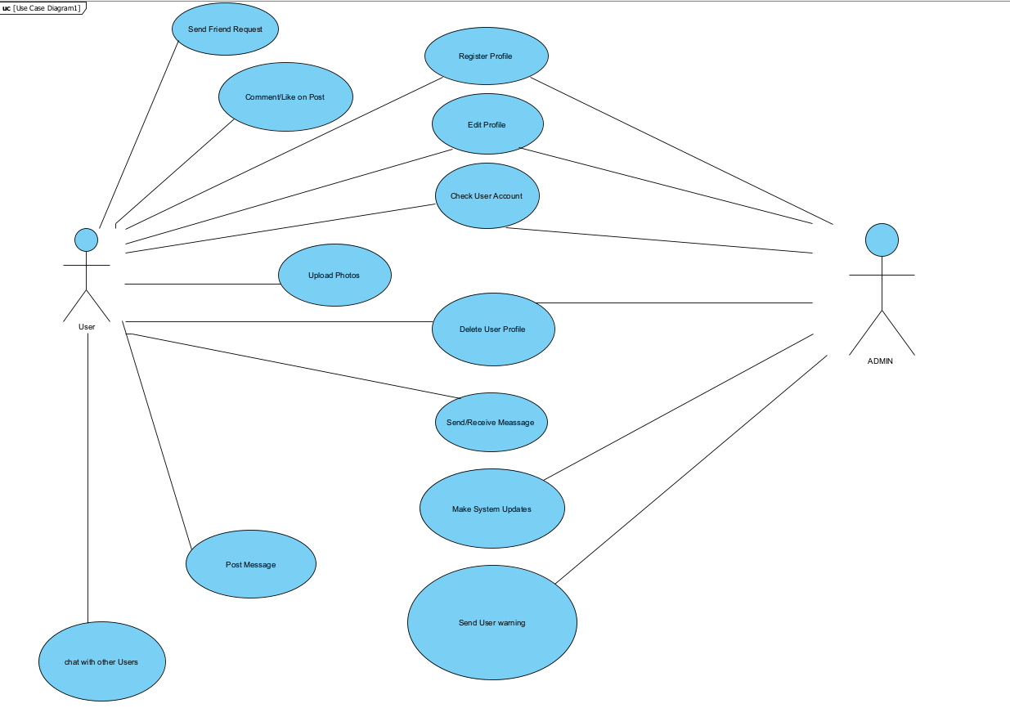
Top Level Use Case Model

Slide 6
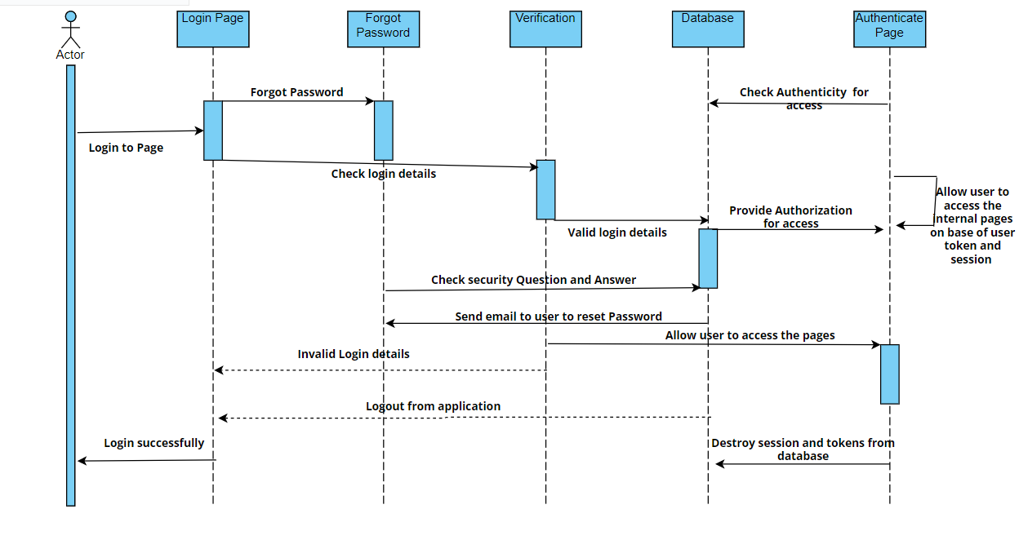
Sequence diagram

Slide 7
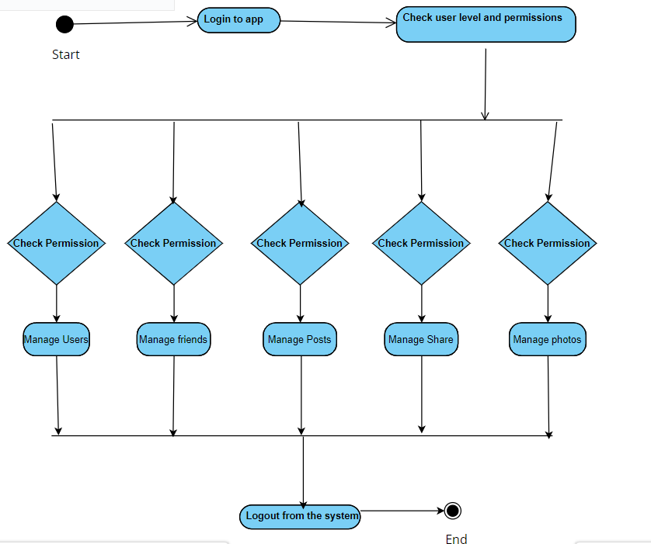
Activity Diagram

Slide 8
Application Architecture

Slide 9
Technologies/Tools and libraries
Frontend :- ReactJS, HTML, CSS, JavaScript.
Backend :- MongoDB database.
Tools :- VScode, GitHub

Slide 10
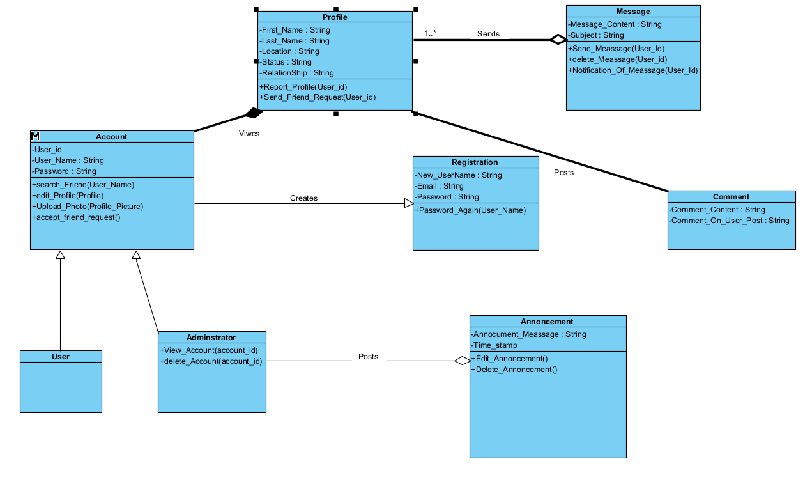
Detail Class Diagram

Slide 11
Summary of Implementation
Implemented login Page with MongoDB.
Implemented post photos.
Implemented home page with feeds.
Implemented Responsive UI.

Slide 12
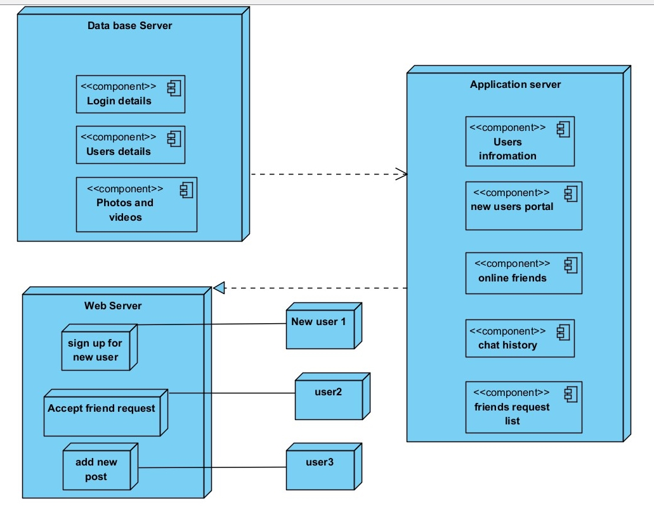
Deployment Diagram

Slide 13
Individual Contribution
Kenil Bhingradiya:-MongoDB authentication, Homepage Page, review PMD, Responsive UI
Axit Dhola:- MongoDB authentication, Homepage Page, review PMD
Keval Savaliya:- Draft PMD, login page, Draft/review Project Proposal
Sanny Dhameliya:- MongoDB authentication, review PMD, Responsive UI
Bhadrayu Bhalodia:- Draft PMD, login page, Draft/review Project Proposal
Dhruvil Gorasiya:- Draft PMD, login page, Draft/review Project Proposal

Slide 14
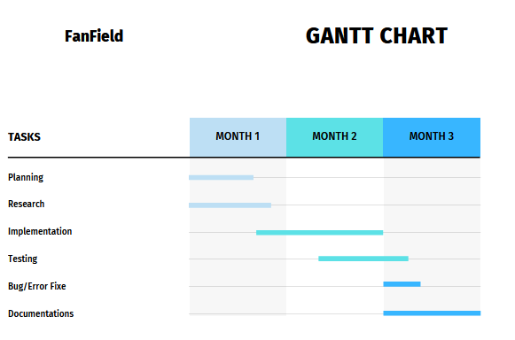
Gantt Chart

Slide 15
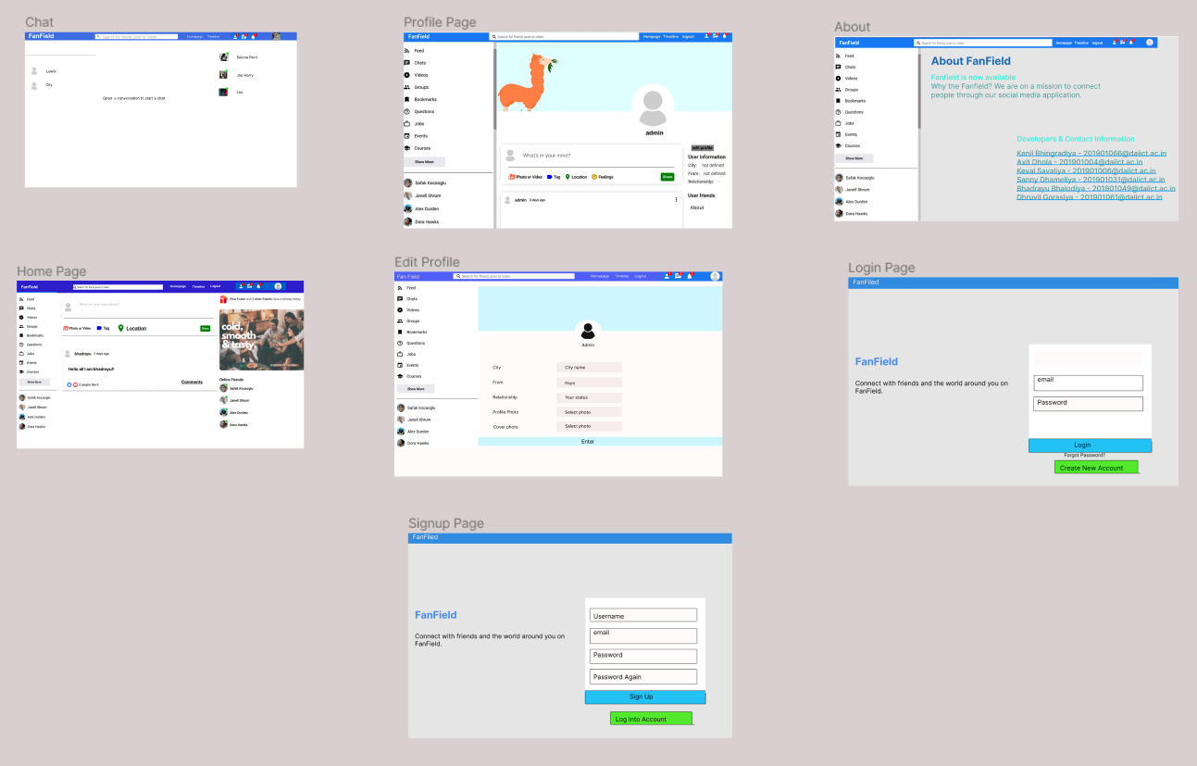
Application Navigation Using UI/UX Design
Login page and signup page all the buttons , text fields and box are grouped together. Every pages have different background.
In Profile page all user details are in one group and other details are in other group.
In Edit profile page all text fields , box and buttons are in one group.
Chat page have three groups. Each for chat conversation , currently online friends and friends with recent chats.
About page has only one group which contains text field.

Slide 16
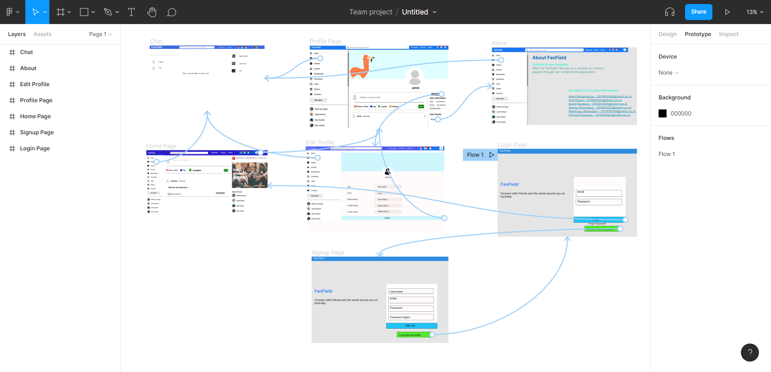
Application Navigation Using UI/UX Design
The light-blue lines show flow in the direction from one page to another (dot to the arrow.)
On all the pages, there are three common buttons: profile, timeline and homepage.
The Sign up button will redirect the user to the Sign up page.
On the login page, login button will lead the user to the home page.
On click on profile, it will lead user to profile page and in profile page edit button lead to Edit profile page.
Chat button will lead user to chat page.

Slide 17
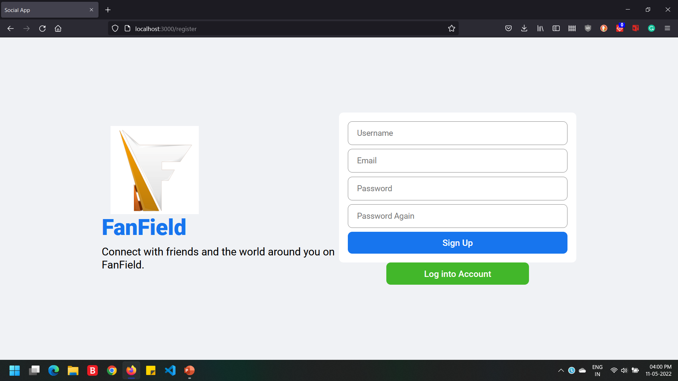
Register page

Slide 18
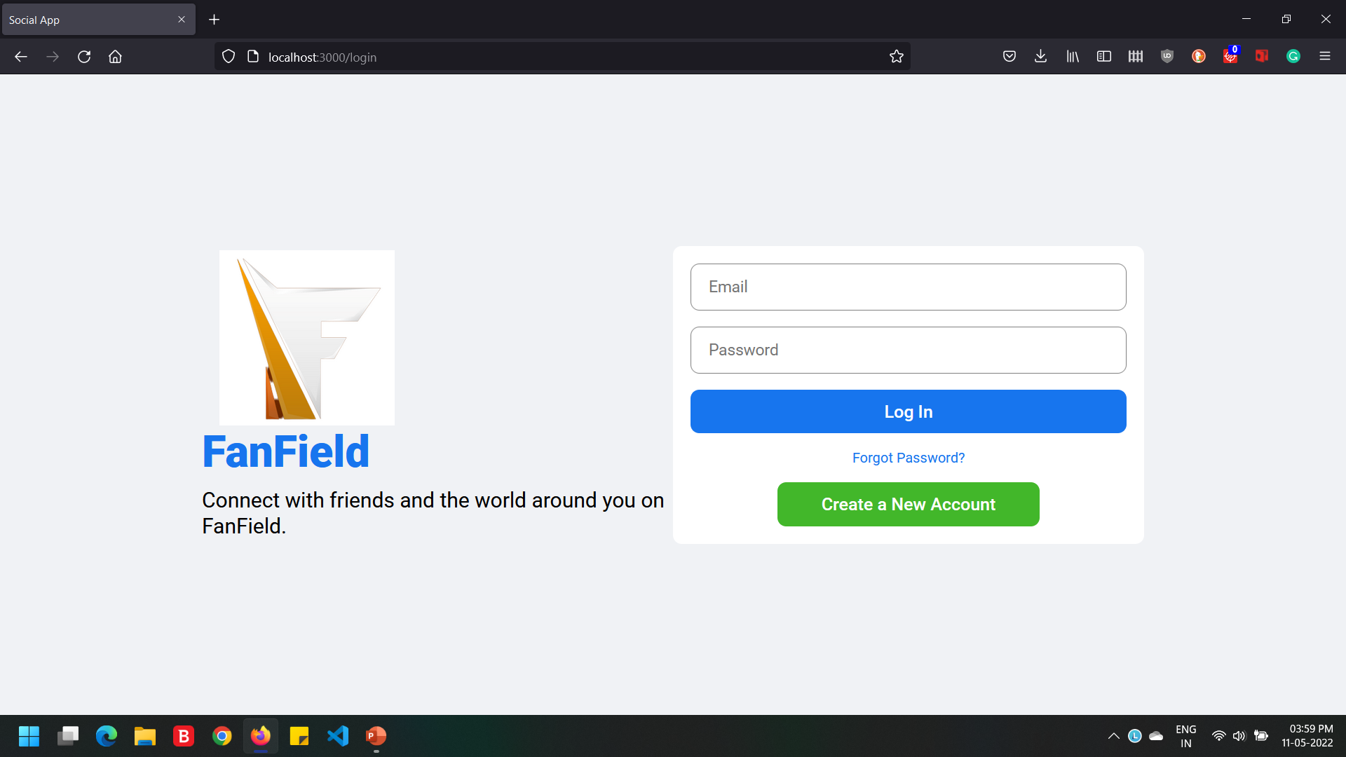
Login page

Slide 19
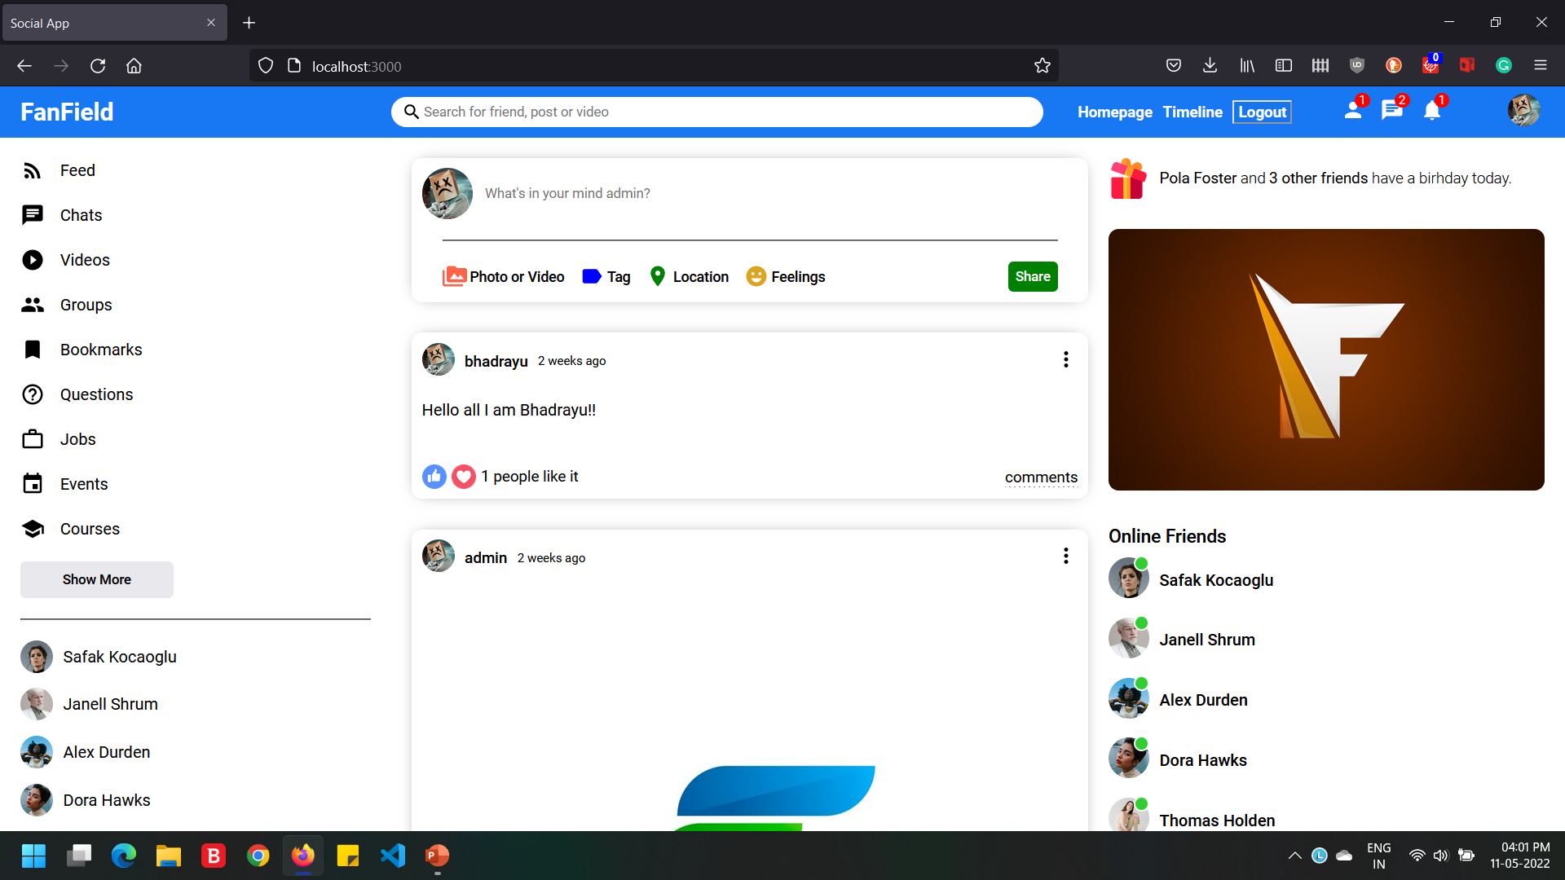
Home page

Slide 20
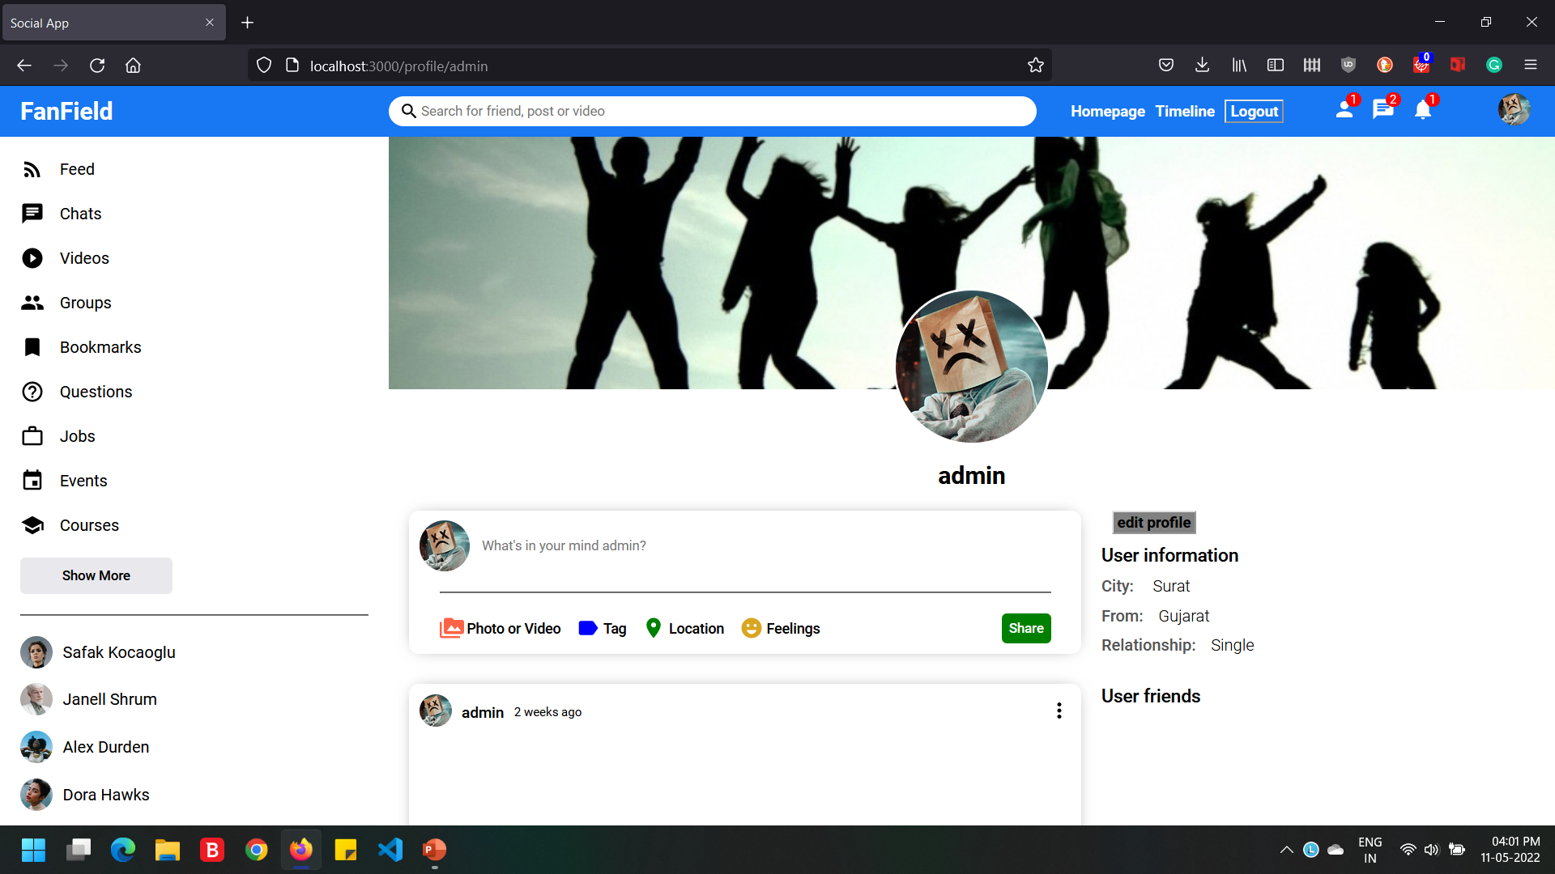
Profile page

Slide 21
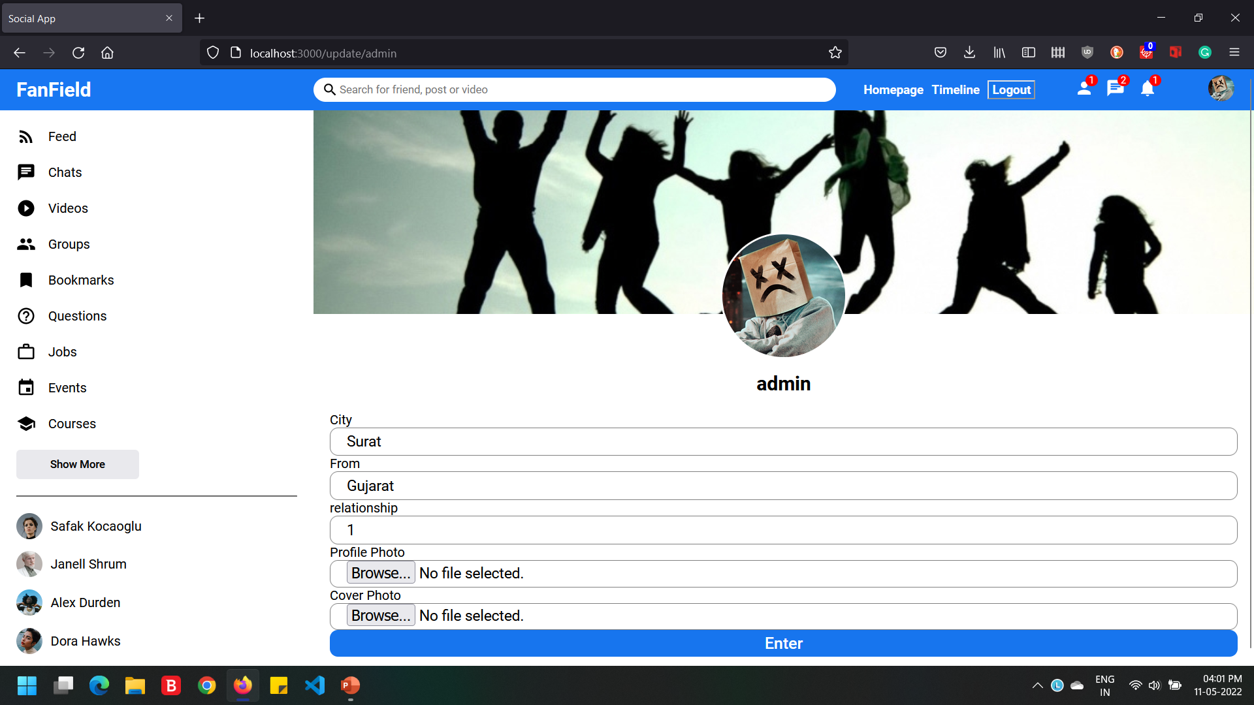
Edit Page

Slide 22
Summary of Test Plan
Testing is done using Mixed integration Testing.
Software testing while implementing code is done by us using Mixed Integration testing, so after writing one part that part is tested, if any error found then debug and resolve it.
If any error found during testing then it is resoled immediately.
After we implemented our web application, every member of our group tested this web application one by one by creating account, login, uploading different posts like text, image, image with text etc.
For every member of team, it is black box testing because they can only see output not internal component of it.

Slide 23
The end
Thank you.

