Slide 1
Fanfield
Group:- 17
IT314 – software engineering

Slide 2
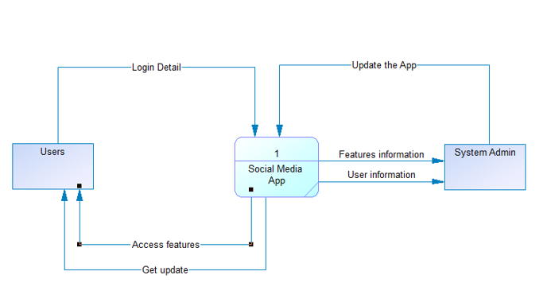
Context diagram

Slide 3
Functional summary (User Stories)
Register / Login : As a User, I should be able to register & login to my own account.
View(home page) : As a User, I should be able to view a list of online friends, feed, number of likes, etc..
Search bar: As a User, I should be able to search their friends or anyone’s account by searching the username or name in the search bar.
Like/Comment: As a User, I can like others' posts, I can write something in the comment section.
Logout : As a user, I should be able to logout from the application.

Slide 4
Functional summary (User Stories)
Users Profile page: As a users, I can see, edit my profile page.
Post: As a user, I should be able to post photos/ videos.
Chat: Users can chat with their friends and request to chat with other users.
Follow friends: As a User, I should be able to follow other users to be friends.
Delete post/account: As a user, if I want to delete any of my post or delete if I want.
Feeds: As user I can see recent activities in home page from my friends or from Who I follow.

Slide 5
Functionalities (Future Plan)
Search bar
Logout
Chat
Upload videos
Comment section

Slide 6
Technologies/Tools and libraries
Frontend :- ReactJS, HTML, CSS, JavaScript.
Backend :- MongoDB database.
Tools :- VScode, GitHub

Slide 7
Summary of Implementation
Implemented login Page with MongoDB.
Implemented post photos.
Implemented home page with feeds.
Implemented Responsive UI.

Slide 8
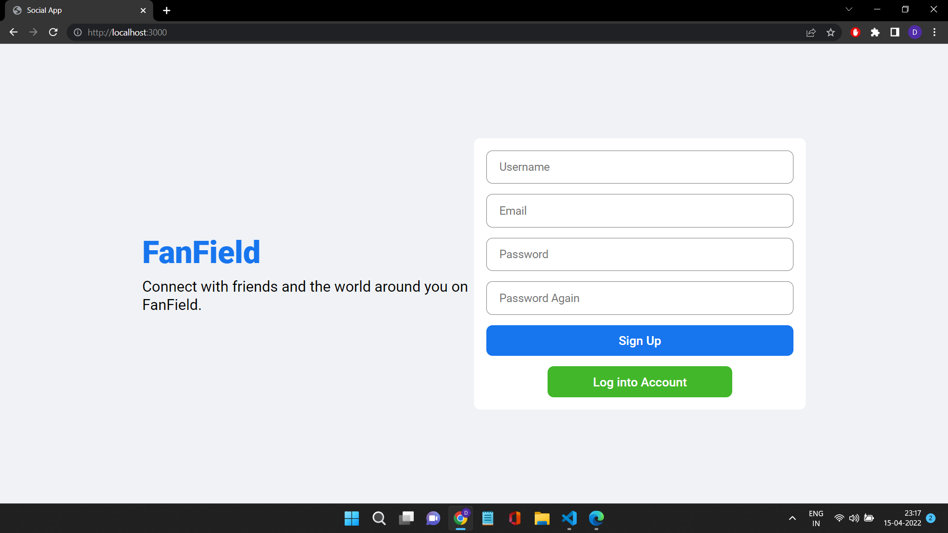
Register page

Slide 9
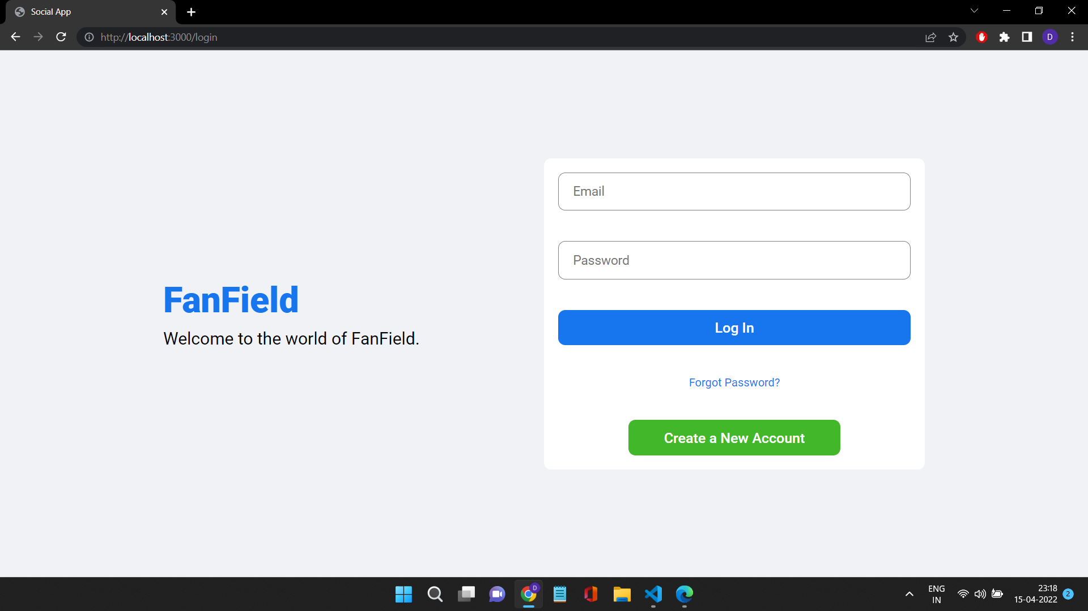
Login page

Slide 10
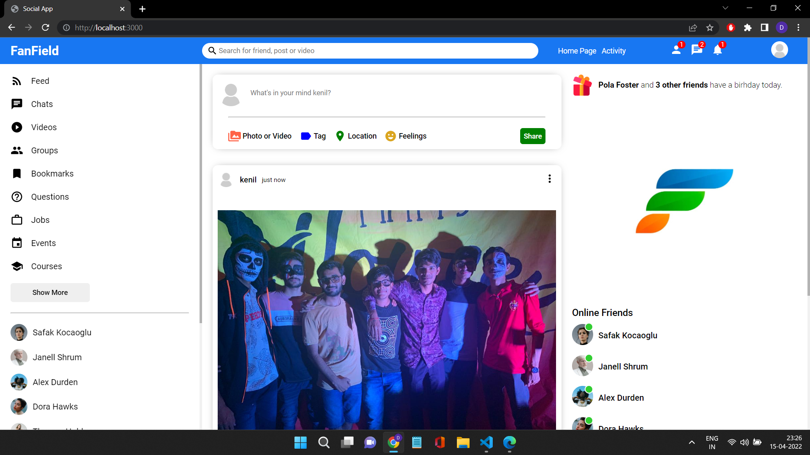
Home page

Slide 11
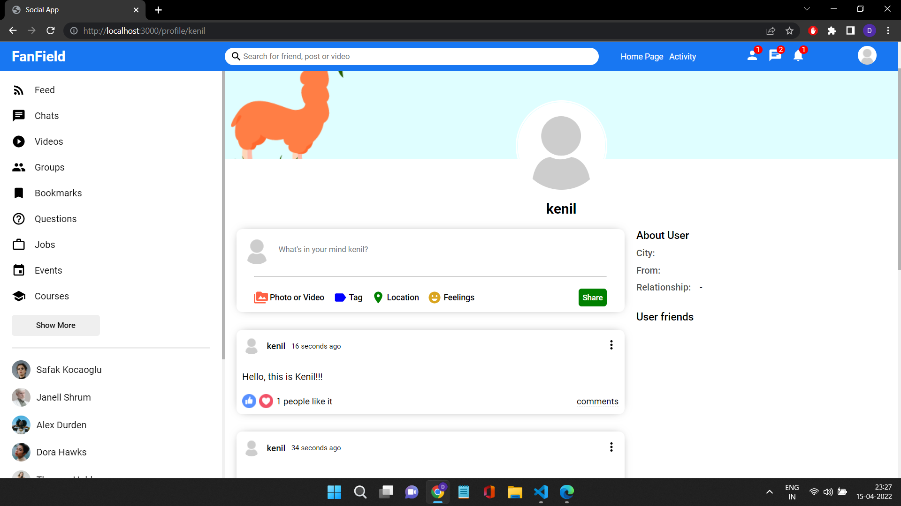
Profile page

Slide 12
Individual Contribution
Kenil Bhingradiya:-MongoDB authentication, Homepage Page, review PMD, Responsive UI
Axit Dhola:- MongoDB authentication, Homepage Page, review PMD
Keval Savaliya:- Draft PMD, login page, Draft/review Project Proposal
Sanny Dhameliya:- MongoDB authentication, review PMD, Responsive UI
Bhadrayu Bhalodia:- Draft PMD, login page, Draft/review Project Proposal
Dhruvil Gorasiya:- Draft PMD, login page, Draft/review Project Proposal

Slide 13
The end
Thank you.

