Slide 1
Category review: Chips
July 2018 – June 2019
Retail Analytics
Brand note: If client logo is not required, use alternate title page layout right click slide thumbnail > Layout > Title

Slide 2
Notes:
To view Privacy video explaining how important data privacy is to Quantium, please click here: https://www.youtube.com/watch?v=Zq1QDAkoRzU
or here Q:\Company Reference\Brand & Design\Brand videos\Q Privacy.mp4
At Quantium, we believe that data is the behavioural footprint of humanity and that it has to be treated with the utmost care and responsibility.
Histories, attitudes, indeed lives are stored within it in ways that aren’t always apparent – and that’s what makes its potential so powerful.
To work with it responsibly, sensitively, we set ourselves the highest data privacy protection and governance standards.
We have spent 17 years perfecting privacy-by-design and secure-by-design principles. Central to this is not holding any personally identifiable information about people –
we neither receive it, and put the necessary protections in place to be unable to decipher it.
Every aspect of handling data is safeguarded: from its de-identification, to its encryption – data security is paramount and of the highest grade.
We pride ourselves on gaining the trust of iconic organisations around the world through years of securely working with their data,
and in turn the trust that builds with their stakeholders.

Slide 3
Executive summary
01
Task 1
Budget - Older Families, Mainstream Young Singles/Couples and Mainstream Retirees drive the majority of chip sales. Mainstream Young Singles/Couples are 23% more likely to buy Tyrrells and prefer larger pack sizes (270g+).
02
Task 2
Trial stores 77 and 88 showed significant uplift in both sales and customers (2/3 trial months). Store 86 showed strong customer growth across all 3 months but mixed sales — recommend investigating pricing. Overall: roll out the new layout.

Slide 4
01
Category

Slide 5
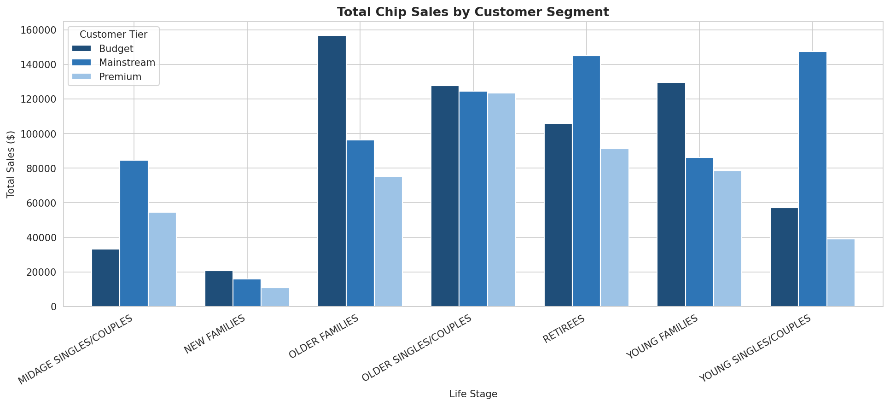
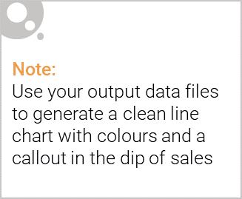
Budget - Older Families: $156,864 | Mainstream Young Singles/Couples: $147,582 | Mainstream Retirees: $145,169

Slide 6
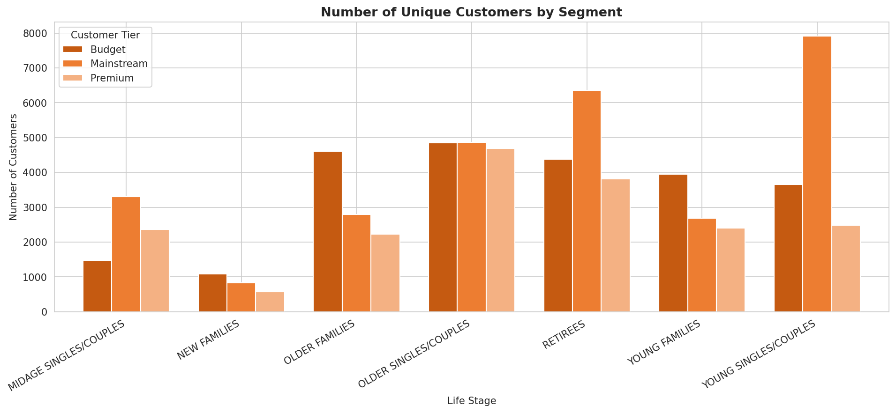

Mainstream Young Singles/Couples and Retirees have the most buyers. Budget Older Families achieve top revenue with fewer customers — higher spend per visit.

Slide 7
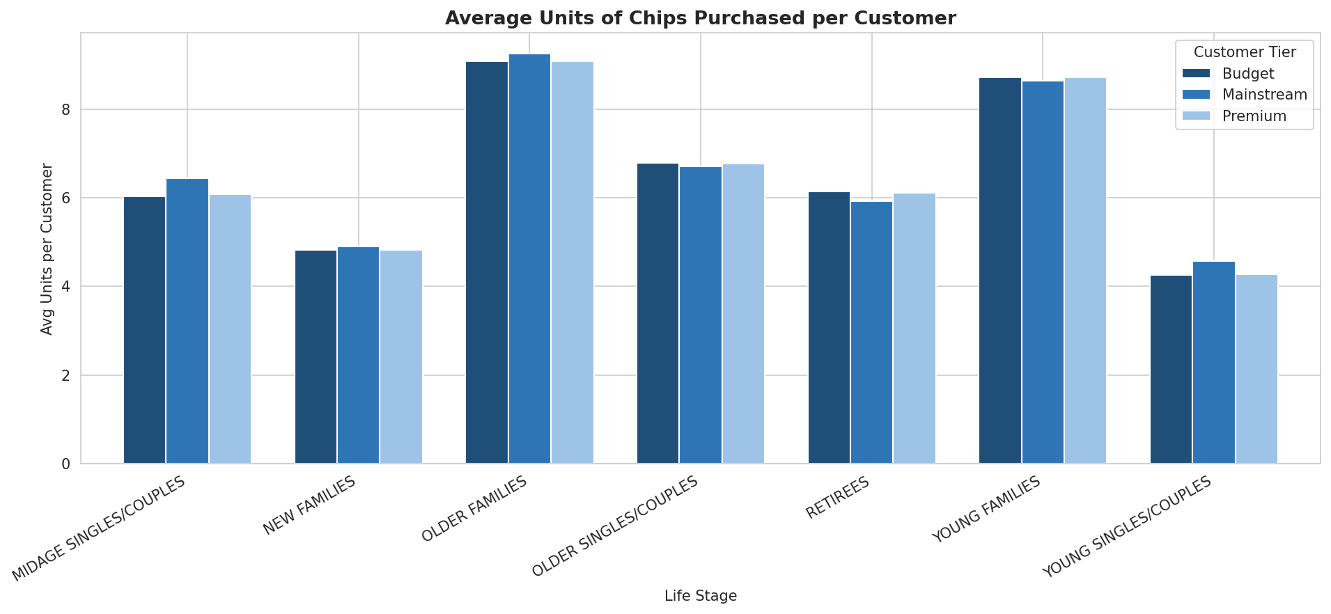
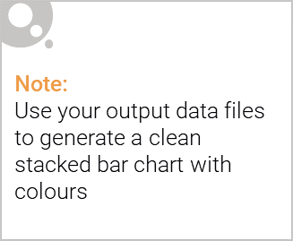
Editable (delete this)
Older Families and Young Families buy significantly more chip units per customer — consistent with bulk household purchasing behaviour.

Slide 8
02
Trial store performance

Slide 9
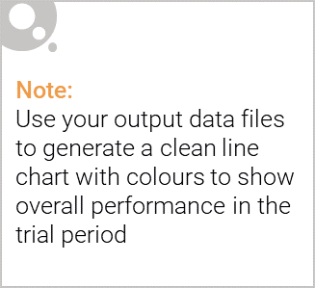
Control stores were selected using a composite score combining Pearson Correlation and Magnitude Distance on pre-trial monthly sales and customer counts (Jul 2018 – Jan 2019). Selected: Store 233 for Trial 77 | Store 155 for Trial 86 | Store 237 for Trial 88

Slide 10
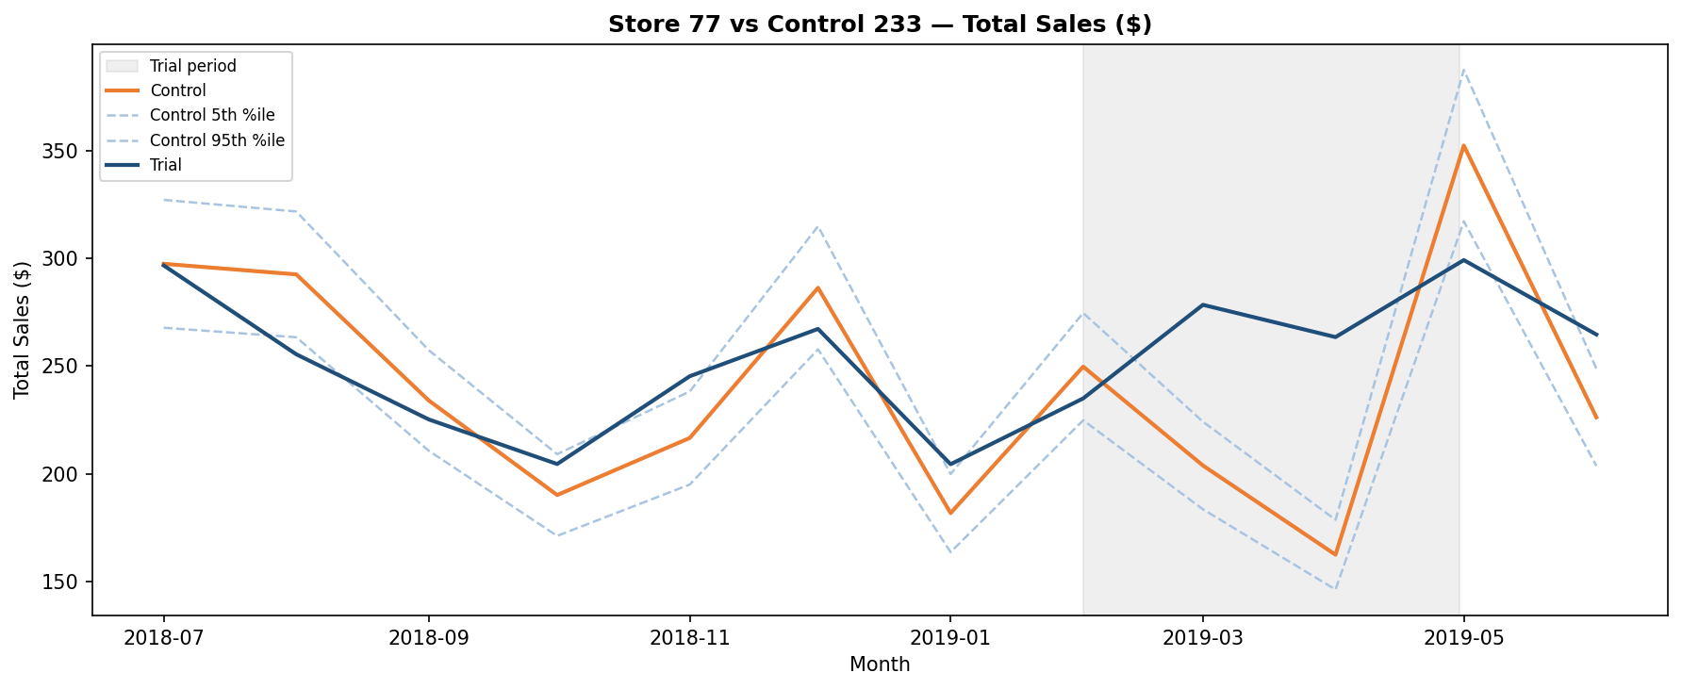
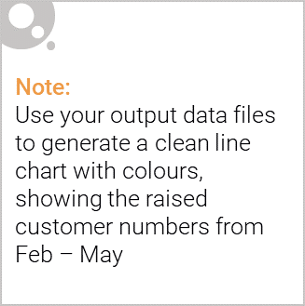
Trial Store 77 vs Control Store 233: Sales and customers significantly exceeded the 95% confidence interval in March and April 2019 (t=7.3 and t=12.5). VERDICT: Trial SUCCESSFUL — recommend rollout.

Slide 12
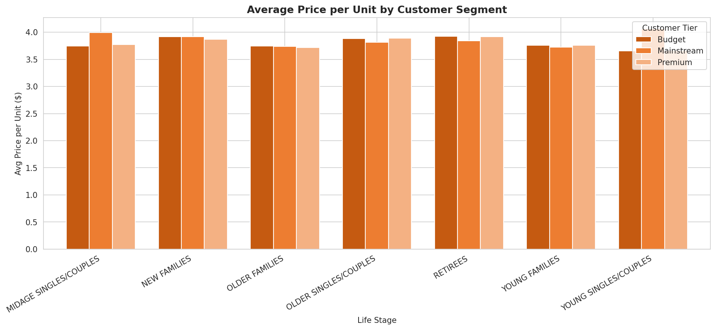
Mainstream Mid-age and Young Singles/Couples pay the most per unit (statistically significant, p<0.001) — impulse-buying behaviour at a slight price premium.

Slide 13
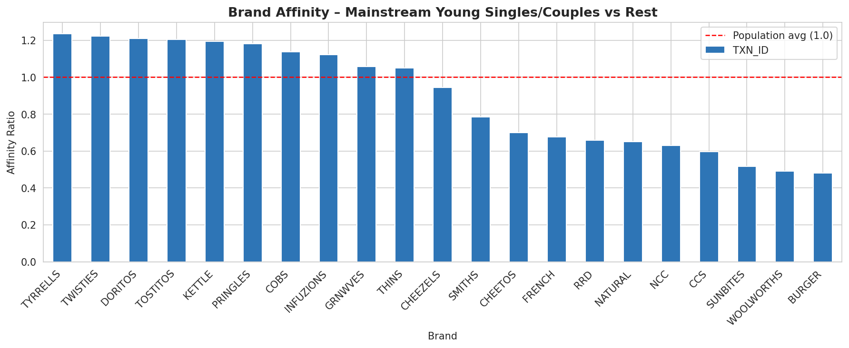
Mainstream Young Singles/Couples over-index on Tyrrells (+24%), Twisties (+22%) and Doritos (+21%) vs the rest of the population. Target promotions on these brands.

Slide 14
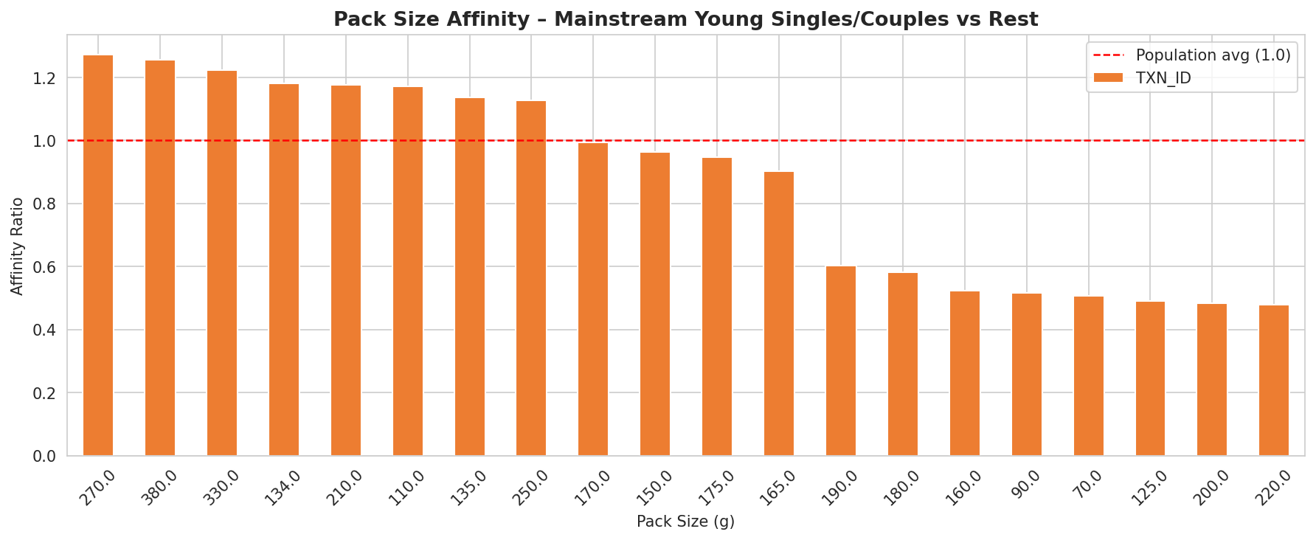
Mainstream Young Singles/Couples are 27% more likely to buy 270g packs. Note: 270g is exclusively Twisties — this reflects brand preference as much as pack size preference.

Slide 15
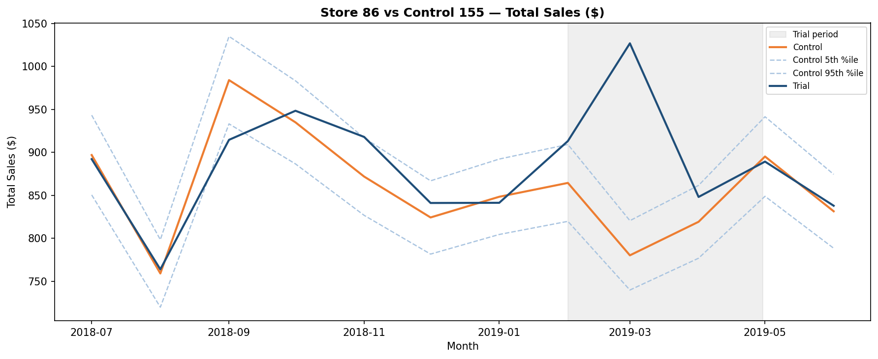
Trial Store 86 vs Control Store 155: Customer numbers significantly higher across all 3 months. Sales significant in 2/3 months — possible in-store discounting. VERDICT: Investigate pricing then roll out.

Slide 16
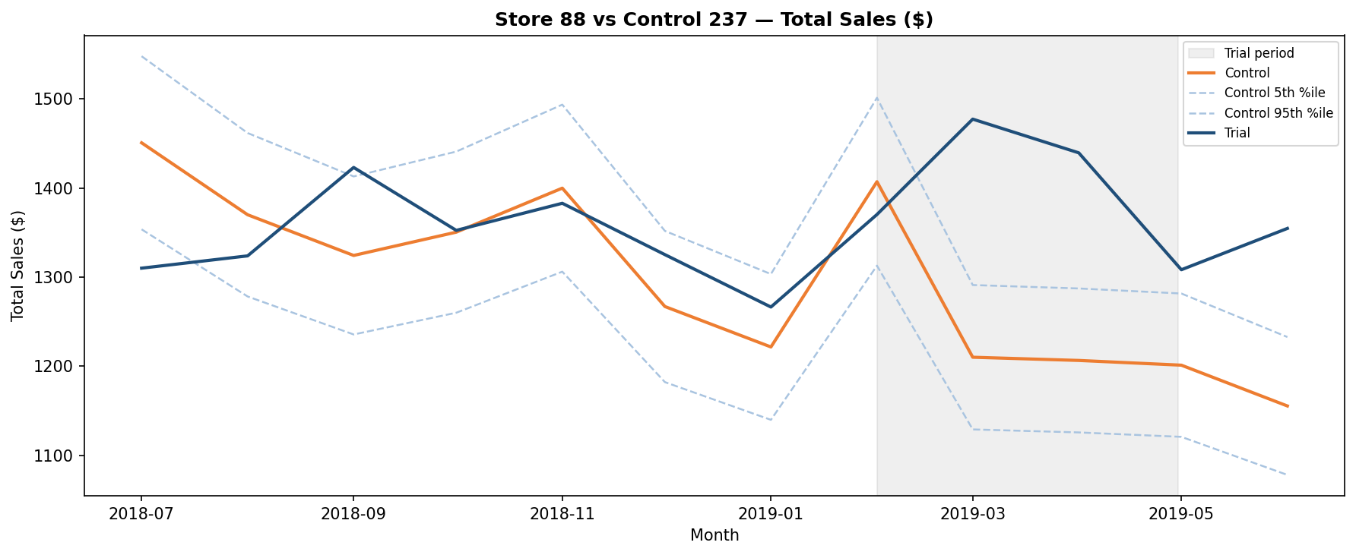
Trial Store 88 vs Control Store 237: Sales and customers significantly exceeded the 95% confidence interval in March and April 2019 (t=6.6 and t=5.8). VERDICT: Trial SUCCESSFUL — recommend rollout.

Slide 17
Overall Recommendation: The chip category trial was successful. 1. Roll out the new layout to all stores similar to Stores 77 and 88. 2. Investigate Store 86 pricing dynamics before including in rollout. 3. Target Tyrrells, Kettle and Doritos promotions for Mainstream Young Singles/Couples. 4. Ensure strong availability of 175g packs (most popular) and 270g packs for Mainstream Young Singles/Couples. 5. Run promotional activity in the first two weeks of December to capitalise on the Christmas sales spike.

