Slide 1
Prediction of sea surface Temperature using Atmospheric features
DHANASEKAR GOVINDARAJ

Slide 2





Overview
INTRODUCTION
DATA CLEANING
OR
PRE-PROCESSING
EXPLORATORY
DATA
ANALYSIS
MODEL TRAINING
AND
PREDICTION
CONCLUSION

Slide 3
INTRODUCTION
The idea came from rising temperatures which cause heavy rainfalls, destructive floods, and droughts around the world. To forecast this kind of devastating event in the future that might happen at some particular time or place and to take possible evacuation action earlier, prediction of available parameters beforehand is a vital thing. That will explain such events more accurately. Sea Surface Temperature is one of the target variables when analyzing the El Nino effect. El Nino is one of the important instances that might trigger natural disasters. In this study, I aim to explore the predictive capabilities of atmospheric variables in forecasting SST variations, contributing to the advancement of climate modeling and predictive analytics.

Slide 4
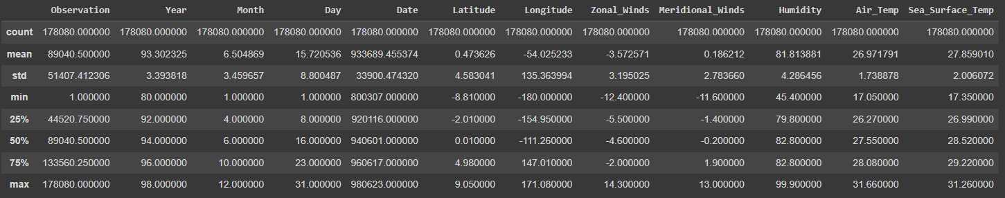
Data Cleaning OR Pre-processing
I have taken a dataset called El Nino from the Kaggle website.
After I loaded the dataset into the environment, I started to explore it.
It contains more than one hundred thousand observations with 12 features.
It has many missing values and inappropriate datatypes for some features. So I pre-processed the dataset before doing EDA.
Data pre-processing ensures the quality of the data and the accuracy of model performance.
It will enhance the interpretability of results, and save a lot of time.

Slide 5
EXPLORATORY DATA ANALYSIS (EDA)
EDA refers to the process of knowing more about the data in hand and preparing it for modeling.
EDA and feature engineering is an art where you get to play around with the data and try to get insights from it before the process of prediction.
By asking predictive questions, and answering along the way will take our analysis into the next level.
Q1. How do the variables relate to each other?
Q2. Which variables have a greater effect on climate variations?
These questions insisted me to do my analysis further.

Slide 6
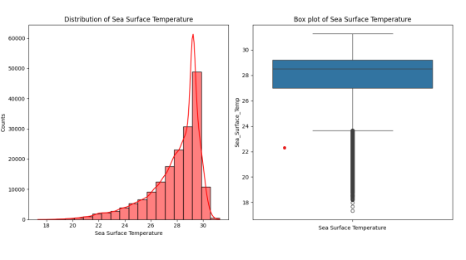
I am specifically interested in relevant features including Zonal Winds, Meridional Winds, Humidity, Air Temperature, and Sea Surface Temperature.
The Sea Surface Temperature indicates the change of the El Nino effect.
Therefore, I want to investigate the association between Sea Surface Temperature and the rest of the variables.
Then I plotted a histogram and boxplot of my target variable.
Histogram and Bar plot of Sea Surface Temperature

Slide 7
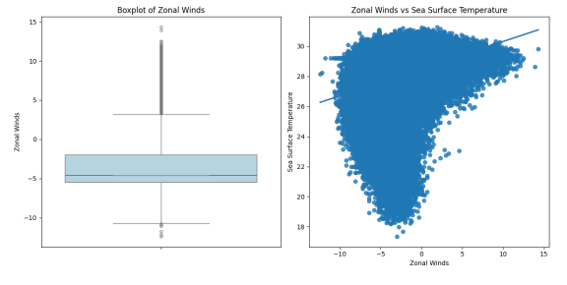
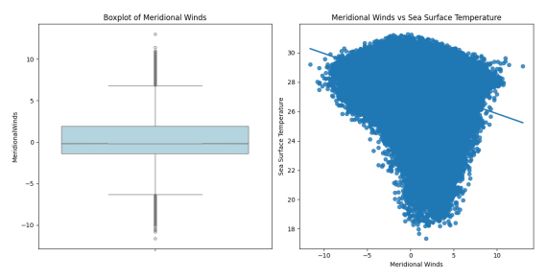
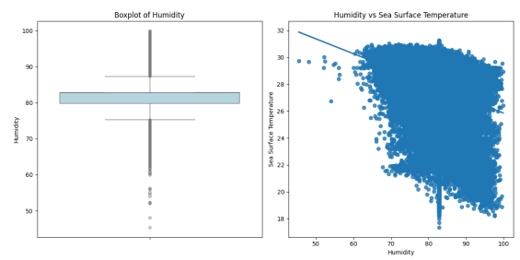
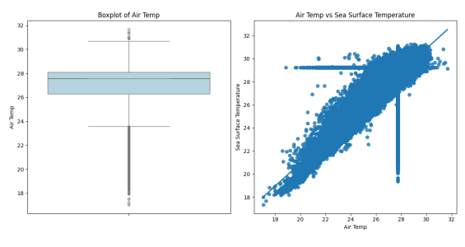
Relationship between features
It seems all the predictor variables have some linear relationship with the target variable (Sea Surface Temperature).

Slide 8
Splitting Data into Training and Test Sets:
I split the data into train and test sets to evaluate the machine learning model’s performance.
Feature Engineering:
Feature engineering refers to the process of creating new features or transforming existing ones to improve the performance of machine learning models.
Feature Selection:
Feature selection is the process of choosing the most relevant features from the original dataset.
It helps improve model performance by reducing dimensionality, decreasing training time, and mitigating the risk of overfitting.

Slide 9
Prediction Models
I used Linear regression, Decision tree regression, Random forest regression, and k-nearest neighbor regression algorithms to predict sea surface temperature (SST).
Each algorithm offers unique advantages suited to the complex and dynamic nature of SST prediction.

Slide 10
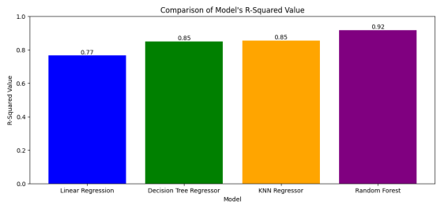
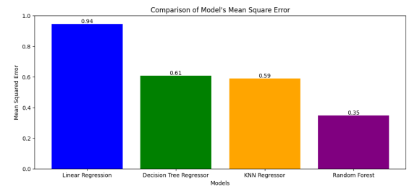
Result Interpretation
Among the algorithms I used, the Random Forest method effectively predicted the sea surface temperature (SST) based on atmospheric variables with a notable high R-squared value and the lowest Mean Squared Error.
It demonstrated superior performance in capturing the complex relationships between atmospheric conditions and SST dynamics.
The achieved R-squared value of over 91% indicates the model’s ability to explain the variation in SST with exceptional accuracy.

Slide 11
CONCLUSION
In this study, I investigated the predictive modeling of sea surface temperature (SST) using atmospheric variables, employing a range of regression algorithms.
Our results demonstrated that the Random Forest method outperforms the other algorithms, achieving a remarkable R-squared value and the lowest Mean Squared Error. Indicates its exceptional ability to explain SST variation with high accuracy.
Moving forward, further research could explore additional predictors and refine modeling techniques to enhance the accuracy and robustness of SST predictions, ultimately contributing to our understanding of climate dynamics and environmental forecasting.

Slide 12
Thank you…

