Slide 1
CHATBOT DEPLOYMENT WITH IBM CLOUD WATTSON ASSISTANT
TEAM LEADER –DHANALAKSHMI C-731221205006
TEAM MEMBERS
AHALYA.JC-731221205301
MANILA.K-731221205020
MAHADEVAMMA.S-731221205017
RATHNA.R-731221205033

Slide 2
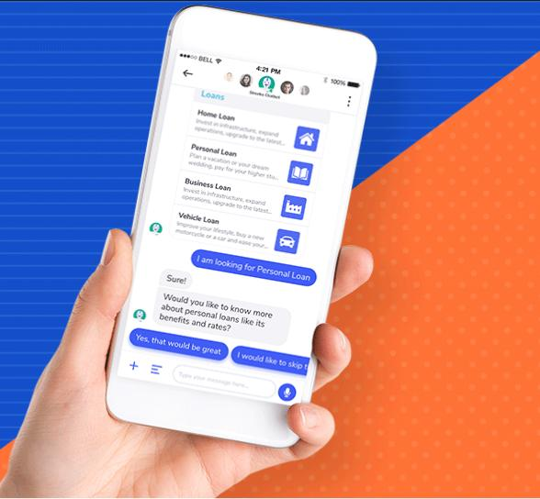
Definition
IBM watsonx Assistant is a market-leading, conversational artificial intelligence platform designed to help you overcome the friction of traditional support and deliver exceptional experiences to prospects, customers, and employees.

Slide 3
Data collection
We collect information from the use of our business processes, websites, cloud and online services, products, or technologies. This information may include personal information and is used for product and process development.
Data sources in object storage in Watson Query. You can use data that is stored as files on IBM Cloud Object Storage, Amazon S3, or Ceph data sources to create virtual tables.

Slide 4
Building on chatbox
You complete these tasks: Gain a basic understanding of Watson Assistant. Understand the development steps. Apply design thinking for a cognitive solution. Create an instance of Watson Assistant and a workspace. Define intent and entities to help natural language processing. Build a simple dialog flow.

Slide 5
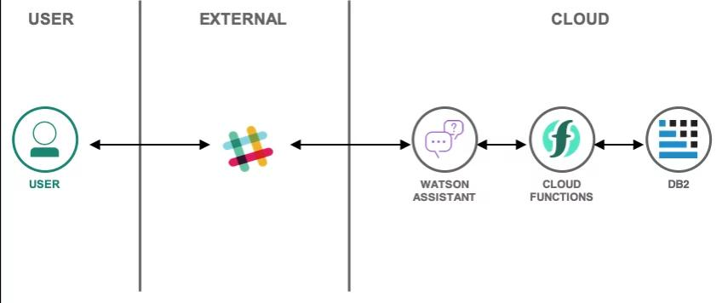
Building a model on chat box

Slide 6
Model deployment
From the Assistants page, click to open the assistant tile that you want to deploy to your site. From the Integrations section, either click Integrate web chat, or click Add integration, and then choose the Web chat tile. The web chat integration is added to your first assistant automatically.

Slide 7
Report
Watson uses machine learning algorithms and asks follow-up questions to better understand customers and pass them off to a human agent when needed. In addition, Watson leverages large language models (LLMs).
IBM Watson Assistant is a powerful platform that enables developers to build natural language processing (NLP) chatbots to interact with users and provide accurate responses. By the end of this guide, you will have a functional chatbot that can answer questions, engage users, and improve with additional training data.

