Slide 1

Vel Tech Rangarajan Dr. Sagunthala R&D Institute of Science and Technology
School of Computing
Department of Computer Science and Engineering
10211CS224 / FULL STACK APPLICATION DEVELOPMENT (JAVA)
END SEMESTER PROJECT REVIEW
Date: 06\05\2026
Educational Event Management Using Spring MVC
SDG 4 – Quality Education, SDG 9 – Industry, Innovation and Infrastructure
Presented By:
A.Dhanunjaya – VTU25920 – 23UECS0644.
Courses Handling Faculty:
Dr .S . HEMAMALINI –M.E.,Ph.D.,

Slide 2
INTRODUCTION
The Campus Event Management System is a web-based platform developed to automate the process of managing college events and student registrations.
Traditional event management in colleges often relies on manual announcements and record keeping, which leads to inefficiency and errors.
This project provides a centralized system for event creation, scheduling, registration, and participant tracking.
Students can browse available events, register online, and manage their participation. Administrators can create, update, and monitor events through a secure dashboard.
The system improves communication, reduces paperwork, and enhances event coordination.
It is designed using Spring Boot following MVC architecture for scalability and maintainability.
1
2
3
4
5
6
7
8
9

Slide 3
PROBLEM STATEMENT
Many educational institutions still manage campus events manually through notices, spreadsheets, and physical registration processes.
This causes delays, duplicate registrations, poor tracking of participants, and inefficient communication between organizers and students.
There is no centralized platform for managing event details, registrations, and participation status.
Hence, a secure and automated web-based system is required to streamline campus event management and improve operational efficiency.
1
2
3
4
5
6
7
8
9

Slide 4
OBJECTIVE(S)
To design and develop a secure web-based Campus Event Management System for managing events and student registrations efficiently.
To implement automated event registration, tracking, and administrative control to improve campus event coordination.
1
2
3
4
5
6
7
8
9

Slide 5
PROPOSED SYSTEM
Develop a centralized platform for campus event management.
Allow administrators to create, edit, and delete events.
Enable students to view available events and register online.
Prevent duplicate event registrations using validation mechanisms.
Maintain registration records in a structured database.
Provide role-based secure authentication for admins and students.
Offer dashboard views for monitoring events and registrations.
Improve efficiency, accuracy, and accessibility over manual systems.
1
2
3
4
5
6
7
8
9

Slide 6
PROPOSED SYSTEM ARCHITECTURE
Input:
Student login credentials
Event details entered by admin
Registration requests from students
Processing:
Authentication & Authorization via Spring Security
Business logic handled by Service Layer
Validation of event and registration data
Exception handling for duplicate/invalid operations
Database:
Stores Students, Events, and Registrations
Managed using JPA Repositories
Output:
Event Listings
Registration Confirmation
Admin Dashboard Reports
Student Registered Events View
1
2
3
4
5
6
7
8
9

Slide 7
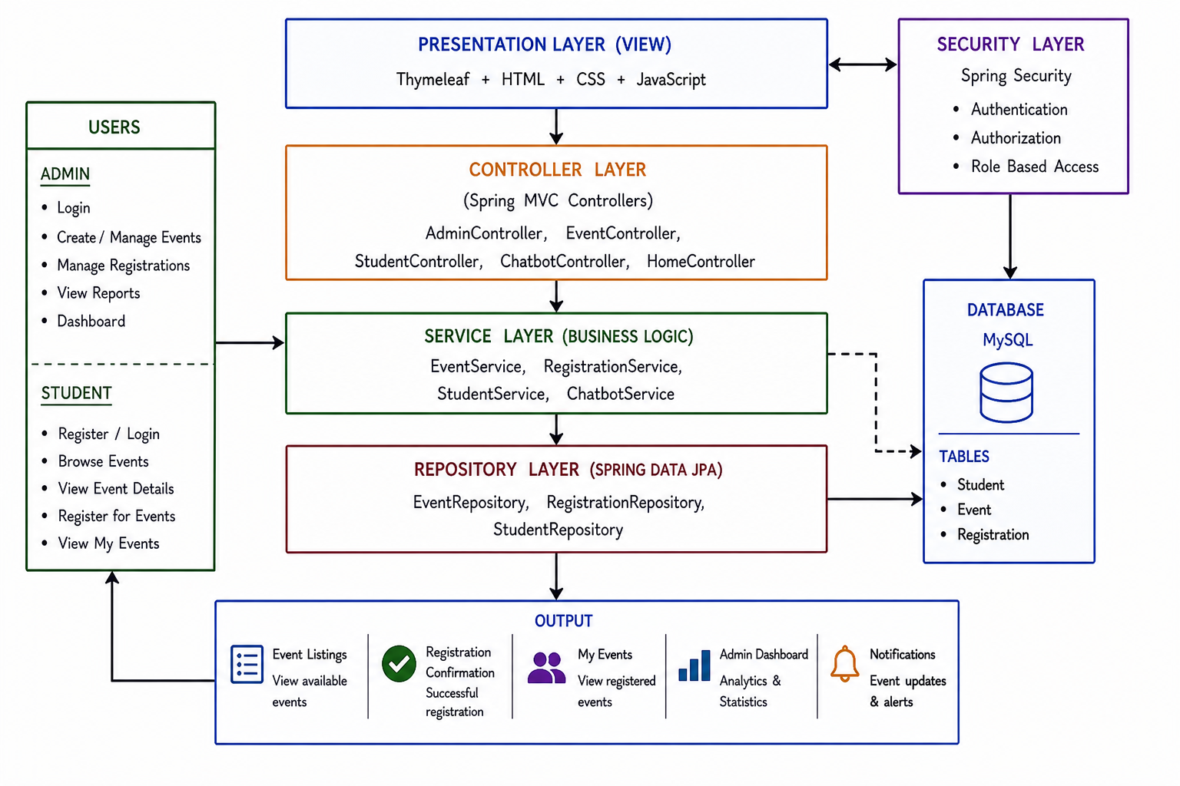
PROPOSED SYSTEM ARCHITECTURE
1
2
3
4
5
6
7
8
9

Slide 8
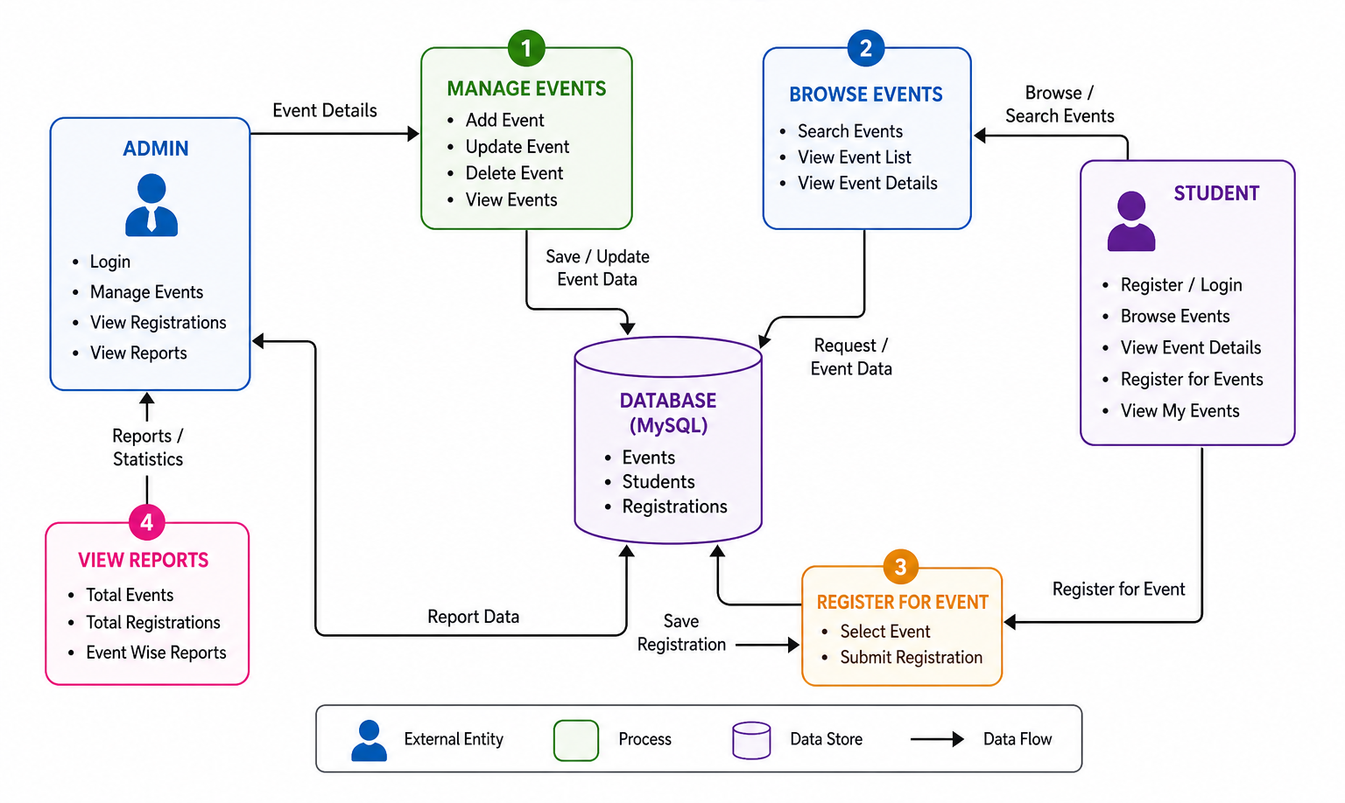
WORKFLOW
1
2
3
4
5
6
7
8
9

Slide 9
TECHNOLOGIES USED
Frontend:
HTML,CSS,JavaScript,Thymeleaf Template Engine
Backend:
Java,Spring Boot,Spring MVC,Spring Security
Database:
MySQL
Third-Party API:
Chatbot Integration / AI Rule-Based Chatbot
Tools:
VS code,Maven
Hardware/Software Requirements:
Minimum 8GB RAM
JDK 17+
MySQL Server
Modern Web Browser
1
2
3
4
5
6
7
8
9

Slide 10
MODULE DESCRIPTION
Module 1: Student Management
Handles student login, registration, dashboard access, and event participation tracking.
Module 2: Event Management
Allows administrators to create, update, delete, and manage event details.
Module 3: Registration Management
Processes student event registrations with duplicate registration prevention.
Module 4: Admin Dashboard & Analytics
Displays event statistics, participant counts, and registration overview.
Module 5: Chatbot Assistance
Provides automated chatbot support for user queries and navigation help.
1
2
3
4
5
6
7
8
9

Slide 11
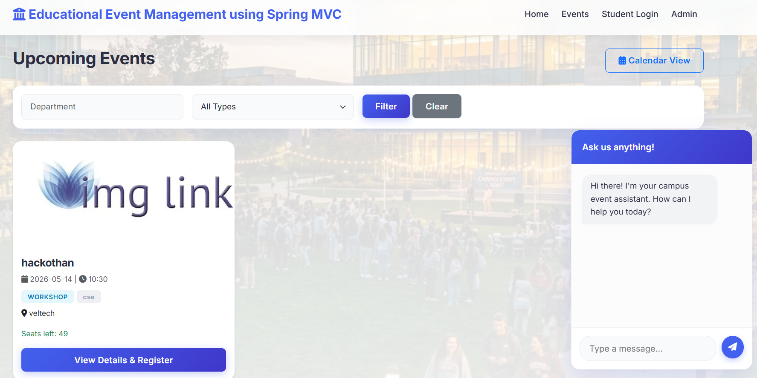
IMPLEMENTATION SCREENSHOTS
1
2
3
4
5
6
7
8(A)
9
Home Page
Displays welcome interface and navigation options for students and administrators.

Slide 12
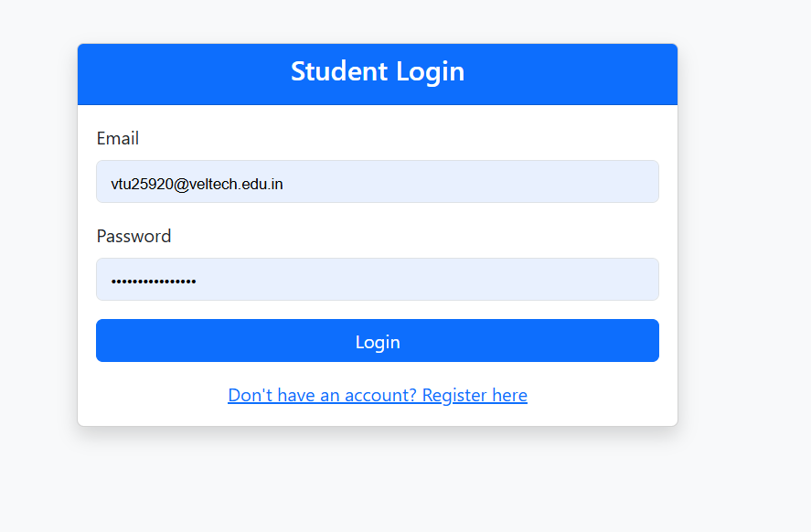
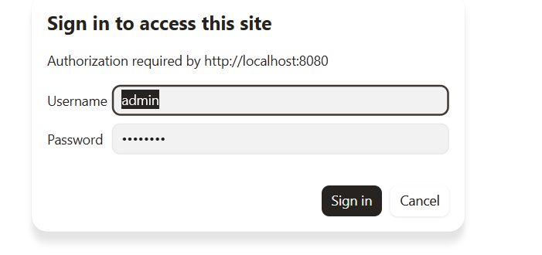
IMPLEMENTATION SCREENSHOTS
1
2
3
4
5
6
7
Admin Login Page
Secure authentication page for administrator access.
8(B)
User Login Page
Student login interface for accessing personalized dashboard.
9

Slide 13
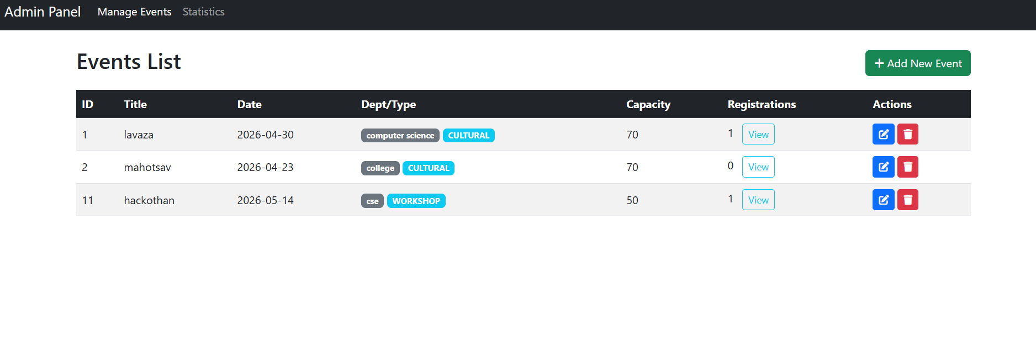
IMPLEMENTATION SCREENSHOTS
1
2
3
4
5
6
7
8(C)
Event Management Page
Allows admin to manage all event-related operations.
9

Slide 14
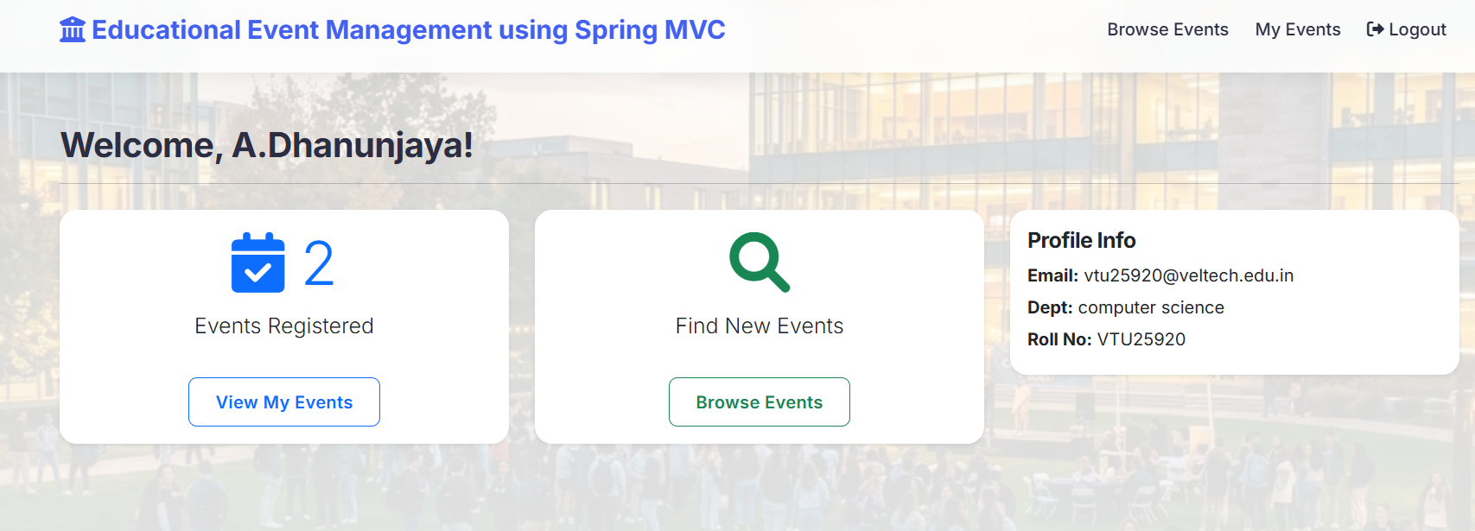
IMPLEMENTATION SCREENSHOTS
1
2
3
4
5
6
7
8(C)
9
Student Dashboard
Shows available events and student participation details.

Slide 15
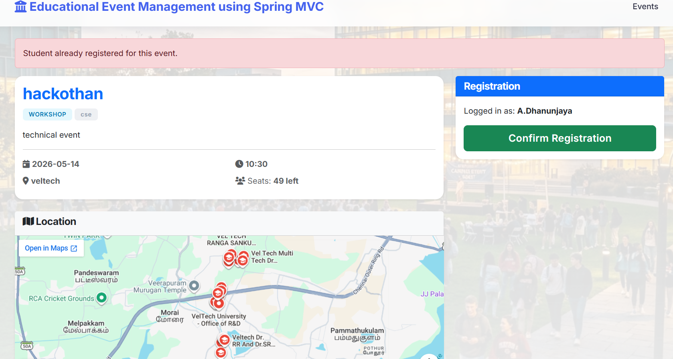
IMPLEMENTATION SCREENSHOTS
1
2
3
4
5
6
7
8(C)
9
Registration Page
Allows students to register for desired events

Slide 16
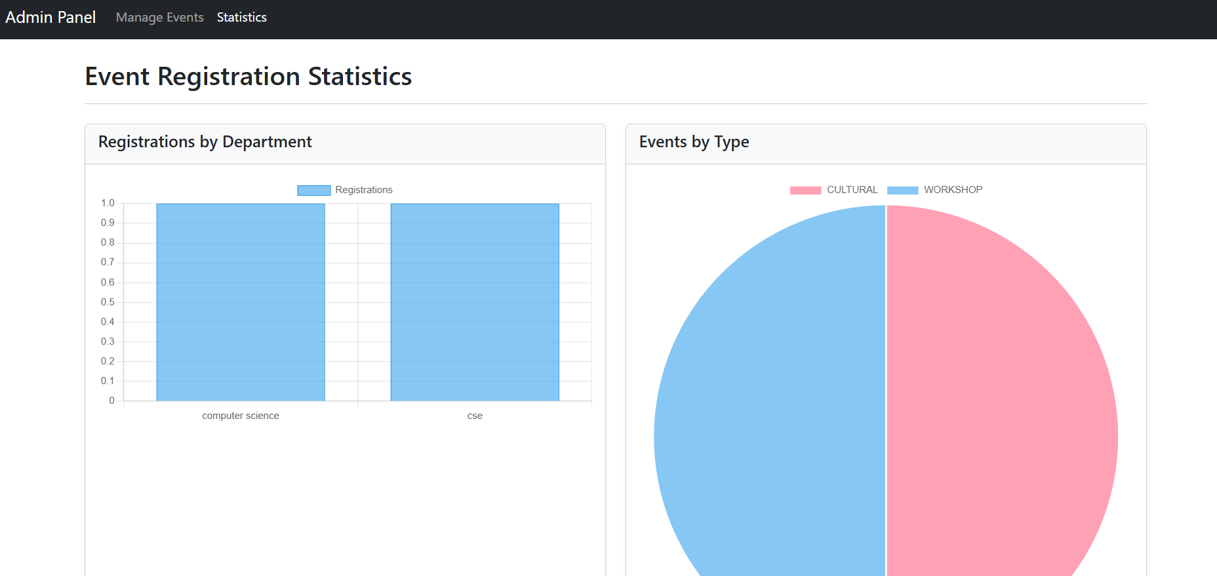
IMPLEMENTATION SCREENSHOTS
1
2
3
4
5
6
7
8(C)
9
Admin Statistics Page
Displays registration metrics and event analytics.

Slide 17
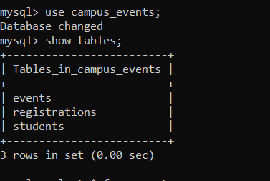
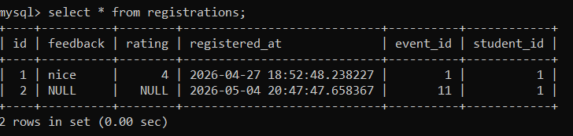
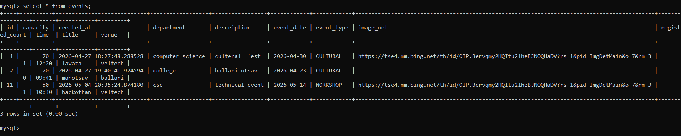
IMPLEMENTATION SCREENSHOTS
1
2
3
4
5
6
7
8(C)
9

Slide 18
IMPLEMENTATION SCREENSHOTS
1
2
3
4
5
6
7
8(C)
Database Screenshot
Displays MySQL tables storing students, events, and registrations with sample records.
9

Slide 19
ADVANTAGES & LIMITATIONS
Advantages:
Automates campus event management process
Reduces manual paperwork and errors
Secure role-based authentication
Prevents duplicate registrations
Easy access for students and administrators
Centralized event and registration tracking
Limitations:
Requires internet/network availability
Currently limited to campus-level usage
No mobile app support in current version
Basic chatbot functionality only
1
2
3
4
5
6
7
8
9

Slide 20
Thank you

