Slide 1
HOUSEHOLD ANIMALS
CLASSIFICATION
Cat vs Dog Recognition using Deep Learning
VGG-like CNN • VGG16 Transfer Learning • Fine-tuning
Project presentation
Household Animals Classification • 1

Slide 2
1. Introduction
Objective and dataset
• Goal: classify an image as Cat or Dog.
• Dataset: Microsoft Cats vs Dogs archive (Kaggle competition download was unavailable).
• 24,998 usable images after validation: 12,499 per class.
• Per class: 9,999 train, 2,000 validation, 500 test images (approximately 80/16/4).
• Images resized to 224 × 224 pixels; batch size 32.
Workflow
• Validate and clean images
• Train baseline CNN
• Add augmentation + dropout
• Transfer learning with VGG16
• Fine-tune from block5_conv1
Household Animals Classification • 2

Slide 3
2. Model Architecture
Three model stages
A. VGG-like CNN
B. Regularized CNN
C. VGG16 transfer
• Input: 224×224×3
• 3×3 convolutions: 32 → 64 → 128 → 128 filters
• ReLU + max pooling
• Flatten → Dense(128) → Sigmoid
• Same convolutional backbone
• Random horizontal flip
• Dropout 0.5 in classifier
• Designed to reduce overfitting
• ImageNet-pretrained VGG16
• Freeze convolutional base
• Global Average Pooling
• Dense(128) → Sigmoid
• Fine-tune from block5_conv1
Training: binary cross-entropy • RMSprop • Cat = 0, Dog = 1
Household Animals Classification • 3

Slide 4
3. Results
Test-set performance from this run
Model | Test loss | Test accuracy
VGG-like baseline | 1.6643 | 85.10%
Dropout + augmentation CNN | 0.1856 | 92.20%
VGG16 transfer (before fine-tuning) | 0.1036 | 98.40%
VGG16 fine-tuned | 0.0951 | 98.60%
Best result
98.60%
Test accuracy
Fine-tuning improved test accuracy by 0.20 percentage points over the frozen transfer model.
The scratch baseline has a larger train–validation gap, suggesting overfitting.
Household Animals Classification • 4

Slide 5
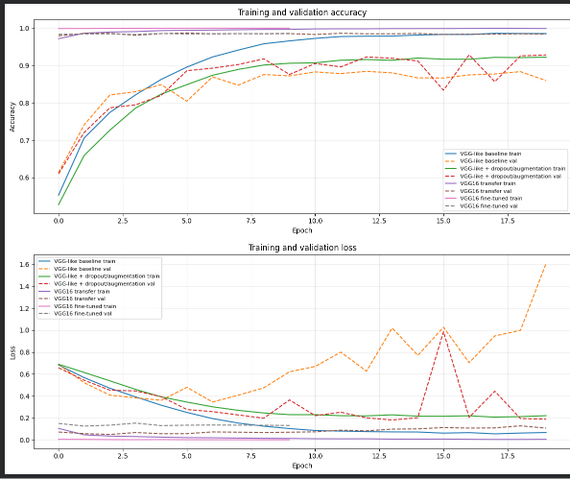
4. Learning Curves
Training and validation trends
Household Animals Classification • 5

Slide 6
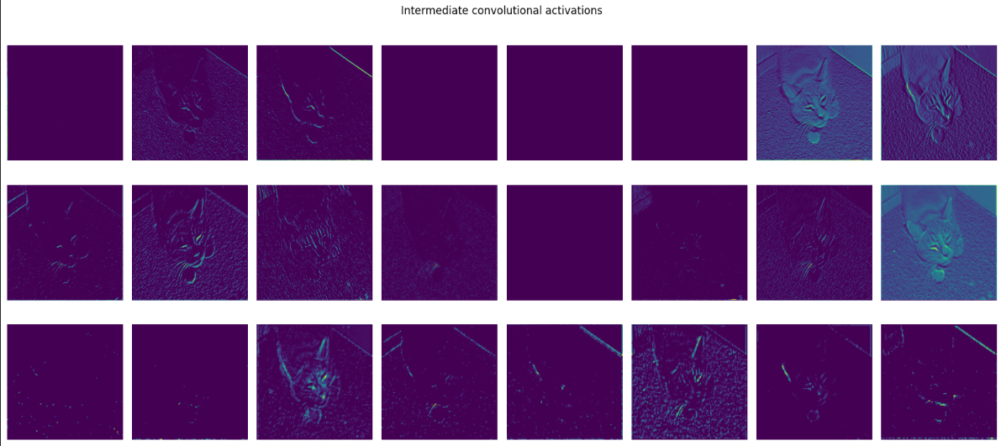
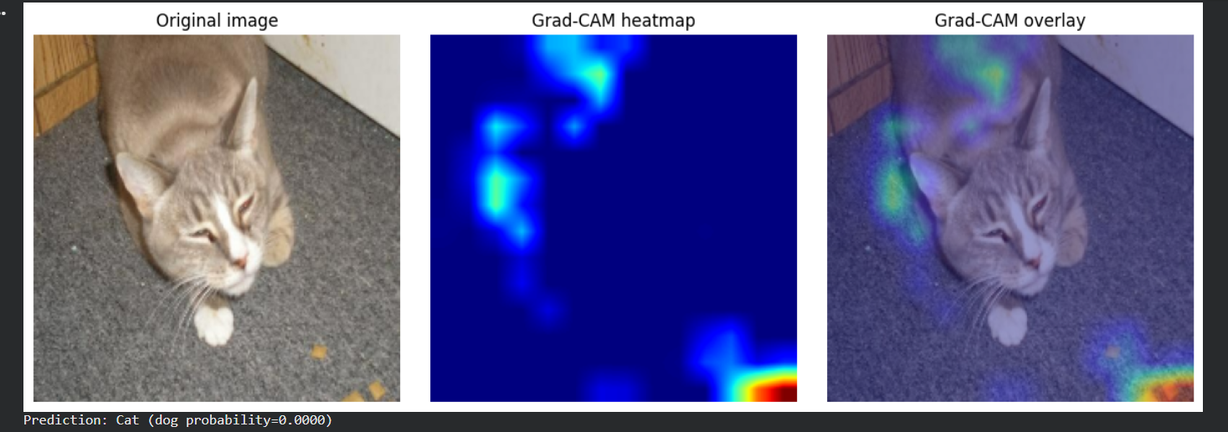
5. Model Interpretability
Intermediate activations and Grad-CAM
Activations visualize learned feature responses. Grad-CAM highlights regions influencing the score; this example is classified as Cat.
Household Animals Classification • 6

Slide 7
6. Conclusion
• Transfer learning outperformed the scratch CNN.
• VGG16 fine-tuning achieved 98.60% test accuracy.
• Dropout and augmentation improved generalization versus baseline.
• Grad-CAM gives a qualitative view of regions affecting predictions.
• Future work: confusion matrix, precision/recall, external images, repeated-seed evaluation.
Household Animals Classification • 7

