Slide 1
FINAL REVIEW
Comparative Analysis of A* and Dijkstra Algorithms for Autonomous Mobile Robot Path Planning Using MATLAB
Benchmarking, heuristic selection and robot motion simulation
Robotics and Automation - BECE312L
Nithujaa J - 23BEC1354 | Dhanya S - 23BEC1432 | Sri Nithi Sathiyamoorthy - 23BEC1440
October 2026

Slide 2
Introduction
How should an autonomous robot find its way?
The problem
Dijkstra
Warehouse, hospital and home robots must plan a path from start to goal without hitting obstacles. The path should be as short as possible, and it must be found quickly on limited onboard hardware.
We model the floor as a grid: each cell is free or blocked, and the robot can move to any of its 8 neighbours.
Spreads out evenly in all directions. Always finds the shortest path, but explores many cells that lead away from the goal.
A* (A-star)
Adds a heuristic: an estimate of the distance left to the goal. This steers the search toward the goal, so far fewer cells are explored.
Research question: How much better is A* than Dijkstra, under which conditions, and which version of A* should a robot use?
Final Review | A* vs Dijkstra Path Planning
2

Slide 3
Methodology
One MATLAB framework, identical maps for every planner
45
9
4
4
random maps
configurations
planners
metrics
1
Generate maps
2
Plan paths
3
Measure
3 sizes (20, 50, 100) × 3 densities (10, 20, 30%), 5 seeded maps each
Dijkstra and A* with Euclidean, Octile and Manhattan heuristics
Path length, planning time, cells explored, memory
4
Verify
5
Simulate robot
6
Conclude
Every path compared with Dijkstra's guaranteed shortest path
Path smoothing + two-wheeled robot with pure-pursuit steering
Decision guideline: when to use which algorithm
Final Review | A* vs Dijkstra Path Planning
3

Slide 4
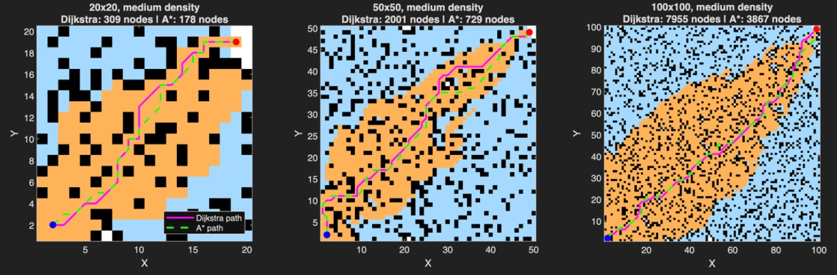
A* vs Dijkstra: Search Space
Medium density maps - cells explored by each algorithm
Explored by Dijkstra only
Explored by both
Obstacle
A* explored 36-78% fewer cells and found the same shortest path on all 45 maps. Dijkstra wastes effort in every direction; A* stays in a band toward the goal.
Final Review | A* vs Dijkstra Path Planning
4

Slide 5
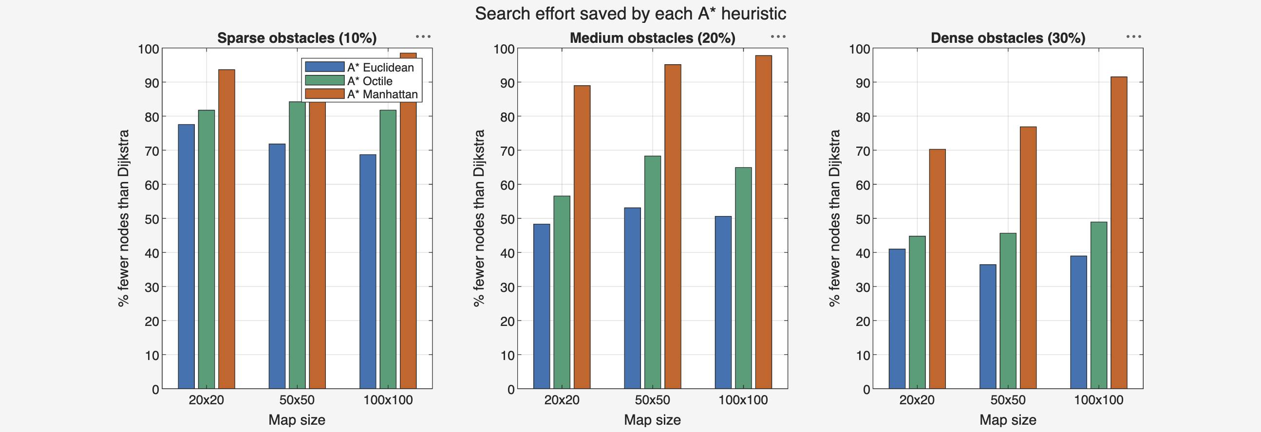
Figure 1: Comparing A* Heuristics
% fewer cells explored than Dijkstra (higher = less work)
Octile is best
Obstacles reduce the gain
Manhattan looks best...
Fewest cells of the heuristics that keep the shortest path: 1,134 vs 1,555 for Euclidean.
Octile saves ~82% on sparse maps but only ~45-49% on dense maps.
...saving up to 99%, but only because it gives up the shortest path (Figure 2).
Final Review | A* vs Dijkstra Path Planning
5

Slide 6
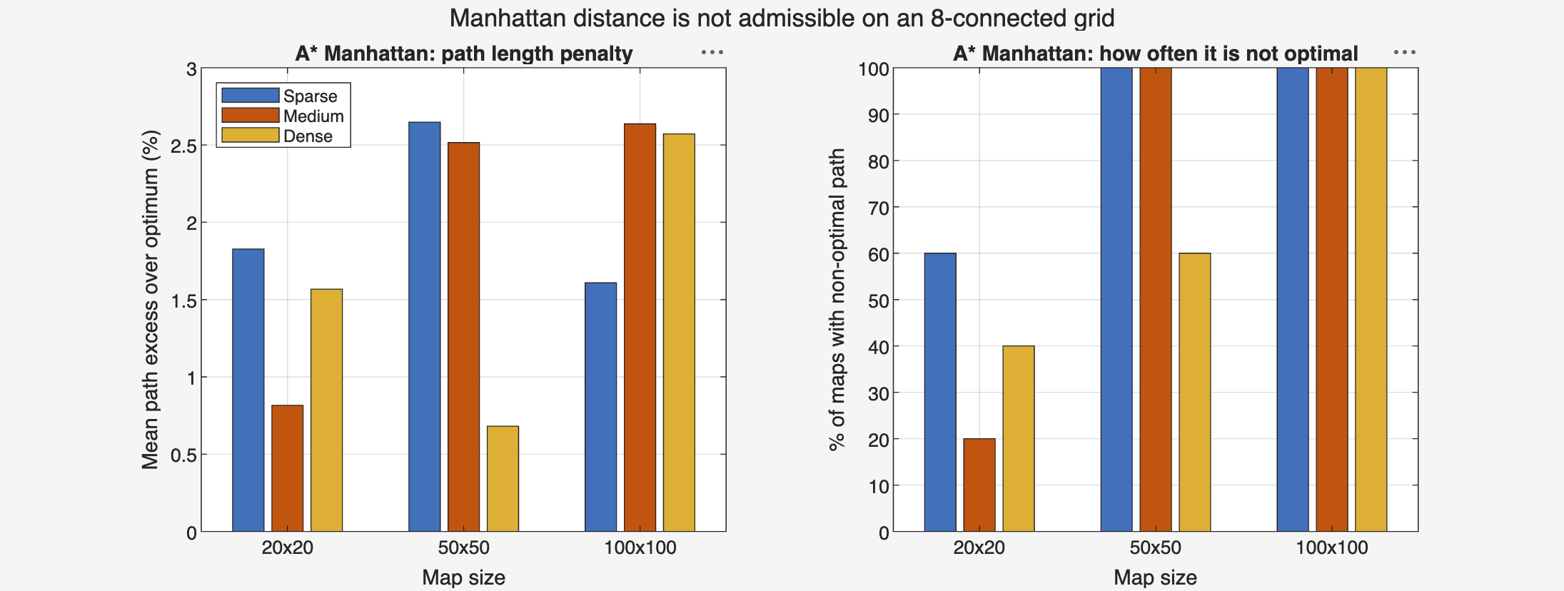
Figure 2: Why Not Manhattan?
Manhattan overestimates diagonal moves (counts 2 instead of 1.41)
Not optimal on 76% of maps
Up to 5.84% longer paths
Use Octile instead
A heuristic that overestimates breaks A*'s shortest-path guarantee.
Every extra metre costs the robot time and battery on every trip.
Shortest path guaranteed, and still the fewest cells explored.
Final Review | A* vs Dijkstra Path Planning
6

Slide 7
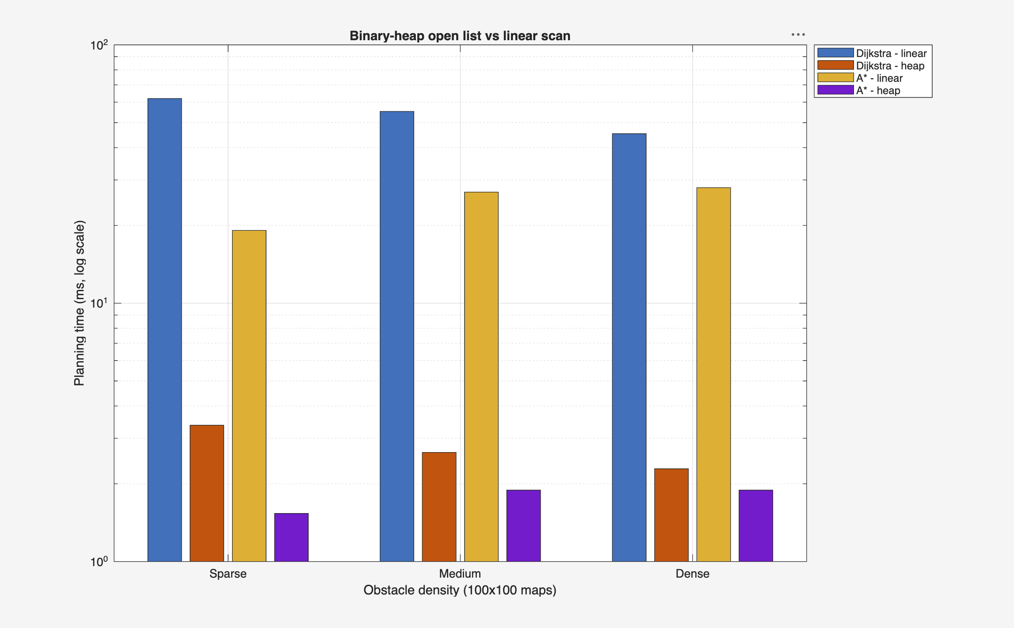
Figure 3: Faster Open List
Planning time on 100×100 maps, log scale
≈20×
faster Dijkstra with a heap (~55 ms → ~3 ms)
≈14×
faster A* with a heap (~25 ms → ~2 ms)
0
difference in paths - only speed changes
Final Review | A* vs Dijkstra Path Planning
7

Slide 8
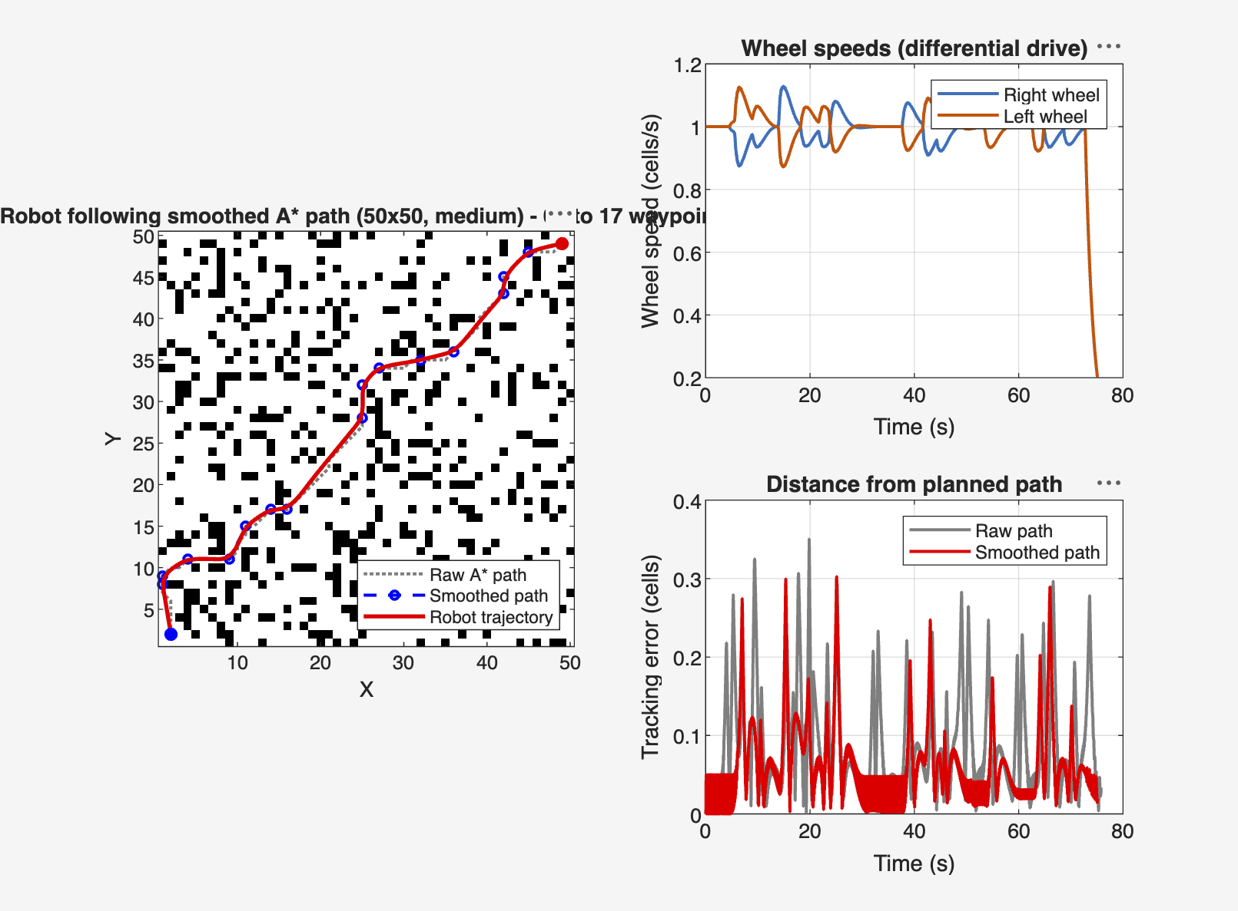
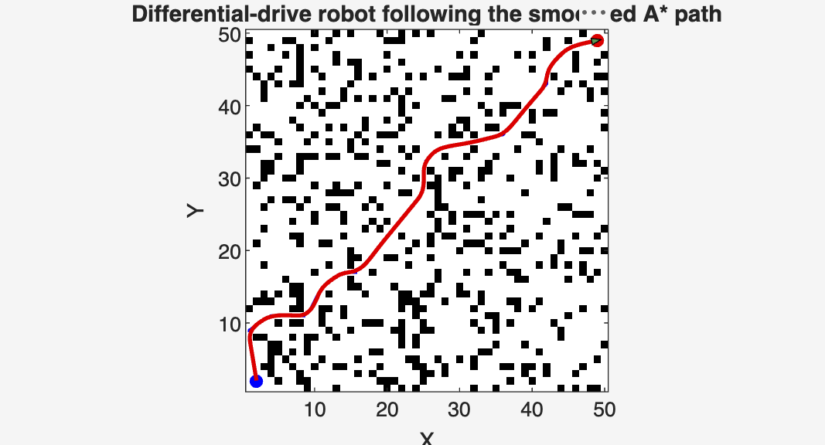
Figures 4 & 5: Robot Motion Simulation
Two-wheeled robot following the smoothed A* path (50×50, medium density)
Smoothing replaces grid zig-zags with straight, obstacle-free segments.
Pure pursuit steers toward a point just ahead on the path.
Result: the robot reaches the goal, staying within 0.35 cells of the plan; smoothing reduces tracking error.
Final Review | A* vs Dijkstra Path Planning
8

Slide 9
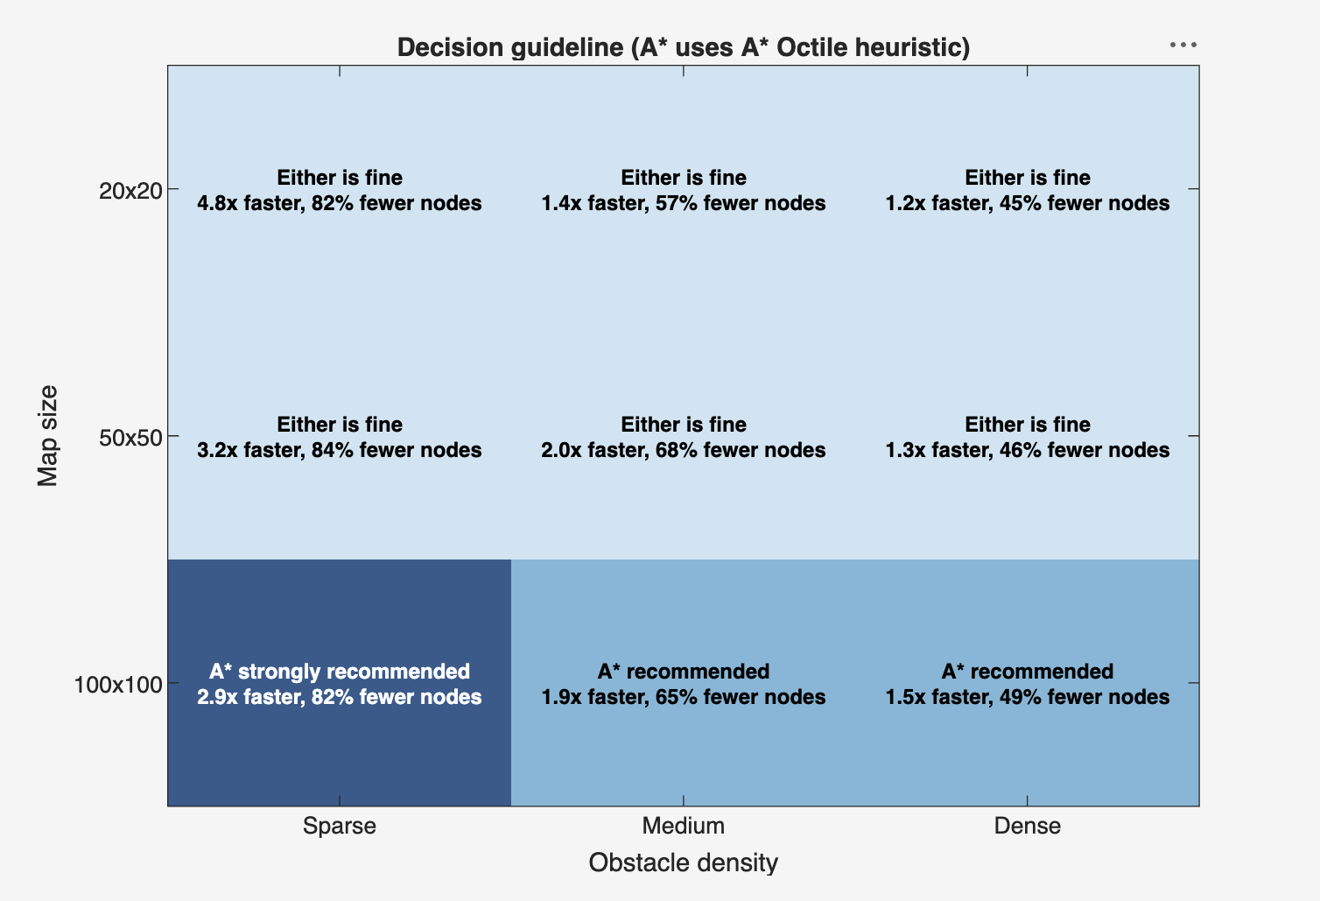
Figure 6: Decision Guideline
When should a robot use A* (with Octile) instead of Dijkstra?
Small maps
Either is fine - Dijkstra already plans in under 1 ms.
Large maps
A* recommended: 1.5-1.9× faster on medium and dense maps.
Large, open maps
A* strongly recommended: 2.9× faster, 82% fewer cells.
Final Review | A* vs Dijkstra Path Planning
9

Slide 10
Key Findings
1
A* is always optimal and faster
2
Octile is the best heuristic
Same shortest path as Dijkstra on all 45 maps, with 36-78% fewer cells explored.
For 8-direction movement: shortest path guaranteed and 27% fewer cells than Euclidean.
3
Manhattan is not safe here
4
Obstacle density matters most
Non-optimal on 76% of maps, up to 5.84% longer paths.
A*'s advantage is largest on open maps and shrinks as obstacles increase.
5
Implementation matters
6
Plans are drivable
A binary-heap open list made planning about 14-20× faster with identical paths.
A simulated two-wheeled robot followed the smoothed path to the goal.
Final Review | A* vs Dijkstra Path Planning
10

Slide 11
Conclusion & Future Scope
Conclusion
Future Scope
A* with the Octile heuristic is the recommended planner for grid-based mobile robots that move in 8 directions.
Its benefit grows with map size and openness: on large open maps it is about 3× faster with over 80% less search.
On small maps either algorithm works; Dijkstra stays useful when distances to many goals are needed at once.
Admissibility is essential: a heuristic that overestimates trades path quality for speed.
Dynamic and moving obstacles (D* Lite)
Weighted A* and Jump Point Search
Larger and real-world maps
Deployment on a physical robot with ROS
Final Review | A* vs Dijkstra Path Planning
11

Slide 12
References
[1] E. W. Dijkstra, "A note on two problems in connexion with graphs," Numerische Mathematik, vol. 1, pp. 269-271, 1959.
[2] P. E. Hart, N. J. Nilsson and B. Raphael, "A formal basis for the heuristic determination of minimum cost paths," IEEE Trans. Systems Science and Cybernetics, vol. 4, no. 2, pp. 100-107, 1968.
[3] J. Pearl, Heuristics: Intelligent Search Strategies for Computer Problem Solving. Addison-Wesley, 1984.
[4] R. C. Coulter, "Implementation of the pure pursuit path tracking algorithm," Tech. Rep. CMU-RI-TR-92-01, Carnegie Mellon University, 1992.
[5] S. M. LaValle, Planning Algorithms. Cambridge University Press, 2006.
[6] R. Siegwart, I. R. Nourbakhsh and D. Scaramuzza, Introduction to Autonomous Mobile Robots, 2nd ed. MIT Press, 2011.
[7] N. R. Sturtevant, "Benchmarks for grid-based pathfinding," IEEE Trans. Computational Intelligence and AI in Games, vol. 4, no. 2, pp. 144-148, 2012.
[8] S. Russell and P. Norvig, Artificial Intelligence: A Modern Approach, 4th ed. Pearson, 2020.
Final Review | A* vs Dijkstra Path Planning
12

Slide 13
Thank You
Questions welcome

