Slide 1
PARTNERSHIP AND FUNDING APP
LEND LEAGUE
DHANYASAKTHI S
SANTHOSH A
RAGHUL AR
JANA KARTHIKEYAN M
PRABU P
KARTHIK RAJA T

Slide 2
ABSTRACT
The Partnership & Funding Web App DT Challenge aims to innovate and streamline collaborative funding efforts. Objectives include enhancing partnership engagement, improving funding accessibility, and fostering community-driven initiatives. By leveraging technology, the project seeks to bridge gaps in funding opportunities, ensuring equitable access for all stakeholders while promoting transparency and efficiency in the funding process.

Slide 3
PERSONA DEVELOPMENT – DT CHALLENGE CONTEXT
Demographic Data
Gender: Male/Female
Age: 17–65
Occupation: Student / Young Entrepreneur
Inferences / Observations
Seeks guidance in securing funding and finding collaborators.
Uses digital platforms but prefers simple, interactive designs.
Interesting Points in Relation to DT Challenge
Wants funding opportunities in a structured, easy-to-track manner (deadlines, favorites).
Prefers visual progress tracking over text-heavy reports.
.

Slide 4
PERSONA DEVELOPMENT – DT CHALLENGE CONTEXT
Surprising / Contradictory Element
Knows how to search for funding online but finds it difficult to organize deadlines, multiple applications, and project milestones in one place.
Key Pain Points (Emotional & Functional)
Emotional: Anxiety and confusion due to lack of clarity in partner/funding search.
Functional: No centralized dashboard to manage partners, funding, and impact simultaneously.

Slide 5

PARTNERSHIP &FUNDING WEB APP DT CHALLENGE
The Partnership & Funding Web App DT Challenge aimed to develop innovative solutions for funding partnerships.
The QBD framework facilitated structured discussions, guiding us through critical questions, brainstorming sessions, and decision-making.

Slide 6

KEY OUTCOMES AND AGREEMENTS
The Partnership & Funding Web App DT Challenge has resulted in consensus on several crucial decisions.
Key outcomes include the identification of target user personas, brainstorming feasible funding strategies, and prioritizing impactful features.
Agreements on implementation timelines and roles have been established to ensure effective collaboration.
These decisions form a solid foundation for the successful development and launch of the application.

Slide 7
TARGET USER PROFILES
Understanding the target users is essential for effective app development.
The primary personas include community organizers, local business owners, and non-profit leaders.
Each persona's unique goals and challenges must be addressed to ensure the app meets their needs.
By tailoring features to these personas, we can enhance user engagement and drive adoption, ultimately maximizing the app's effectiveness and reach.

Slide 8
CORE FEATURES OF THE WEB APP
The Partnership & Funding Web App offers user-friendly navigation, allowing users to easily find and apply for funding opportunities.
The app also provides tools for tracking application progress and managing partnerships, ensuring users can maximize their funding potential and foster meaningful collaborations.
Key features include a dynamic search function, personalized funding recommendations, and a collaborative platform for stakeholders.

Slide 9
CONCEPT DESCRIPTION
A simple, browser-based platform that integrates partner matchmaking, funding management, and impact tracking.
Matchmaking
Select a role (Startup/NGO/World Bank) + goal (Education/Health/Finance).
App suggests “Best Match” or random “Surprise Match.”
Partners can be rated with stars ⭐.
Funding Hub
Add and save funding opportunities (with deadlines).
Countdown of days left until deadlines.
Impact Tracker
Add projects with progress % and goals.
View colorful progress bars.
Completed projects trigger confetti celebration.
Interactive Guidance
AI-style rotating tips every 10 seconds.
Clear navigation tabs (Matchmaking, Funding, Impact).
Intended Impact (Upon User)
Simplifies collaboration and funding search.
Reduces stress by organizing project data visually.
Motivates users with gamified features (ratings, confetti).
Improves accountability by tracking progress clearly.

Slide 10
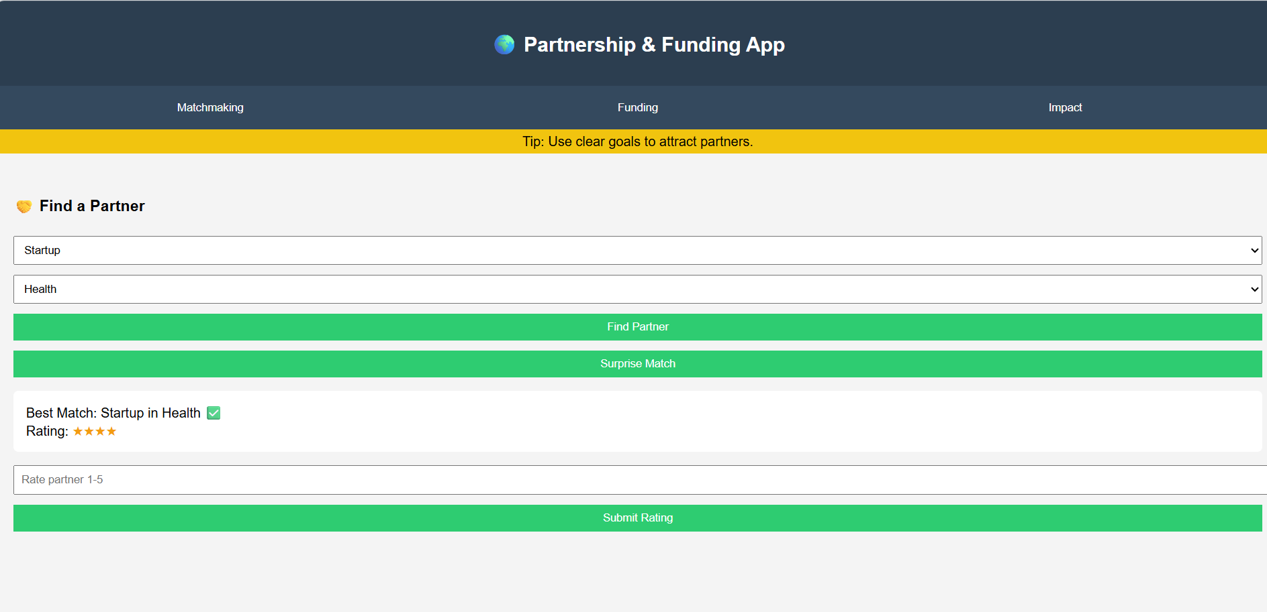
PROTOTYPE REFERENCE

Slide 11
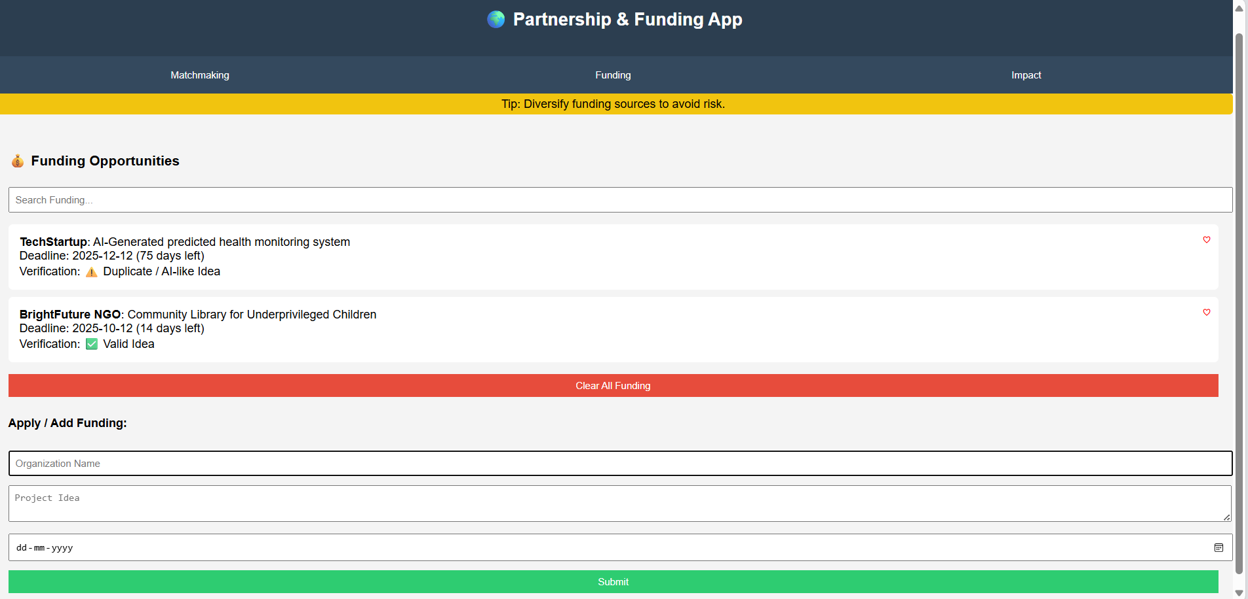
PROTOTYPE REFERENCE

Slide 12
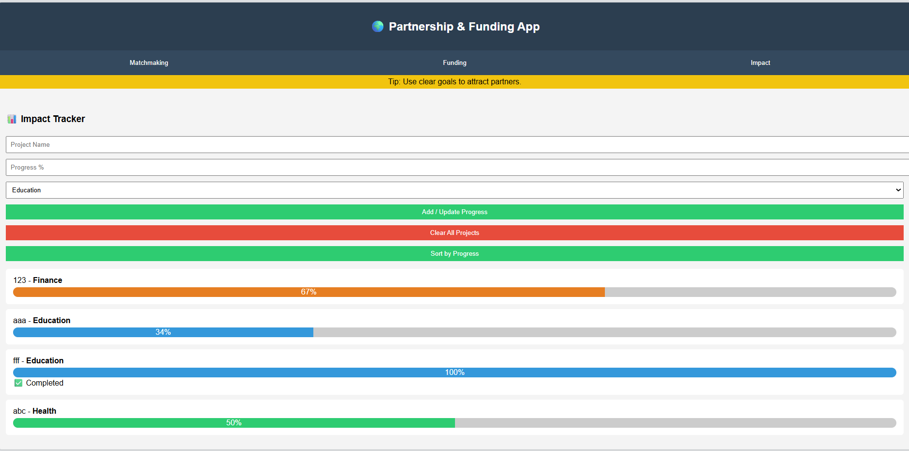
PROTOTYPE REFERENCE

Slide 13
RESEARCH AND REFERENCE
GlobalGiving → https://www.globalgiving.org/ (globalgiving.org)
Ketto → https://www.ketto.org/ (ketto.org)
Chandra, K., Menon, A., Manikonda, L., & Kumaraguru, P. (2025).
Ketto and the Science of Giving: A Data-Driven Investigation of Crowdfunding for India.
Khurana, I. (2021). Legitimacy and Reciprocal Altruism in Donation-Based Crowdfunding: Evidence from India. Journal of Risk and Financial Management, 14(5), 194.

Slide 14
Business Model Canvas Overview
Key Partners
Key Activities
Key Resources
Universities & accelerators
Smart matchmaking algorithms
Web platform technology
NGOs & social enterprises
Funding database maintenance
Partner & funding databases
Funding organizations
Progress tracking tools
AI-powered recommendation engine
Mentorship networks
Community engagement
User community network
Value Proposition
Customer Segments
Core Promise: Transform the overwhelming process of finding partners and funding into an engaging, visual experience that celebrates progress and reduces entrepreneurial anxiety.
Primary Users: Ages 17-65
College students with big ideas
Young entrepreneurs
All-in-one collaboration hub
Early-stage NGOs
Gamified progress tracking
Student-led startups
AI-powered guidance
Stress-free project management
Users seeking simple tools to organize complex collaboration and funding processes.
1
Revenue Streams
2
Cost Structure
Freemium model with premium features for advanced tracking, priority matchmaking, and enhanced funding alerts.
Platform development, database maintenance, AI algorithm updates, and community management resources.

Slide 15
Fostering Connections
Customer Relationships
Channels
We reach our users and deliver our value proposition via:
Our app builds strong relationships through:
Strategic partnerships with universities and startup accelerators.
Personalized mentorship and guidance programs.
Active, moderated online community forums for peer support.
Targeted social media campaigns on platforms popular with young changemakers.
Gamified feedback loops and recognition for milestones.
Prominent app store listings and digital advertising.
Direct, responsive in-app support and resource access.
Engagement through online communities, workshops, and virtual events.

