Slide 1

Cloud
Sphere
Cloud Infrastructure Management Simulation
BACSE202 Database Management Systems · Fall 2026-2027
Faculty: Dr. S. Geetha
Dharaneeshwaran — 25BCE5350
Rohith V S — 25BCE5776
Raakesh M — 25BCE1991

Slide 2







Problem and
Provide consistent allocation records across projects, capacity, and budgets
Objectives
Enable customers to request
and manage cloud resources
Manage capacity and quotas
to ensure fairness and limits
Academic simulation using
synthetic demonstration data only

Slide 3













Architecture and Core ER Model
Technology stack and core data model for CloudSphere
TECHNOLOGY STACK
CORE MODEL
Organization
React + TypeScript
Frontend
1:N
Project
Express REST API
1:N
Backend
1:N
N:1
VMConfiguration
VirtualMachine
CloudHost
1:N
PostgreSQL
Database
MonitoringLog

Slide 4


































Relational Design and Normalization
From redundant records to a normalized schema
Denormalized record (repeats)
Dependency
vm_id
project_id
project_name
org_id
config_id
vcpu
ram_gb
os Image
host_id
state
vm_id → project_id, config_id
project_id → project_name, org_id
config_id → vcpu, ram_gb, os Image
Normalized schema (3NF)
project
virtual_machine
vm_configuration
project_id (PK)
organization_id (FK)
name
vm_id (PK)
project_id (FK)
config_id (FK)
host_id (FK)
state
config_id (PK)
vcpu
ram_gb
os_image
Enforced integrity
Consistency controls
Intentional denormalization
Primary and foreign keys maintain references
Partial unique index prevents
Stored usage counters for faster reporting
Check constraints enforce capacity limits
duplicate active VM names
Protected by transactional routines
config_id abbreviates vm_configuration_id; org_id abbreviates organization_id.

Slide 5
Implementation and SQL
Customer request, administrator decision, transactional allocation
Implemented workflows
Sign-in and project creation
Cost estimate and VM request
Administrator approval or rejection
Start, stop and terminate VM records
Notifications and resource accounting
SELECT p.name, COUNT(v.vm_id) AS vm_count
FROM public.project p
LEFT JOIN public.virtual_machine v
ON v.project_id = p.project_id
GROUP BY p.project_id, p.name;
LEFT JOIN keeps projects with no VMs.
COUNT(v.vm_id) returns zero for those projects.
allocate_resource validates quota, budget and host capacity using row locks. Infrastructure is simulated.

Slide 6
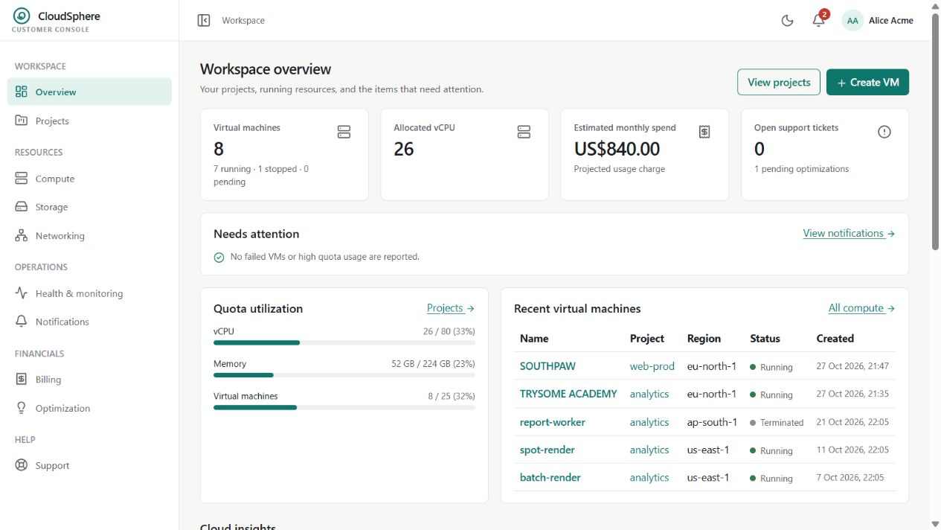
Working application
Actual local screenshot with synthetic demonstration data

Slide 7
Testing and findings
Recorded SQL checks, 3 November 2026
Check
Host capacity counters
Request status consistency
Temporary INSERT / UPDATE / DELETE
Temporary CHECK: vcpu = 0
Frontend production build
Observed result
0 violations
0 inconsistent records
Expected rows returned
Rejected: SQLSTATE 23514
Passed
Temporary CRUD changes were rolled back. Full automated suites were not rerun.
Evidence: tests/review-results.json and tests/README.md

Slide 8







Limitations and Next Steps
CURRENT LIMITATIONS
NEXT STEPS
VM lifecycle is fully simulated in database only
Real local VM or clearly labelled container integration
Monitoring uses stored samples, no real telemetry
Background provisioning worker service
No real hypervisor provisioning integrated
Actual telemetry and monitoring pipeline
Relational integrity and transactional allocation are the current project contribution.
Sources: project README · database migrations 0001-0009 · backend tests · docs/DATABASE DEMO_GUIDE.md
References: PostgreSQL docs: https://www.postgresql.org/docs/ · React docs: https://react.dev/

