Slide 1
SMART INDIA HACKATHON 2026
TITLE PAGE
Problem Statement ID – 26192
Problem Statement Title- FLASH FLOOD PREDICTION SYSTEM FOR HILLY REGIONS USING MULTISOURCE DATA
Theme- disaster management
PS Category- Software
Team ID-
Team Name - TECH TITANS

Slide 2

TRISHUL AI
TECH TITANS
PROPOSED SOLUTION:
* DETAILED EXPLANATION :
AUTONOMOUS SYSTEM: Integrated pipeline tracking environmental changes.
DATA FUSION : Combines satellite, sensor, and drone data.
DATA HUB: Central agency dashboard linked to local nodes
* PROBLEM RESOLUTION :
EARLY WARNINGS: Turns raw data into proactive timelines.
OFFLINE SYNC: Uses mesh networks during grid failure.
UNIFIED MAP: Connects scattered teams via live data.
* INNOVATION AND UNIQUENESS : TRISHUL AI
HYBRID NETWORK: Auto-switches to offline channels during blackouts.
CLEAR IMAGERY: AI penetrates cloud cover via multi-spectrum feeds.
EDGE INDEXING: Low-power sensors calculate risk without cloud servers

Slide 3
TECHNICAL APPROACH
TECH
TITANS
System Architecture:
Ingestion: Streams satellite, drone, and weather data.
AI Core: Runs computer vision and predictive models.
Alert Layer: Routes notifications via online/offline channels.
Key Tech Stack
AI/Backend: Python, TensorFlow, PyTorch, Node-RED.
GIS Engine: GDAL, QGIS, Sentinel Hub API.
Edge Hardware: Raspberry Pi, LoRa Transceivers.
EXECUTION STEPS
1
2
3
Collection
Pulls real-time spatial & environmental streams
Analysis
Detects terrain changes & calculates active hazards
Dispatch
Pushes localized danger indices to field teams

Slide 4
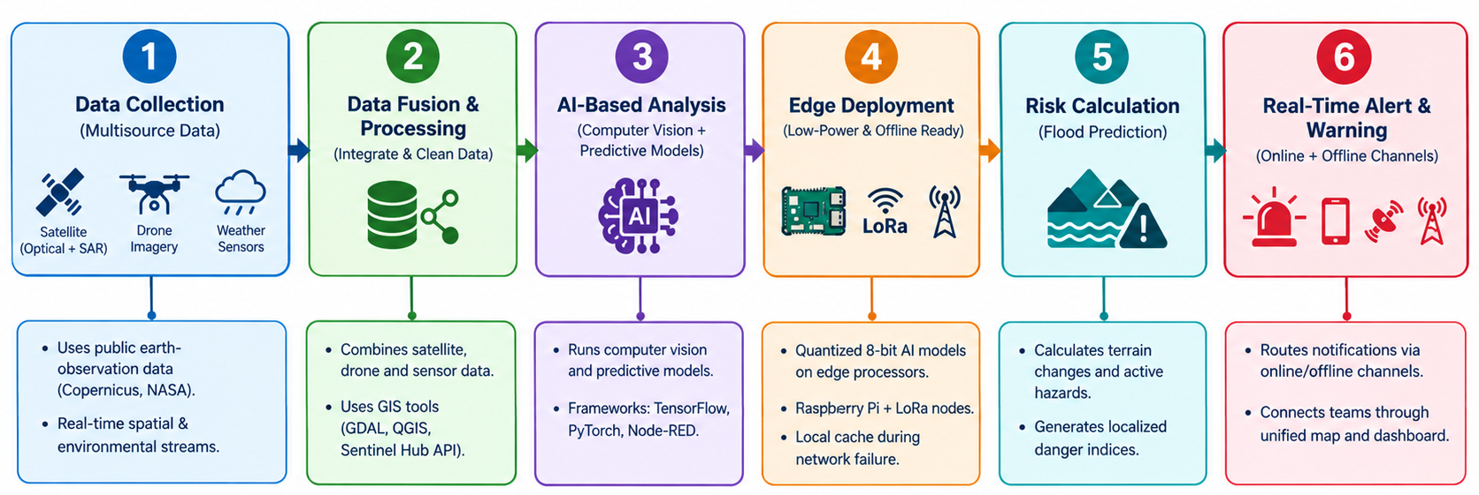
FEASIBILITY AND VIABILITY
TECH
TITANS

Slide 5
IMPACT AND BENEFITS
TECH
TITANS
Evacuation Readiness
Provides predictive early warning timelines directly to district disaster authorities.
.
Responder Safety
Generates live, automated risk maps to protect first responders from hazardous terrain paths
Institutional Alignment
Consolidates fragmented agency data feeds into a unified situational map layer.
Asset Protection
Flags highly vulnerable infrastructure zones to deploy preventative reinforcements early.

Slide 6
RESEARCH AND REFERENCES
TECH TITANS
Spatial Earth OBs Data:
Parameters adapted from public telemetry, specifically Copernicus Sentinel-1/2 SAR/Optical methodologies and NASA Earth Data registries.
AI Vision Baseline:
Spatial segmentation frameworks mapped from peer-reviewed computer vision research on environmental hazard classification.
Wireless Protocols:
Ad-hoc broad-range networking logic built over standardized long-range low-power wide-area network (LPWAN) structures.
NDMA Guidelines:
Risk index definitions and alert staging steps calibrated directly to national disaster mitigation standards.

