Slide 1



IoT-Based Weather Monitoring System
M KUMARASAMY COLLEGE OF ENGINEERING
(Affiliated to Anna University)
Department of Electronics and communication Engineering
Academic Year : (2024-2025) – III Year
Batch : (2022-2026)
Review : First Review
MEMBERS :
AJITHA.M
APARNA . A
DHARANI . S
Guide Name :
MR.L.RAMESH, AP/ECE,
DEPARMENT OF ECE

Slide 2
Objective
• To Develop a real-time IoT-based weather monitoring system, which can be used commonly.
• Monitor parameters like temperature, humidity, and gas level, dust level
• Transmit data to a cloud platform for remote access
• Enable real-time data visualization and alerts.

Slide 3
Literature Survey
Existing Systems
Manual Weather Monitoring Systems
Traditionally, weather monitoring involves manual data collection, which is time-consuming and prone to errors.
Requires human intervention for reading and recording weather conditions.
Automatic Weather Stations (AWS)
Utilizes sensors to capture data automatically but lacks real-time remote access and data storage.
High initial cost and maintenance are major drawbacks.

Slide 4
Methodology
Step 1: Requirement Analysis
Identify required sensors: Temperature, Humidity, Pressure, Rainfall (Optional).
Select communication protocols: Wi-Fi (ESP8266/ESP32) or LoRa.
Step 2: Hardware Setup
Microcontroller: ESP8266/ESP32
Sensors:
DHT11/DHT22 – Temperature and Humidity
BMP180/BMP280 – Atmospheric Pressure

Slide 5
Step 3: Software Development
Code development in Arduino IDE using C/C++.
Use relevant libraries to read data from sensors.
Establish a connection with the cloud platform to upload sensor data.
Step 4: Cloud and Data Processing
Configure a cloud platform (e.g., Thingspeak, Blynk, or Firebase) for data storage.
Visualize data through real-time dashboards.
Implement data logging for historical analysis

Slide 6
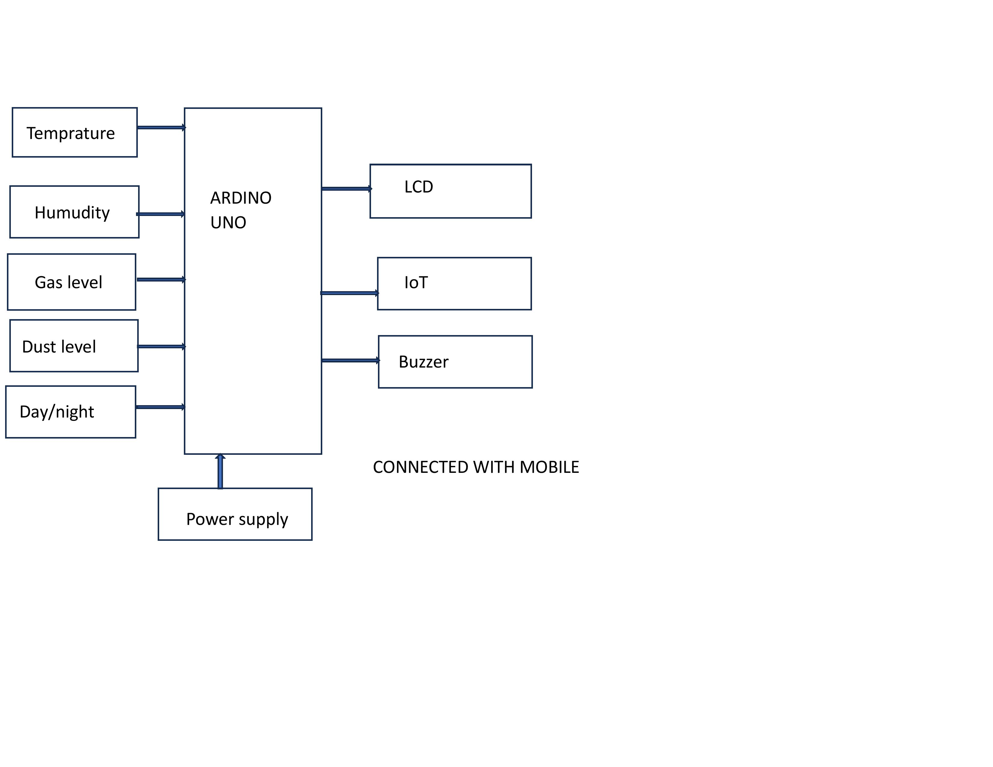
BLOCK DIAGRAM

Slide 7
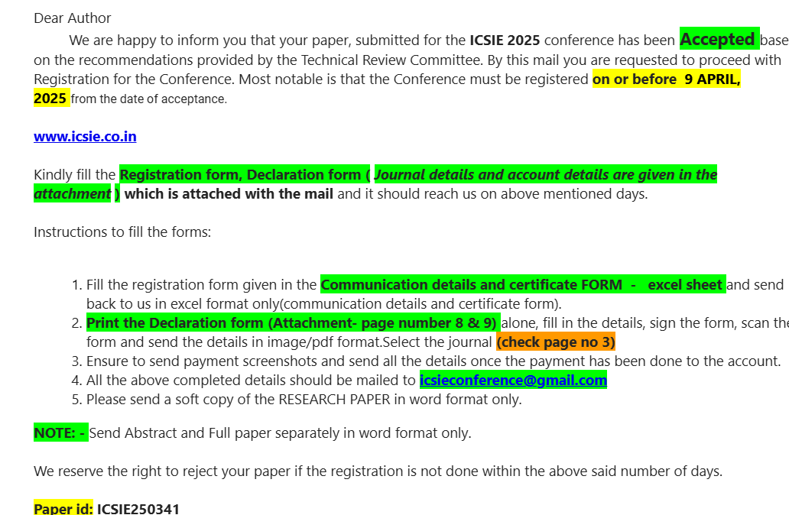
Outcome of the Project

Slide 8
Thank You

