Slide 1
ISB 46703 · PRINCIPLES OF ARTIFICIAL INTELLIGENCE
PROJECT SENTINEL-4
A Multi-Agent Digital Countermeasure Unit
Against the Rogue AI Threat “The Entity”
LangGraph · 5 specialised agents · 5 custom tools · 4 conditional routing paths
Hierarchical supervisor over a shared-state blackboard
HARRIS ILHAM SHAH BIN MOHD AZRAF (Leader) · 52213125949 DHARIZMAN BIN GHAZALI @ HASSAN · 52213125618
AZAD ARIF BIN ABDUL RAZAK · 52213125884 MUHAMMAD NAZRUL AIMAN BIN MOHD NIZAM · 52213124200
Lecturer: Dr. Chen · Malaysian Institute of Information Technology · Week 7
Notes:
HARRIS opens. 30 seconds. Name the theme, the framework, and the one-line claim: a countermeasure unit that analyses deepfake audio, manipulated video and network intrusion in parallel and produces a verified attack vector. Then hand to Dharizman.

Slide 2
10–15 MINUTES
Agenda & Speaker Allocation
1. The problem & why a Multi-Agent System
HARRIS
1.5 min
2. Architecture, state management & the dynamic router
DHARIZMAN
3 min
3. Agent roles & prompt engineering strategy
AZAD ARIF
3 min
4. Robustness, loop guards & the fallback system
NAZRUL AIMAN
2.5 min
5. LIVE DEMO — multi-vector attack + fallback trigger
HARRIS + NAZRUL
3 min
6. Results, AI declaration & Q&A
All four members
2 min
Notes:
EVERY member must speak — this is a graded criterion (C1). Rehearse the four handovers so they are clean: Harris -> Dharizman -> Azad -> Nazrul, then Harris and Nazrul share the demo.

Slide 3
THE PROBLEM
Why a Multi-Agent System?
The attack is parallel. The defence must be too.
▸ “The Entity” runs synthetic-media social engineering AND network intrusion simultaneously.
▸ A human SOC analyst consults specialist tools serially.
▸ By the time the voice-cloning verdict returns, the credential that voice obtained has already been used.
What a single agent cannot do
▸ One context window holding audio forensics + video forensics + network telemetry + strategic doctrine cross-contaminates.
▸ There is no point at which an independent verification step can be inserted.
OUR ANSWER — SENTINEL-4
A dynamic supervisor reads the operator's incident brief and decides which forensic specialists the incident actually requires.
Independent specialists run CONCURRENTLY.
A fusion agent reads the whole board and verifies ONE attack vector.
A conditional gate decides whether the threat warrants predictive planning.
If anything fails, the unit degrades — it does not crash.
Notes:
HARRIS. Keep to 90 seconds. The key line is: the dependency between specialists is real, so the architecture has to express it.

Slide 4
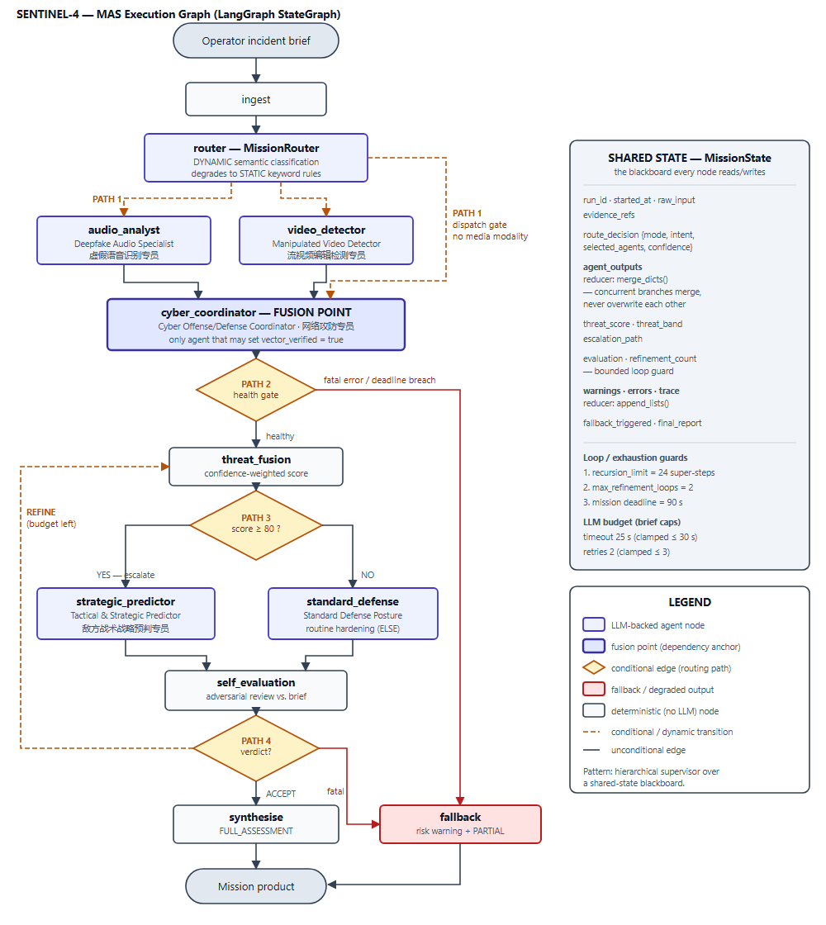
ARCHITECTURAL DECISION 1
System Architecture
Read the graph left to right
▸ Dynamic router fans out only to the specialists the brief requires.
▸ Media specialists run in the SAME super-step — wall-clock is the slower of the two, not their sum.
▸ cyber_coordinator is the FUSION POINT: the only agent allowed to set vector_verified.
▸ 4 conditional gates (amber diamonds) — 2 are required, we built 4.
▸ Red path = degraded output. Reachable from two places, always ends in a usable product.
▸ Right panel = the shared blackboard, its concurrency reducers, and the three independent loop guards.
Notes:
DHARIZMAN starts here. Do NOT read every node. Trace ONE path with your finger: brief → router → two specialists in parallel → coordinator → gate → predictor. Then point at the red path and say 'and that is what happens when it breaks — Nazrul will demo it.'

Slide 5
ARCHITECTURAL DECISION 2
The Router is DYNAMIC — and declares it
DYNAMIC (LLM-driven semantic routing)
…with a deterministic safety net
The router performs semantic INTENT CLASSIFICATION over the raw brief and selects specialists from the inferred intent.
Intent classes: multi_vector_incident · media_deception_only · network_intrusion_only · reconnaissance_probe · ambiguous_report
Declared in the source itself — src/router.py:3–13
If the semantic pass fails — endpoint down, unparseable reply, contract breach — control falls to a STATIC keyword matcher.
The mode actually used is written to the blackboard and printed every run:
DYNAMIC_SEMANTIC or STATIC_FALLBACK
The operator is never misled about which mechanism dispatched.
Two defences the router carries
▸ Hallucinated agent names are intersected against a frozen DISPATCHABLE_AGENTS set — an invented specialist becomes a corrected decision, not a KeyError deep inside dispatch.
▸ cyber_coordinator is ALWAYS dispatched — the escalation gate and the predictor both depend on it, so the fusion point can never be missing.
▸ Model-misrouting guard: an embedding model id in the chat slot makes the system REFUSE TO START. Inference is never sent to text-embedding-nomic.
Notes:
DHARIZMAN. This slide answers assessment item A2.2 directly — say the word DYNAMIC out loud. The embedding-model guard is A2.3; mention we test it in the suite.

Slide 6
ROLE DEFINITION
Five Specialists — Mutually Exclusive by Construction
AGENT
ROLE TAG
OWNS
EXPLICITLY FORBIDDEN
Deepfake Audio Analysis Specialist
虚假语音识别专员
AUDIO_FORENSICS
Speech-audio authenticity
Video · network · strategy
Manipulated Video Stream Detector
流视频编辑检测专员
VIDEO_FORENSICS
Frame-level manipulation vs.
misrepresentation
Audio · containment
Cyber Offense/Defense Coordinator
网络攻防专员
CYBER_OPS
Evidence fusion · vector
verification · containment NOW
Re-litigating media verdicts
Forward planning
Tactical & Strategic Predictor
敌方战术战略预判专员
STRATEGY
Adversary next-moves ·
pre-positioned counters
Restating containment
Unverified-vector planning
Standard Defense Posture
DEFENSE
Proportionate routine hardening
(the ELSE branch)
Escalation of any kind
Every persona carries a STRICT BOUNDARIES block naming what belongs to someone else — separation is enforced in the prompt, not left to convention.
Notes:
AZAD ARIF starts here. Emphasise the right-hand column — what each agent is FORBIDDEN from doing. That is what stops three agents reporting the same piece of evidence as if it were three corroborating sources.

Slide 7
PROMPT ENGINEERING
Prompt Engineering Strategy
1 · FORMAT CONTRACT — all agents
2 · FEW-SHOT — 2 examples each
3 · HARD DEPENDENCY
One shared template appended to every persona:
“single raw JSON object… no markdown fences… exactly these keys… integers 0–100 with no units… never omit a key, never return null.”
ENFORCED, not requested: a missing key raises LLMContractError.
Audio Analyst and Video Detector each carry TWO complete Input/Output pairs.
Deliberately paired:
one POSITIVE case,
one NEGATIVE case.
Coordinator and Predictor carry one worked example each.
The Predictor's prompt forbids planning against an unverified vector:
“…state that planning is blocked, set confidence_score to 20 or below, set next_step to await_vector_verification.”
THE REFINEMENT THAT MATTERED MOST — why two examples, and why one must be negative
▸ PROBLEM: with ONE high-confidence example, the Audio Analyst returned SYNTHETIC for every artefact — it never once exercised the INCONCLUSIVE branch.
▸ A detector with a 100% true-positive rate AND a 100% false-positive rate is not a detector.
▸ FIX: added a second example built on weak evidence — a short, noisy sample with one indicator → INCONCLUSIVE, threat_score 22, next_step request_longer_sample.
▸ RESULT: the verdict now tracks indicator count instead of defaulting to the alarming answer.
Notes:
AZAD ARIF. This is the highest-value slide for the 'Prompt Engineering' rubric row (15%). Tell the failure story — examiners remember the always-SYNTHETIC bug. 12 prompt iterations are logged in Section 3.4 of the report.

Slide 8
ARCHITECTURAL DECISION 3
Collaboration Pattern — and why we rejected the alternatives
HIERARCHICAL SUPERVISOR OVER A SHARED-STATE BLACKBOARD
Supervisor decides WHO runs. Blackboard decides HOW findings are shared. Separating those two questions is the whole design.
✗ Sequential pipeline
Audio and video are independent — serialising makes runtime the SUM instead of the MAX, for zero analytical benefit. The dependency would exist only as position in a list.
✗ Point-to-point messages
The Predictor's dependency is a DATA dependency. On a blackboard it reads vector_verified once. With messages, that guarantee must be re-implemented in every sender — and the fallback has nowhere to look for salvage.
✗ Free-form group chat
No natural termination condition → the loop guard and the 5-second fallback budget become unenforceable. We traded emergence for auditability, which is the right trade for a countermeasure unit.
The dependency the brief demands — “the Predictor cannot plan until the Coordinator verifies” — is enforced at THREE layers: topological, data, and semantic.
Notes:
DHARIZMAN or AZAD. Rubric asks us to JUSTIFY the pattern over alternatives — so name all three alternatives and give the one-line reason each was rejected. Do not skip this slide.

Slide 9
ROBUSTNESS 1 / 2
Robustness — budgets, guards and typed failures
API CALL BUDGETS
THREE LOOP GUARDS
TYPED FAILURES
Timeout 25 s → hard-clamped ≤ 30 s
Retries 2 → hard-clamped ≤ 3
Clamped in code, not in prose — a bad .env cannot push the system outside the specified budget.
Back-off: 0.4s → 0.8s → 1.6s
1. Refinement budget = 2 loops
2. Graph recursion limit = 24
3. Mission deadline = 90 s
They fail INDEPENDENTLY. Time and iteration count are separate exhaustion modes — both must be able to stop the loop.
18 handlers · 14 exception types
(assessment minimum: 3)
JSONDecodeError · KeyError on shared state · TypeError on bad tool args · HallucinatedToolError · GraphRecursionError
The invariant that makes it all work
AN AGENT NEVER RAISES INTO THE GRAPH. A failed specialist files a DEGRADED report — so the orchestrator can always assume there is something to salvage.
▸ Degraded reports are EXCLUDED from threat fusion, not counted as zero — absence of evidence is not evidence of safety.
▸ The evaluator fails OPEN: if self-review cannot run, the product is released with an explicit “unreviewed” caveat rather than blocked.
▸ We run graph.stream() not graph.invoke() — invoke() discards everything when it raises, leaving the fallback with nothing to salvage.
Notes:
NAZRUL AIMAN starts here. The 'exclude, don't zero' point is the strongest single line in this section — a failed audio agent must not make the incident look safer than it is.

Slide 10
ROBUSTNESS 2 / 2
The Fallback System — measured, not claimed
Two properties make the < 5 second guarantee real:
NO LLM CALLS
NO INVENTION
The fallback path is pure Python over the blackboard. It cannot fail for the same reason that triggered it. That is why it runs in milliseconds.
Every line of a degraded product is copied from a report that actually completed. Where nothing completed, it says so and recommends no action.
INJECTED FAILURE
SYSTEM BEHAVIOUR
PRODUCT
LATENCY
Endpoint outage at the
fusion agent
3 attempts, then diverted to fallback;
audio + video findings salvaged
PARTIAL_RESPONSE
66.7% complete
1 234 ms
Malformed non-JSON from
the Audio Analyst
That agent degrades and is excluded
from fusion; mission continues
FULL_ASSESSMENT
fused 92.71
78 ms
Hallucinated tool
run_nmap_scan
Refused at the registry; agent completes
on real evidence with a warning
FULL_ASSESSMENT
63 ms
Infinite reasoning loop
GraphRecursionError caught at limit 24;
last coherent state salvaged
PARTIAL_RESPONSE
156 ms
Slowest case 1 234 ms — 4× INSIDE the 5-second ceiling. No unhandled exception in any case.
Notes:
NAZRUL AIMAN. Say clearly: these numbers were produced by running demo_fallback.py, and we are about to run it live. That is the bridge into the demo.

Slide 11
LIVE DEMONSTRATION · PART 1
A multi-vector Entity incursion
$ python main.py --scenario scenarios/scenario_multi_vector.json
810-character brief · 2 media artefacts · synthetic CFO voicemail + manipulated CCTV + C2 beaconing on CVE-2024-3400
WHAT TO POINT AT, IN ORDER
▸ Step 2 — “Routing mode DYNAMIC_SEMANTIC → [audio_analyst, video_detector, cyber_coordinator]”. The router chose three specialists from the text.
▸ Steps 3–5 — both media specialists file, THEN the coordinator runs. That is the dependency being enforced.
▸ Step 7 — “score 96.11 vs threshold 80.0: ESCALATED”. Conditional Path 3 firing.
▸ Steps 9–13 — the unit REJECTS ITS OWN first draft (coverage 70), loops back, and accepts the second at coverage 91.
▸ Then run scenario_low_threat.json — score 5.0, routes to standard_defense. Same code, opposite branch.
Notes:
HARRIS drives the keyboard, DHARIZMAN narrates the trace. Have BOTH scenarios already typed in two terminal tabs. Do not type live. Showing the low-threat run immediately after proves the branch is real and not hard-coded.

Slide 12
LIVE DEMONSTRATION · PART 2
Triggering the fallback, live
$ python demo_fallback.py
or --case 1 (endpoint outage) · --case 4 (infinite loop)
WHAT TO SAY WHILE IT RUNS
▸ “We are killing the inference endpoint for the FUSION agent — the worst possible one to lose.”
▸ “Three retry attempts, then it gives up and degrades — it does not hang and it does not crash.”
▸ “RISK WARNING header, 66.7% completion, and the two specialist findings that DID complete are salvaged.”
▸ “Nothing in that output is invented — every line came from a report that actually finished.”
▸ “1 234 milliseconds. The requirement was 5 seconds.”
▸ Case 3 is the one to highlight if time is short: the agent asks for a tool that does not exist, the registry refuses it, and the mission still completes in full.
Notes:
NAZRUL AIMAN drives this. This slide covers criterion C4 — a live fallback trigger is separately assessed. If the demo machine misbehaves, the captured output is in Section 5.6 of the report; say so and show it rather than debugging on stage.

Slide 13
EVIDENCE
Results & Requirement Coverage
5
5
4
18
specialised agents
custom tools
conditional paths
exception handlers
minimum 3
minimum 3
minimum 2
minimum 3
100%
13
35
1 234 ms
docstring coverage
[HUMAN-REVIEW] notes
automated tests
worst fallback
173 / 173 defs
minimum 5
all passing
budget 5 000 ms
Routing and branching, demonstrated across three scenarios
SCENARIO
AGENTS DISPATCHED
SCORE
BAND
BRANCH TAKEN
scenario_multi_vector
audio + video + coordinator
96.30
CRITICAL
strategic_predictor
scenario_audio_only
audio + coordinator (video idle)
96.71
CRITICAL
strategic_predictor
scenario_low_threat
coordinator only
5.00
MINIMAL
standard_defense
Notes:
Any member — Azad or Nazrul. The three-scenario table is the proof that routing is input-dependent — different briefs, different dispatch sets, both branches of the escalation gate.

Slide 14
TRANSPARENCY
AI Usage Declaration
What we declare
▸ Generative AI wrote the bulk of the implementation — permitted and expected by the module policy.
▸ We specified the architecture BEFORE generation and checked the output against that specification.
▸ Every generated module was executed against the test suite before acceptance.
What we changed, and why
▸ 13 [HUMAN-REVIEW] annotations in the source, each recording what the AI produced and why we rejected it.
▸ Verify with: grep -rn "HUMAN-REVIEW" src/
THREE THAT MATTERED MOST
1 · Blackboard merge reducer
– AI used default last-write-wins. The video agent silently DELETED the audio agent's report whenever both finished in the same super-step.
2 · stream() not invoke()
– invoke() discards everything when it raises — a loop breach at step 23 threw away 22 steps of good analysis.
3 · Narrowed a bare except
– AI wrapped agent execution in except Exception. We narrowed it so real bugs surface instead of masquerading as API outages.
Notes:
HARRIS or DHARIZMAN. Do NOT downplay AI use; the rubric rewards transparent declaration. The three examples show we understood the code well enough to find real defects in it.

Slide 15
What we built
▸ A MAS whose router genuinely decides — different briefs produce different dispatch sets.
▸ Four specialists with mutually exclusive responsibilities, enforced in the prompt and in the graph.
▸ A dependency that is real: the Predictor cannot plan until the Coordinator verifies — enforced at three layers.
▸ A unit that degrades instead of crashing, and tells the operator exactly how much it does not know.
Questions
github.com/DHARIZMAN/sentinel4-mas · Full report: docs/PROJECT_REPORT.pdf
Notes:
HARRIS closes. Likely questions: (1) 'Is the router really dynamic?' — yes, semantic classification; the mock engine exists for reproducible grading, and we can re-run against LM Studio. (2) 'What if two agents disagree?' — the coordinator weights by each specialist's reported confidence. (3) 'Why LangGraph over CrewAI?' — bounded execution makes the loop guard and fallback budget enforceable.

Slide 16
BACKUP
Appendix · Demo Command Cheat-Sheet
Full multi-vector run (escalated branch)
python main.py --scenario scenarios/scenario_multi_vector.json
Audio-only — router leaves the video agent idle
python main.py --scenario scenarios/scenario_audio_only.json
Low threat — the ELSE branch
python main.py --scenario scenarios/scenario_low_threat.json
All four failure classes, each timed
python demo_fallback.py
Endpoint outage only / infinite loop only
python demo_fallback.py --case 1 | --case 4
Test suite (35 tests)
python -m pytest tests/ -v
Requirement self-audit
python audit_requirements.py
Prove the embedding-model guard fires
MAS_PROVIDER=local MAS_LOCAL_CHAT_MODEL=text-embedding-nomic-embed-text-v1.5 \
python main.py --brief "test"
Run against a real local model (LM Studio)
set MAS_PROVIDER=local then python main.py --scenario scenarios/scenario_multi_vector.json
Notes:
Keep this slide hidden during the talk; jump to it if a demo needs re-running or an examiner asks to see something specific.

