Slide 1

Project Title : Implementing Deep Learning Models for Face Recognition Domain: Pattern Recognition and Neural Networks
Final Review
Course Code: CS7510
Course Title: Project 2
Register Number:23MSP3068
Name: Dharshani A
Date: 01/03/2024

Slide 2
Abstract
Facial recognition technology harnesses deep learning algorithms to identify and verify individuals, presenting a crucial tool in security, personalization, and other applications. However, the effectiveness of these algorithms varies significantly based on their design and the specific tasks they are applied to.
This study aims to explore the development and evaluation of deep learning models for facial recognition tasks, focusing on their capability to accurately identify and verify individual faces within diverse datasets.
Three distinct deep learning models were analysed, each employing unique methodologies and documented in separate notebooks. These included Convolutional Neural Networks (CNNs) for direct facial recognition, VGG16-based models for classifying images of BTS members, and custom models for image similarity verification.
The CNN-based model demonstrated moderate success in facial recognition with an accuracy of approximately 71.93%. In contrast, the VGG16-based model, despite its focus on the nuanced task of classifying BTS member images, struggled significantly, achieving only 15% accuracy. The model designed for image similarity verification, utilizing feature extraction and similarity scoring, performed near-randomly with an accuracy close to 49%.
The study's findings illuminate the diverse challenges and complexities inherent in designing deep learning models for facial recognition tasks. The varying levels of success across models underscore the necessity for ongoing research, model refinement, and the exploration of innovative approaches to improve accuracy and reliability.
Keywords: Deep Learning, Facial Recognition, Convolutional Neural Networks, VGG16, Image Similarity, Model Evaluation, Feature Extraction, Machine Learning.

Slide 3
Introduction
In the realm of access control systems, the quest for secure, efficient, and user-friendly solutions continues to drive innovation.
Traditional methods, such as keycards and PIN codes, while prevalent, are not without their limitations, often susceptible to theft, loss, or unauthorized duplication.
Biometric alternatives, particularly facial recognition technology, offer a promising avenue for overcoming these challenges.
However, the widespread adoption of facial recognition systems has been hindered by their limited performance in diverse environmental conditions and susceptibility to spoofing attacks.
To address these issues, this project seeks to develop a robust facial recognition system tailored for biometric building access.
By leveraging convolutional neural networks (CNNs) and exploring advanced techniques like Siamese networks, we aim to enhance accuracy, speed, and security in facial recognition.
Our approach involves comprehensive data collection, preprocessing, model training, and evaluation, with a focus on real-world applicability and scalability.
Through this endeavor, we anticipate making significant contributions to the field of access control systems, offering an innovative solution that addresses key challenges and paves the way for enhanced security and convenience in various domains.

Slide 4
Need of study
1. Ensure accurate recognition across varied conditions (e.g., lighting, appearance changes) for reliable access control.
2. Develop rapid and efficient recognition methods to minimize entry delays and enhance user experience.
3. Implement robust security measures to counter spoofing attempts, safeguarding against unauthorized access.
4. Address privacy concerns by prioritizing data protection and ensuring user consent in facial recognition systems.
5. Facilitate seamless integration with existing access control infrastructure for easy adoption and scalability.

Slide 5
Problem Statement
Modern urban settings require secure, efficient, and non-intrusive access control systems.
Traditional access methods like keys, cards, and PINs can be lost, stolen, or forgotten, compromising security and convenience.
Facial recognition offers a promising keyless and personalized alternative for access control.
Achieving consistent accuracy and reliability in varied conditions (lighting, angles, facial changes) is a significant challenge.
The project aims to develop a facial recognition system for building access, focusing on enhanced accuracy, speed, and robustness against environmental variations and spoofing attempts.

Slide 6
Objectives
To evaluate the performance of Convolutional Neural Networks (CNNs) and Siamese networks in facial recognition to determine their accuracy and reliability across varied datasets.
To assess the robustness of Siamese networks in learning facial features, and their effectiveness in verification tasks with the implementation of attention mechanisms.
To explore the versatility of Siamese networks in recognizing complex relationships, such as kinship, and their potential integration with egocentric vision systems for enhanced object identification.
To identify and bridge gaps in the literature concerning the application of Siamese networks in challenging environments, focusing on issues like partial occlusion and diverse lighting conditions.
To contribute innovative solutions for the advancement of facial recognition technology by developing models that are more adaptable, interpretable, and effective in real-world scenarios.

Slide 7
Related Work
Research explores Siamese neural networks for face recognition and kinship verification.
Transfer learning, ResNet, and VGGNet architectures are key techniques utilized.
These studies highlight the networks' versatility in biometric verification and security enhancement.
The collective progress indicates a unified approach towards addressing complex biometric and deep learning challenges.
Each piece of research contributes to advancing identification methods and relationship analysis, facilitating security and social analytical applications.

Slide 8
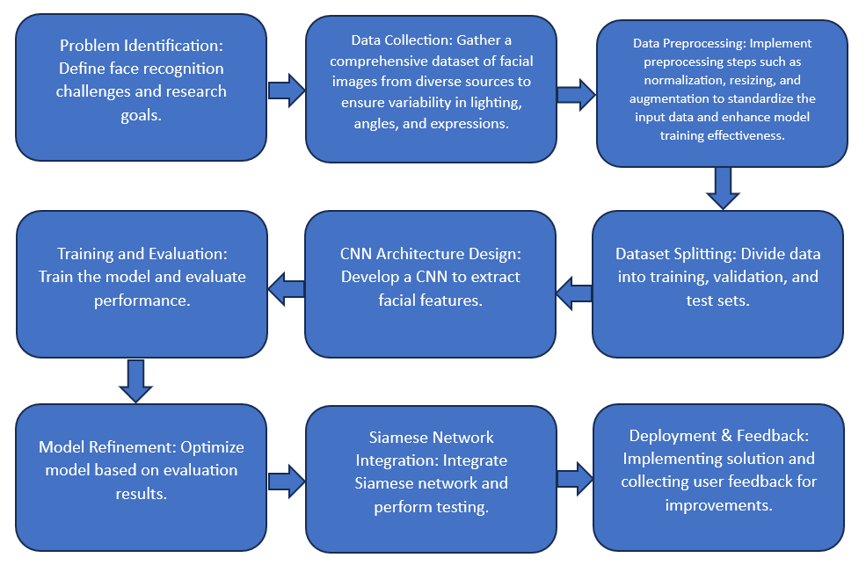
Proposed Methodology

Slide 9
Proposed Methodology
Problem Identification:
Identify challenges in facial recognition, including lighting, angle, and expression variations. Define research goals to address these challenges.
Data Collection:
Collect a diverse dataset of facial images from various sources to ensure variability in lighting, angles, and expressions. Ensure the dataset represents real-world scenarios.
Data Preprocessing:
Implement preprocessing steps like normalization, resizing, and augmentation to standardize input data. These steps enhance model training effectiveness and robustness to variations.
Dataset Splitting:
Divide collected data into training, validation, and test sets. This ensures proper evaluation and prevents overfitting during model training.
CNN Architecture Design:
Design a Convolutional Neural Network (CNN) tailored for facial feature extraction. Experiment with different architectures to optimize performance.

Slide 10
Proposed Methodology
Training and Evaluation:
Train the CNN model using the training data and evaluate its performance on the validation set. Adjust hyperparameters and model architecture as needed for better results.
Model Refinement:
Optimize the CNN model based on evaluation results. Fine-tune parameters and layers to improve accuracy and generalization.
Siamese Network Integration:
Integrate a Siamese network architecture to capture fine-grained differences between facial features. Test the integrated model and compare performance with the CNN.
Deployment & Feedback:
Deploy the facial recognition solution in real-world scenarios, such as biometric access control systems. Gather user feedback for further improvements and iterations.

Slide 11

Dataset
Source of the Dataset: @bts.bighitofficial on Instagram
No. of Observations: 50 images * 7 members
Total Observations after Augmentation: 16800 = 50*7*24*2

Slide 12
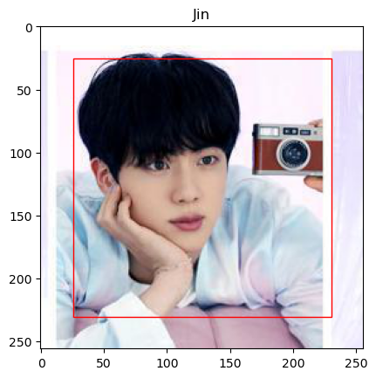
Exploratory Data Analysis
A Python function was designed to display an image with bounding box annotations and a caption.
It opens an image file and an annotation file, which contains the coordinates for the bounding box.
These coordinates are normalized and scaled according to the image's dimensions to properly position the bounding box on the image.
The Rectangle method is used to draw the bounding box.

Slide 13
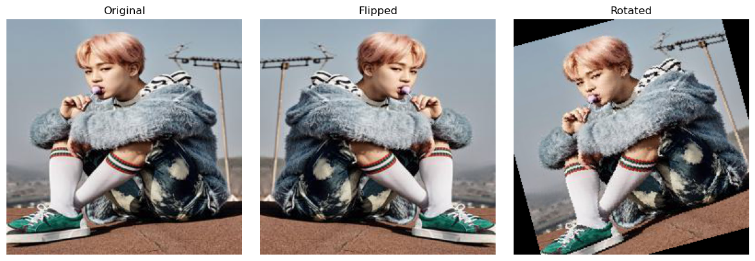
Exploratory Data Analysis
The data is augmented on an image by creating two altered versions: one that is mirrored and one that is rotated.
A random image is chosen from a dataset, manipulated, and then three versions — the original, the mirrored, and the rotated (by 15°)— are displayed together with their corresponding labels.
This process is part of preparing a more diverse set of training data for machine learning models, helping them to better generalize by learning from varied representations of the same object.
The output image illustrates the result of these augmentations, with the original image in the centre flanked by its horizontally flipped and slightly rotated counterparts.

Slide 14
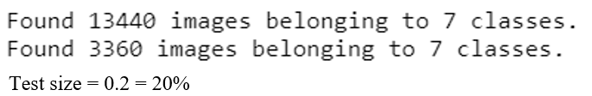
Exploratory Data Analysis
Train-Test Split for 16800 images
There is a collection of 16,800 images that are divided into two sets: One set with 13,440 images and another set with 3,360 images, both distributed across 7 different classes (7 members of BTS).
This division corresponds to a training and a validation (or test) set with the test set size being 20% of the total images.

Slide 15
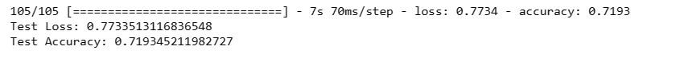
Results and Discussion
Classification Convolutional Neural Networks (CNNs)
Test Loss: The test loss is a quantitative measure of how well the model's predictions match the actual labels of the test data. A lower test loss indicates a model that makes predictions closer to the true labels. In the context of the image, the test loss is 0.7733513116836548, which suggests that there is some room for improvement, as a perfect model would have a test loss of 0.
Test Accuracy: The test accuracy is a measure of the fraction of predictions the model got right. In this case, the model has a test accuracy of 0.719345211982727 or about 71.93%. This indicates that the model correctly predicts the class of the input image around 72% of the time on the test dataset.

Slide 16
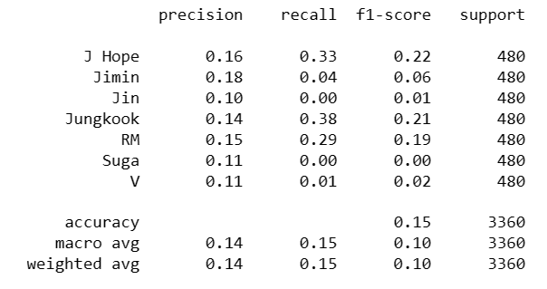
Results and Discussion
Custom CNN Model
Looking at these performance metrics…
The f1-scores are quite low, which suggests the model is not performing well in identifying the individuals accurately. In particular, the f1-scores for Jin, Suga, and V are extremely low (0.01, 0.00, and 0.02, respectively), indicating a poor performance in classifying these individuals.
It’s also worth noting that the accuracy is quite low at 0.15.

Slide 17
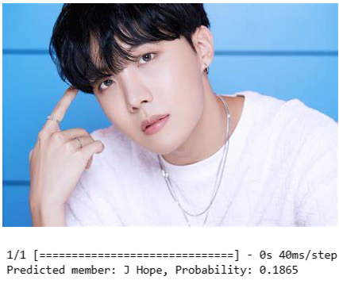
Results and Discussion
Class Prediction using CNN
The model is predicting a member's face
with a probability. The predicted member
is "J Hope" with a probability of 0.1865,
which is quite low and indicates uncertainty
in the model's prediction.

Slide 18
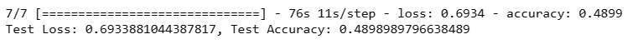
Results and Discussion
VGG16 and Siamese Model
Test Loss: The loss function value on the test data is 0.6933. In the context of binary classification, a loss value close to 0.693 (which is the -log (0.5)) suggests that the model is doing no better than random guessing. This is especially the case when you have a balanced dataset (equal number of positive and negative pairs).
Test Accuracy: The accuracy on the test set is 0.4899, which is just below 50%. Since accuracy is the number of correct predictions divided by the total number of predictions, an accuracy of around 0.5 in a two-class problem indicates that the model's predictive capability is not better than flipping a coin.

Slide 19
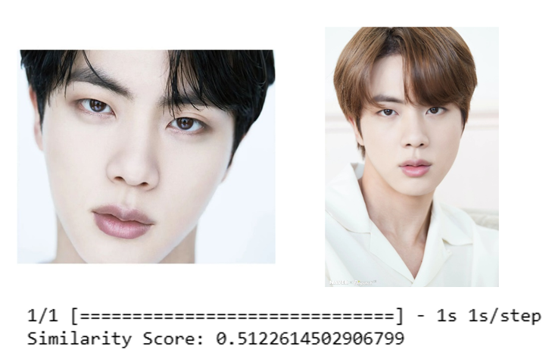
Results and Discussion
VGG16 and Siamese Model
The model predicts the similarity score between two images. The output shows a similarity score of 0.5122. This score, typically between 0 and 1, indicates how similar the two images are, according to the model. A score close to 0.5 may suggest that the model is uncertain whether the images are of the same person or not.

Slide 20
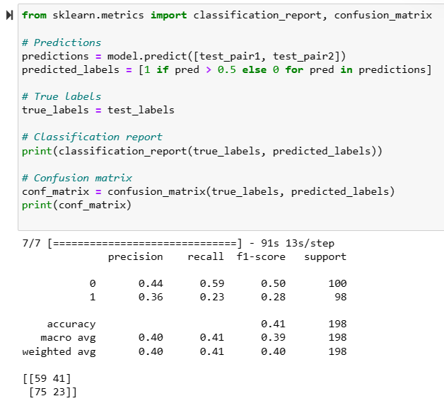
Results and Discussion
The classification report and confusion matrix are generated for the predictions made by the model. The classification report shows the following metrics for each class (0 and 1):
Precision: For class 0, it is 0.44, and for class 1, it is 0.36. Precision tells us out of all the instances the model predicted for a class, how many were actually correct. Low precision for both classes indicate many false positives.
Recall: For class 0, the recall is 0.59, and for class 1, it is 0.23. Recall tells us out of all the actual instances of a class, how many the model correctly predicted. The model is better at identifying class 0 than class 1, but neither are particularly good.
F1-score: For class 0, it's 0.50, and for class 1, it's 0.28. The F1-score is a harmonic mean of precision and recall, and a low F1-score for both classes indicate poor performance.
Support: This indicates the number of actual occurrences of each class. Both classes have a support of 98, suggesting the test set is balanced.
VGG16 and Siamese Model
Confusion Matrix | Predicted: No | Predicted: Yes
Actual: No | 59 | 41
Actual: Yes | 75 | 23
The high number of false negatives suggests the model is conservative in predicting positives.
The relatively balanced number of true negatives and false positives indicates the model is somewhat indiscriminate in its predictions.
Overall, the model is underperforming in both separating the classes and identifying positives accurately.

Slide 21
Conclusion
Techniques for improved facial feature differentiation were explored, enhancing the system's ability to distinguish between individuals even under varied conditions such as different lighting or appearance changes​​.
A CNN model specifically tailored for the accurate recognition of BTS members was developed and refined through preprocessing and augmentation strategies.
Siamese Neural Network was implemented thereby boosting the model's performance and reliability on test datasets​​.
The model's accuracy and reliability were evaluated, ensuring its robustness and applicability in real-world scenarios​​.

Slide 22
Future Enhancement
Enhancing the dataset to cover a wider range of conditions and expressions for improved model robustness, while also refining the system for faster, real-time authentication.
Advancing cross-platform integration and developing stronger anti-spoofing measures to secure against fraudulent access attempts.
Incorporating privacy safeguards and continuous learning to ensure the system respects user privacy and adapts to new data over time.
Scaling the system for broader application and training on an internationally diverse set of faces to ensure global effectiveness.

Slide 23
References : APA format
Kumar, C. R., N, S., Priyadharshini, M., E, D. G., & M, K. R. (2023). Face recognition using CNN and Siamese network. Measurement: Sensors, 27(2023), 100800. https://doi.org/10.1016/j.measen.2023.100800
Solomon, E., Woubie, A., & Emiru, E. S. (2024). Deep Learning Based Face Recognition Method using Siamese Network. arXiv preprint arXiv:2312.14001. Retrieved from https://arxiv.org/abs/2312.14001
Hamdani, N. D., Bousahba, N., Bousbai, A. H., & Braikia, A. (2023). Face Detection and Recognition Using Siamese Neural Network. International Journal of Computing and Digital Systems, 14(1), 889-897. http://dx.doi.org/10.12785/ijcds/140169
Yu, H. Q. (2024). Attention Enhanced Siamese Neural Network for Face Validation. Artificial Intelligence and Applications, 2(1), 21–27. https://doi.org/10.47852/bonviewAIA32021018
Navghare, T., Muley, A., & Jadhav, V. (2024). Siamese Neural Networks for Kinship Prediction: A Deep Convolutional Neural Network Approach. Indian Journal of Science and Technology, 17(4), 352-358. https://doi.org/10.17485/IJST/v17i4.3018
Menendez, E., Martínez, S., Díaz-de-María, F., & Balaguer, C. (2024). Integrating Egocentric and Robotic Vision for Object Identification Using Siamese Networks and Superquadric Estimations in Partial Occlusion Scenarios. Biomimetics, 9(100), 1-21. https://doi.org/10.3390/biomimetics9020100
Hajamohideen, F., Shaffi, N., Mahmud, M., Subramanian, K., Al Sariri, A., Vimbi, V., ... & for the Alzheimer’s Disease Neuroimaging Initiative. (2023). Four-way classification of Alzheimer’s disease using deep Siamese convolutional neural network with triplet-loss function. Brain Informatics, 10(5). https://doi.org/10.1186/s40708-023-00184-w

