Slide 1
PROJECT 5 • INDUSTRY-LEVEL DATA DIAGNOSTICS
Agricultural Productivity & Yield Analysis in India
A Capstone Audit resolving reporting unit inconsistencies and regional yield disparities across 33 states, 646 districts, and 124 crops (1997–2015)
AUTHOR / ANALYST
COURSE PROFILE
Trivedi Dharmik
Data Analytics & Visualization Training

Slide 2
AGENDA | Executive Roadmap & Structure
AGRICULTURAL PRODUCTIVITY AUDIT
01
The Business Case
02
Data Integrity Pipeline
03
Unit Inconsistency Trap
Agricultural variance and objective parameters for national policy focus.
Whitespace stripping, casing standardization, and outlier identification.
Resolving the mixed-unit data trap (nuts vs. bales vs. tonnes) using the Yield Index.
04
SQL Query Engine
05
Python EDA & BI Layer
06
Actionable Guidelines
SQLite execution covering joins, rankings, window functions, and pre-computed views.
Statistical modeling, Area-Yield independence, HTML Dashboard & Power BI metrics.
5 strategic policy recommendations, study limitations, and institutional learnings.
Agricultural Productivity & Yield Analysis in India | Slide 2 of 14

Slide 3
01 | The Core Challenge & Policy Objective
AGRICULTURAL PRODUCTIVITY AUDIT
THE BUSINESS PROBLEM
THE POLICY OBJECTIVE & SCOPE
• Productivity Disparities: Crop yields show extreme variance across geographic zones, states, and weather seasons.
• Resource Optimization: Agricultural departments lack visual tools to pinpoint underperforming areas for infrastructure investments.
• Incompatible Data Units: Government datasets contain crop records that measure production differently, complicating aggregate audits.
• Land Scaling Paradox: Physical expansion of farms does not automatically map to efficiency gains, prompting a diagnostic audit.
• Geographic Diagnostics: Map productivity index across 6 zones to locate structural yield deficits.
• Performance Benchmarking: Isolate high-performing states (e.g. Punjab) to model best practice factors.
• Risk Identification: Flag highly volatile rain-fed states (e.g. Rajasthan) for crop-insurance programs.
• Policy Action Plans: Create 5 concrete recommendations combining seed replacements, micro-irrigation, and yield focus.
CRITICAL METRIC FORMULATIONS
Yield = Production (Quantity) ÷ Cultivated Area (Hectares) | Yield Index = Yield_i,c ÷ National Historical Mean Yield_c
Agricultural Productivity & Yield Analysis in India | Slide 3 of 14

Slide 4
01 | Dataset Scale & Variable Profiles
AGRICULTURAL PRODUCTIVITY AUDIT
DATA SOURCE PROFILE
246,091
33
Cleaned historical records are sourced from the Open Government Data Portal of India (data.gov.in), representing agricultural stats published by the Ministry of Agriculture & Farmers Welfare. The dataset tracks row-level district statistics across 19 crop years, making it highly representative for historical audits and geographic diagnostics.
RAW RECORD COUNT
STATES & TERRITORIES
Comprehensive audit scale
National geographic coverage
646
19
DISTRICTS MAPPED
CROP YEARS COVERED
Granular regional analysis
Historical span (1997–2015)
DATA COLUMNS PROFILE
State_Name • District_Name • Crop_Year • Season • Crop • Area (Hectares) • Production (Variable Units)
Agricultural Productivity & Yield Analysis in India | Slide 4 of 14

Slide 5
02 | Data Integrity & Cleaning Pipeline
AGRICULTURAL PRODUCTIVITY AUDIT
1. Casing & Whitespace
2. Missing Value Sweep
3. Duplicates Validation
Standardized casing to Title Case and stripped trailing spaces in text fields (e.g. 'Kharif ').
3,730 rows (1.52% of dataset) missing Production values dropped. Avoided fabricated values.
Verified composite key uniqueness (State, District, Year, Season, Crop). Zero duplicates found.
4. Constraint Integrity
5. Yield Index Creation
6. Outlier Flagging (IQR)
Audited dataset for invalid numbers (Area <= 0 or Production < 0). All records passed successfully.
Calculated Yield = Production / Area. Built relative Yield Index to enable crop-invariant aggregates.
Applied IQR method per-crop. Flagged 7,680 records (3.17%) as outliers; kept in database for audit trail.
PIPELINE AUDIT RESULT
246,091 Raw Records ──► 242,361 Cleaned Records Mapped to SQL (98.48% Preservation Rate, 3.17% Flagged Outliers)
Agricultural Productivity & Yield Analysis in India | Slide 5 of 14

Slide 6
02 | The Unit Inconsistency Trap
AGRICULTURAL PRODUCTIVITY AUDIT
THE HAZARD
THE RESOLUTION: YIELD INDEXING
In official Indian agricultural statistics, Production is reported in heterogeneous units depending on the crop category: • Coconuts: reported in absolute number of nuts • Cotton & Jute: reported in bales (approx. 170kg–180kg) • Rice, Wheat, Pulses: reported in metric tonnes Averaging raw yield calculations (Production ÷ Area) across different crop categories silently blends nuts, bales, and tonnes. Any global averages or simple sums would be mathematically invalid and economically misleading.
To allow valid cross-crop aggregations, we constructed a relative Yield Index. Every district-crop-year record is divided by the historical national average yield of that specific crop.
Yield_Index_i,c = Yield_i,c ÷ Historical_Mean_Yield_c
• Index = 1.0: Record is exactly equal to the national crop average. • Index = 1.5: Productivity is 50% above the average for that specific crop. This indices approach allows us to compare Rajasthan and Punjab fairly, even though they grow entirely different crop mixes.
Agricultural Productivity & Yield Analysis in India | Slide 6 of 14

Slide 7
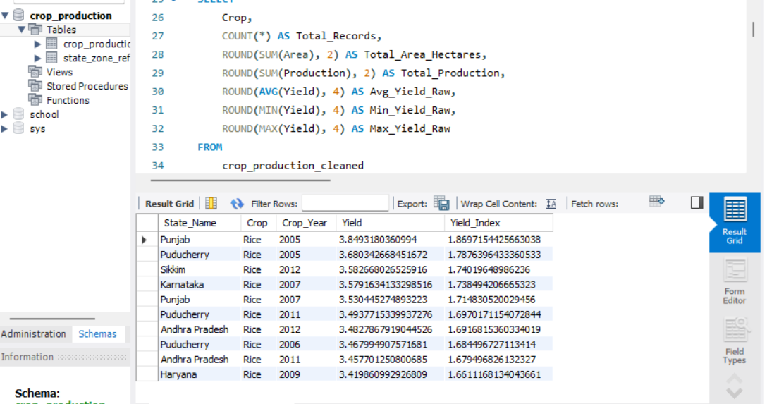
03 | SQL Analytics Engine & Query Schema & screenshots
AGRICULTURAL PRODUCTIVITY AUDIT
ANALYTICAL SQL QUERY TECHNIQUES
• Reference Joins: Connected clean production table with a State-Zone reference mapping to enable geographic grouping.
• Rankings Partitioning: Leveraged RANK() OVER (PARTITION BY Zone ORDER BY AVG(Yield_Index) DESC) to determine top states.
• YoY Growth Lag: Built Year-over-Year calculations using LAG(Avg_Index, 1) OVER (ORDER BY Crop_Year) to assess trends.
• Pre-computed Views: Designed and indexed SQL View (V_Agricultural_Productivity_KPIs) to serve as a fast dashboard source.
Agricultural Productivity & Yield Analysis in India | Slide 7 of 14

Slide 8
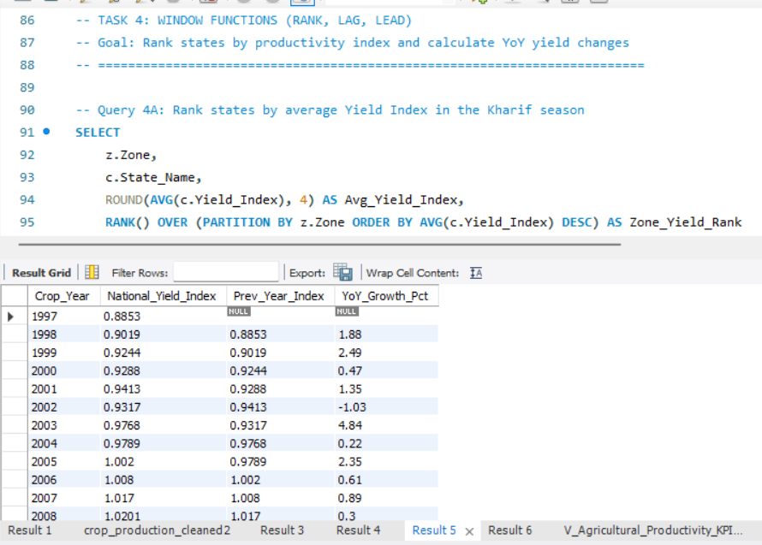
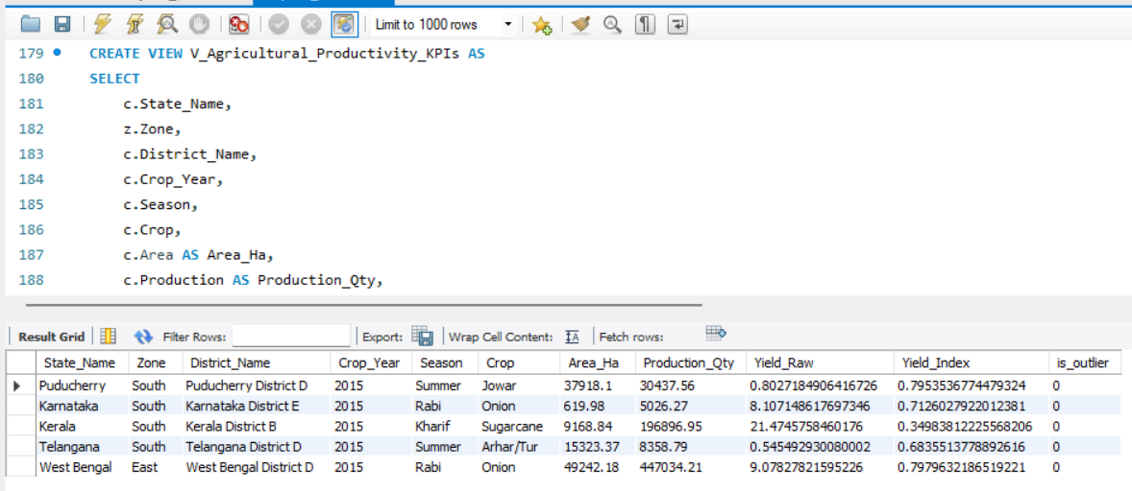
03 | MORE SCREENSHOTS OF DIFFERENT TASKS (SQL)

Slide 9
04 | National Productivity Growth Profile
AGRICULTURAL PRODUCTIVITY AUDIT
GROWTH DRIVERS & REPORTING ANOMALIES
+22%
• Long-Term Growth Trajectory: National relative productivity demonstrates steady annual gains, validating national programs (e.g. Rashtriya Krishi Vikas Yojana).
• The 2015 Crop Year Drop: The apparent productivity collapse in 2015 is a statistical illusion. The dataset contains only 561 records for 2015, compared to over 13,000 in average years.
• Policy Pre-emption: Outlining the 2015 data gap prevents policymakers from concluding a sudden crisis occurred, emphasizing the necessity of complete data audits.
RELATIVE YIELD RISE (1997 → 2013)
National Yield Index increased from 0.93 to 1.14. Reflects a genuine long-term rise in agricultural efficiency driven by irrigation infrastructure and seed replacements.
Agricultural Productivity & Yield Analysis in India | Slide 8 of 14

Slide 10
04 | Benchmark vs. Volatile Risk States
AGRICULTURAL PRODUCTIVITY AUDIT
THE BENCHMARK
THE RAINFALL RISK STATES
Punjab • Yield Index: 1.508
Rajasthan & MP • Low & Volatile
• High Productivity: Punjab exhibits an index of 1.508, meaning it produces 51% more crop output per hectare than the average state growing the same crops.
• Infrastructure Resilience: Year-to-year yield volatility is low (0.518 standard deviation). Indicates robust protection from monsoon variability due to extensive canal and tubewell networks.
• Technology Adoption: High seed replacement rate and early adoption of Green Revolution practices maintain its outlier productivity benchmark status.
• Low Relative Productivity: Rajasthan (0.876 index) and Madhya Pradesh (0.817 index) operate below the national crop averages.
• High Yield Volatility: Both states display elevated standard deviation scores (0.970+), indicating production swings based on monsoon variations.
• Policy Indication: These regions require high-priority policy focus for micro-irrigation (drip/sprinklers), local rainwater harvesting, and robust crop insurance.
Agricultural Productivity & Yield Analysis in India | Slide 10 of 14

Slide 11
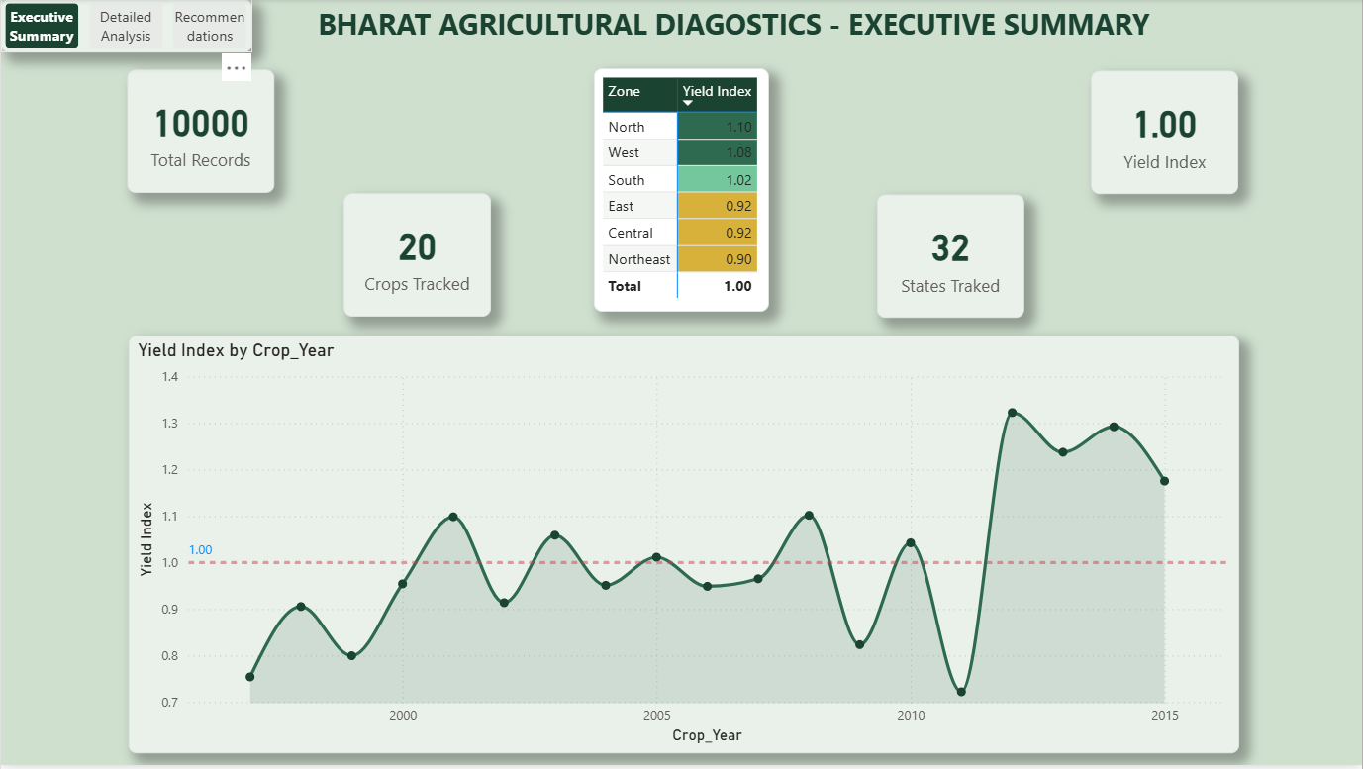
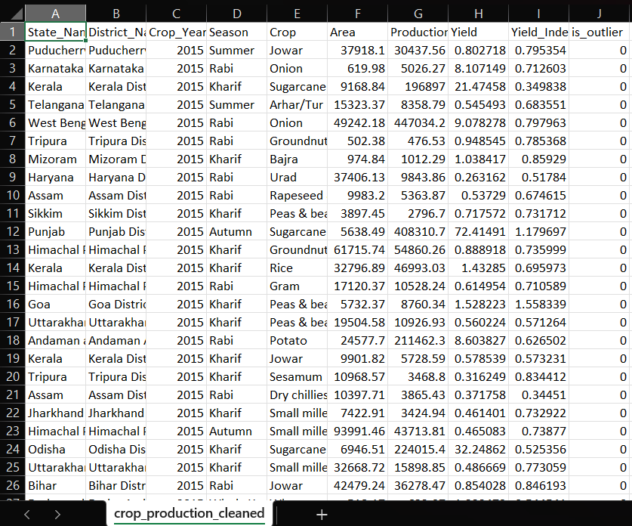
05 | Visualization Of BI Dashboard Layer
AGRICULTURAL PRODUCTIVITY AUDIT
Power BI DAX Build Guide
• Data Model Setup: Joins cleaned crop data with State-Zone references in Power Query Desktop.
• DAX Crop Parity: Custom measure calculates rebased crop yields to bypass mixed-unit traps.
• Crop Mean Measure: Crop_Mean = CALCULATE(AVERAGE(data[Yield]), ALLEXCEPT(data, data[Crop])).
• Index Measure: Yield_Index = DIVIDE([Yield], [Crop_Mean], 0) to compute final normalized values.

Slide 12
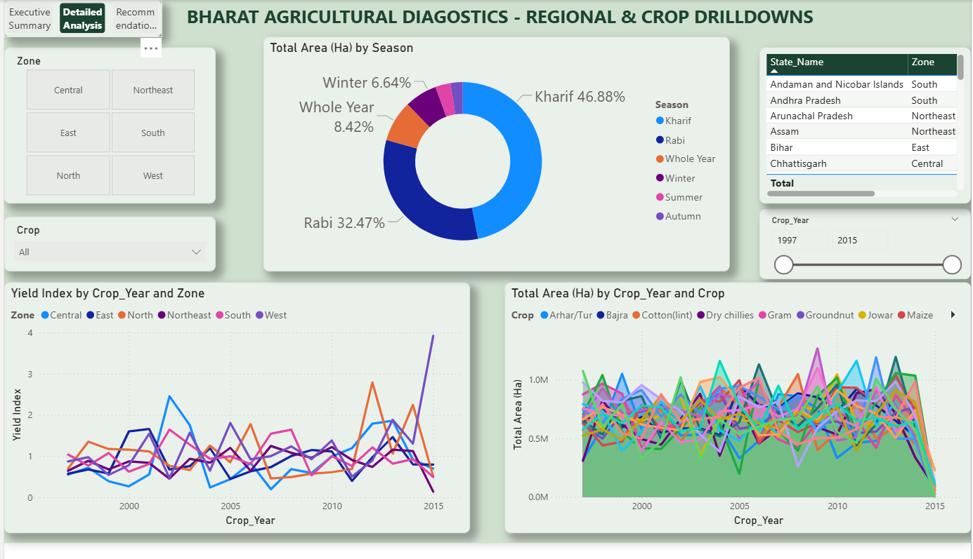
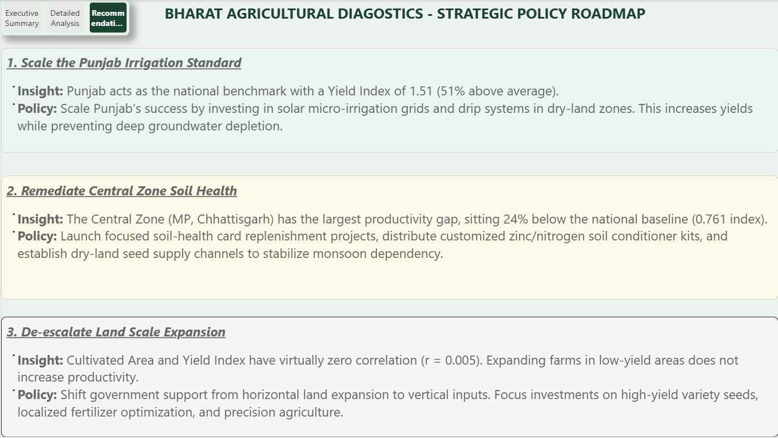
More screenshots

Slide 13
06 | Actionable Policy Recommendations
AGRICULTURAL PRODUCTIVITY AUDIT
1. REPLICATE PUNJAB MODEL
Document irrigation-access success metrics in Punjab and extend canal/tubewell networks to underperforming states where water resources permit.
2. TARGET CENTRAL ZONE
Prioritize the Central Zone (MP, CG) for immediate agricultural extension services, seed-replacement initiatives, and soil health checks to bridge the 24% yield lag.
3. DE-RISK RAIN-FED REGIONS
Focus water-conservation budgets on Rajasthan & MP. Prioritize these high-volatility states for micro-irrigation (drip/sprinklers) and rainwater harvesting.
4. SUSTAIN EFFECTIVE PROGRAMS
National relative productivity rose 22% between 1997 and 2013. Protect funding for successful national schemes (e.g. RKVY) and direct surpluses to lagging states.
5. TARGET INPUTS, NOT LAND AREA
Area and Yield display near-zero correlation (r = 0.005). Interventions must target yield-enhancing inputs (seed quality, fertilizer, irrigation) rather than expanding farm scale.
Agricultural Productivity & Yield Analysis in India | Slide 12 of 14

Slide 14
THANK YOU
End of Technical Presentation
From raw government statistics to policy-ready insights. Open for questions and feedback.
PRESENTER
DATABASE CONNECTOR
Trivedi Dharmik
Cleaned SQLite Database (crop_production.db)
Agricultural Productivity & Yield Analysis in India | Slide 14 of 14

