Slide 1



ATTENDANCE SYSTEM USING RFID
DEPARTMENT OF ELECTRONICS AND COMMUNICATION ENGINEERING
PRESENTED BY
ASHVATHAN V M – 20ECR015
ASWIN S – 20ECR018
DHARSHIKA S – 20ECR034
GUIDED BY
NAME : S . PREETHI M.E
DESIGNATION : ASSISTANT PROFESSOR (SrG)

Slide 2
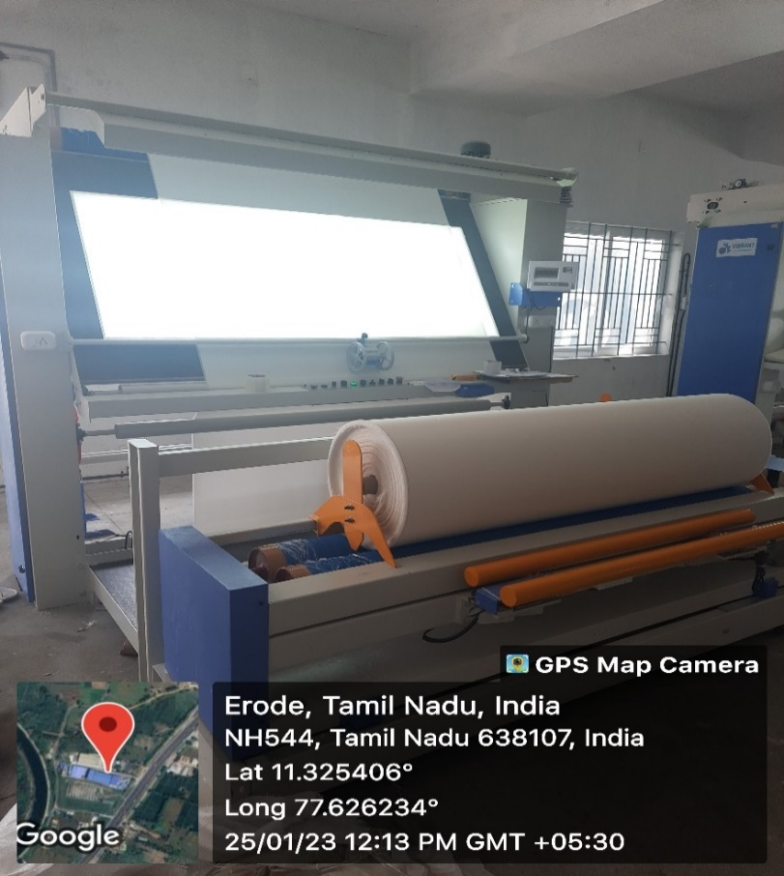
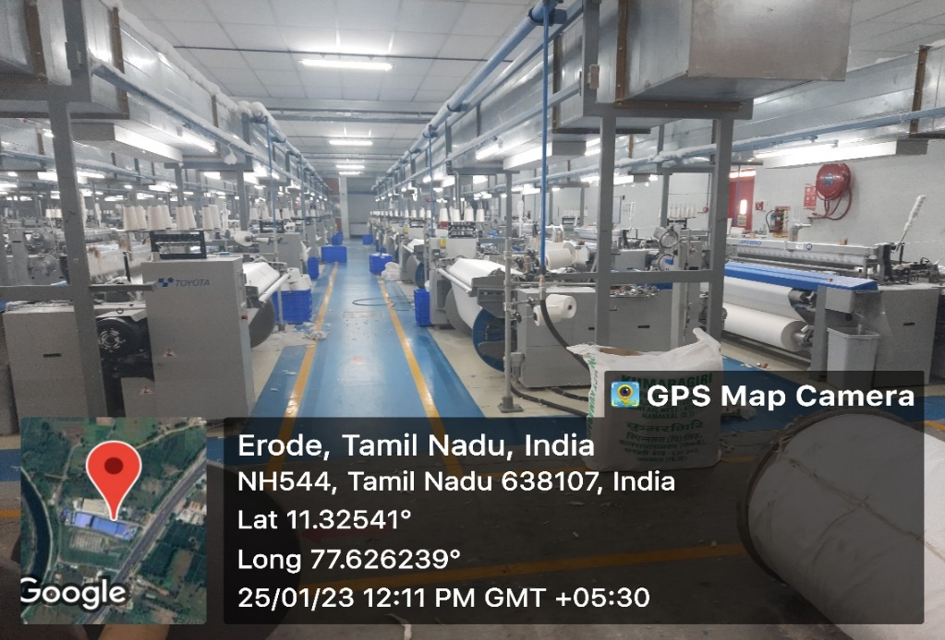
INDUSTRY DETAILS
NAME : ADITYA EXPORTS
ADDRESS : NH 54,
PERIYA VAIKALMEDU,
ERODE - 638107
TYPE OF INDUSTRY : AUTOLOOMS
NO OF EMPLOYEES : AROUND 250

Slide 3
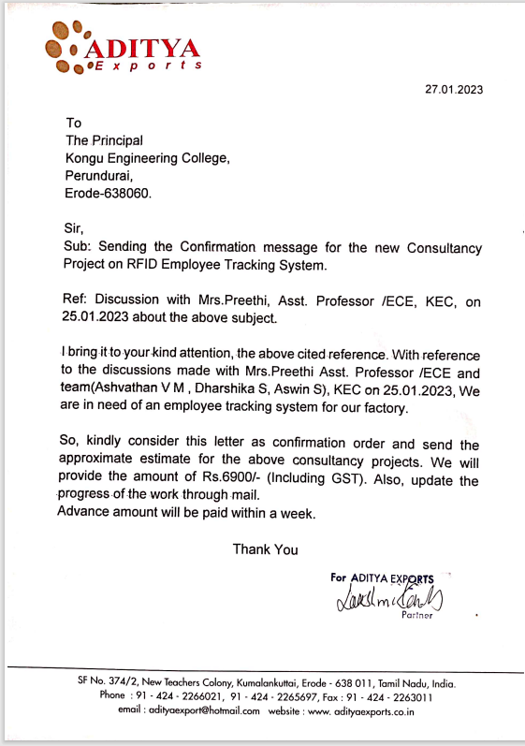
CONSENT LETTER FROM COMPANY

Slide 4
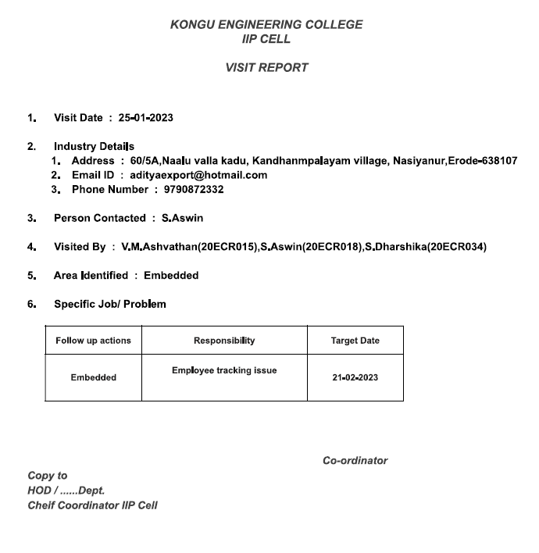
SCREENSHOT OF IC-01

Slide 5
PROBLEM STATEMENT
It is nearly impossible to monitor attendance in a large scale industry where hundreds of employees work. Especially in a in Hence, to overcome this, we came up with an idea by monitoring the attendance of the employees using RFID system .
OBJECTIVE
The aim of this project is to design attendance system using RFID and the objectives:
To design an architectural framework for the attendance system using RFID.
Provide Security - Assign access to zones in your facility only to personnel with the appropriate security level.
Ensure Accountability - Log personnel time & attendance activity to ensure employee productivity.

Slide 6
INTRODUCTION

Slide 7
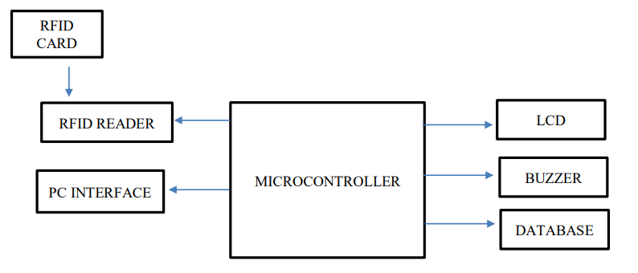
METHODOLOGY
A typical RFID application involves tags which are attached to objects and readers which receive signals from tags to identify objects. Compared with traditional barcode systems, RFID allows tags to be read outside the line of sight of the reader, and the distance between tag and reader can be several meters.

Slide 8
Here NODE MCU acts as a central processor for controlling all other components as input/output unit.
RFID Reader module is interfaced with Arduino to read the data from the RFID card/tag.
LCD displays output like information of user.
Buzzer is used for the indication of arriving and leaving. Similarly, the buzzer produces sound whenever the interrupt is detected.
It stores the data whenever the users swap the card over the RFID reader.

Slide 9
TECHNOLOGY AND TOOLS
RFID Tags – These tags may be embedded in employee ID badges. The signals sent out by RFID tags contain information that is associated with a person or visitor in the system
RFID reader - RFID reader is the device capable of reading, storing and retrieving information stored inside the RFID tags
NODE MCU- a microcontroller board which has Flash memory to store data and programs

Slide 10
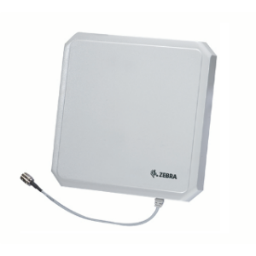
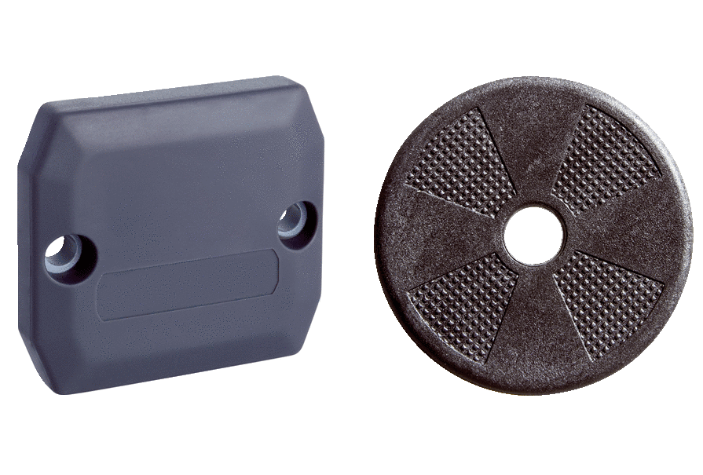
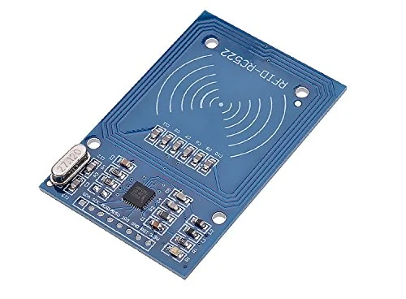
TECHNOLOGY AND TOOLS
LCD screen – to display the card holder name
Host computer - with appropriate application software
Software – This organized the data, allowing you to know whether the employee is present or absent.

Slide 11
PROPOSED METHOD

Slide 13
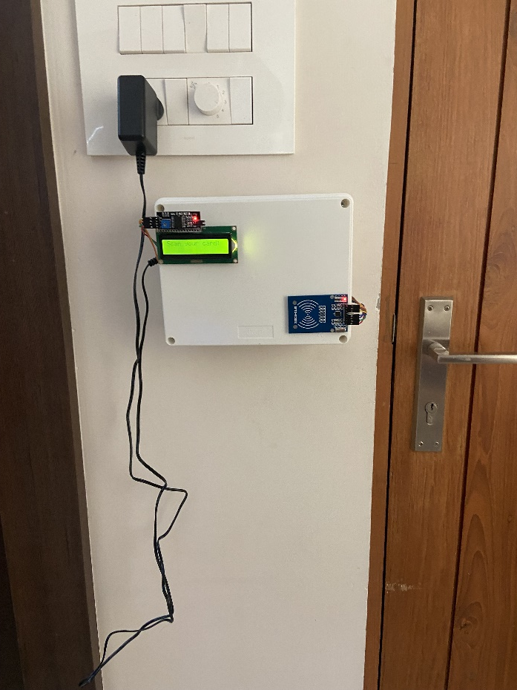
INSTALLATION OF CONSULTANCY WORK IN INDUSTRY

Slide 14

COMPANY APPRECIATION LETTER

Slide 15
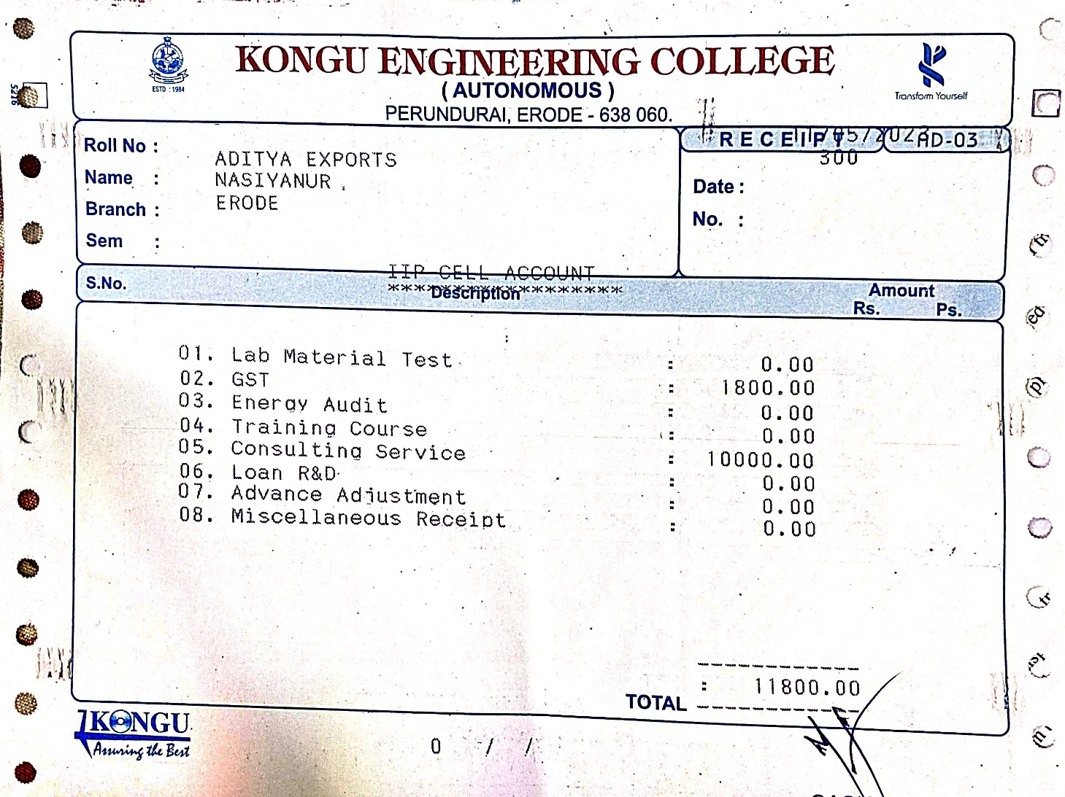
CONSULTANCY FEES PAID IN KEC - BILL SETTLEMENT STATUS

Slide 16
CONCLUSION

Slide 17
REFERENCES
[1]. Pandit, Anala Aniruddha, Ankit Kumar Mundra, and Jyot Talreja. "RFID tracking system for vehicles (RTSV)." 2009 First International Conference on Computational Intelligence, Communication Systems and Networks. IEEE, 2009.
[2]. Al-Ali, A. R., et al. "Mobile RFID tracking system." 2008 3rd international conference on information and communication technologies: from theory to applications. IEEE, 2008.
[3]. Aravindhan, K., et al. "Design of attendance monitoring system using RFID." 2021 7th International Conference on Advanced Computing and Communication Systems (ICACCS). Vol. 1. IEEE, 2021.

Slide 18
THANK YOU

