Slide 1



PIPELINE RELIABILITY MONITORING SYSTEM
DEPARTMENT OF ELECTRONICS AND COMMUNICATION ENGINEERING
PRESENTED BY
DHARSHIKA S – 20ECR034
GUIDED BY
PREETHI S. ME,
ASSISTANT PROFESSOR (SrG)
Dr ZAZILAH BT MAY ME
UNIVERSITI TEKNOLOGI PETRONAS
FINAL Review

Slide 2
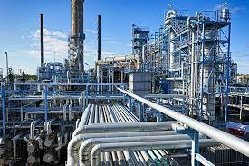
INTRODUCTION
Pipelines play a crucial role in various industries, serving as a structured and efficient means of managing complex processes. In a broad sense, a pipeline is a system or method for the sequential and often automated flow of materials, information, or tasks from one stage to the next. The extraction, transportation, and refinement of oil and gas involve extensive pipeline systems.

Slide 3
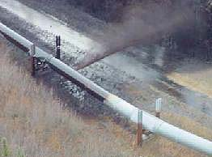
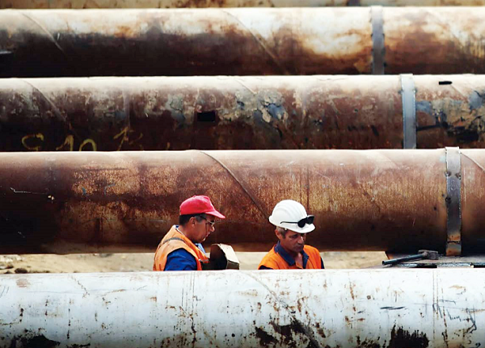
PROBLEM STATEMENT
In the operation process, the performance of the Pipeline gradually deteriorates, influenced by various factors, such as electrical, thermal, mechanical factors and the surrounding environment, which ultimately make the Pipeline break down.
Thus the requirement of early diagnosis and early warning is becoming increasingly urgent. Through analysis of the vibration collection signal, the fault source separation and fault pattern recognition in Pipeline running state, the Pipeline fault can be detected and further deterioration can be prevented, reducing production losses caused by unexpected incidents.

Slide 4
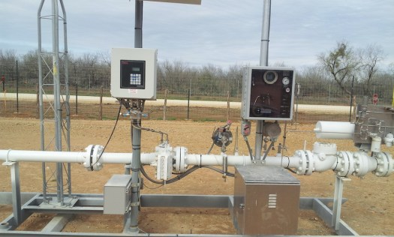
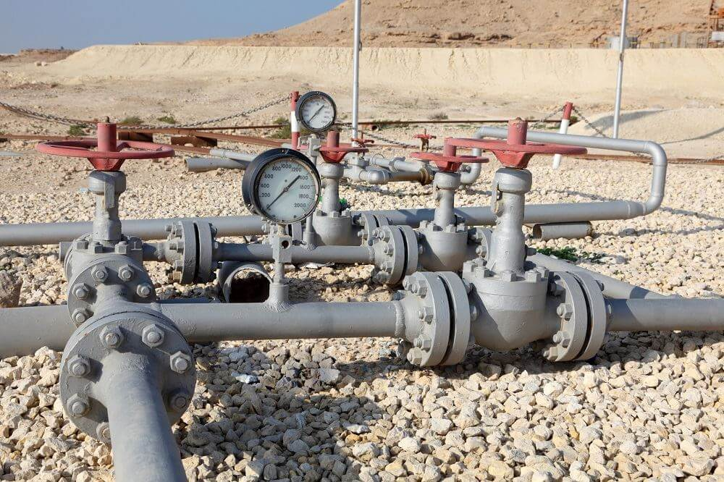
OBJECTIVE
To enhance safety for workers by detecting if the pipeline is at fault by taking various parameters into account as data and ensuring the pipeline integrity.

Slide 5
LITERATURE REVIEW
S.NO | TITLE OF THE PAPER | AUTHOR | JOURNAL NAME AND YEAR | REMARKS/LIMITATIONS
1. | Studying Corrosion Failure Prediction Models and Methods for Submarine Oil and Gas Transport Pipelines | J. Cui, Y. Wu, Z. Lu, and W. Xiao | Applied Science and 2023 | The document emphasizes the significance of incorporating factors. It discusses the creation of a novel corrosion failure prediction model tailored for submarine oil and gas transport pipelines, integrating time and flow rate variables to enhance accuracy. Furthermore, a corrosion prediction management system is developed based on this new model, aiming to improve the efficiency of predicting and controlling oil and gas pipeline corrosion failures.
2. | Damage Detection in Machining Tools Using Acoustic Emission, Signal Processing, and Feature Extraction | L. P. Bernardes, P. O. C. Júnior, F. R. L. Dotto, A. R. Rodrigues, and M. M. Silva | Engineering Proceedings and 2023 | Three critical frequency ranges (40-80 kHz, 10-20 kHz, and 20-40 kHz) are identified for analyzing milling cutter wear, with higher frequencies deemed less significant. This research contributes to enhancing productivity and reducing manufacturing costs.

Slide 6
S.NO | TITLE OF THE PAPER | AUTHOR | JOURNAL NAME AND YEAR | REMARKS/LIMITATIONS
3. | Wavelet Packet Transform-Based Feature Extraction for Acoustic Emission Pattern Recognition | W. Sheng, S. F. Wirtz, and D. Söffker | Structural health and 2023 | This study introduces a novel method utilizing Wavelet Packet Transform (WPT) feature extraction based on energy differences to characterize non-stationary acoustic emission (AE) signals in carbon fiber reinforced polymer (CFRP) materials.
4. | Classification of Located Acoustic Emission Events Using Neural Network | G. Manthei and M. Guckert | Journal of Nondestructive Evaluation | The study highlights the robustness and potential of Deep Learning methods in AE event location analysis, indicating promising prospects for further utilization of neural networks in acoustic emission data analysis.
5. | Analysis and prediction of pipeline corrosion defects based on data analytics of in-line inspection | B. Cui and H. Wang | Journal of Infrastructure Preservation and Resilience | The study achieved a high classification rate of around 91% for clustered events, while some spatially scattered events remained unassigned. It highlights the robustness and potential of Deep Learning methods in AE event location analysis

Slide 7
S.NO | TITLE OF THE PAPER | AUTHOR | JOURNAL NAME AND YEAR | REMARKS/LIMITATIONS
6. | Pipeline Leakage Detection Using Acoustic Emission and Machine Learning Algorithms | N. Ullah, Z. Ahmed, and J. M. Kim | Sensors and 2023 | The paper provides a thorough examination of pipeline corrosion defects utilizing in-line inspection (ILI) data, addressing challenges stemming from data imbalance and instrument influences.
7. | Classification of Located Acoustic Emission Events Using Neural Network | G. Manthei and M. Guckert | Journal of Non destructive Evaluation and 2023 | The study highlights the robustness and potential of Deep Learning methods in AE event location analysis, indicating promising prospects for further utilization of neural networks in acoustic emission data analysis.
8. | Feature extraction of time-series data using DWT and FFT for ball-screw condition monitoring | N. Alegeh, M. Thottoli, N. Mian, A. Longstaff, and S. Fletcher | Manufacturing Research | The study demonstrates a notable increase in classification accuracy following the application of FFT and wavelet transform to the data.

Slide 8
SUMMARY FROM LITERATURE
There is a need for standardization in AE signal processing methodologies and benchmark datasets for evaluating the performance of different algorithms.
While most studies focus on specific applications such as machining tools, pipelines, or concrete structures, there is potential for cross-domain application of AE signal processing techniques. Exploring how techniques developed for one domain can be adapted and applied to other domains could lead to innovative solutions and insights.
Research focusing on the practical implementation and deployment of AE-based monitoring systems in real-world industrial settings is limited.

Slide 9




TECHNOLOGY
Python Version3.7.3
Jupyter , Colab
Operating System –Windows

Slide 10
EXISTING METHOD
The current existing methods run using the sensor data like acoustic sensors and so on directly using the audio.
The continuous data are directly fed to the model for analysing and the continuous data is computationally intensive, especially for real-time applications.

Slide 11
PROPOSED METHOD
A deep learning model is proposed based on DWT and transfer learning approach for the classification and recognition of faults.
The model uses the network where the spectrogram features are extracted and classified automatically in an end-to-end. The results of the model are evaluated using evaluation metrics such as accuracy, balanced accuracy, and F1-score.

Slide 12
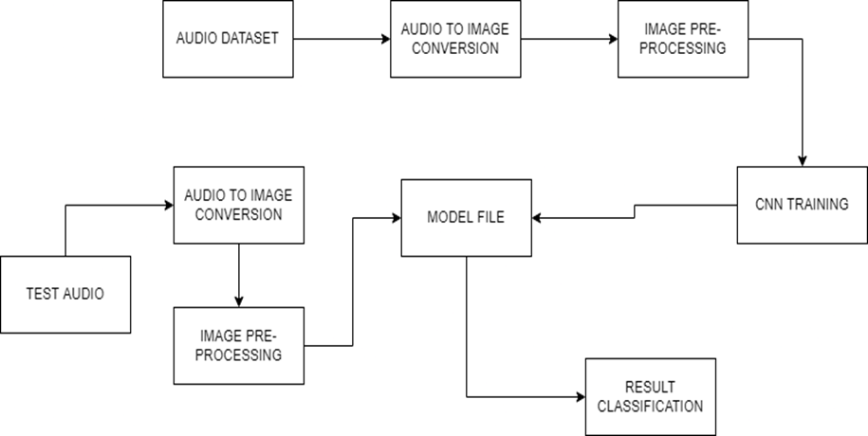
BLOCK DIAGRAM OF PROPOSED METHOD

Slide 13
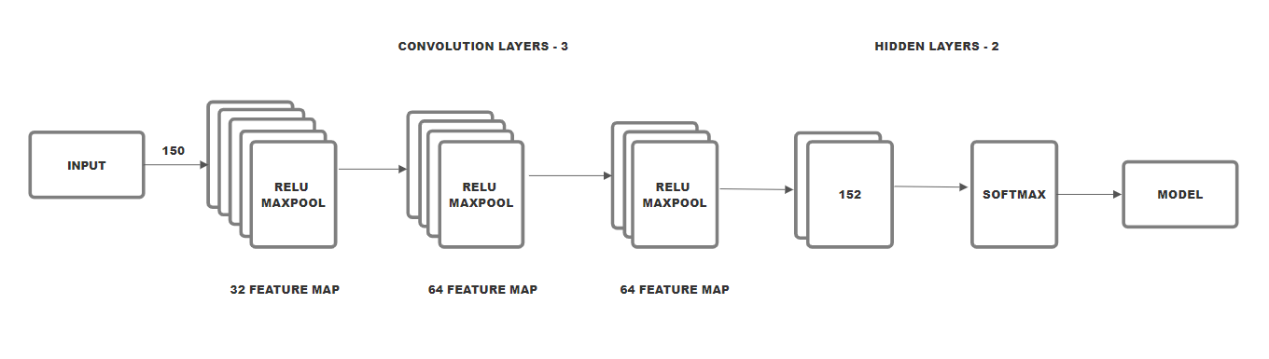
BLOCK DIAGRAM OF PROPOSED ARCHITECTURE

Slide 14
DATASET DESCRIPTION
DATASET | NUMBER OF CLASSES | NUMBER OF VALUES PER CLASS | TOTAL NUMBER OF SAMPLE DATA | DATA CONSIDERED FOR TRAINING PER CLASS | DATA CONSIDERED FOR TESTING PER CLASS
Excel sheet data | 2 | 9 | 1-2 L | 80% | 20%

Slide 15
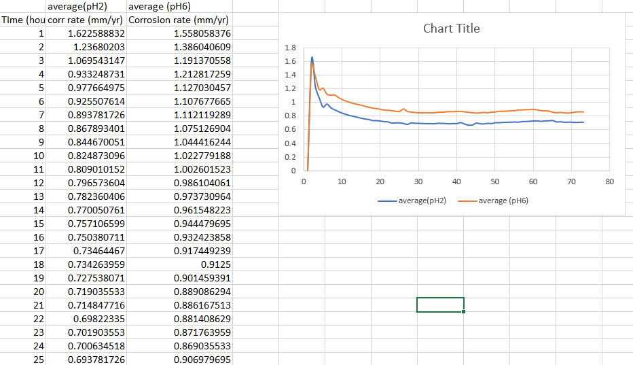
SAMPLE OF EXCEL DATASET

Slide 16
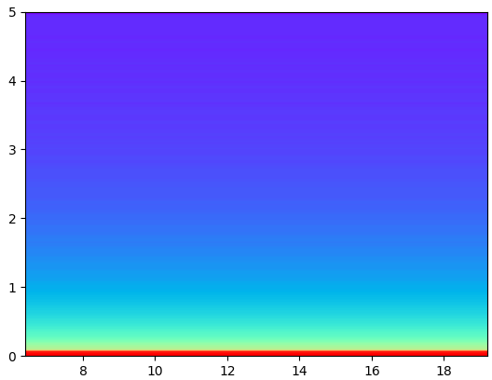
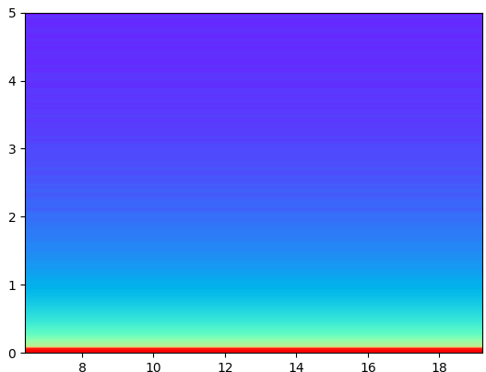
SAMPLE OF IMAGE CONVERTED DATA
Image of a normal pipeline

Slide 17
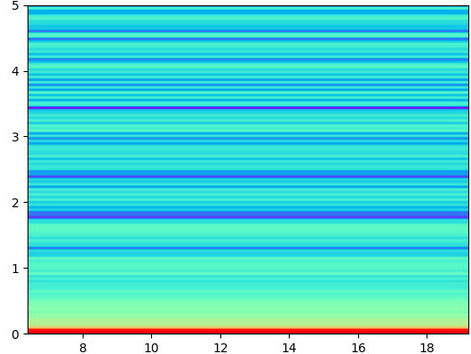
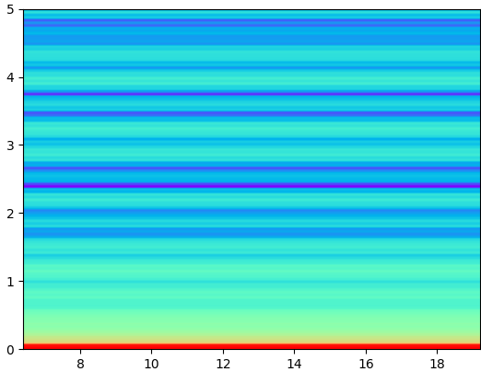
SAMPLE OF IMAGE CONVERTED DATA
Image of a faulted pipeline

Slide 18
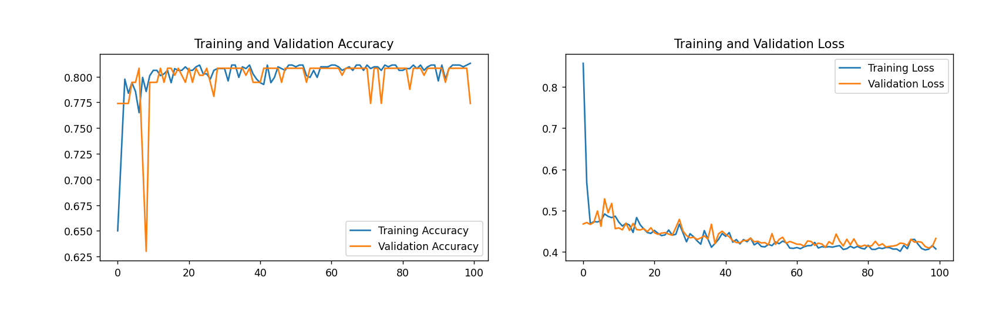
MODEL ACCURACY AND LOSS
TRAINING SAMPLES | BATCH SIZE | EPOCHS | VAL LOSS | VAL ACCURACY | TRAINING LOSS | TRAINING ACCURACY | TESTING ACCURACY
1-2L | 37 | 100 | 0.42 | 90.2% | 0.21 | 92.08% | 92.08%
Accuracy
Loss
Epoch
Epoch

Slide 19
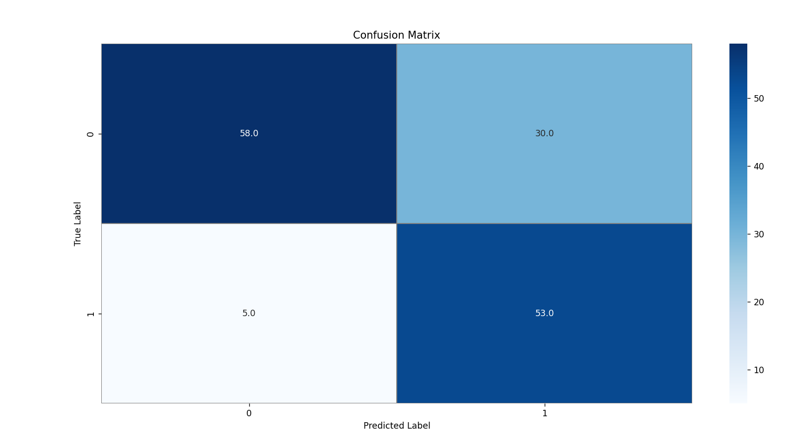
CONFUSION MATRIX

Slide 20
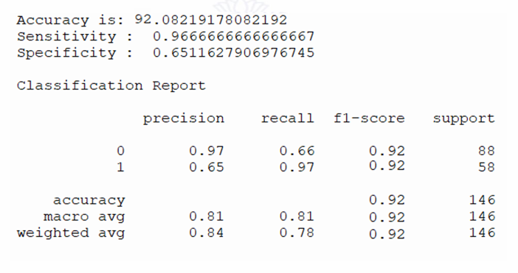
CLASSIFICATION REPORT

Slide 21
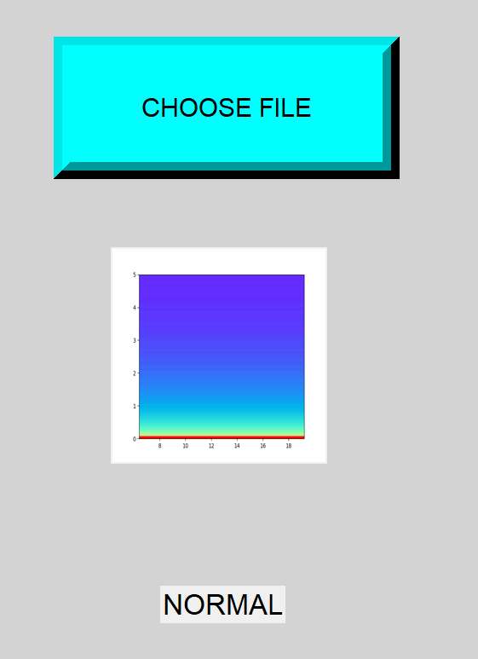

OUTPUT

Slide 22
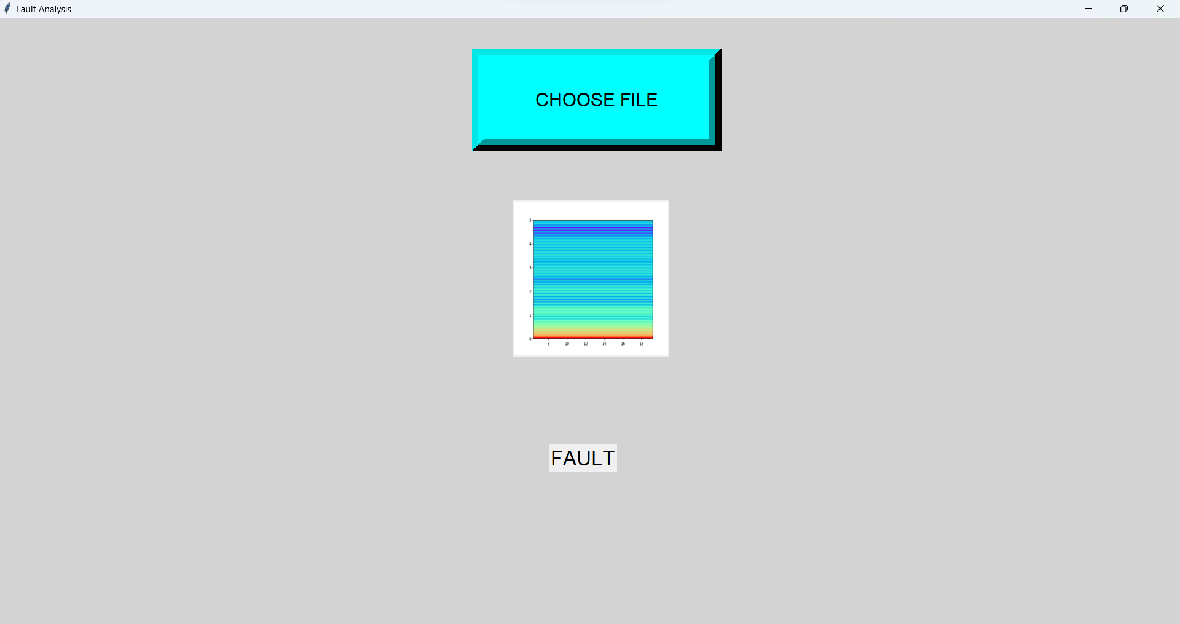
OUTPUT

Slide 23
REFERENCES
1. L. P. Bernardes, P. O. C. Júnior, F. R. L. Dotto, A. R. Rodrigues, and M. M. Silva, “Damage Detection in Machining Tools Using Acoustic Emission, Signal Processing, and Feature Extraction,” p. 109, 2024, doi: 10.3390/ecsa-10-16258.
2. W. Sheng, S. F. Wirtz, and D. Söffker, “Wavelet packet transform-based feature extraction for acoustic emission pattern recognition,” 9th Eur. Work. Struct. Heal. Monit. EWSHM 2018, no. July, 2018.
3. G. Manthei and M. Guckert, “Classification of Located Acoustic Emission Events Using Neural Network,” J. Nondestruct. Eval., vol. 42, no. 1, 2023, doi: 10.1007/s10921-022-00913-x.
4. B. Cui and H. Wang, “Analysis and prediction of pipeline corrosion defects based on data analytics of in-line inspection,” J. Infrastruct. Preserv. Resil., vol. 4, no. 1, 2023, doi: 10.1186/s43065-023-00081-w.
5. N. Ullah, Z. Ahmed, and J. M. Kim, “Pipeline Leakage Detection Using Acoustic Emission and Machine Learning Algorithms,” Sensors, vol. 23, no. 6, 2023, doi: 10.3390/s23063226.
6. J. Cui, Y. Wu, Z. Lu, and W. Xiao, “Studying Corrosion Failure Prediction Models and Methods for Submarine Oil and Gas Transport Pipelines,” Appl. Sci., vol. 13, no. 23, p. 12713, 2023, doi: 10.3390/app132312713.

Slide 24
7. N. Alegeh, M. Thottoli, N. Mian, A. Longstaff, and S. Fletcher, “Feature extraction of time-series data feature extraction of time-series data condition monitoring,” Adv. Transdiscipl. Eng., vol. 15, pp. 402–407, 2021, doi: 10.3233/ATDE210069.
8. J. K. Thang Bui Quy, “Leak Detection in a Gas Pipeline Using Spectral Portrait of Acoustic Emission Signals,” Measurement, 2019, doi: http://dx.doi.org/10.1016/j.measurement.2019.107403.
9. G. Baldazzi et al., “Systematic analysis of wavelet denoising methods for neural signal processing,” J. Neural Eng., vol. 17, no. 6, 2020, doi: 10.1088/1741-2552/abc741.
10. M. Z. Ali and X. Liang, “Induction Motor Fault Diagnosis Using Discrete Wavelet Transform,” 2019 IEEE Can. Conf. Electr. Comput. Eng. CCECE 2019, no. c, pp. 1–4, 2019, doi: 10.1109/CCECE.2019.8861923.
11. I. G. P. S. Wijaya and N. N. Kencanawati, “Denoising acoustic emission signal using wavelet transforms for determining the micro crack location inside of concrete,” Int. J. Technol., vol. 5, no. 3, pp. 259–268, 2014, doi: 10.14716/ijtech.v5i3.613.
12. A. Widodo, B. S. Yang, E. Y. Kim, A. C. C. Tan, and J. Mathew, “Fault diagnosis of low speed bearing based on acoustic emission signal and multi-class relevance vector machine,” Nondestruct. Test. Eval., vol. 24, no. 4, pp. 313–328, 2009, doi: 10.1080/10589750802378974.

Slide 25
THANK YOU

