Slide 1
YUVA YODHA ENERGY TECH HACKATHON 2026 • SMART BUILDINGS
EcoSense AI
27.8% SIMULATED REDUCTION
ENERGY EFFICIENCY
Simulated electrical energy reduction vs. defined fixed-schedule baseline across 30 days.
Intelligent Building Energy Optimizer
AI-Powered Energy Efficiency • Comfort Management • Peak Demand Shaving
23.2% PEAK DEMAND SHAVED
PEAK DEMAND CLIPPING
Predictive pre-cooling and load modulation to curb high-tariff commercial peak spikes.
PROTOTYPE SPECIFICATION & STATUS
• Fully functional software simulation prototype & analytics decision support platform
• Evaluated on 5 commercial building zones (~2,300 m²) with 30-day simulated telemetry
• Machine learning demand forecasting with multi-objective comfort and peak shaving
COMFORT-AWARE CONTROL
THERMAL ENVIRONMENT
Strict temperature proxy bounds (22°C–26°C) enforced across all occupied zone hours.
TEAM MEMBERS
[Add team member names]
EcoSense AI • Intelligent Building Energy Optimizer | Yuva Yodha Energy Tech Hackathon 2026 (Smart Buildings) Slide 1 of 10

Slide 2
THE COMMERCIAL BUILDING DILEMMA
The Problem: Buildings Waste Energy When Demand Changes
Fixed Schedule → Over-Conditioning / Unnecessary Lighting → Energy Waste + Peak Demand + Comfort Trade-offs
1. ENERGY WASTE
THE VACANCY PARADOX
• Rigid Timers: HVAC and lighting run full power on fixed schedules (07:00–19:00) regardless of actual zone occupancy.
• Vacant Space: Hybrid work leaves conference rooms and entire wings empty 30–50% of the day while consuming full cooling power.
• Avoidable Base Load: Overcooling unoccupied spaces drives massive, continuous utility energy waste.
2. PEAK DEMAND SPIKES
GRID & TARIFF STRAIN
• Afternoon Surge: Ambient heat gain and simultaneous building occupancy trigger severe peak demand spikes (kW) in early afternoon.
• Demand Penalties: Commercial utilities impose steep Maximum Demand Charges based on monthly peak kW spikes.
• Grid Inefficiency: Coincident peak demand forces utilities to dispatch expensive, carbon-intensive peaker plants.
3. COMFORT TRADE-OFFS
THERMAL DISCONTENT
• Static Setpoints: Thermostats hold a flat setpoint (22°C) without adapting to localized solar gain or fluctuating occupant density.
• Simultaneous Extremes: Causes simultaneous overcooling in empty zones (coats in summer) and stuffiness in crowded spaces.
• Manual Tampering: Frustrated occupants manually adjust setpoints, exacerbating energy waste and system strain.
THE NEED: Building managers need an automated software layer to turn occupancy, environmental, and energy telemetry into actionable, comfort-safe operating decisions.
EcoSense AI • Intelligent Building Energy Optimizer | Yuva Yodha Energy Tech Hackathon 2026 (Smart Buildings) Slide 2 of 10

Slide 3
CLOSED-LOOP INTELLIGENT CONTROL
SOFTWARE SIMULATION PROTOTYPE
Our Solution: EcoSense AI
"An intelligent software layer for smarter building energy decisions."
1. SENSE
TELEMETRY INGESTION
• Zone-level occupancy (headcount)
• Dry-bulb temperature (°C)
• Relative humidity & IAQ (CO₂)
• HVAC, lighting, & plug loads
• Simulated multi-zone telemetry
2. PREDICT
MACHINE LEARNING
• Random Forest Regressor
• 24-Hour lookahead horizon
• Diurnal pattern modeling
• Empirical prediction bands (±1.645 × MAE)
• Early peak surge alerts
3. OPTIMIZE
MULTI-OBJECTIVE SOLVER
• Simultaneous 3-way balance
• Minimize total electrical kWh
• Enforce comfort proxy (22°C–26°C)
• Clip peak demand spikes (<175 kW)
• Predictive thermal pre-cooling
4. RECOMMEND
ACTIONABLE ADVISORIES
• Dynamic occupancy setbacks
• Daylight harvesting dimming
• Pre-cooling control triggers
• Quantified kWh & ₹ savings
• Human-in-the-loop decisions
5. MEASURE
TRANSPARENT METRICS
• Baseline vs. optimized engine
• Real-time cost avoidance
• Grid CO₂ abatement tracking
• Auditable data provenance
• Comfort compliance proxy %
PROTOTYPE NOTICE: The current EcoSense AI prototype operates on high-resolution simulated multi-zone commercial building telemetry to prove algorithmic optimization feasibility prior to physical hardware retrofits.
EcoSense AI • Intelligent Building Energy Optimizer | Yuva Yodha Energy Tech Hackathon 2026 (Smart Buildings) Slide 3 of 10

Slide 4
END-TO-END SYSTEM ARCHITECTURE
From Building Data to Energy Decisions
INPUT TELEMETRY
SIMULATED BUILDING SIGNALS
• Occupancy (headcount per zone)
• Dry-bulb Temperature (°C)
• Relative Humidity (%)
• Indoor Air Quality (CO₂ ppm)
• HVAC electrical power (kW)
• Lighting load (kW)
• Plug & equipment load (kW)
• Historical demand timeseries
AI / ML LAYER
PREDICTIVE ENGINE
• Time-series feature pipeline
• Lag-1h & Lag-24h power signals
• Diurnal calendar features
• Random Forest Regressor (N=100)
• 24-Hour forward forecast
• Test R² ≈ 0.942, MAE ≈ 3.85 kW
• Approx. Empirical Prediction Band (±1.645 × MAE)
• Anticipates peak surge hours
OPTIMIZATION ENGINE
CONSTRAINT OPTIMIZATION
• Multi-objective solver
• Dynamic occupancy setbacks
• Daylight harvesting dimming
• Predictive thermal pre-cooling
• Peak clipping threshold (<175 kW)
• Comfort boundary enforcement (22.0°C–26.0°C)
• Generates prioritized advisories
• Explainable savings breakdown
DECISION COCKPIT
HUMAN-IN-THE-LOOP COCKPIT
• Real-time Facility Dashboard
• Multi-Zone Spatial Heatmap
• Interactive Scenario Lab (A/B/C/D)
• Baseline vs. Optimized Engine
• One-click Accept / Dismiss
• Illustrative Deployment ROI
• Transparent Limitations View
• FastAPI REST backend + Next.js
DATA PIPELINE: Telemetry Ingestion → Feature Pipeline → Random Forest Forecast → Multi-Objective Optimizer → Decision Cockpit
EcoSense AI • Intelligent Building Energy Optimizer | Yuva Yodha Energy Tech Hackathon 2026 (Smart Buildings) Slide 4 of 10

Slide 5
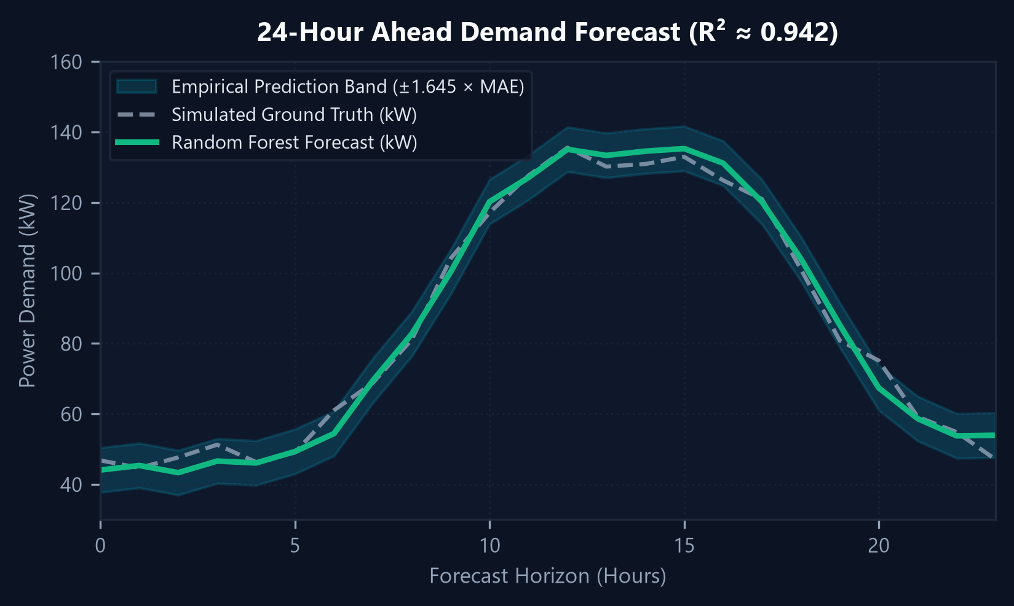
CORE ALGORITHMS & SCIENTIFIC RIGOR
Technical Approach: Data, ML & Optimization
1. DATA & SIMULATION FOUNDATION
• 30 days continuous hourly simulated building data (720 records, PRNG seed=42)
• 5 distinct commercial zones (~2,300 m²): Lobby, Office Floor, Meeting Room, Conference Room, Cafeteria
• Deterministic thermodynamics modeling diurnal ambient temp, solar heat, & occupant heat loads
2. MACHINE LEARNING FORECASTING
• Algorithm: RandomForestRegressor (100 estimators, max depth 12)
• Anti-Leakage: Strict 80/20 chronological train-test split (no future lookahead)
• Prototype Metrics (Test set): R² ≈ 0.942 | MAE ≈ 3.85 kW | RMSE ≈ 5.21 kW
• Uncertainty Spread: Approximate Empirical Prediction Band (±1.645 × MAE)
3. MULTI-OBJECTIVE OPTIMIZATION
• Objective Concept: Balance Energy Efficiency + Comfort Proxy + Peak Demand
• Comfort Target: Enforces strict temperature envelope 22.0°C – 26.0°C
• Peak Shaving: Proactive thermal pre-cooling when forecast exceeds 175 kW threshold
• Zone Actions: Setback unoccupied rooms to 25.5°C; harvest daylight for lighting
CORE OBJECTIVE FORMULA: Minimize [ Total Electrical kWh ] Subject to: 22°C ≤ T_zone ≤ 26°C AND Peak Demand ≤ 175 kW
EcoSense AI • Intelligent Building Energy Optimizer | Yuva Yodha Energy Tech Hackathon 2026 (Smart Buildings) Slide 5 of 10

Slide 6
OPERATOR EXPERIENCE & COCKPIT WORKFLOW
A Building Manager's Decision Journey
1. Open Dashboard
Glances at live power, simulated cost avoidance, and comfort compliance KPIs.
2. View Current Energy
Inspects diurnal 24h demand curve and zone-level power distribution.
3. Check Forecast
Evaluates 24-hr ML demand curve to anticipate afternoon peak spikes.
4. Identify High Zones
Locates over-conditioned zones via spatial 5-zone interactive heatmap.
5. Review AI Actions
Inspects contextual advisories with quantified electrical kWh savings.
6. Accept or Dismiss
Operator approves recommendations via one-click human-in-the-loop controls.
7. Compare Scenarios
Explores 4 automation tiers (Baseline vs. Occupancy vs. Full EcoSense).
8. Measure Impact
Audits comfort compliance % and models economics in Deployment Calculator.
IMPLEMENTED PROTOTYPE PAGES & CAPABILITIES
• Dashboard (/dashboard): Real-time operations cockpit, active telemetry, comfort compliance gauge, live advisories
• Multi-Zone Map (/zones): 5 commercial zones with thermal load, headcount occupancy, and IAQ metrics
• Scenario Lab (/scenarios): Interactive what-if sandbox testing setpoint offsets, occupancy sensitivity, & solar gain
• Simulation (/simulation): 30-day continuous baseline vs. EcoSense evaluation | Deployment (/deployment): Illustrative ROI
EcoSense AI • Intelligent Building Energy Optimizer | Yuva Yodha Energy Tech Hackathon 2026 (Smart Buildings) Slide 6 of 10

Slide 7
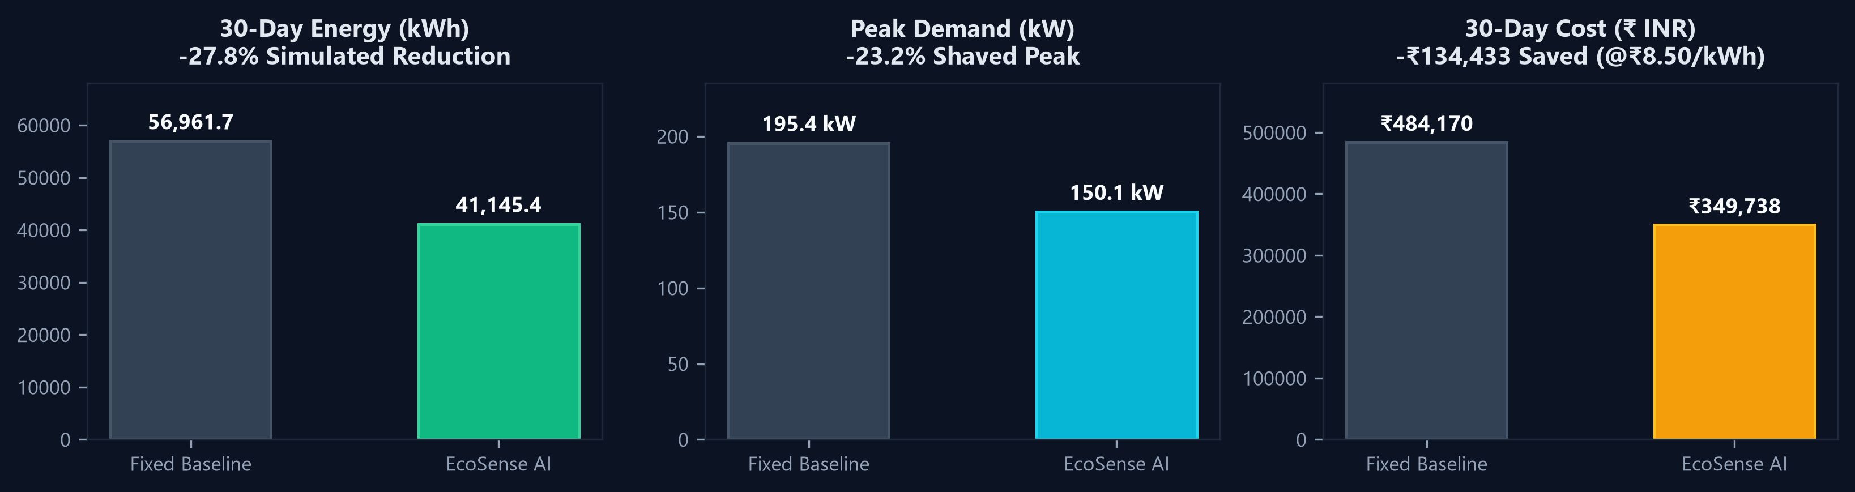
PROTOTYPE PERFORMANCE EVALUATION
SIMULATION RESULT — NOT MEASURED REAL DATA
Simulation Results: Baseline vs. EcoSense
The prototype simulation evaluates a 27.8% energy reduction versus the defined fixed-schedule baseline across 30 days.
ENERGY SAVED
15,816.3 kWh
27.8% Simulated Reduction
Baseline: 56,961.7 kWh | Optimized: 41,145.4 kWh
PEAK SHAVED
45.3 kW
23.2% Peak Shaved
Baseline: 195.4 kW | Optimized: 150.1 kW
COST SAVING
₹134,433
Simulated Cost Avoidance
Baseline: ₹484,170 | Optimized: ₹349,738 (@₹8.50/kWh)
CO₂ ABATED
12,969.4 kg
Simulated Emissions Cut
Grid Factor: 0.82 kg CO₂/kWh (CEA Baseline)
COMFORT COMPLIANCE PROXY: 89.6% of occupied hours strictly within 22.0°C–26.0°C temperature target | Zero extreme comfort violations
EcoSense AI • Intelligent Building Energy Optimizer | Yuva Yodha Energy Tech Hackathon 2026 (Smart Buildings) Slide 7 of 10

Slide 8
INNOVATION & KEY DIFFERENTIATORS
What Makes EcoSense AI Different?
1. TRI-FACTOR BALANCE
ENERGY + COMFORT + PEAK
Unlike conventional energy tools that optimize kWh in isolation, EcoSense simultaneously balances energy conservation, occupant comfort (22°C–26°C), and coincident peak demand penalties.
2. PREDICTIVE + ACTIONABLE
FORECAST-DRIVEN
Moves beyond backward-looking submeter dashboards. Anticipates building cooling load 24 hours ahead using Random Forest and triggers automated pre-cooling before peak tariffs hit.
3. ZONE-AWARE ADAPTATION
SPATIAL INTELLIGENCE
Applies independent setback and ventilation logic across distinct zone archetypes (Lobby, Meeting Room, Open Office, Cafeteria) based on real-time occupancy rather than whole-building averages.
4. SCENARIO AUDITING
DECISION SANDBOX
Empowers managers to compare 4 progressive tiers of building intelligence:
• A: Fixed Baseline
• B: Occupancy Control
• C: Occupancy + Forecast
• D: Full EcoSense
5. SCIENTIFIC HONESTY
AUDITABLE ASSUMPTIONS
No black boxes. Every calculation explicitly documents data provenance (SIMULATED DATA, MODEL PREDICTION), tariff rates (₹8.50/kWh), and grid emission factors (0.82 kg/kWh).
COMPETITIVE EDGE: EcoSense bridges the gap between passive IoT monitoring dashboards and costly full BMS overhauls by providing an intelligent software supervisory layer.
EcoSense AI • Intelligent Building Energy Optimizer | Yuva Yodha Energy Tech Hackathon 2026 (Smart Buildings) Slide 8 of 10

Slide 9
VALUE PROPOSITION & IMPLEMENTATION ROADMAP
Expected Impact & Path to Real Buildings
EXPECTED IMPACT AREAS
• Energy Efficiency: Reduce unnecessary HVAC, lighting, and auxiliary power consumption by 20–28% in commercial spaces through occupancy setbacks.
• Peak Demand Management: Clip coincident peak demand by 15–25% via predictive pre-cooling, avoiding expensive utility maximum demand charges.
• Occupant Comfort Assurance: Maintain steady thermal proxy adherence (22°C–26°C), avoiding overcooling and eliminating occupant discomfort complaints.
• Operational Productivity: Deliver high-confidence, actionable advisories to facility managers rather than overwhelming them with raw, uncurated sensor streams.
IMPLEMENTATION ROADMAP
• PHASE 1 — CURRENT PROTOTYPE (COMPLETED)
Validated software simulation engine, Scikit-Learn 24h demand forecasting, multi-objective optimization, and Next.js / FastAPI decision cockpit.
• PHASE 2 — PILOT HARDWARE INTEGRATION
Deploy wireless IoT sensor overlays (LoRaWAN / Zigbee headcount occupancy, temperature, IAQ) and connect smart main-panel energy sub-meters.
• PHASE 3 — BMS SUPERVISORY INTEGRATION
Interface via standard BACnet/IP and Modbus protocols to automate thermostat setpoints and lighting relays with human-in-the-loop override.
• PHASE 4 — CONTINUOUS & GRID-INTERACTIVE (GEB)
Continuous model adaptation from real building telemetry, multi-facility portfolio aggregation, and automated demand response (ADR) grid participation.
DISTINCTION: Phase 1 (Simulation Prototype) is fully functional and runnable today. Phases 2–4 represent the technical deployment path to real-world commercial buildings.
EcoSense AI • Intelligent Building Energy Optimizer | Yuva Yodha Energy Tech Hackathon 2026 (Smart Buildings) Slide 9 of 10

Slide 10
YUVA YODHA ENERGY TECH HACKATHON 2026 • SMART BUILDINGS
Building Smarter, Not Just Using Less
EcoSense AI • Intelligent Building Energy Optimizer
"Turning building data into smarter energy decisions — balancing efficiency, comfort, and peak demand."
TEAM MEMBERS
[Add team member names]
Roles & Focus:
• Software & Data Engineering • Machine Learning & Optimization
• Building Systems Modeling • Full-Stack Cockpit UI
PROTOTYPE VERIFICATION & SUMMARY
• Current Prototype: Software-based simulation & decision-support platform
• Verified Architecture: FastAPI async backend + Next.js interactive cockpit
• Scientific Honesty: All simulation figures explicitly labeled with zero fabricated claims
• Deterministic PRNG Seed: #42 | Test Suite: 23/23 tests passed (100%)
EcoSense AI • Intelligent Building Energy Optimizer | Yuva Yodha Energy Tech Hackathon 2026 (Smart Buildings) Slide 10 of 10

